Slide 1

QUALITY INTERNAL AUDIT REPORT
Project A
System and Process audits against ISO 9001:2015
AUDIT REFERENCE
AUDIT DATES
CONTRACT / PROJECT NO.
REPORT REVISION
QAM-IA/26-001
01-01-2026 – 05-01-2026
1
To be mapped

Slide 2
Document control and approval
TEMPLATE CONTROL
TEMPLATE PAGE
Approval
Document information
Role | Name and title | Signature | Date
Prepared by | Noura Alharbi / QC Manager | To be mapped | To be mapped
Reviewed by | To be mapped | To be mapped | To be mapped
Approved by | To be mapped | To be mapped | To be mapped
Form title
Quality Internal Audit Report
Form no.
QAM-IA/26-001
Revision
To be mapped
Effective date
To be mapped
Revision history
Rev | Date | Description of change | By
To be mapped | To be mapped | To be mapped | To be mapped
To be mapped | To be mapped | To be mapped | To be mapped
To be mapped | To be mapped | To be mapped | To be mapped
Process owner
To be mapped
Applies to
All quality internal audits conducted by Algihaz auditors

Slide 3
Audit details and project profile
AUDIT OVERVIEW
Audit details
Project profile
Audit title
QMS Audit - 1 - Project A
Client
Client A
Audit reference
QAM-IA/26-001
Contractor
Contractor B
Audit type
Quality Internal Product Audit
Contract / project no.
Contract No 1
Audit dates
01-01-2026 – 05-01-2026
Contract signed
12-05-2024
Location / department
Chennai
Contract period
36 months
Lead auditor
Noura Alharbi / QC Manager
TCC
15-05-2024
Audit team
Ajay Mishra, Sara Al-Dosari, Noura Al-Qahtani / QA/QC Manager, Test User 1 / Line Engineer
PAC
20-05-2024
Auditee representatives
Ajay Mishra, Ajay Mishra, Ajay Mishra, Subbu Sankar, Sara Al-Dosari
FAC
25-05-2024

Slide 4



Objective, scope, criteria and method
AUDIT OVERVIEW
OBJECTIVE
We have to control the floodings. To create awareness
Scope
Audit criteria
Method
In scope: System and Process audits against ISO 9001:2015
Not in scope / not audited, and why: To be mapped
Period and sample covered: Screenshot 2026-10-18 231543.png
Screenshot 2026-09-06 101611.png
clock.png
AFIF PV- 1_BiWeekly Report Summary (16-JUNE-2026 to 30-JUNE-2026)_page-0001.jpg
fast-time.png
audit-plan-4804f2c3-ed3e-417b-ab43-2bc6c3acb948 (2).pdf
Project phases covered: Project management and organization
Design and engineering
QMS and documentation
Storage and material control
Construction and site works
Testing and commissioning
ISO 9001 — All clauses
Method: To be mapped
Sampling basis: To be mapped

Slide 5



AUDIT OVERVIEW
Audit programme and participation
Daily programme (01-01-2026 – 05-01-2026)
Audit team
Start: 1 Jan 2026, 09:05
End: 1 Jan 2026, 10:05
Ajay Mishra, Sara Al-Dosari, Noura
Al-Qahtani / QA/QC Manager, Test User 1
/ Line Engineer
Activity: Opening Meeting
Remarks: 1. Introduction
2. Plan for the Internal Audit
Start: 1 Jan 2026, 09:05
End: 1 Jan 2026, 10:05
3. Work scope
4. Resources
5. Auditing /Reporting methods
Auditees present
Start: 1 Jan 2026, 09:05
End: 1 Jan 2026, 10:05
Audit Program Manager
Audit Team Lead / Auditor
Memo Communication
Process / Product Owner
6. Type of Audit Finding / Grading
Auditee: To be mapped
Start: 2 Jan 2026, 09:05
End: 2 Jan 2026, 12:05
Activity: Cost Control Department
Remarks: 1. Review of Process
2. Department Organization Chart
Not represented
Start: 2 Jan 2026, 09:05
End: 2 Jan 2026, 12:05
To be mapped
3. Cost Control Objectives achievements
4. KPI Status
5. Implementation Review of Cost Control
QAM-IA/26-001 | Project A
5

Slide 6
AUDIT OVERVIEW
Audit programme and participation
Daily programme (01-01-2026 – 05-01-2026)
Audit team
Start: 2 Jan 2026, 09:05
End: 2 Jan 2026, 12:05
To be mapped
department of SOPs
6. Review of All Algihaz projects documents
related to Cost Control
Start: 2 Jan 2026, 09:05
End: 2 Jan 2026, 12:05
7. Verify close out of previous audit
findings and its effective implementation.
8. Records
Auditees present
Start: 2 Jan 2026, 09:05
End: 2 Jan 2026, 12:05
To be mapped
9. Controls of Document System
10. Suggestions and Improvements
Start: 2 Jan 2026, 09:05
End: 2 Jan 2026, 12:05
Auditee: To be mapped
Not represented
Start: 3 Jan 2026, 09:05
End: 3 Jan 2026, 15:05
To be mapped
Activity: Procurement Department
Remarks: 1. List of Approved SEC Suppliers
2. Procurement Process
QAM-IA/26-001 | Project A
6

Slide 7
AUDIT OVERVIEW
Audit programme and participation
Daily programme (01-01-2026 – 05-01-2026)
Audit team
Start: 3 Jan 2026, 09:05
End: 3 Jan 2026, 15:05
To be mapped
3. Supplier Evaluation/Approval Status
Record
4. Procurement Key Milestones
Start: 3 Jan 2026, 09:05
End: 3 Jan 2026, 15:05
5. Achievements
6. Material Receiving Inspection Process\
7. Records of Material Receiving at site
Auditees present
Start: 3 Jan 2026, 09:05
End: 3 Jan 2026, 15:05
To be mapped
8. Records of Procurement Non- Conformities
Auditee: To be mapped
Start: 5 Jan 2026, 10:05
End: 5 Jan 2026, 14:05
Activity: Design
Remarks: 1. List of Approved Project
Designing Companies
Not represented
Start: 5 Jan 2026, 10:05
End: 5 Jan 2026, 14:05
To be mapped
2. Design Consultant Approval Status
3. Design Process Procedure
4. Design Schedule
QAM-IA/26-001 | Project A
7

Slide 8
AUDIT OVERVIEW
Audit programme and participation
Daily programme (01-01-2026 – 05-01-2026)
Audit team
Start: 5 Jan 2026, 10:05
End: 5 Jan 2026, 14:05
To be mapped
5. Design Schedule Approval Status
6. Design Engineer’s Approval Status
7. Key Milestones /Achievements
Start: 5 Jan 2026, 10:05
End: 5 Jan 2026, 14:05
8. List of overall Drawings
9. Record of Design Modifications
10. Record of Technical Queries
Auditees present
Start: 5 Jan 2026, 10:05
End: 5 Jan 2026, 14:05
To be mapped
Auditee: To be mapped
Start: 01-01-2026
End: To be mapped
Activity: Opening meeting (recorded)
Remarks: Test Minutes
Auditee: Audit Program Manager
Not represented
Start: 01-01-2026
End: To be mapped
To be mapped
Audit Team Lead / Auditor
Memo Communication
Process / Product Owner
QAM-IA/26-001 | Project A
8

Slide 9
AUDIT OVERVIEW
Audit programme and participation
Daily programme (01-01-2026 – 05-01-2026)
Audit team
Start: 05-01-2026
End: To be mapped
To be mapped
Activity: Closing meeting (recorded)
Remarks: ok
Auditee: Audit Program Manager
Start: 05-01-2026
End: To be mapped
Audit Team Lead / Auditor
Memo Communication
Process / Product Owner
Auditees present
To be mapped
To be mapped
To be mapped
To be mapped
To be mapped
Not represented
To be mapped
To be mapped
To be mapped
QAM-IA/26-001 | Project A
9

Slide 10
Audit results at a glance
EXECUTIVE SUMMARY
12
4
OVERALL RATING: Effective with improvements required
Non-conformities
Opportunities for improvement
☐
Effective
Requirements are met; improvements only.
☑
Effective with improvements required
5
5
2
Corrective action needed on non-conformities.
☐
Not effective
Major
Moderate
Minor
Major or systemic failures of the system or controls.
OVERALL CONCLUSION
KEY MESSAGES
okay
okau

Slide 11
Findings summary by audit area
FINDINGS
Audit area | Major | Moderate | Minor | OFI | Total
Project management and organization | 0 | 1 | 1 | 0 | 2
Design and engineering | 2 | 0 | 0 | 0 | 2
QMS and documentation | 0 | 3 | 1 | 0 | 4
Storage and material control | 0 | 0 | 0 | 1 | 1
Construction and site works | 2 | 1 | 0 | 2 | 5
Testing and commissioning | 1 | 0 | 0 | 1 | 2
Total | 5 | 5 | 2 | 4 | 16
To be mapped | To be mapped | To be mapped | To be mapped | To be mapped | To be mapped
To be mapped | To be mapped | To be mapped | To be mapped | To be mapped | To be mapped
RECURRING THEMES
1
okay
okay · okay
2
To be mapped
To be mapped
3
To be mapped
To be mapped
Totals must equal the number of findings in the register.

Slide 12
Overall project progress
PROJECT STATUS
Phase | Weight | Plan | Actual | Variance | Prior period
Project Preparation | 25% | 4 | 3 | -1 | 2
Engineering & Design | 5% | 25 | 15 | -10 | 5
Equipment & Material | 5% | 10 | 5 | -5 | 3
Construction | 20% | 0 | 0 | 0 | To be mapped
Installation | 20% | 0 | 0 | 0 | To be mapped
Testing, Commissioning & Energization | 15% | 0 | 0 | 0 | To be mapped
Project Close-out | 10% | 0 | 0 | 0 | To be mapped
To be mapped | To be mapped | To be mapped | To be mapped | To be mapped | To be mapped
How to read
Variance = Actual − Plan, in percentage points
Weights must total 100%
Overall = Σ (weight × phase progress)
Auditor comment
To be mapped
Data as at: To be mapped Source: To be mapped

Slide 13
Design and procurement status
PROJECT STATUS
Design submittals (DTS)
Procurement
Status | Count | %
Status A | 25 | 16.34%
Status B | 25 | 16.34%
Status C | 14 | 9.15%
Status D | 14 | 9.15%
Under Review(U/R) | 25 | 16.34%
Cancelled | 50 | 32.68%
Total submittals | 153 | 100%
Item | Count
Total items tracked | 50
Purchase order issued | 50
In manufacturing | 14
FAT completed | 50
FAT pending / report under approval | 56
Shipped / in transit | 25
Received at site | 14
Past planned receipt date | 20
☐ Check: sum of statuses equals total submittals
Comment: ok
Comment: ok

Slide 14
Areas verified as conforming and good practices
CONFORMING AREAS
Area / process | What was verified and found conforming | Record / evidence reference
Construction | Co-ordination | To be mapped
To be mapped | To be mapped | To be mapped
To be mapped | To be mapped | To be mapped
To be mapped | To be mapped | To be mapped
To be mapped | To be mapped | To be mapped
Good practices and positive observations
Construction · Co-ordination · To be mapped · ok

Slide 15
Non-conformities
NON-CONFORMITY REGISTER
Ref | Finding | Objective evidence | Requirement | Grade
Non-conformities
To be mapped | Project management and organization Test | Screenshot 2026-10-18 231543.png | Project management and organization | Moderate
To be mapped | Design and engineering Test | Screenshot 2026-09-06 101611.png | Design and engineering | Major
To be mapped | QMS and documentation Inspected materials have defects | fast-time.png | QMS and documentation | Moderate
To be mapped | Construction and site works test | To be mapped | Construction and site works | Major
To be mapped | QMS and documentation test | To be mapped | QMS and documentation | Moderate
To be mapped

Slide 16
Non-conformities
NON-CONFORMITY REGISTER
Ref | Finding | Objective evidence | Requirement | Grade
Non-conformities
To be mapped | QMS and documentation ok | To be mapped | QMS and documentation | Moderate
To be mapped | Construction and site works test | To be mapped | Construction and site works | Major
To be mapped | Testing and commissioning ok | To be mapped | Testing and commissioning | Major
To be mapped | Construction and site works test | To be mapped | Construction and site works | Moderate
To be mapped | QMS and documentation ok | To be mapped | QMS and documentation | Minor
To be mapped

Slide 17
Non-conformities
NON-CONFORMITY REGISTER
Ref | Finding | Objective evidence | Requirement | Grade
Non-conformities
To be mapped | Project management and organization ok | To be mapped | Project management and organization | Minor
To be mapped | Design and engineering test | To be mapped | Design and engineering | Major
To be mapped | To be mapped | To be mapped | To be mapped | To be mapped
To be mapped | To be mapped | To be mapped | To be mapped | To be mapped
To be mapped | To be mapped | To be mapped | To be mapped | To be mapped
To be mapped

Slide 18
Opportunities for improvement (OFI)
OPPORTUNITIES FOR IMPROVEMENT
Ref | Finding | Objective evidence | Requirement | Grade
Opportunities for improvement
To be mapped | Storage and material control ok | To be mapped | Storage and material control | OFI
To be mapped | Testing and commissioning ok | To be mapped | Testing and commissioning | OFI
To be mapped | Construction and site works ok | To be mapped | Construction and site works | OFI
To be mapped | Construction and site works test | To be mapped | Construction and site works | OFI
To be mapped | To be mapped | To be mapped | To be mapped | To be mapped
An OFI does not require a formal corrective action response; the auditee decides and records its response.

Slide 19
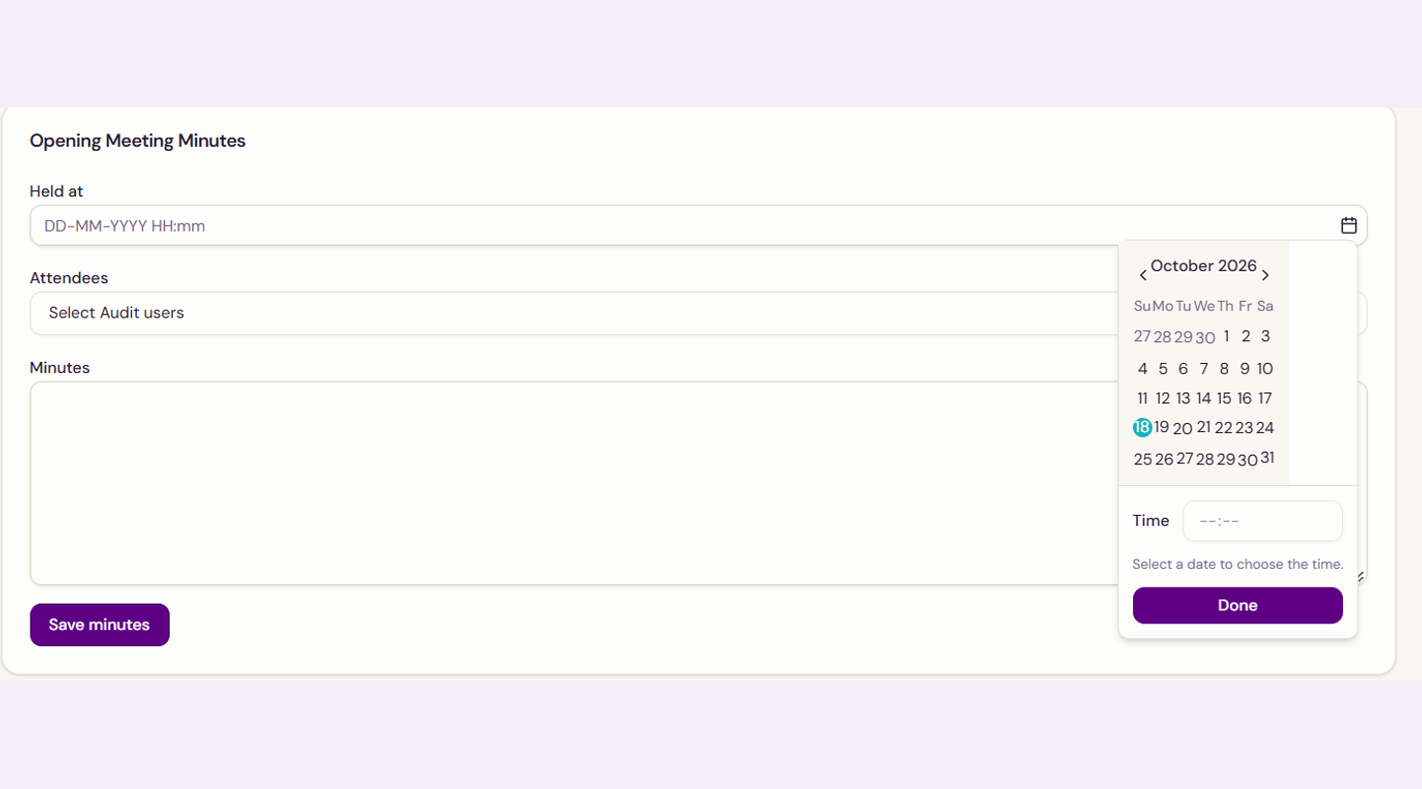

Photographic evidence
EVIDENCE
To be mapped
Screenshot 2026-10-18 231543.png
To be mapped
Ref: B.1.1 Grade: Moderate Date: To be mapped
Ref: To be mapped Grade: To be mapped Date: To be mapped
Location: Chennai
Location: To be mapped
Description: Test
Description: To be mapped
Requirement: 1
Requirement: To be mapped

Slide 20
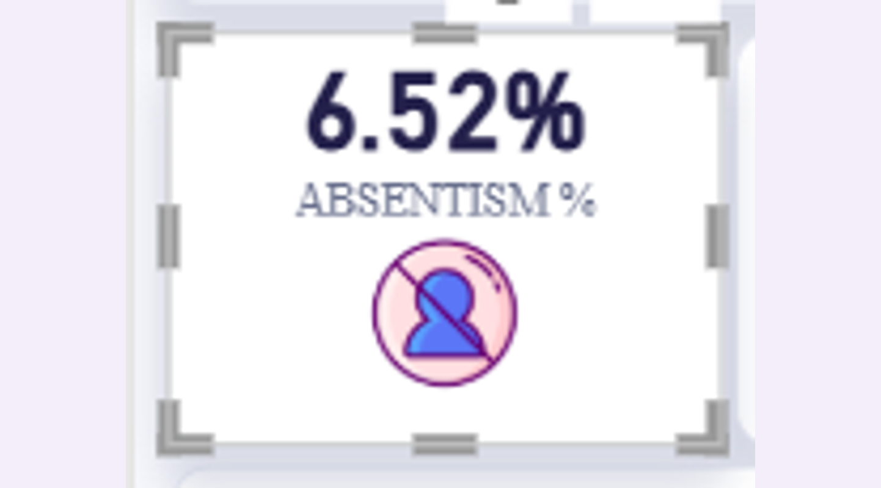
Photographic evidence
EVIDENCE
To be mapped
Screenshot 2026-09-06 101611.png
To be mapped
Ref: B.2.1 Grade: Major Date: To be mapped
Ref: To be mapped Grade: To be mapped Date: To be mapped
Location: Chennai
Location: To be mapped
Description: Test
Description: To be mapped
Requirement: 2
Requirement: To be mapped

Slide 21

Photographic evidence
EVIDENCE
To be mapped
fast-time.png
To be mapped
Ref: B.3.1 Grade: Moderate Date: To be mapped
Ref: To be mapped Grade: To be mapped Date: To be mapped
Location: Chennai
Location: To be mapped
Description: Inspected materials have defects
Description: To be mapped
Requirement: 5
Requirement: To be mapped

Slide 22
Finding grades and response requirements
GRADING AND RESPONSE
1
2
3
4
5
Auditee root-cause analysis and CAPA plan
Audit team reviews and accepts plan
Actions implemented with evidence
Effectiveness verified by auditors
Finding closed in tracker
Grade | Definition | Response requirement (days from report issue)
Major | Failure of a required control, or a condition that could compromise the integrity, safety or performance of the works or the system. | Immediate containment. CAPA plan within 7 days; closure within 30 days.
Moderate | Significant departure from a specified requirement that could affect quality if left uncorrected. | CAPA plan within 14 days; closure within 45 days.
Minor | Isolated lapse or documentation gap with low immediate impact. | CAPA plan within 14 days; closure within 60 days.
OFI | Improvement suggestion; not a breach of a requirement. | Auditee decides and records its response; reviewed at the next audit.
Definitions and response windows are proposed for approval of this standard.

Slide 23
Corrective action tracker
CORRECTIVE ACTIONS
Ref | Grade | Root cause | Correction and corrective action | Owner | Due date | Status | Verified by / date
To be mapped | To be mapped | To be mapped | To be mapped | To be mapped | To be mapped | To be mapped | To be mapped
To be mapped | To be mapped | To be mapped | To be mapped | To be mapped | To be mapped | To be mapped | To be mapped
To be mapped | To be mapped | To be mapped | To be mapped | To be mapped | To be mapped | To be mapped | To be mapped
To be mapped | To be mapped | To be mapped | To be mapped | To be mapped | To be mapped | To be mapped | To be mapped
To be mapped | To be mapped | To be mapped | To be mapped | To be mapped | To be mapped | To be mapped | To be mapped
To be mapped | To be mapped | To be mapped | To be mapped | To be mapped | To be mapped | To be mapped | To be mapped
To be mapped | To be mapped | To be mapped | To be mapped | To be mapped | To be mapped | To be mapped | To be mapped
Status: Open, In progress, Implemented, Verified, Closed. Use the same reference numbers as the register.

Slide 24
CONCLUSION
SIGN-OFF
Test Conclusion
Prepared by
Lead auditor: Noura Alharbi / QC Manager
To be mapped
To be mapped
Signature
Date
Yes
okay
Follow-up audit: 2026-05-05 · Usual
Reviewed by
To be mapped
To be mapped
To be mapped
Signature
Date
Approved by
To be mapped
To be mapped
To be mapped
Signature
Date
Report issue date: To be mapped
Acknowledged by
Distribution: To be mapped
To be mapped
To be mapped
To be mapped
Signature
Date

Slide 25
End of Report
ATTACHMENTS (TICK THOSE INCLUDED)
To be mapped
Audit plan / programme
To be mapped
Signed attendance sheet
To be mapped
Audit checklists and working notes
To be mapped
Photographic evidence
To be mapped
Non-conformity forms and CAPA responses
To be mapped
Supporting records and reports

