Slide 1
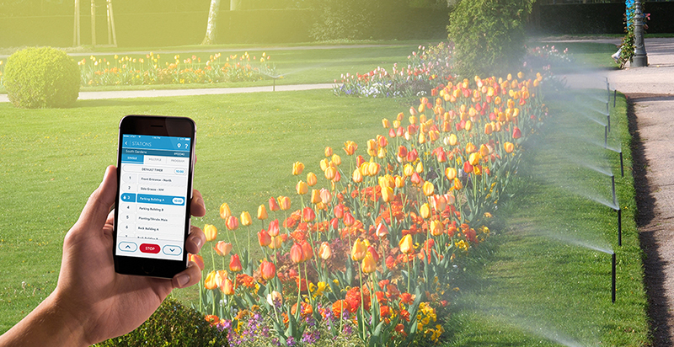
SMART IRRIGATION

Slide 2
Introduction
The rise in energy demand has outpaced power generation capacity due to the high increase in population and industries. This calls for management of demand to optimize the usage of the limited generated power. One of the areas where power is so essential is irrigation. However, two scarce and valuable resources of irrigation, i.e. water and energy, are not efficiently utilized by the current irrigation systems. They do not have the means to determine where and when irrigation is required. Consequently, irrigation is sometimes performed when it is not necessary or delayed when required. This leads to water/energy waste and low-crop yield, respectively. The modern technology has come up with the solution, smart irrigation to be able to perform irrigation more efficiently.

Slide 3

Need for smart irrigation
Scarcity of water
Time consumption
Waste of water more than required
difficult to know when irrigation is needed
difficult to know where irrigation is needed
Unaware of the current situation of plants
More manpower is required

Slide 4
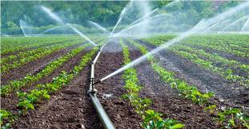
Advantages of smart irrigation
Based on soil moisture , smart irrigation systems can optimize water levels.
It can tells us if the plants need water or not.
It notifies us when there is enough water for plants.
Farmers do not need to be present in the field to irrigate and know the water condition of plants
Farmers can control the system from anywhere and irrigate there lands.
With the help of app it will be just a single persons job without consuming much time.
Wastage of water is controlled which will be caused by not knowing how much water is needed for the plants.
Power required to generate water is also reduced

Slide 5
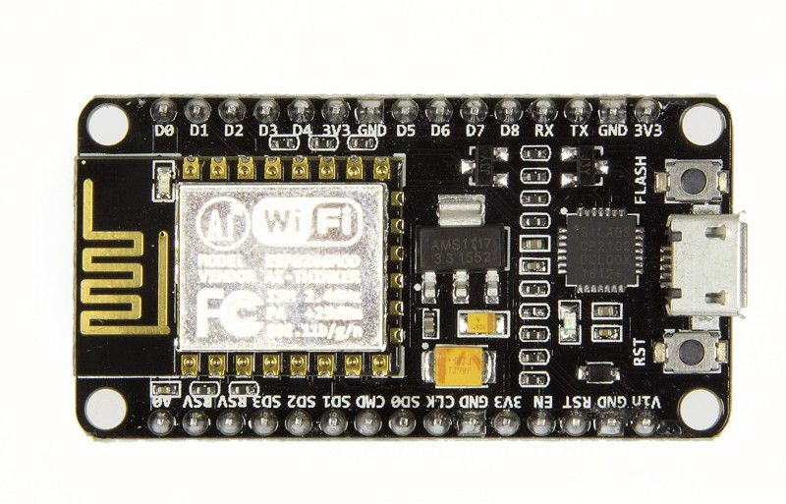
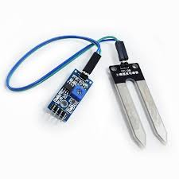
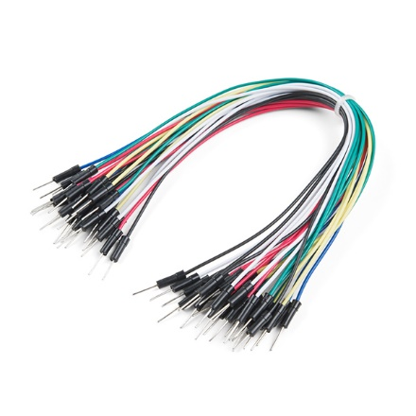
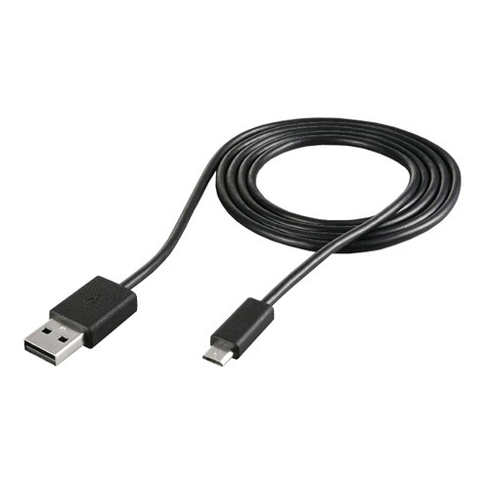
Implementation of smart irrigation prototype
components
Node Mcu
Soil moisture sensor
Jumper wires
Data cable

Slide 6
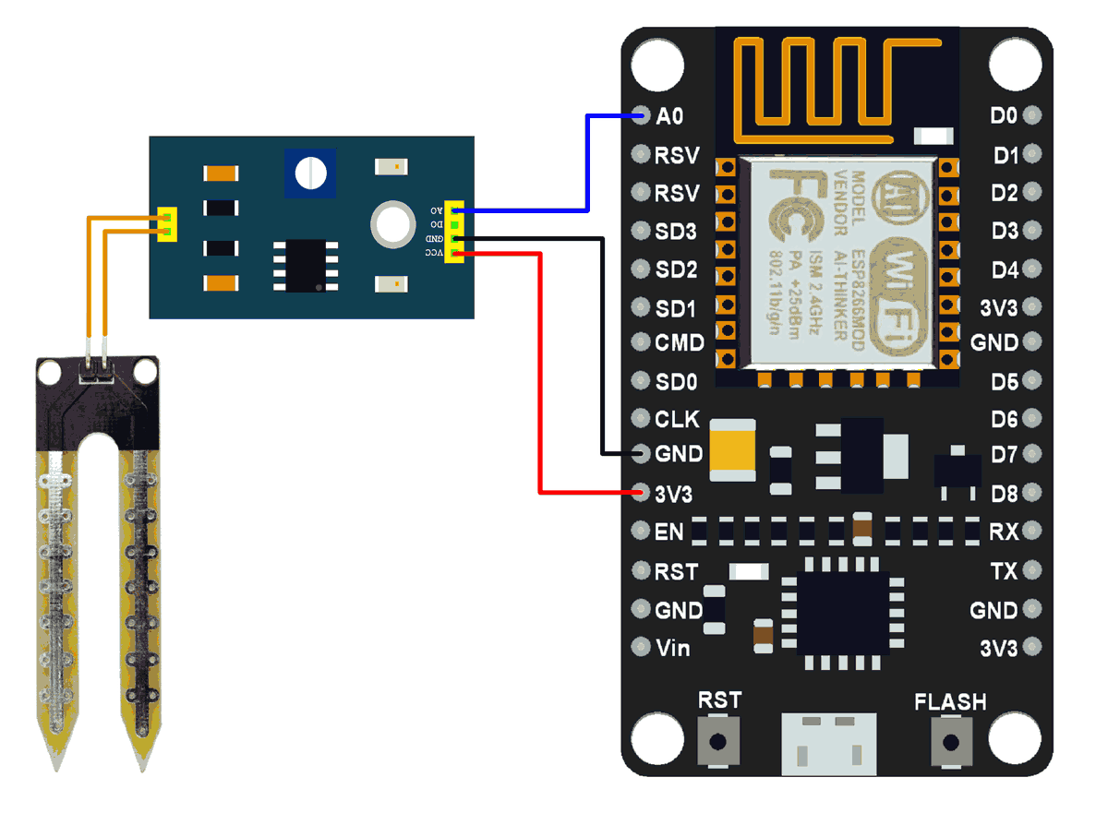
Connection of components/ circuit diagram

Slide 7
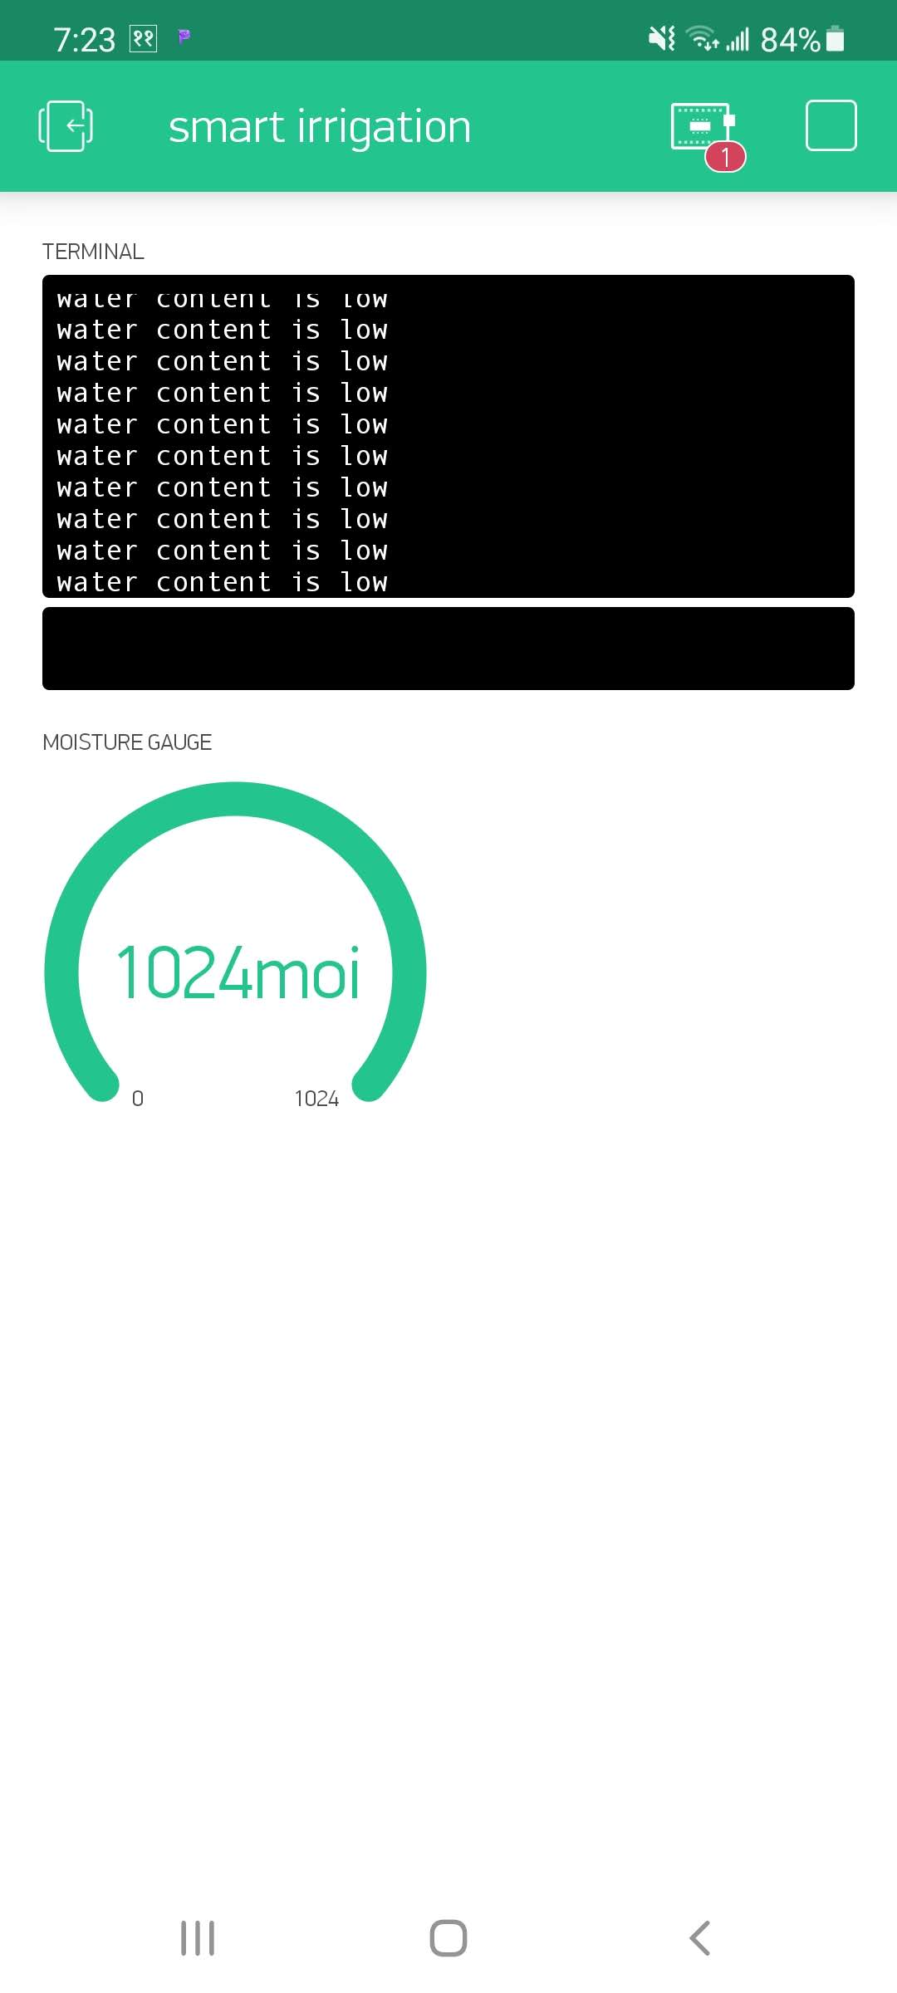
Connections and Working
Firstly, components of soil moisture sensor that is sensor and relay control module are inter connected.
GND of sensor is connected to GND of node mcu.
A0 pin of sensor is connected to A0 of node mcu to read external voltage applied on the ADC pin of the module.
VCC of sensor is connected VIN of node mcu for power supply.
A data cable connects the mcu to the code required to run the program.
The data coming from the sensor is displayed in serial monitor and blynk application.
Blynk application displays the data coming from sensor, it is connected through the internet.

Slide 8
Future work
In order to grow well, plants require more than just water. This method can be improved in such a way that even soil nutrient knowledge is collected and used to assess the nutrients needed in particular regions of the field, rather than just irrigation control. This is the key focal point for future work.

