Slide 1
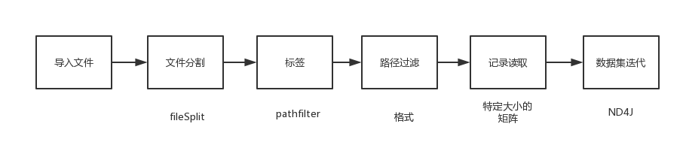

Slide 2
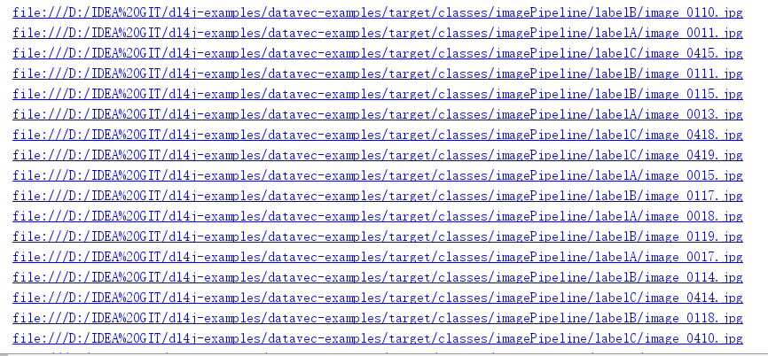
File parentDir=new File("D:/IDEA GIT/module/ImagePipeline")
FileSplit filesInDir = new FileSplit(parentDir, allowedExtensions, randNumGen)
Notes:
.locations

Slide 3
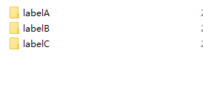
ParentPathLabelGenerator labelMaker = new ParentPathLabelGenerator()
BalancedPathFilter pathFilter = new BalancedPathFilter(randNumGen, allowedExtensions, labelMaker);
InputSplit[] filesInDirSplit = filesInDir.sample(pathFilter, 80, 20);
InputSplit trainData = filesInDirSplit[0];

Slide 4
ImageRecordReader recordReader = new ImageRecordReader(height,width,channels,labelMaker);
ImageTransform transform = new MultiImageTransform(randNumGen,new ShowImageTransform("Display - before "));
recordReader.initialize(trainData,transform);
int outputNum = recordReader.numLabels();
int batchSize = 10; // Minibatch size. Here: The number of images to fetch for each call to dataIter.next().
int labelIndex = 1; // Index of the label Writable (usually an IntWritable), as obtained by recordReader.next()
DataSetIterator dataIter = new RecordReaderDataSetIterator(recordReader, batchSize, labelIndex, outputNum);
Notes:
javacv
用记录读取器转换为迭代器进行训练数据
数据集是dl4j

Slide 5
