Slide 1





Database Performance
Database Performance for Developers
Svetlin Nakov
Manager Technical Training
SQL
http://www.nakov.com
Telerik Software Academy
http://academy.telerik.com

Slide 2

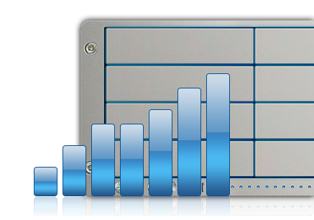
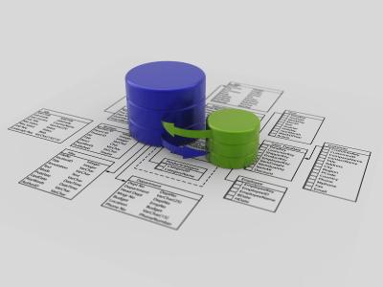
Table of Contents
DB Performance Factors
Query Execution Plans
Operations and Costs: Table Scan, Nested Loops, Index Seek, Clustered Index Seek, Merge Join, Hash Join, Sort, Hash Match, …
Table Indexes
Clustered Indexes and Non-Clustered Indexes
Caching SQL Query Results
Table Partitioning in MySQL

Slide 3





Database Performance Factors
Overview

Slide 4


DB Performance
DB performance depends on many factors:
Hardware
CPU & RAM
Storage, drives, RAID arrays
SSD drives boost I/O performance
Operating system configuration
Services → turn off unused services
Drivers → use high-performance devices drivers
Network configuration → maximize throughput
Virtual memory → pagefile.sys on each HDD

Slide 5


DB Performance (2)
DB performance depends on many factors:
SQL Server version
Standard Edition – 2 GB RAM, 4 CPUs
Enterprise Edition – 64 GB RAM, 32 CPUs
SQL Server configuration
Configure database storage and files
Configure tempdb size and location
Reinitialize indexes and table fill factor (weekly)
Update statistics (nightly)
Update sysindexes (nightly)

Slide 6

DB Performance (2)
DB performance depends on many factors:
Database design
Schema normalization (3rd & 4th normal form?)
Indexes
Constraints
Triggers
Indexed views
Table partitioning
Physical storage settings
Clustering

Slide 7


DB Performance (3)
DB performance depends on many factors:
Query tuning
Efficient SQL
Use efficiently indexes
Optimize physical I/O
Stored procedures tuning
Application design
E.g. ORM framework, caching, query efficiency, N+1 query problem, batch operations, transactions, etc.

Slide 8

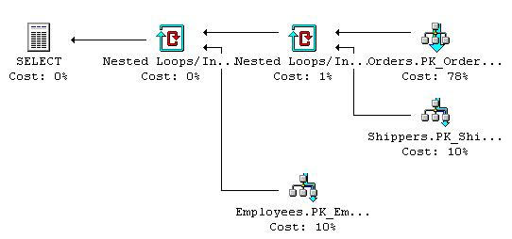
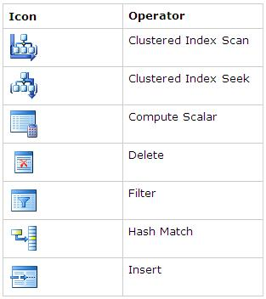



Query Execution Plans
How to Analyze Query Execution Plans?

Slide 9
Query Execution Plans
The query execution is serial
SQL Server “compiles” query into a sequential steps which are executed one after the other
Individual steps also have internal sequential processing
E.g. table scans are processed one page after another & row by row within page
Some steps could be complex, consisting of several sub-steps (like an expression tree)
Execution Plans visualize these steps

Slide 10
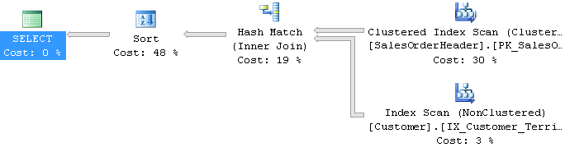
Execution Plan: Example
Consider the following SQL query:
Its execution plan might be as follows:
Read execution plans from top right to bottom left
SELECT c.CustomerID, soh.SalesOrderID, soh.OrderDate
FROM Sales.Customer c JOIN Sales.SalesOrderHeader soh
ON c.CustomerID = soh.CustomerID
WHERE soh.OrderDate > '20040101'
ORDER BY soh.OrderDate DESC

Slide 11




Query Operations
Clustered Index Scan – O(n) operation
Walks through the B-Tree clustered index
The data is sorted by the clustered-index key
Index Scan – O(n) operation
Walks through the B-Tree index
Index Seek – O(log(n)) operation
Similar performance like Clustered Index Seek
Key Lookup – O(1) operation
Finds a table record by its ID (read a record)

Slide 12



Join Operations
Nested Loops Join – O (n*m) operation
Nested “for each row…” operation
Merge Join – O (n + m) operation
Scans both sides of join in parallel
Ideal for large range scans
No sort is required when both columns are indexed
Hash Join – O (n + m) operation
“Hashes” the join column/s from one side of join
“Probes” with the other side (the larger)

Slide 13
Query Execution Plans
Live Demo

Slide 14

Table Indexes
Clustered and Non-Clustered Indexes

Slide 15
Indexes
Indexes speed up searching of values in a certain column or group of columns
Provide fast data access in log(N) steps
Usually implemented as B-trees
Insert / update / delete of records in indexed tables is slower!
Useful for big tables (50 000+ rows)
Indexes can be built-in the table (clustered) or stored externally (non-clustered)

Slide 16
Clustered Indexes
Clustered indexes are the actual physically written records
An index built-in the table as B-tree – very fast!
A SELECT statement with no ORDER BY clause will return data in the clustered index order
Highly recommended for every table!
Very useful for fast execution of WHERE, ORDER BY and GROUP BY clauses
Maximum 1 clustered index per table

Slide 17
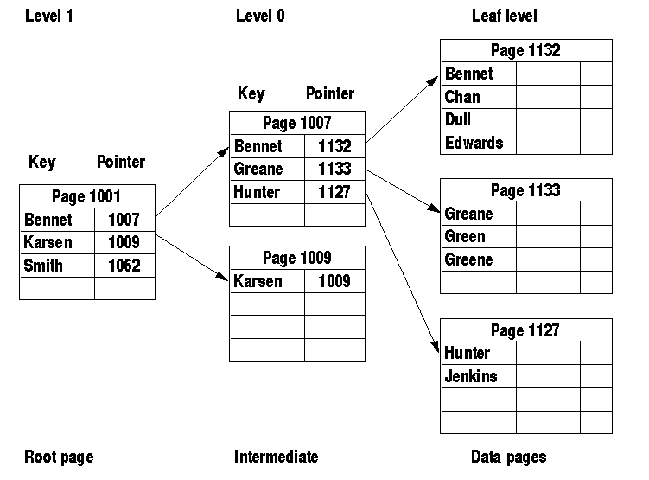
Clustered Index: Structure

Slide 18
Non-Clustered Indexes
Non-Clustered Indexes
Useful for fast retrieving a single record or a range of records
Maintained in a separate structure in the DB
Tend to be much narrower than the base table
Can locate the exact record(s) with less I/O
Has at least one more intermediate level than the clustered index
Much less valuable if table doesn’t have a clustered index

Slide 19
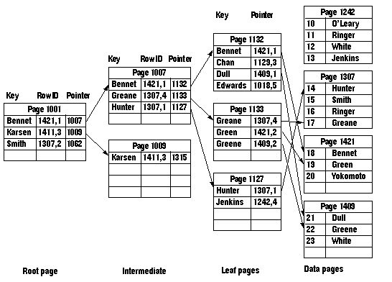
Non-Clustered Index: Structure

Slide 20
Full-Text Indexes
Full-Text Search in SQL Server
Allows full-text queries against character-based data in SQL Server table
It splits the text into words and indexes them
Create a Full-Text Catalog
Create a Full-Text Index for the tables and columns you want to search
The index is populated in background
Use WHERE CONTAINS(<column>, 'text')

Slide 21
Add Index When
You need fast access by some column or group of columns
Unless the records are less than 1 000
Search by certain column/s (WHERE clause)
Data within the column is used to build joins
Foreign keys are almost always good candidates for indexes
The data in the column is needed in the same order every time it is retrieved (ORDER BY)

Slide 22
Add Index When (2)
The values in the intermediate node can answer the query without going to the leaf node
E.g. in WHERE + JOIN
The values in the column must be unique (avoid duplicates)
Primary key constraints always create an index
Unique key constraints always create an index
The values of a column group is used to split into categories
Especially in the GROUP BY clause

Slide 23
How Many Indexes?
Adding non-clustered indexes to a table can greatly speed-up SELECT statements
Every index has a certain amount of overhead
The greater the number of indexes, the more overhead with every INSERT, UPDATE, and DELETE statements
Must balance the needs of the application with the pros and cons of added indexes
OLAP → more indexes (more read, less modify)
OLTP → less indexes (more modify, less read)
Notes:
Any time you rebuild the clustered index, you also automatically rebuild all non-clustered indexes on the table.

Slide 24
Fill Factor
When SQL Server creates indexes, every page is nearly 100% full
No room on the leafs or intermediate pages for INSERTs, UPDATEs, or DELETEs
The default (100%) can cause costly page splits on certain tables
Promotes table fragmentation
You can specify amount of free space in leaf pages with FILLFACTOR (prefer 75-80%)
An option in the CREATE INDEX
Notes:
Can set FILL FACTOR at a server level or specify with each clustered index.
A good rule of thumb setting is 75-80%
Should not set at the server level since some tables perform worse with fill factor of less than 100%.
Naturally, this option strongly affects the amount of space that a table and its indexes will consume. However, disk is cheap!

Slide 25


Table Indexes
Live Demo

Slide 26



Caching SQL Query Results
Using Cache Table for Improved Performance

Slide 27
Caching SQL Query Results
Caching can significantly improve the performance of heavy joins
E.g. joining 8 tables is slower than scanning an already pre-computed (de-normalized) table
Can be done at application or at DB level
Caching SQL query results at database level
Just insert the SQL results into a cache-table
Update the cache at certain time interval
May be automated through a scheduled job

Slide 28
Caching SQL Query Results (2)
Creating a cache-table:
Rebuilding the cache:
CREATE TABLE CacheOfMsgCheapJan2012(
MsgId int PRIMARY KEY,
MsgDate datetime,
MsgPrice int,
AuthorName varchar(100))
BEGIN TRANSACTION
DELETE FROM CacheOfMsgCheapJan2012
INSERT INTO CacheOfMsgCheapJan2012
SELECT m.MsgId, m.MsgDate, m.MsgPrice, a.AuthorName
FROM dbo.Messages m JOIN dbo.Authors a
ON m.AuthorId = a.AuthorId
AND m.MsgDate BETWEEN '1-Jan-2012' AND '31-Jan-2012'
AND m.MsgPrice < 100000
COMMIT

Slide 29
Caching SQL Query Results
Live Demo

Slide 30
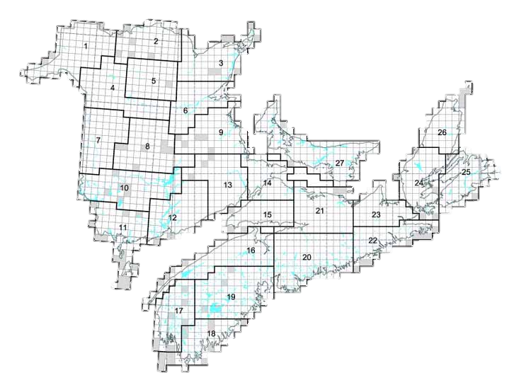


Table Partitioning
Overview

Slide 31
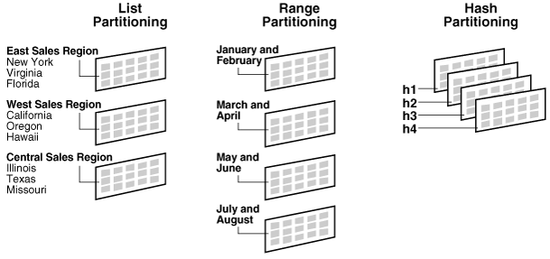
Table Partitioning: Concepts
Partitioning is a physical split of a large table into several pieces by some criteria

Slide 32
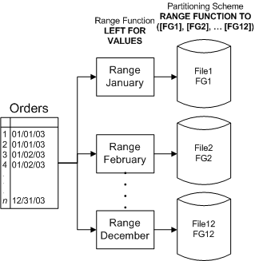
Table Partitioning – Example

Slide 33
Partitioning in MySQL
Partitioning by hash code:
Partitioning by range:
CREATE TABLE Messages(
MsgId int NOT NULL AUTO_INCREMENT,
AuthorId int NOT NULL,
MsgText nvarchar(300),
MsgDate datetime,
PRIMARY KEY (MsgId, AuthorId)
) PARTITION BY HASH(AuthorId) PARTITIONS 5;
CREATE TABLE Messages( … ))
PARTITION BY RANGE(YEAR(MsgDate)) (
PARTITION p0 VALUES LESS THAN (1990),
PARTITION p2 VALUES LESS THAN (2000),
PARTITION p4 VALUES LESS THAN MAXVALUE
);

Slide 34

Partitioning in MySQL
Live Demo

Slide 35
Database Performance
http://academy.telerik.com

Slide 36
Exercises
Create a table in SQL Server with 100 000 000 log entries (date + text). Search in the table by date range. Check the speed (without caching).
Add an index to speed-up the search by date. Test the search speed (after cleaning the cache).
Add a full text index for the text column. Try to search with and without the full-text index and compare the speed.
Create the same table in MySQL and partition it by date (1990, 2000, 2010). Fill 1 000 000 log entries. Compare the searching speed in all partitions (random dates) to certain partition (e.g. year 1995).

Slide 37



Free Trainings @ Telerik Academy
"Web Design with HTML 5, CSS 3 and JavaScript" course @ Telerik Academy
html5course.telerik.com
Telerik Software Academy
academy.telerik.com
Telerik Academy @ Facebook
facebook.com/TelerikAcademy
Telerik Software Academy Forums
forums.academy.telerik.com

