Slide 1
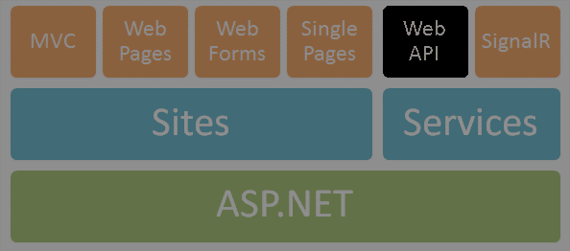





ASP.NET Scaffolding
Nikolay Kostov
Team Lead, Senior Developer and Trainer
http://Nikolay.IT
Telerik Software Academy
academy.telerik.com

Slide 2


Table of Contents
ASP.NET Scaffolding with Web Forms
Data Annotations and Scaffolding
Code Generation Tools

Slide 3
ASP.NET Scaffolding with Web Forms

Slide 4
What is ASP.NET Scaffolding?
Code generation framework for ASP.NET
When you want to quickly add boilerplate code that interacts with data models
Developer productivity enhancer
Can reduce the amount of time to develop standard data operations in your project
Enables customization
Provides an extensibility mechanism to customize generated code
VS 2013 Preview includes pre-installed code generators for MVC, Web Forms, and Web API

Slide 5
TODO
TODO

Slide 6
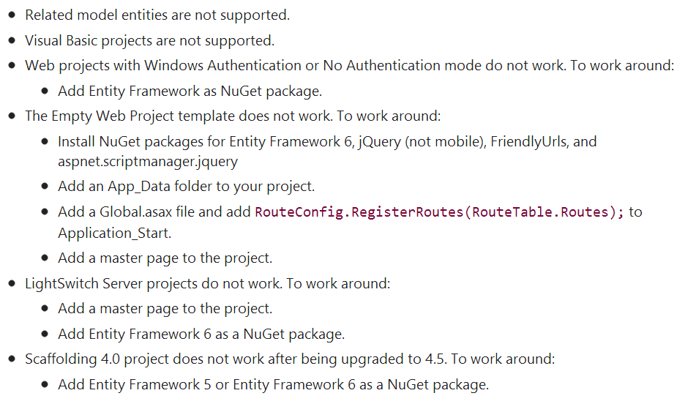
Known Issues
This preview release contains some issues that limit the use of ASP.NET Scaffolding

Slide 7
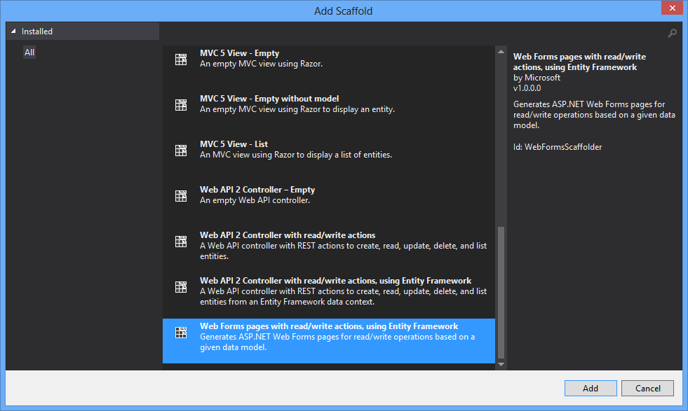
Demo: Create Scaffold
Create Web Forms pages with read/write actions, using Entity Framework

Slide 8
Data Annotations and Scaffolding

Slide 9
TODO
TODO: Data annotations
[ScaffoldColumn(false)]
Display, DisplayFormat

Slide 10

Code Generation Tools
Visual Studio T4 Engine, CodeSmith, AndroMDA

Slide 11
Code Generators – Concepts
Source code generation
Template based
Build data access layer by given database schema
E.g. Visual Studio Data Designer for LINQ-to-SQL
Build Web application by database schema
E.g. Django (Python based Web application platform)
Model based
Build entire application by high-level model

Slide 12
Code Generation Tools
Microsoft T4 Engine, CodeSmith
Template based code generators
Can generate classes, Web pages and other project assets by set of templates
E.g. data access layer based on database schema
AndroMDA
Application generator framework
Transforms UML models to Java EE applications based on Spring, Hibernate and JSF

Slide 13
Microsoft T4 Template Engine
Visual Studio T4 Engine
T4 == Text Template Transformation Toolkit
Integral part of Visual Studio
ASP.NET-like syntax
T4 templates consist of:
Processing directives (e.g. include template)
Text blocks (static text)
Code blocks (in C#, VB.NET)
Compiled to C# and then to .NET assemblies

Slide 14
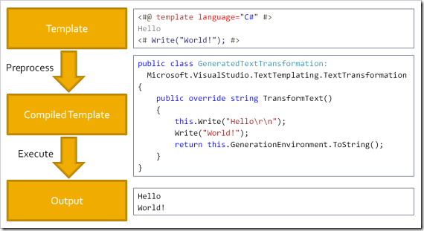
T4 Template Engine – Architecture

Slide 15
Visual Studio T4 Example
<#@ template debug="false" hostspecific="false" language="C#" #>
<#@ assembly name="System.Core" #>
<#@ import namespace="System.Text" #>
<#@ import namespace="System.Collections.Generic" #>
<#@ output extension=".cs" #>
<# for(int i = 0; i < 3; i++) { #>
public int Item<#=i#> { get; set; }
<# } #>
public int Item0 { get; set; }
public int Item1 { get; set; }
public int Item2 { get; set; }

Slide 16
Visual Studio T4 Example (2)
<#@ template language="C#" hostspecific="true" #>
<#@ output extension=".xml" #>
<#@ import namespace="System.IO" #>
<#@ import namespace="Microsoft.VisualStudio.TextTemplating" #>
<?xml version="1.0" ?>
<project>
<# string currentDir = this.Host.ResolvePath(".");
foreach (string dir in Directory.GetFiles(currentDir))
{
FileInfo fileInfo = new FileInfo(dir);
#>
<file><#= fileInfo.Name #></file>
<# } #>
</project>

Slide 17
ASP.NET Scaffolding
http://academy.telerik.com

Slide 18
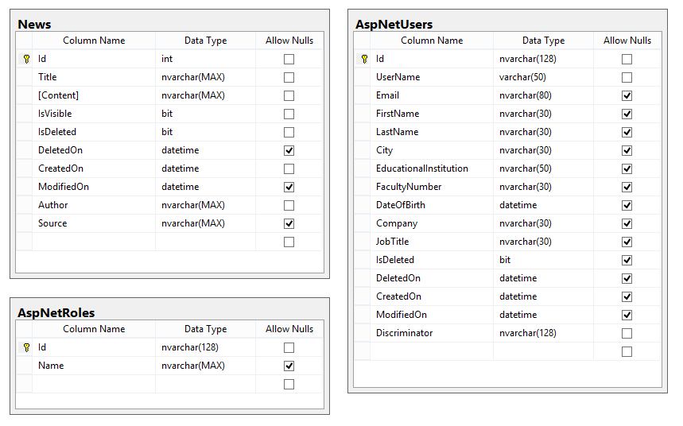
Homework
Create C# classes (models) and full (CRUD) web forms administration (using scaffolding) for the following database tables

Slide 19




Free Trainings @ Telerik Academy
C# Programming @ Telerik Academy
csharpfundamentals.telerik.com
Telerik Software Academy
academy.telerik.com
Telerik Academy @ Facebook
facebook.com/TelerikAcademy
Telerik Software Academy Forums
forums.academy.telerik.com

