Slide 1
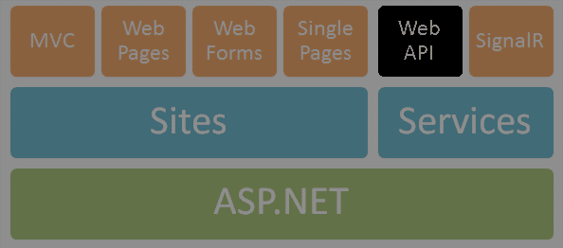
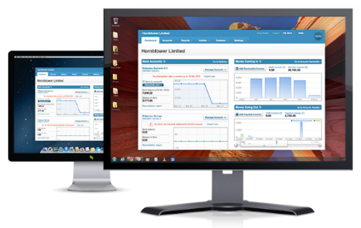




ASP.NET Identity
Ivaylo Kenov
Technical Assistant
Telerik Software Academy
academy.telerik.com

Slide 2

Table of Contents
Basics of Authentication and Authorization
Old ASP.NET Membership
Windows Authentication
Forms Authentication
Old Users and Roles
Old Membership Provider
Getting Current User Information at the server

Slide 3

Table of Contents
Introduction to ASP.NET Identity
Basic ASP.NET Identity Template
Database Identity Tables
Basic functionality
Extending the built-in user profile
User roles
OAuth 2.0 authentication
Cookie information

Slide 4

Authentication and Authorization
Main difference

Slide 5
Basics
Authentication
The process of verifying the identity of a user or computer
Questions: Who are you? How you prove it?
Credentials can be password, smart card, etc.
Authorization
The process of determining what a user is permitted to do on a computer or network
Question: What are you allowed to do?

Slide 6

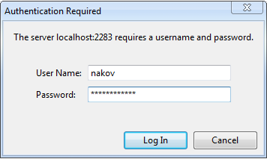
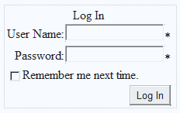
Old Windows and Forms Authentication in ASP.NET

Slide 7
Old Authentication in ASP.NET
Windows Authentication
Uses the security features integrated into the Windows operating systems
Uses Active Directory / Windows accounts
Forms Authentication
Uses a traditional login / logout pages
Code associated with a Web form handles users authentication by username / password
Users are usually stored in a database

Slide 8
Windows Authentication
In Windows Authentication mode the Web application uses the same security scheme that applies to your Windows network
Network resources and Web applications use the same:
User names
Passwords
Permissions
It is the default authentication when a new Web site is created

Slide 9
Windows Authentication (2)
The user is authenticated against his username and password in Windows
Known as NTLM authentication protocol
When a user is authorized:
ASP.NET issues an authentication ticket (which is a HTTP header)
Application executes using the permissions associated with the Windows account
The user's session ends when the browser is closed or when the session times out

Slide 10
Windows Authentication (3)
Users who are logged on to the network
Are automatically authenticated
Can access the Web application
To set the authentication to Windows add to the Web.config:
To deny anonymous users add:
<authentication mode="Windows" />
<authorization>
<deny users="?"/>
</authorization>

Slide 11
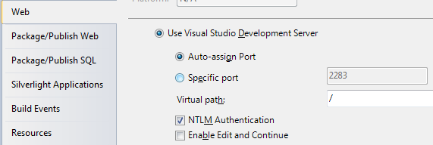
Windows Authentication (4)
The Web server should have NTLM enabled:
HTTP requests:
HTTP responses:
GET /Default.aspx HTTP/1.1
…
HTTP/1.1 401 Unauthorized
WWW-Authenticate: NTLM
GET /Default.aspx HTTP/1.1
Authorization: NTLM tESsB/ yNY3lb6a0L6vVQEZNqwQn0sqZ…
HTTP/1.1 200 OK
…
<html> … </html>

Slide 12
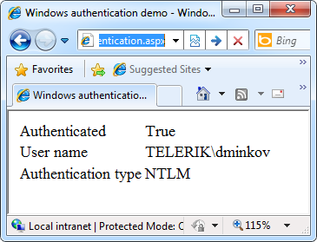
Windows Authentication
Live Demo

Slide 13
Forms Authentication
Forms Authentication uses a Web form to collect login credentials (username / password)
Users are authenticated by the C# code behind the Web form
User accounts can be stored in:
Web.config file
Separate user database
Users are local for the Web application
Not part of Windows or Active Directory

Slide 14
Forms Authentication (2)
Enabling forms authentication:
Set authentication mode in the Web.config to "Forms"
Create a login ASPX page
Create a file or database to store the user credentials (username, password, etc.)
Write code to authenticate the users against the users file or database
<authentication mode="Forms" />

Slide 15
Configuring Authorization in Web.config
To deny someone's access add <deny users="…"> in the <authorization> tag
To allow someone's access add <allow users="…"> in the authorization tag
<deny users="?" /> denies anonymous access
<deny users="*" /> denies access to all users
<system.web>
<authorization>
<deny users="?"/>
</authorization>
</system.web>

Slide 16
Configuring Authorization in Web.config (2)
Specifying authorization rules in Web.config:
The deny/allow stops the authorization process at the first match
Example: if a user is authorized as Pesho, the tag <deny users="*" /> is not processed
<location path="RegisterUser.aspx">
<system.web>
<authorization>
<allow roles="admin" />
<allow users="Pesho,Gosho" />
<deny users="*" />
</authorization>
</system.web>
</location>

Slide 17
Implementing Login / Logout
Logging-in using credentials from Web.config:
Logging-out the currently logged user:
Displaying the currently logged user:
if (FormsAuthentication.Authenticate(username, passwd))
{
FormsAuthentication.RedirectFromLoginPage(
username, false);
}
else
{
lblError.Text = "Invalid login!";
}
This method creates a cookie (or hidden field) holding the authentication ticket.
FormsAuthentication.SignOut();
lblInfo.Text = "User: " + Page.User.Identity.Name;

Slide 18
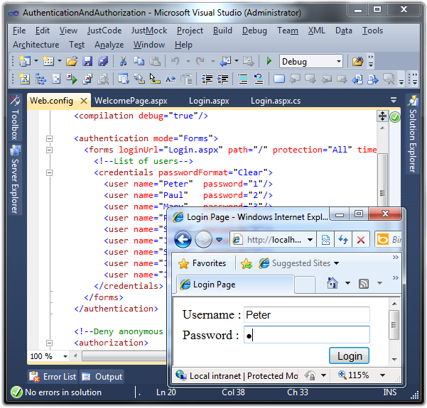
Forms Authentication
Live Demo

Slide 19

Old Users and Roles
Membership Provider and Roles Provider

Slide 20

Users, Roles and Authentication
User is a client with a Web browser running a session with the Web application
Users can authenticate (login) in the Web application
Once a user is logged-in, a set of roles and permissions are assigned to him
Authorization in ASP.NET is based on users and roles
Authorization rules specify what permissions each user / role has

Slide 21
ASP.NET Membership Providers
Membership providers in ASP.NET
Simplify common authentication and user management tasks
CreateUser()
DeleteUser()
GeneratePassword()
ValidateUser()
…
Can store user credentials in database / file / etc.

Slide 22
Roles in ASP.NET
Roles in ASP.NET allow assigning permissions to a group of users
E.g. "Admins" role could have more privileges than "Guests" role
A user account can be assigned to multiple roles in the same time
E.g. user "Peter" can be member of "Admins" and "TrustedUsers" roles
Permissions can be granted to multiple users sharing the same role

Slide 23
ASP.NET Role Providers
Role providers in ASP.NET
Simplify common authorization tasks and role management tasks
CreateRole()
IsUserInRole()
GetAllRoles()
GetRolesForUser()
…
Can store user credentials in database / file / etc.

Slide 24
Registering a Membership Provider
Adding membership provider to the Web.config
<membership defaultProvider="MyMembershipProvider">
<providers>
<add connectionStringName="UsersConnectionString"
minRequiredPasswordLength="6"
requiresQuestionAndAnswer="true"
enablePasswordRetrieval="false"
requiresUniqueEmail="false"
applicationName="/MyApp"
minRequiredNonalphanumericCharacters="1"
name="MyMembershipProvider"
type="System.Web.Security.SqlMembershipProvider"/>
</providers>
</membership>

Slide 25
Registering a Role Provider
To register role provider in ASP.NET 4.0 add the following to the Web.config:
<roleManager enabled="true" defaultProvider="MyRoleProvider">
<providers>
<add connectionStringName="UsersConnectionString"
name="MyRoleProvider"
type="System.Web.Security.SqlRoleProvider" />
</providers>
</roleManager>
<connectionStrings>
<add name="UsersConnectionString"
connectionString="Data Source=.\SQLEXPRESS;Initial
Catalog=Users;Integrated Security=True"
providerName="System.Data.SqlClient" />
</connectionStrings>

Slide 26
The SQL Registration Tool: aspnet_regsql
The built-in classes System.Web.Security. SqlMembershipProvider and System.Web. Security.SqlRoleProvider use a set of standard tables in the SQL Server
Can be created by the ASP.NET SQL Server Registration tool (aspnet_regsql.exe)
The aspnet_regsql.exe utility is installed as part of with ASP.NET 4.0:
C:\WINDOWS\Microsoft.NET\Framework\v4.0.30319\ aspnet_regsql.exe

Slide 27
The Standard ASP.NET Applications Database Schema

Slide 28
ASP.NET Membership API
Implementing login:
Implementing logout:
Creating new user:
if (Membership.ValidateUser(username, password))
{
FormsAuthentication.RedirectFromLoginPage(
username, false);
}
FormsAuthentication.SignOut();
Membership.CreateUser(username, password);

Slide 29
ASP.NET Membership API (2)
Getting the currently logged user:
Creating new role:
Adding user to existing role:
Deleting user / role:
MembershipUser currentUser = Membership.GetUser();
Roles.CreateRole("Admins");
Roles.AddUserToRole("admin", "Admins");
Membership.DeleteUser("admin", true);
Roles.DeleteRole("Admins");

Slide 30
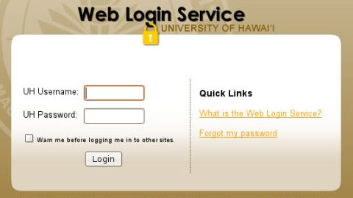
Membership Provider
Live Demo

Slide 31

Getting User Information
From the Back-end C#

Slide 32
Getting User Information
You can get basic user information by using the User class in the back-end
By User class:
IsInRole(string) method
Identity property
string Name property
bool IsAuthenticated property
string AuthenticationType property

Slide 33

Introduction to Identity
Who are you?

Slide 34

ASP.NET Identity
The new membership system for building ASP.NET applications
Makes it easy to integrate user specific profile data with the application data
Allows you to control the persistence model of your application
Local database
External service store

Slide 35

Important Identity Interfaces
IIdentityStore – contains DbContext and classes for database interactions
IdentityManager – manages user interaction with the application through IIdentityStore
IdentityResult – contains results after certain user command – success and error
Methods
CheckPasswordAndSignInAsync
CreateLocalUserAsync
SignInAsync
SignOut

Slide 36

Basic Template With Identity
Creates basic web application
Contains useful libraries
Contains User access options
Ready to use:
Models for extending profiles
Register, Login, Manage pages
Local cookie-based authentication
Remote OAuth services – Facebook, Google, Twitter, etc.

Slide 37
Basic Template
Live Demo with Web Forms and MVC 5

Slide 38

Identity Database
Where are you?

Slide 39
Local Database Tables
Tables
AspNetRoles – role types
AspNetTokens – tokens from external services
AspNetUserClaims – external services claims
AspNetUserLogins – user logins and types
AspNetUserManagement – last logins
AspNetUserRoles – user roles
AspNetUsers – usernames and ids
AspNetUserSecrets – encrypted passwords

Slide 40
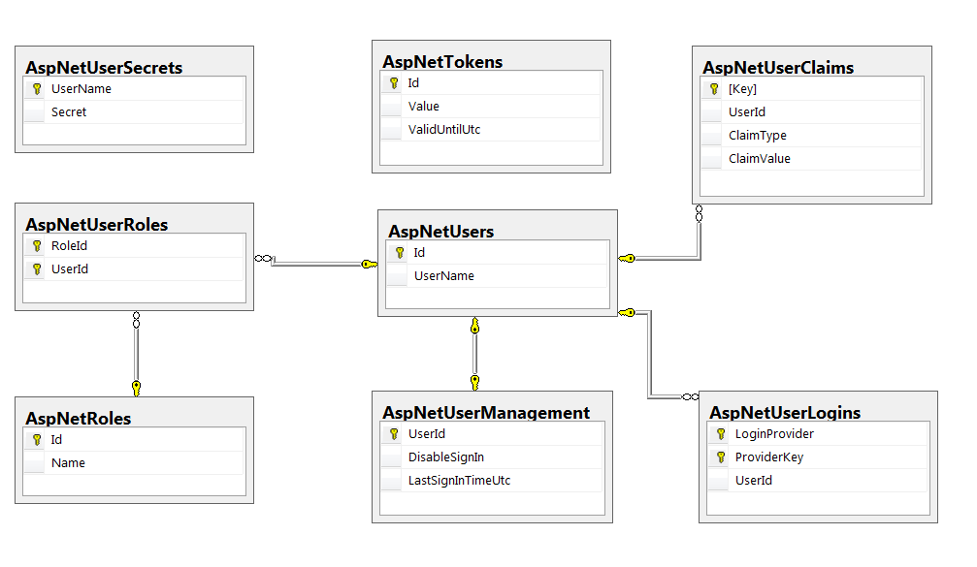
Local Database Schema

Slide 41
Local Database
Live Demo with Web Forms and MVC 5

Slide 42

Basic Functionality
This is how we do it!

Slide 43

Register
Front-end
Provide fields for Username, Password, etc.
Provide submit button
Provide validation messages
Back-end
Instantiate IdentityManager with IdentityStore
Create User instance
Create local user through IdentityManager
If success – sign in and redirect the page

Slide 44

Login
Front-end
Provide fields for Username, Password
Provide submit button
Provide validation messages
Back-end
Instantiate IdentityManager with IdentityStore
Use IdentityManager’s property Authentication
Log in the user
If success – redirect the page to return URL

Slide 45
Register and Login
Live Demo with Web Forms and MVC 5

Slide 46

Extending User Profile
Additional properties

Slide 47
Extending User Profile
Steps
Add properties to Models/IdentityModel/ApplicationUser
ApplicationDbContext should inherit IdentityDbContext and have constructor
Enable migrations for the project/data layer
In Global.asax add database initializer
All IdentityStore instances should take ApplicationDbContext as parameter
Replace all User instances with ApplicationUser

Slide 48
Extended User Profile
Live Demo with Web Forms

Slide 49

User Roles
Who is authorized

Slide 50
User Roles
Role-based authorization
Control over the application modules
Categorizing users and memberships
Defined in Web.config
<location path="About">
<system.web>
<authorization>
<allow roles="Admin"/>
<deny users="*"/>
</authorization>
</system.web>
</location>

Slide 51
User Roles
Live Demo with Web Forms

Slide 52

Remote Authentication
Easier than your ex!

Slide 53

Claims-base authentication (1)
Claims
Piece of information identifying user
Sent as key-value pairs
Contains authentication token and/or signature
Claims-based authentication
Users authenticate on remote system
Information is passed to the application
User is authenticated and recognized

Slide 54
Claims-base authentication (2)
Authentication flow
User makes request to application
System redirects to external page
After authentication the external system returns back to the application with user information
Application makes request to external system to validate user
User gets access to the application

Slide 55

OAuth2
OAuth
Allow secure authentication
Simple and standard protocol
Can be used by web, desktop or mobile apps
Steps
Users tries to authenticate at application
Application relies on remote service
Application receives access token
User gets access

Slide 56
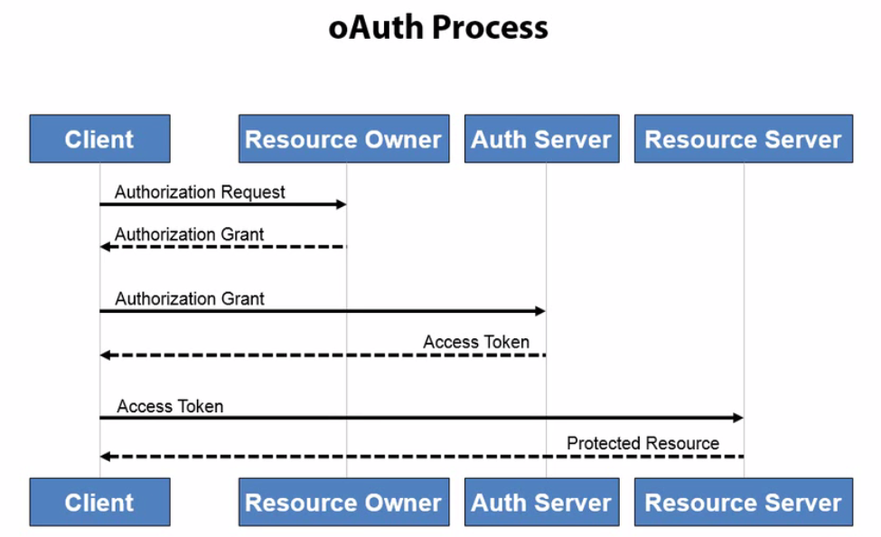
OAuth2 Process

Slide 57
Facebook and Google Authentication
Live Demo with Web Forms

Slide 58

Cookie Information
Where to find user information

Slide 59

Cookie
Identity cookie: .AspNet.Application
Contains information about the application
Contains information about the logged user
Heavily encrypted
If wrong hands find it – serious damage!
For security – use https/SSL protocol

Slide 60
Cookie Information
Live Demo with Web Forms

Slide 61
ASP.NET Identity
http://academy.telerik.com

Slide 62
Homework
Create a Chat canal web application.
Users must have First name, Last name and e-mail fields. Display name should be First name + Last Name
There is only one canal where every registered user can only post (create) a message
There must be Moderator role, which can post and edit all the posted content
There must be Administrator role, which can post, edit and delete all the posted content

Slide 63




Free Trainings @ Telerik Academy
C# Programming @ Telerik Academy
csharpfundamentals.telerik.com
Telerik Software Academy
academy.telerik.com
Telerik Academy @ Facebook
facebook.com/TelerikAcademy
Telerik Software Academy Forums
forums.academy.telerik.com

