Slide 1



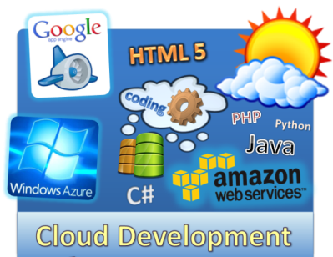

Cloud Technologies and Cloud Platforms – Overview
Cloud: a New Paradigm for Developers
Svetlin Nakov
Manager Technical Training
www.nakov.com
Telerik Software Academy
academy.telerik.com

Slide 2


Table of Contents
The Coming of the Cloud Technologies
What is Cloud Computing?
Cloud Computing Models
IaaS
PaaS
PaaS Architecture
PaaS Development Stacks
Transition PaaS Platforms
SaaS

Slide 3


The Cloud is Coming …
We Can’t Stop It. Better Join It!

Slide 4
Players in the Cloud Industry
Microsoft Azure
IBM Cloud
Apple iCloud
Oracle Public Cloud
SAP NetWeaver on Demand
Google App Engine
Amazon Web Services
HP Cloud Services
VMware Cloud Foundry
The Rackspace Cloud
Cisco Cloud Applications and Services
Intel Hybrid Cloud
Dell Cloud Computing Solutions
Adobe Creative Cloud
CA Cloud Solutions
Symantec.cloud services
EMC Atmos Cloud Delivery Platform
Salesforce Force.com Cloud Computing Platform

Slide 5
The Cloud is Everywhere!
The cloud technologies are becoming inseparable part of our life:
Software developers will also jump into the cloud: now or later, it will happen
This year, or few years later, everyone will develop applications for the cloud
The cloud is coming, we cannot avoid it!
The world is moving towards the cloud!

Slide 6
The Cloud and Developers
Look at the job offers in the software industry
Still "cloud development experience" is not often requirement, but it will come soon
Still Amazon / GAE / Azure jobs are exotic but this is changing day by day
The new "cloud developer" job title is coming
Cloud software developer / cloud software engineer / cloud computing engineer / cloud computing analyst / software engineer with cloud computing / cloud application developer

Slide 7

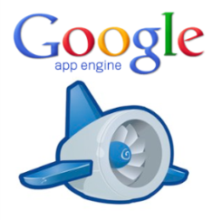


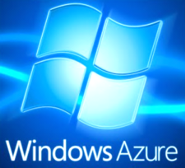
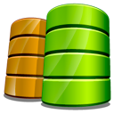
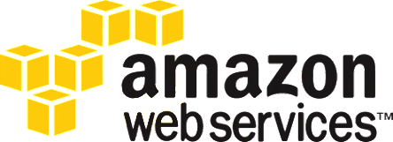
What is Cloud Computing?
HTML 5
coding
Java
Python
PHP
C#
Ruby
Cloud Computing for Developers

Slide 8
What is Virtualization?
Virtualization
Running several virtual machines (virtual computers) inside a single powerful machine
Supported by special software called hypervisor
Uses resources more efficiently
E.g. 12 GB physical RAM is shared to 6 virtual machines with 4 GB shared RAM each
Most applications use 1-5% of the CPU
A single shared CPU can serve thousands of users
Reduces costs due to better utilization

Slide 9
What is Cloud Computing?
Cloud ≈ multiple hardware machines combine their computing power and resources
Share them between multiple applications
To save costs and use resources more efficiently
Cloud computing environment
Suppose we have 20-30 powerful machines
We can run 100-200 virtual machines
We can deploy 1000-5000 applications
We can serve 100 000 – 1 000 000 users

Slide 10
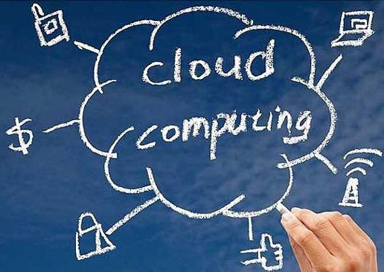
How the Cloud Works?
In the cloud everyone consumes a portion of the shared computing resources
CPU, memory, storage, IO, networking, etc.
If you business is small, you consume less
If your business is growing, you consume more resources from the cloud
Pay as you go
Start for free, pay when you grow and need more resources

Slide 11
Cloud Computing – Example
Suppose we have a mail server software
It needs computing resources (CPU, disk operations, networking, etc.) only when sending or receiving emails
It the rest of the time it does nothing
The mail server on dedicated machine will use less than 1% of its power and resources
You can run 100 mail servers in the cloud for the same job on the same hardware
Less hardware, reduces costs, increased quality

Slide 12
Cloud == Computing Resources on Demand
Cloud computing benefits
Computing on demand → pay as you go
Rent a hosting + CPU power + RAM + storage + IO operations + networking + other services
Cloud has better support and reliability
Your data lives in a professional data center
Has 24 x 7 monitoring + backup + support
Reduces costs: rent a piece of a data center instead build you own IT infrastructure

Slide 13
Public / Private / Hybrid Cloud
Public clouds
IT infrastructure, platform or service publicly accessible from Internet (free or paid)
Private clouds
Cloud infrastructure (hardware + software) for internal use only, e.g. for banking / government
Hybrid clouds
Mix of private and public cloud infrastructure and services, e.g. private cloud + backup in Amazon S3

Slide 14
Public Clouds
Public clouds
Provide computing resources on demand
Publicly in Internet, for everyone
Paid or free of charge (to some limit)
Could be IaaS, PaaS, SaaS or mix of them
Examples of public clouds
Amazon AWS, Google App Engine, Windows Azure, Heroku, App Fog, Rackspace, Force.com AppForce, Engineyard, AppHarbor, Appenda, Cloud Foundry, OpenShift, CloudBees, HP Cloud, Oracle Public Cloud, Salesforce, Zoho, WordPress.com, …

Slide 15
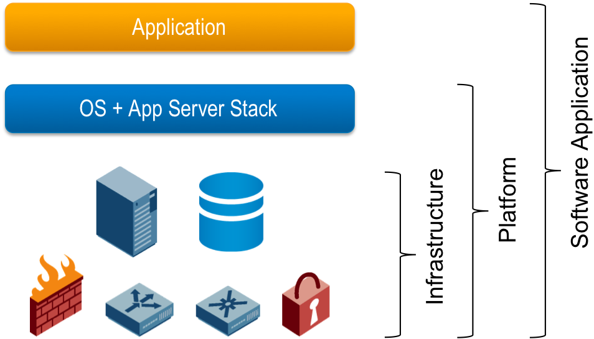
Cloud Computing Models
IaaS, PaaS, SaaS

Slide 16
Cloud Computing Models
Infrastructure as a Service (IaaS)
Virtual machines in the cloud on demand
Users install the OS and software they need
Platform as a Service (PaaS)
Platform, services and APIs for developers
E.g. Java + JBoss + JSF + JPA + MongoDB or JavaScript + Node.js + MongoDB + RabbitMQ
Software as a Service (SaaS)
Hosted application on demand (e.g. WordPress)

Slide 17
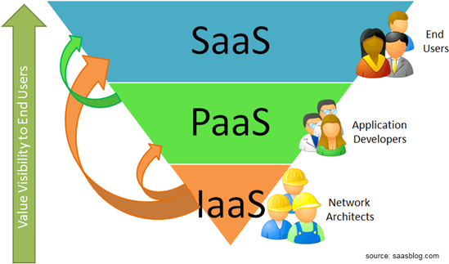
SaaS, PaaS and IaaS

Slide 18

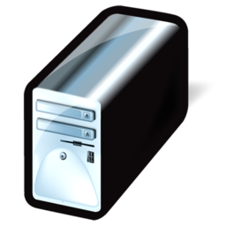



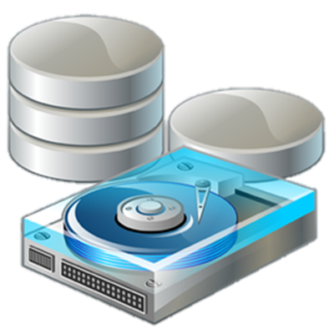
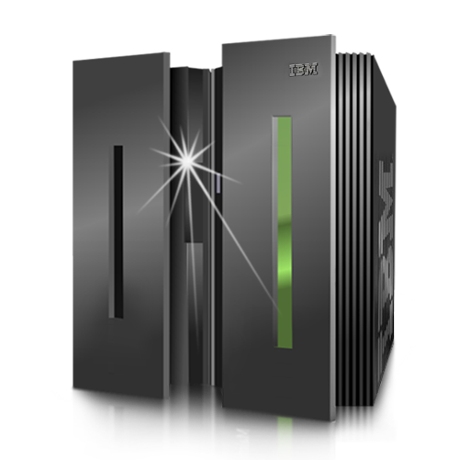
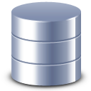

IaaS
Infrastructure as a Service

Slide 19
IaaS (Infrastructure as a Service)
IaaS (Infrastructure as a Service)
IaaS ≈ rent a virtual machine (VPS)
You could modify your resources as you go
Dedicated resources + shared resources
E.g. add more 100 GB HDD storage + 2 GB RAM
Most IaaS providers give you an API for managing your cloud infrastructure
E.g. create a new virtual machine / allocate more resources / network config / install software / etc.

Slide 20
IaaS Pricing Models
IaaS providers offer different pricing models
Fixed price per month for a virtual server
Offered by most hosting companies
Pricing based on computing hours
E.g. Amazon EC2, Rackspace Cloud Servers, Windows Azure Compute
Pricing per resources used. e.g.
E.g. $0.125 per GB storage, $0.040 per CPU hour, $0.06 per GB data transfer

Slide 21
PaaS
HTML 5
coding
Java
Python
PHP
C#
Ruby
PaaS Cloud Platforms
Platform as a Service

Slide 22
PaaS (Platform as a Service)
PaaS ≈ rent a complete development platform
Full technological stack as a service
E.g. Linux + Python + Django + MongoDB + cron jobs + Nginx load balancer + Gunicorn web server
Back-end technologies
E.g. relational and NoSQL DBs, blob storage, …
Business-tier technologies and languages
E.g. Java, Java EE, PHP, Python, Ruby, C#, JS
Frameworks: Django, Rails, Symfony, Spring, JSF

Slide 23
Typical PaaS Platform
Front-End: HTML5, JavaScript / Mobile Front-Ends
Middle-Tier Languages and Frameworks:
PHP, Java, C#, Python, Ruby, JavaScript, Symfony, CakePHP, Zend Framework, JSF, ADF, Django, Rails, Sinatra, Play, ASP.NET, ASP.NET MVC, Node.js
Computing Nodes:
Amazon EC2, Azure Compute, App Engine Backends, …
Back-End Technologies:
Relational DBs, NoSQL DBs, Blob Storage, Message Queues, Notifications, CDN, Email, …
Operating Systems: Linux / Windows / other

Slide 24
Typical PaaS Services
Back-Ends on the Cloud
Relational DBs
MySQL, Oracle, PostgreSQL, MS SQL Server, …
Non-relational DBs
Amazon SimpleDB, App Engine Datastore, Azure Tables, Cloudant (CouchDB + MapReduce), MongoDB, Redis, Couchbase, Cassandra
Blob storage / file storage
Amazon S3, Azure Blobs, App Engine Blobstore, Rackspace Cloud Files, Dropbox

Slide 25
Typical PaaS Services (2)
Middle-Tier on the Cloud
Computing nodes
Amazon EC2, Azure Compute, App Engine Backends, Rackspace Cloud Servers, …
Languages
PHP, Java, C#, Python, Ruby, JavaScript
Frameworks
Symfony, Zend Framework, JSF, ADF, Django, Rails, ASP.NET, ASP.NET MVC, Node.js

Slide 26
Typical PaaS Services (3)
Other PaaS Services and APIs
Queues
Amazon SQS, Google Task Queues, Azure Queues
Notification services
Amazon SNS, Windows Push Notifications, Apple Push Notification Service, PubNub
Email services
CDN (content delivery networks)
DNS, load balancing, quality of services, logging, monitoring, … and many others

Slide 27
Typical PaaS Architecture
The typical cloud architecture is multi-tier, SOA, highly-scalable and highly-available
At each tier different managed services, technologies and languages can run
Monitoring
Load Balancer
Administration
Computing Node
Computing Node
Computing Node
…
Data-bases
Storage Services
Back-End Services
Other Services

Slide 28
AWS Architecture
AWS SDK for Java, C#, PHP, Python + VS / Eclipse Plugins
Elastic Load Balancing (ELB)
AWS Management Console
EC2 Instances + Storage (EBS)
Any OS and development platform C# / Java / PHP / Python / Ruby / …
Any development framework (.NET / Java EE / Symfony / Zend / Django / Rails / Node.js)
RDB
DynamoDB
S3
EBS
SQS
SWF
Other AWS / external services (ElastiCache, CloudFront CDN, SES, …)

Slide 29
Windows Azure – Architecture
Visual Studio + Azure Tools
Azure Load Balancer
Windows Azure Management Portal
Compute (Web role)
Compute (Worker role)
Compute (VM role)
VM running IIS
Windows VM
Windows VM
ASP.NET / PHP / other
C# / .NET code / Java code
Custom software
SQL Azure
Tables
Blobs
Queues
CDN
Other Azure / external services

Slide 30
AppHarbor Architecture
Visual Studio + Git
Load Balancer (Nginx)
AppHarbor Applications Management Console
Web worker instances
Background workers
Managed IIS environment
Managed Windows environment
C# / ASP.NET MVC / Web Forms / WCF
C# code
Managed SQL Server / MySQL
MongoDB, CouchDB
IronMQ, RabitMQ
Other AppHarbor Add-On Services

Slide 31
Classical PaaS Stacks
Java + JBoss app server + Java ServerFaces + JBoss Rich Faces + Java Persistence API + Oracle database
Python + Django + MongoDB + Linux cron jobs + Nginx load balancer + Gunicorn web server
.NET Framework + C# + ASP.NET + WCF + SQL Server + Nginx load balancer + IIS web server
PHP + Zend Framework + Cassandra DB + Nginx load balancer + Apache web server
JavaScript + Node.js + MongoDB + RabbitMQ
Ruby + Ruby on Rails + MySQL + Sphinx + Memcache + Unicorn HTTP server

Slide 32
Proprietary PaaS Stacks
Amazon Web Services (AWS)
PHP + Amazon EC2 + Linux + Apache + Amazon DynamoDB + Amazon S3 + Amazon Block Store (EBS)
Java + Amazon EC2 + Tomcat + Spring + Hibernate + JavaServer Faces (JSF) + Amazon RDS (Oracle)
Windows Azure
C# + Windows Azure Compute + WCF + ASP.NET MVC + Azure Tables + SQL Azure + Azure Blobs + Azure CDN
Google App Engine (GAE)
Java + App Engine Backends + App Engine Datastore + JPA + Google Cloud Storage + JSF + Memcache

Slide 33
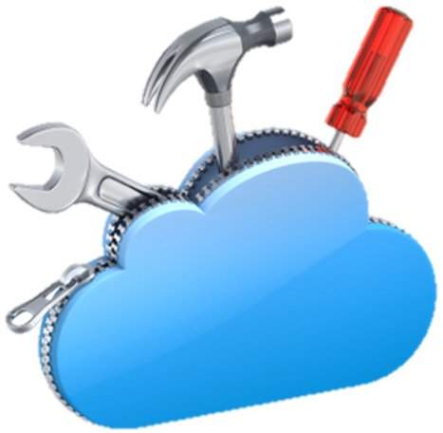
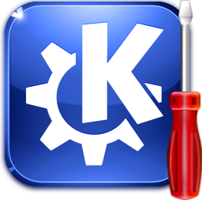

Cloud Development
Challenges for Cloud Developers

Slide 34
What is Cloud Development?
Cloud software development
Design and develop an application for the cloud
Especially for the public PaaS cloud platforms
Typical steps in cloud software development
Choose a development stack of technologies
Choose a cloud platform + services
Design the application for the cloud
Develop the application using the cloud APIs
Deploy and run the application in the cloud

Slide 35
Transition to Cloud Development
Transition to cloud development
New architecture (based on SOA)
New programming paradigms
E.g. NoSQL databases
New APIs
E.g. Amazon S3, Azure Blobs, App Engine Datastore
New deployment model
Git + vendor-specific continuous integration process

Slide 36
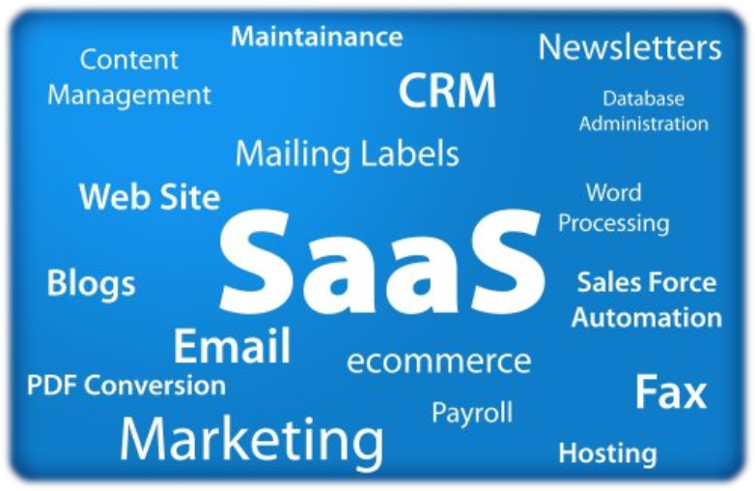
SaaS
Software as a Service

Slide 37
SaaS (Software as a Service)
SaaS ≈ rent an application in the cloud
Fully managed application
Examples of public SaaS services
WordPress.com – hosting of WordPress sites
Basecamp – web-based project management and team collaboration
Salesforce.com – CRM on demand
Adobe Creative Cloud – cloud for designers and creative artists

Slide 38

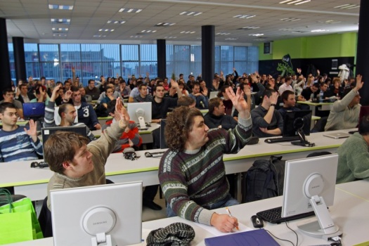
Cloud Technologies and Cloud Platforms – Overview
Questions?
http://clouddevcourse.telerik.com

