Slide 1
LESS
The Dynamic Stylesheet Language
Doncho Minkov
Technical Trainer
http://minkov.it
Telerik Software Academy
http://academy.telerik.com

Slide 2
Table of Contents
LESS Overview
Working with LESS
Using LESS
On the Client
On the Server
LESS Features
Selector nesting
Mixins and Functions
Variables and Interpolation

Slide 3

LESS Overview
What is LESS?

Slide 4
SASS Overview
Extension to CSS
Much like SASS
Can be parsed both Client and Server side
Using a LESS parser written in JavaScript
LESS Features include
Variables,
Mixins
Color editing functions
Selector nesting

Slide 5
Working with LESS
Client and Server Side

Slide 6
Using LESS on the Client
LESS can be parsed on the client (browser)
Include a JavaScript file, that does the parsing
Steps:
Write your LESS
Using Visual Studio, you should add a mime type for the LESS in web.config
You are ready to go
<link rel="stylesheet/less" type="text/css" href="styles.less"/>
<script src="less.js"></script> //after the less link
<configuration> <system.webServer> <staticContent>
<mimeMap fileExtension=".less" mimeType="text/css" />
</staticContent> </system.webServer> </configuration>

Slide 7
Using LESS on the Client (2)
How client-side LESS works?
The JavaScript performs a AJAX GET request to LESS file
Then it parses all the LESS code into pure CSS
The CSS is appended to the HEAD of the page
Using client-side LESS is slow
All the parsing is done by the client
i.e. spend some of the browser resources for kinda pointless parsing
Imagine a 2000-lines-long LESS file…

Slide 8
Using LESS on the Client
Live Demo

Slide 9
Parsing LESS on the Server
LESS can be parsed on the server in many ways
Using the client approach and copy the parsed CSS
Not good enough, lots of copy-pastying
Using node.js to do the parsing
Better solution - the parsing is automated
Using VS plugin - Web Essentials
Live parses the LESS to pure CSS

Slide 10
Parsing LESS on the Server
Live Demo

Slide 11

LESS Features
Selector Nesting, Mixins, Variables, etc…

Slide 12
Selector Nesting
LESS introduces selector nesting
body {
font: normal 16px arial;
color: #fff;
background-color: #011b63;
h1 {
font-size: 2.3em;
font-weight: bold;
}
}
body {
font: normal 16px arial;
color: #fff;
background-color: #011b63;
}
body h1 {
font-size: 2.3em;
font-weight: bold;
}
Parses to

Slide 13
Selector Nesting (2)
All selectors inside a selector are translated to nested selectors
Selectors can also reference themselves inside their selector using the symbol & (AND)
body {…
h1 {…}
}
body {…}
body h1{…}
…
a{
&:hover{…}
}
…
…
a{…}
a:hover{…}
…

Slide 14
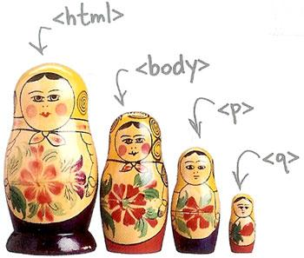
Selector Nesting
Live Demo

Slide 15
LESS Variables
LESS also has variables
Using the @ (at) symbol
Can be used to store colors, size, etc…
Usable to set default background-color, font-color, font-size, etc…
@link-color: #ffffff;
@v-link-color: #646363;
a {
color: @link-color;
&:visited {
color: @v-link-color;
}
body a {
color: white; }
body a:visited {
color: #646363; }

Slide 16

Variables
Live Demo

Slide 17
Interpolation
LESS variables can be inserted as CSS properties
Using @{…}
@border-side:top;
@border-color:blue;
@border-style:ridge;
@border-width:15px;
…
border-@{border-side} :
$border-width $border-style $border-color;
border-top : 15px ridge blue

Slide 18
Interpolation
Live Demo

Slide 19
Functions
LESS support predefined functions
For stuff with colors
For sizes (percentages)
Find all the functions at http://lesscss.org/#reference
@color: #ffffff;
background-color:lighten(@color);
color:darken(@color);
percentage(0.5); //returns 50%

Slide 20
Functions
Live Demo

Slide 21
Mixins
Mixins are kind of developer defined functions
The developer can make them for clear SASS
Two kind of mixins
Parameterless
Get a default styles every time
With parameters
Get style based on some parameters
Gradient, borders, etc…

Slide 22
Mixins (2)
How to define mixins?
Use .mixin-name
Then the styles are normal LESS
How to use the mixin?
Place use .mixin-name
.clearfix{
zoom:1;
&:after{
display:block; content:"";
height:0; clear:both; } }
ul#main-nav{
.clearfix;
}

Slide 23
Basic Mixins
Live Demo

Slide 24
Mixins with Arguments
Mixins can also be defined with parameters
i.e. for gradient-background
Use the arguments like a C# method
.opacity(@value){
…
}
//arguments can take default values
.box(@border:none,@bg:rgba(0,0,0,0.7),@size:200px) {
…
}
…
div.box-div{
.box; //using the mixin with default parameter values
.opacity(0.5); //using the mixin with 0.5 value
}
…

Slide 25
Mixins with Arguments
Live Demo

Slide 26
Pattern-matching Mixins
Mixins can define different behavior, depending on its parameters
.color(dark,@color){
color:@darken(@color);
}
.color(light,@color){
color:@lighten(@color);
}
//called no matter which of the above is called
@color(@_,@color){
border: 1px solid @color; }

Slide 27
Pattern-matching Mixins
Live Demo

Slide 28
SASS
http://academy.Telerik.com

Slide 29
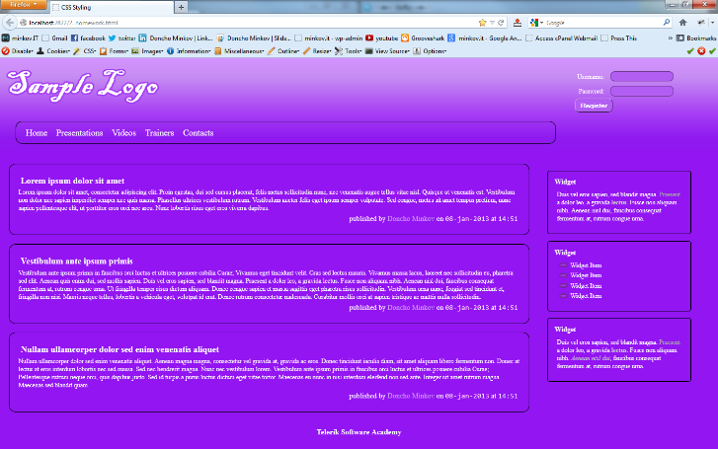
Homework
Implement the following using SASS
Use the HTML code from homework.html
Create the SASS easy to change (backgrounds, fonts)
Use mixins for clears, gradients)

