Slide 1

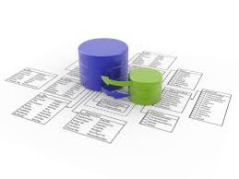


Web Services and Cloud Technologies
Web Services Course Program, Evaluation, Exams
Doncho Minkov
Technical Trainer
http://minkov.it
Telerik Software Academy
academy.telerik.com

Slide 2

Table of Contents
What's Coming Next in the Academy?
The Web Services and Cloud Course Program
The Trainers Team
Exams and Evaluation
Standard Criteria
Bonuses
Resources for the Course
Champions from Databases course

Slide 3

Web Services and Cloud Technologies
Coming To The Next Module

Slide 4

What's Coming Next?
Two courses at the same time
Web Services and Cloud Technologies
Lectures every working day in the week
From 10:30 to 19:00
Practical exam after 2 weeks
Developer Support Course
Lectures 2 time a week
Every Monday and Thursday from 16:00 to 19:00

Slide 5
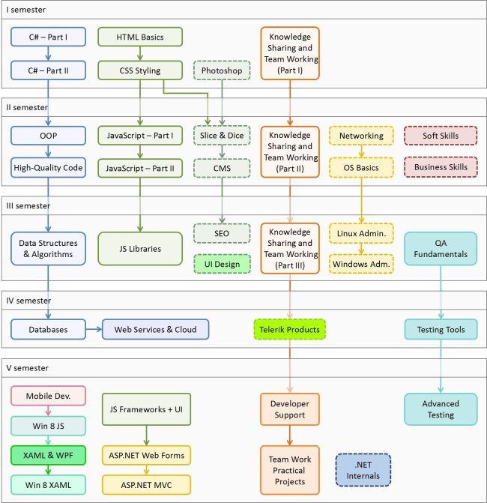

C# Programming Track
Software Academy Curriculum
Specialties @ the Academy
Success Stories @ Telerik

Slide 6

Web Services and Cloud – Program
What Will We Cover in the Web Services and Cloud?

Slide 7


The Databases Course Program
Database Systems – Overview
SQL Server and MySQL – Introduction
Data Modeling and ER Diagrams
Intro to SQL
Advanced SQL
Transact-SQL
ADO.NET
ADO.NET Entity Framework
Entity Framework Performance

Slide 8



The Databases Course Program
Code First in Entity Framework
OpenAccess ORM
Database Projects in Visual Studio
Database Performance
Database Transactions
NoSQL Databases
XML Basics
Processing XML in .NET
Databases Team Work Project
Exam Preparation and Exam

Slide 9
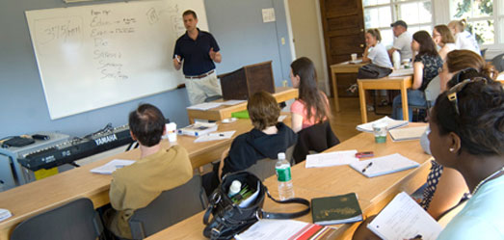
The Trainers Team

Slide 10
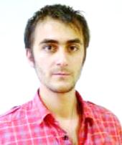
Trainers Team
Doncho Minkov
Technical Trainer @ Telerik Software Academy
Informatics competitions contestant
Graduate from the first season of Telerik Software Academy
Email: doncho.minkov [at] telerik.com
Web site and blog: http://minkov.it
Twitter: @donchominkov

Slide 11
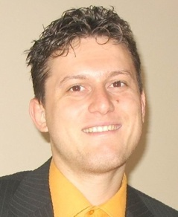
Trainers Team (2)
Svetlin Nakov, PhD
Manager Technical Training @ Telerik Software Academy
20 years software development experience
10+ years experience as trainer
Author of 6 books
Speaker at hundreds of events
E-mail: svetlin.nakov [at] telerik.com
Web site / Blog: http://nakov.com

Slide 12
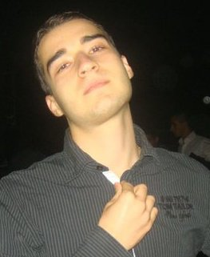
Trainers Team (3)
Nikolay Kostov
Senior Software Developer and Technical Trainer @ Telerik Corp.
Student in Sofia University
Computer Science
IT and Informatics competitions contestant
Graduate from the second season of Telerik Software Academy
Email: nikolay.kostov [at] telerik.com
Blog: http://nikolay.it

Slide 13
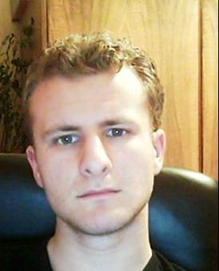
Trainers Team (4)
George Georgiev
Technical Trainer @ Telerik Corp.
Informatics and IT competitions contestant and winner
Student in Sofia University
Software engineering
Graduate from the third season of Telerik Software Academy
E-mail: georgi.georgiev [at] telerik.com
Blog: http://itgeorge.net

Slide 14





Evaluation
Thank God There Are Bonuses!

Slide 15

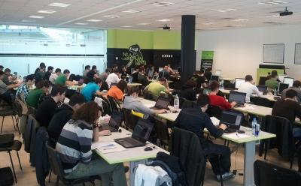
Web Services – Evaluation
Evaluation components
Practical exam – 60%
Teamwork – 15%
Homework – 10%
Homework evaluation – 5%
3 peer reviews per homework (excellent, OK, bad)
Attendance in class – 10%
Bonuses
Forums activity – bonus up to 10%
Helping new C# students – bonus

Slide 16


Pass / Excellence / Fail Criteria
Criteria for pass / pass with excellence / fail
Pass with excellence
Very high exam results
or
High total results
Pass
Average total results
Fail
Low total results or low exam results

Slide 17
Homework Peer Reviews
Everyone will get feedback for their homework
Everyone will give feedback for few random homework submissions
Students submit homework anonymously
Please exclude your name from the submissions!
For each homework submitted
Students evaluate 3 random homeworks
From the same topic, after the deadline
Homework comments are not obligatory

Slide 18
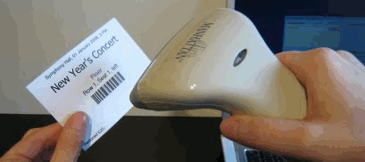
Check Your Presence
From now on you should check your presence on the barcode reader 3 times a day:
In the morning when lectures begin (~10:30)
After lunch break (~13:30)
When you leave academy halls (~19:00)

Slide 19








Resources
What We Need in Addition to this Course Content?

Slide 20

Course Web Site & Forums
Register for the "Telerik Academy Forums":
Discuss the course exercises with your colleagues
Find solutions for the exercises
Share source code / discuss ideas
The databases official web site:
http://forums.academy.telerik.com/web-development/web-services-and-cloud
academy.telerik.com/student-courses/software-technologies/web-services-and-cloud-computing

Slide 21
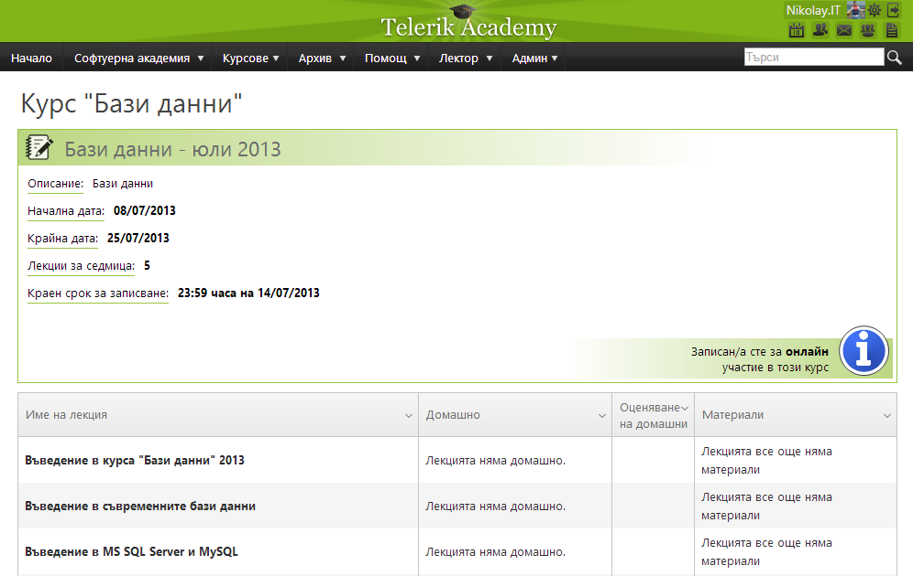
Telerik Integrated Learning System (TILS)
The Telerik Integrated Learning System (TILS)
www.telerikacademy.com
Important resource for all students
Homework submissions
Homework peer reviews
Presence cards with barcode
Reports about your results
telerikacademy.com/Courses/Courses/Details/106

Slide 22


Required Software
Software needed for this course:
Microsoft Visual Studio 2012/2013 or Visual Studio Express 2012 (free version of VS 2012)
Microsoft SQL Server 2012 Developer with Service Pack 1 and Developer Tools
MySQL Community Server 5.x
MySQL Workbench

Slide 23


Champions from the Exams
Telerik Academy Ninja Champions

Slide 24


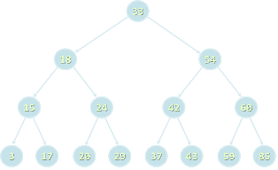
Champions: DSA
# 1 – Ivaylo Kenov
# 2 – Velko Nikolov
# 3 – Vasil Dininski

Slide 25


Champions: JS Applications
# 1 – Asen Valyovski
# 2 – Sevgin Hashimov
# 3 – Dimiter Todorov

Slide 26
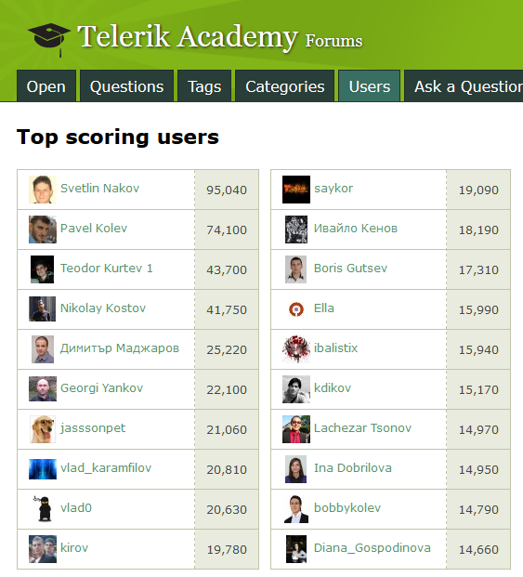

Most Active Students in the Forum
# 1 – Ivaylo Kenov
# 2 – Teodor Kurtev
# 3 – Jasson Jekov

Slide 27

PC Magazine Champions
PC Magazine & Telerik Programming Contest – Round #6 (final round)
Antony Jekov
Ralitsa Nikiforova
More info at http://konkurs.pcmagbg.net/%D1%80%D0%B5%D0%B7%D1%83%D0%BB%D1%82%D0%B0%D1%82%D0%B8-%D0%BE%D1%82-%D1%84%D0%B8%D0%BD%D0%B0%D0%BB%D0%B0-%D0%B7%D0%B0-%D1%81%D0%B5%D0%B7%D0%BE%D0%BD-20122013/

Slide 28
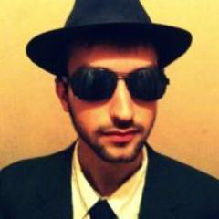

The Absolute Champions
The absolute champions of practical exams of all 10 courses till now:
# 1 – Jasson Jekov
# 2 – Ivaylo Kenov
# 3 – Ivan Buhov

Slide 29


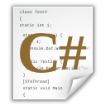
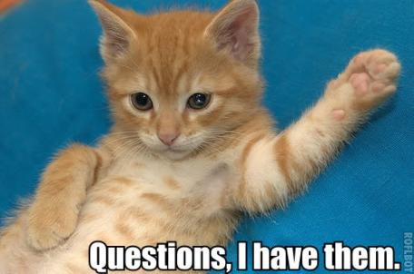

Databases: Course Introduction
http://academy.telerik.com

Slide 30




Free Trainings @ Telerik Academy
C# Programming @ Telerik Academy
csharpfundamentals.telerik.com
Telerik Software Academy
academy.telerik.com
Telerik Academy @ Facebook
facebook.com/TelerikAcademy
Telerik Software Academy Forums
forums.academy.telerik.com

