Slide 1





Entity Framework Performance
Svetlin Nakov
Manager Technical Training
http://nakov.com
Telerik Software Academy
http://academy.telerik.com
Entity Framework

Slide 2

Table of Contents
The N+1 Query Problem
Incorrect Use of ToList()
Incorrect use of SELECT *
Deleting objects faster with native SQL

Slide 3
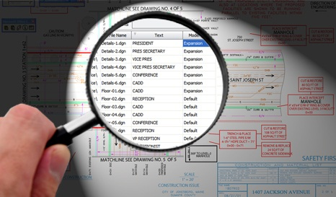
The N+1 Query Problem
What is the N+1 Query Problem and How to Avoid It?

Slide 4
The N+1 Query Problem
What is the N+1 Query Problem?
Imagine a database that contains tables Products, Suppliers and Categories
Each product has a supplier and a category
We want to print each Product along with its Supplier and Category:
foreach (var product in context.Products)
{
Console.WriteLine("Product: {0}; {1}; {2}",
product.ProductName, product.Supplier.CompanyName,
product.Category.CategoryName);
}

Slide 5
The N+1 Query Problem (2)
This code will execute N+1 SQL queries:
One query to retrive the products
foreach (var product in context.Products)
{
Console.WriteLine("Product: {0}; {1}; {2}",
product.ProductName, product.Supplier.CompanyName,
product.Category.CategoryName);
}
Additional N queries to retrieve the supplier for each product
Additional N queries to retrieve the category for each product
Imagine we have 100 products in the database
That's ~ 201 SQL queries → very slow!
We could do the same with a single SQL query

Slide 6
Solution to the N+1 Query Problem
Fortunately there is an easy way in EF to avoid the N+1 query problem:
Using Include(…) method only one SQL query with join is made to get the related entities
foreach (var product in context.Products.
Include("Supplier").Include("Category"))
{
Console.WriteLine("Product: {0}; {1}; {2}",
product.ProductName, product.Supplier.CompanyName,
product.Category.CategoryName);
}
No additional SQL queries are made here for the related entities

Slide 7

Solution to the N+1 Query Problem
Live Demo

Slide 8

Incorrect Use of ToList()
How ToList() Can Significantly Affect the Performance

Slide 9
Incorrect Use of ToList()
In EF invoking ToList() executes the underlying SQL query in the database
Transforms IQueryable<T> to List<T>
Invoke ToList() as late as possible, after all filtering, joins and groupings
Avoid such code:
This will cause all order details to come from the database and to be filtered later in the memory
List<Order_Detail> orderItemsFromTokyo =
northwindEntities.Order_Details.ToList().
Where(od => od.Product.Supplier.City == "Tokyo").ToList();

Slide 10
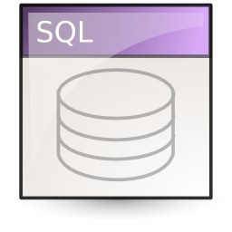
Incorrect Use of ToList()
Live Demo

Slide 11
Incorrect Use SELECT *
Live Demo

Slide 12
Deleting Entities Faster with Native SQL Query
Live Demo

Slide 13
Entity Framework Performance
http://academy.telerik.com

Slide 14
Homework
Using Entity Framework write a SQL query to select all employees from the Telerik Academy database and later print their name, department and town. Try the both variants: with and without .Include(…). Compare the number of executed SQL statements and the performance.
Using Entity Framework write a query that selects all employees from the Telerik Academy database, then invokes ToList(), then selects their addresses, then invokes ToList(), then selects their towns, then invokes ToList() and finally checks whether the town is "Sofia". Rewrite the same in more optimized way and compare the performance.

Slide 15




Free Trainings @ Telerik Academy
C# Programming @ Telerik Academy
csharpfundamentals.telerik.com
Telerik Software Academy
academy.telerik.com
Telerik Academy @ Facebook
facebook.com/TelerikAcademy
Telerik Software Academy Forums
forums.academy.telerik.com

