Slide 1






ASP.NET Web Forms Course Overview
Course Content, Evaluation, Exams
Svetlin Nakov
Technical Trainer
www.nakov.com
Telerik Software Academy
academy.telerik.com

Slide 2

Table of Contents
What's Coming Next in the Academy?
ASP.NET Web Forms Course Program
The Trainers Team
Exams and Evaluation
Standard Criteria
Bonuses
Resources for the Course

Slide 3

ASP.NET Web Forms
Coming To The Next Module

Slide 4

TODO: What's Coming Next?
ASP.NET Web development courses
ASP.NET Web Forms
ASP.NET Basics
Common features for Web Forms and MVC
ASP.NET MVC
Many homework assignments
Several team work projects
Several exams

Slide 5
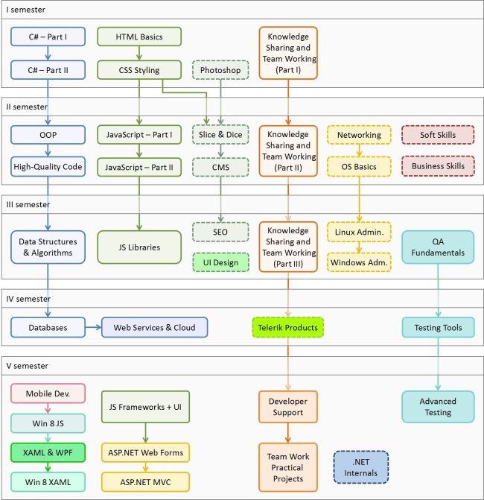

Web Development Track
Software Academy Curriculum
Specialties @ the Academy
Success Stories @ Telerik

Slide 6



ASP.NET Web Forms: Program
What Will We Cover in the Course?

Slide 7


ASP.NET Web Forms: Program
ASP.NET Intro: Web Forms, MVC, Web API, etc.
ASP.NET Web Forms Intro
Web and HTML Controls, Events
Master Pages
Data Binding and Data Controls
Data Source Controls
Scaffolding (Page Generation)
State Management and Sessions
Authentication and ASP.NET Membership

Slide 8




ASP.NET Web Forms: Program (2)
Navigation and Sitemaps
Validation Controls
ASP.NET AJAX & AJAX Control Toolkit
User Controls (.ascx)
Exam Preparation
File Upload + Kendo Upload
Caching Data
IIS Deployment
Team Work
Exam

Slide 9

The Trainers Team

Slide 10

Trainers Team
Svetlin Nakov, PhD
Manager Technical Training @ Telerik Software Academy
20 years software development experience
10+ years experience as trainer
Author of 6 books
Speaker at hundreds of events
E-mail: svetlin.nakov [at] telerik.com
Web site / Blog: http://nakov.com

Slide 11

Trainers Team (2)
Nikolay Kostov
Senior Software Developer and Technical Trainer @ Telerik Corp.
Student in Sofia University
Computer Science
IT and Informatics competitions contestant
Graduate from the second season of Telerik Software Academy
Email: nikolay.kostov [at] telerik.com
Blog: http://nikolay.it

Slide 12





Evaluation
Thank God There Are Bonuses!

Slide 13


ASP.NET Web Forms – Evaluation
Evaluation
Practical exam – 60%
Exams peer evaluation
Teamwork – 15%
Homework – 10%
Homework evaluation – 5%
3 peer reviews per homework (excellent, OK, bad)
Attendance in class – 10%
Bonuses
Forums activity – bonus up to 10%
Helping new C# students – bonus

Slide 14


Pass / Excellence / Fail Criteria
Criteria for pass / pass with excellence / fail
Pass with excellence
Very high exam results
or
High total results
Pass
Average total results
Fail
Low total results or low exam results

Slide 15
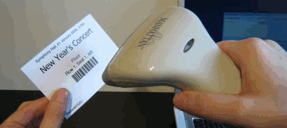
Check Your Presence
From now on you should check your presence on the barcode reader 3 times a day:
In the morning when lectures begin (~10:30)
After lunch break (~13:30)
When you leave academy halls (~19:00)

Slide 16








Resources
What We Need in Addition to this Course Content?

Slide 17

Course Web Site & Forums
Register for the "Telerik Academy Forums":
Discuss the course exercises with your colleagues
Find solutions for the exercises
Share source code / discuss ideas
The course official web site:
http://forums.academy.telerik.com
http://academy.telerik.com/student-courses/software-technologies/asp.net-web-forms/

Slide 18
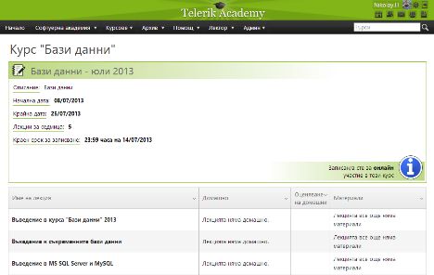
Telerik Integrated Learning System (TILS)
The Telerik Integrated Learning System (TILS)
www.telerikacademy.com
Important resource for all students
Homework submissions
Homework peer reviews
Presence cards with barcode
Reports about your results
telerikacademy.com/Courses/Courses/Details/113

Slide 19




Required Software
Software needed for this course:
Microsoft Visual Studio 2013 (Preview + updates)
ASP.NET Web Frameworks and Tools 2013 (Preview)
Microsoft SQL Server 2012 Developer Tools
Internet Information Services (IIS) 8.0

Slide 20
ASP.NET Web Forms Course Overview
http://academy.telerik.com

Slide 21




Free Trainings @ Telerik Academy
C# Programming @ Telerik Academy
csharpfundamentals.telerik.com
Telerik Software Academy
academy.telerik.com
Telerik Academy @ Facebook
facebook.com/TelerikAcademy
Telerik Software Academy Forums
forums.academy.telerik.com

