Slide 1
Telerik Everlive
SaaS Cloud Platform Providing Database Access Through RESTful API
Doncho Minkov
Senior Technical Trainer
http://minkov.it
Telerik Software Academy
http://academy.telerik.com

Slide 2
Table of Contents
Telerik Everlive Overview
Registering an application
Creating Content Types
Getting an app key
Everlive REST API
Users, Authentication and Content Types
JavaScript SDK
Users, Authentication and Content Types

Slide 3
Telerik Everlive
A SaaS Cloud provider for data storage

Slide 4
Telerik Everlive
Telerik Everlive is a Software-as-a-Service cloud provider
Create Content Types
Get CRUD API over these types
Telerik Everlive is still beta, so it is free to use

Slide 5
Telerik Everlive: Registering an Application
To register an application:
Go to http://everlive.com
Login with Telerik, Facebook, Google, Yahoo or LiveID account
Create an app
Give it name and description
Ready to go!
Once an application is created, an AppKey is generated

Slide 6
Registering an app in Telerik Everlive
Live Demo

Slide 7
Creating Content Types

Slide 8
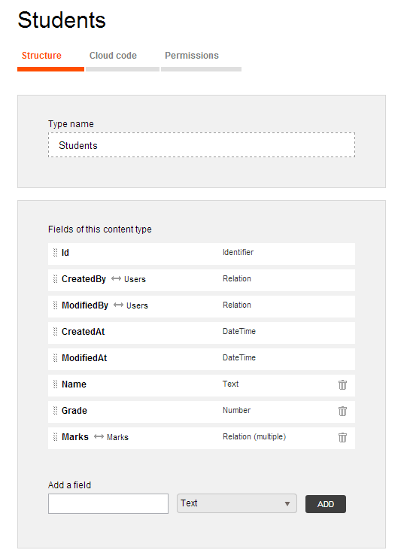
Creating Content Types
Telerik Everlive provides CRUD operations over a set of Content Types
A few built-in Content Types
An unlimited number of custom Content Types
Content Types are much like SQL tables
Yet they have different value types

Slide 9
Creating Content Types (2)
Content Types in Telerik Everlive can have the following types of fields (types of columns)
Text (a regular string)
Number (a decimal floating-point number)
Yes / No (TRUE/FALSE, like a boolean)
File (stores either base64 encoded data or multipart/form-data)
Geopoint (keeps Latitude and Longitude)
Relation (creates a relation between two content types)

Slide 10
Creating Content Types
Live Demo

Slide 11
Everlive REST API
CRUD operations over the created content types

Slide 12
Everlive REST API
Once the Content Types are created, Everlive provides CRUD operations over these content types
The REST API works with JSON data
The end points for the services are as follows:
http://api.everlive.com/v1/{AppKey}/{ContentType}

Slide 13
Everlive REST API: Example
Example for registering a user:
var user = {
"Username": "DonchoMinkov",
"Password": "123456q" };
$.ajax({
type: "POST",
url:
'https://api.everlive.com/v1/5ea2iMpkmWF5AFhW/Users',
contentType: "application/json",
data: JSON.stringify(user),
success: function(data){
alert(JSON.stringify(data));
},
error: function(error){
alert(JSON.stringify(error));
}
});

Slide 14
Everlive REST API: Example (2)
Example for logging in a user:
var user = {
"Username": "DonchoMinkov",
"Password": "123456q" };
$.ajax({
type: "POST",
url:
'https://api.everlive.com/v1/5ea2iMpkmWF5AFhW/oauth/token',
contentType: "application/json",
data: JSON.stringify(user),
success: function(data){
alert(JSON.stringify(data));
},
error: function(error){
alert(JSON.stringify(error));
}
});

Slide 15
Everlive REST API: Registering a User
Live Demo

Slide 16
Everlive REST API: Getting all Users
Everlive provides CRUD operations for all content types
For requests, different from Register/Login, the REST API needs an authentication token
Used to authenticated the users and check for their rights and restrictions
$.ajax({
url:'https://api.everlive.com/v1/5ea2iMpkmWF5AFhW/Users/',
type: "GET",
headers: {"Authorization" : "Bearer ${AccessToken}"},
success: function(data){ pring(data); },
error: function(error){ error(data); });
})

Slide 17
Getting All Users
Live Demo

Slide 18
Everlive JavaScript SDK
Making your live easier

Slide 19
Everlive JavaScript SDK
Telerik Everlive has ready-to-use JavaScript SDK, that wraps the whole REST API
Downloadable for free from http://everlive.com
Provides a global Everlive object to work with
The Everlive.$ object
Provides all kinds of nice things to work with Telerik Everlive
Of course there is a catch:
Some JavaScript files must be included in the correct order

Slide 20
Everlive JavaScript SDK
The following files must be included in the exact same order:
//makes HTTP AJAX requests
<script src="path/to/reqwest.min.js"></script>
//handles promise-based working
<script src="path/to/rsvp.min.js"></script>
//has a set of object extensions
<script src="path/to/underscore.min.js"></script>
//contains the JavaScript SDK over the REST API
<script src="path/to/everlive.min.js"></script>
Or use the following:
<script src="path/to/everlive.all.min.js"></script>

Slide 21
Everlive JavaScript SDK
Live Demo

Slide 22
Telerik Everlive
http://academy.telerik.com

