Slide 1
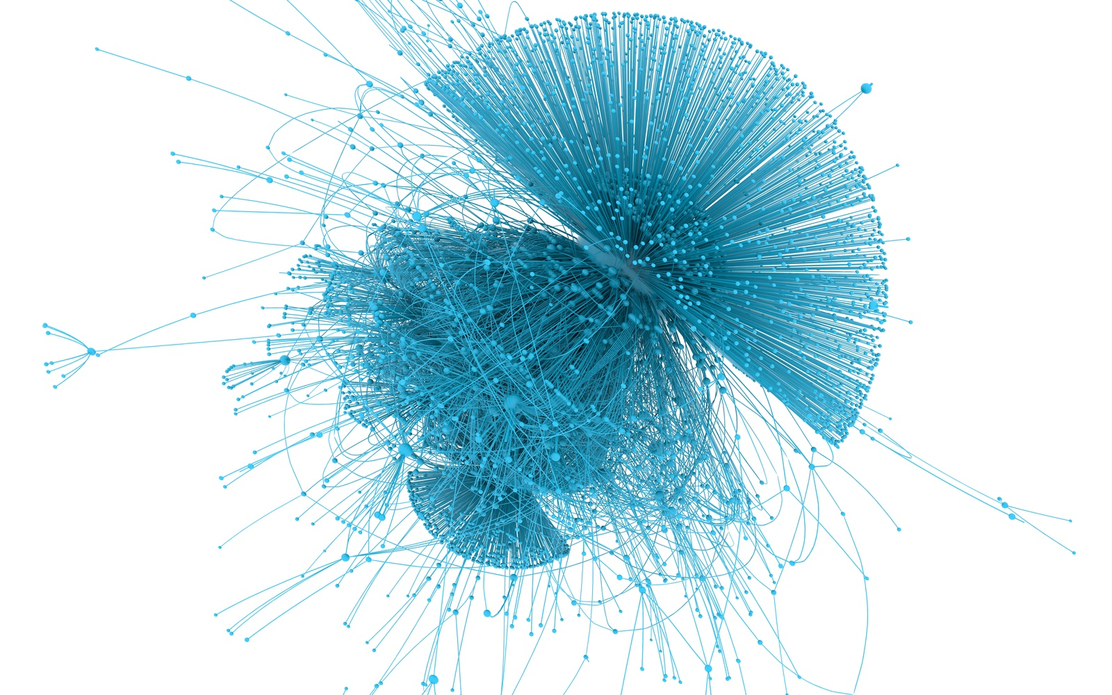
Agent-based Modeling in the Social Sciences
29.01.2026
Veronika Wendler

Slide 2
Mapping the Field of Agent-based Models (ABM) in the Social Sciences
we want to use a large language model–powered bibliometric approach to map the field of agent-based modelling in the social sciences
That is, we gathered many thousands of papers on agent-based modelling in the social sciences and are now interested in understanding the connections between these papers and what the field looks like
Agent-based modelling (ABM) is a computational method that simulates the behaviour and interactions of many autonomous agents (e.g., individuals, animals, firms)
Each agent follows relatively simple rules
System-level patterns emerge over time from agent interactions, rather than being explicitly imposed by the modeler
→ We are interested in papers combining agent-based modelling and human decision making

Slide 3
ABM- Example
In the social sciences, agent-based models are often used to study opinion formation
Individuals are represented as autonomous agents embedded in a social network
Each agent holds an opinion and interacts locally with others in their network
Agents update their opinions according to simple decision rules, such as conforming to similar or influential others
From these repeated local interactions, collective outcomes (such as consensus, clustering, or polarization) can emerge over time
These system-level patterns are not explicitly programmed, but arise naturally from agent interactions
→ This makes agent-based modelling particularly valuable for psychologists, as it allows researchers to examine which opinions persist or dominate within social networks, and which learning strategies outperform others over time (e.g., individual learning vs. social learning, or the conditions under which certain strategies spread and become dominant)

Slide 4
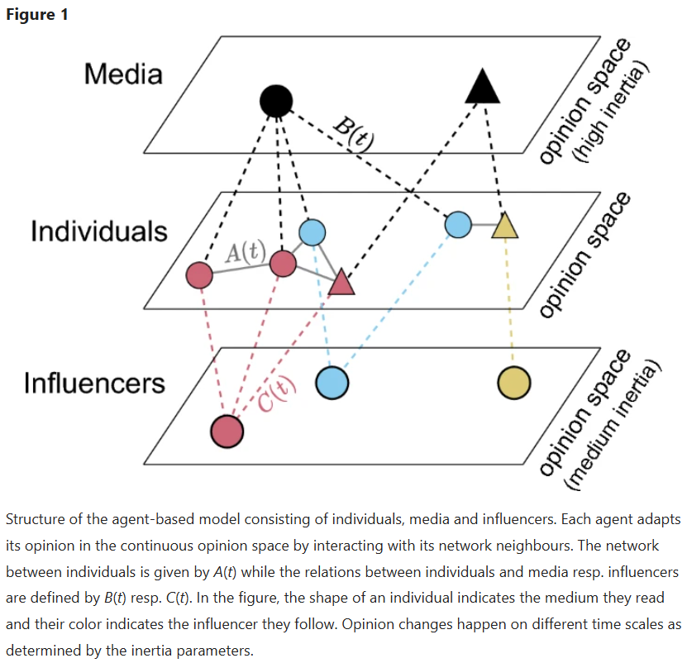
ABM Example
Helfmann, L., Djurdjevac Conrad, N., Lorenz-Spreen, P., & Schütte, C. (2023). Modelling opinion dynamics under the impact of influencer and media strategies. Scientific Reports, 13(1), 19375.

Slide 5
Intention
We conducted a large-scale literature search that identified several thousand papers
To carry out a meaningful bibliometric analysis, we must ensure that these papers accurately capture agent-based modelling applied to human behaviour
This would allow us to map the field as a whole and identify research clusters based on:
dominant research topics and methods
key journals
publication timelines
Examine relationships between clusters and visualise how topics and methods are distributed across the research landscape
Identify isolated or fragmented research areas that may show limited innovative potential
Understand the historical development of the field, including:
which subfields most commonly apply agent-based models
which authors have played leading roles
Assess the future relevance of agent-based modelling, identify likely directions for its development and stop unnecessary fragmentation

Slide 6
Why read through so many abstracts?
Some papers:
truly use agent-based models to study human behaviour
only mention agents-based models vaguely, or use ABMs in biology/engineering (without the connection to human behviour)
Some also only talk about agentic models or agentic-AI in software engineering which is also not what we are interested
Reading thousands of abstracts by hand is slow and error-prone
Solution:
Teach a model to learn from our decisions which papers are in-scope and which are out-of-scope and then apply that knowledge to the full dataset (e.g. a sentence transformer converts each labeled abstract into an embedding)
! But ! For the model to accurately learn which papers are in-scope we need a large enough testing subset which we need to label manually (ca. 1000)

Slide 7
What do I do with all the labelled abstracts?
Train a simple classifier (the “decision rule”)
Then I teach a logistic regression model to answer:
“Given the meaning of this abstract, how likely is it to be out-of-scope?”
To make sure it generalizes well:
We repeatedly split the data into training and test sets
We test different levels of model strictness (regularization)
We choose the version that performs best on unseen data which avoids:
Overfitting (“memorizing” our lables)
Underfitting (being too vague)
Lastly, I train the model on the entire set of labelled data and then apply it to the remaining papers (ca. 8000 papers that are not labelled)
→ We keep papers that are more likely to be relevant than irrelevant and get a clean dataset that actually represents the field of ABM in the social sciences.

Slide 8
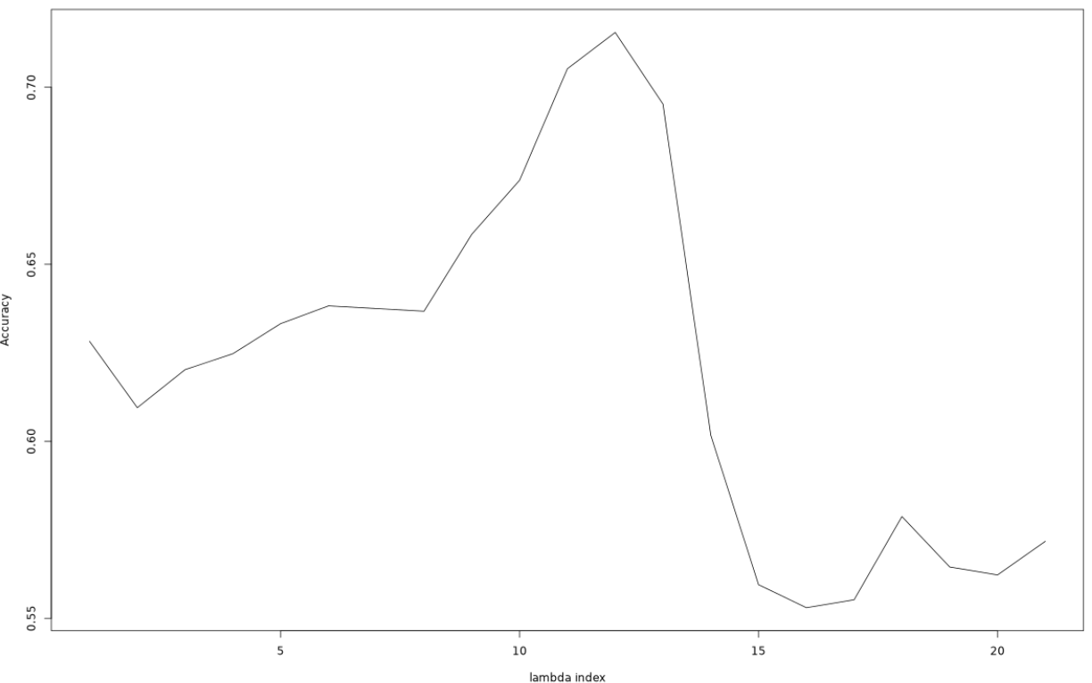
Why I need your help …
After rating 300 abstracts manually (in-scope or out-of-scope, my logistic regression achieved an accuracy of ca 74 % after applying to the entire data set
GOAL: Can we get to ca 95% (while not overfitting) ???
METHOD:
Let’s label 700 more abstracts!

Slide 9
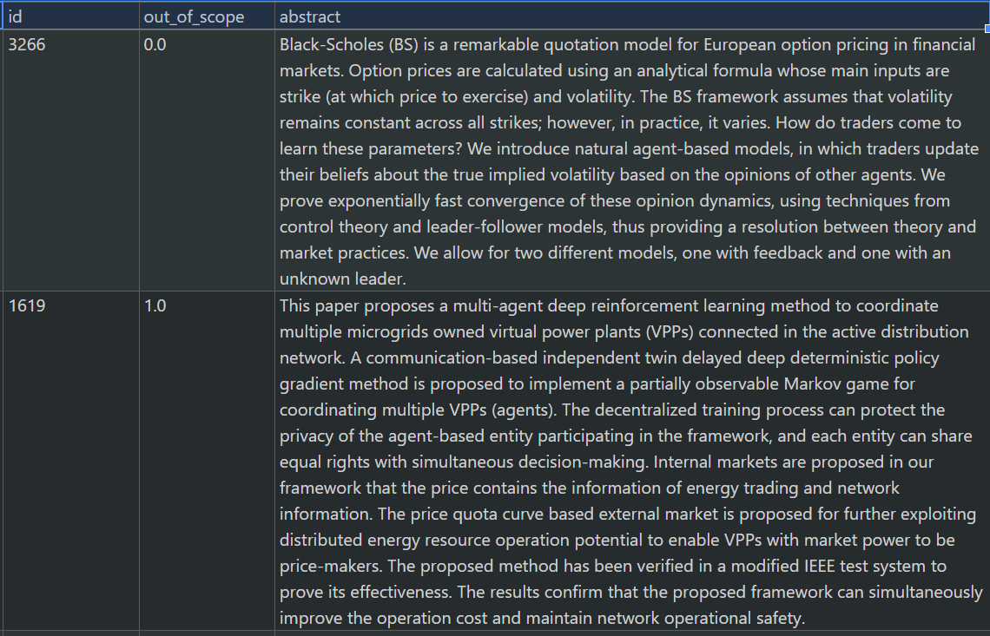
How the abstract rating process works
Out of scope = 0 means that this is a paper we want to keep!
Out of scope = 1 means that this paper does not fall within our category. Why? Because when you read through the abstract you can see that it is purely about simulating virtual power-plants and there is no human involvement or decision making – this is often the case in multi-agent-based modelling papers: if you are unsure about the rating you want to give, then I’d advise to look up the paper associated with the abstact online and check it out.

Slide 10
What we are not looking for
We don’t want papers on:
Animals
Logistics (e.g. no human involvement just engineering workflow etc.)
Power gird simulations or purely manufacturing processes
Simulations other than agent-based models (individual-based models or other names for ABMs are okay, but the paper should be looked up to double-check; e.g. if it is just on deep learning, or neural nets or so then that’s out of context)
If it involves AI or agentic models, make sure to check whether the focus is still on human decision making/ simulating decision making through the ABM method (sometimes these papers are purely on software agents and they don’t model psychology unless explicitly instructed to do so)
You will find lots of papers in the ecological domain, here agent-based models are often used to model human decision making about harvesting or water-management, it can be difficult to understand that it involves human decision-making but most of the time these papers are really relevant and about human policy and decision making around resource management)
→ Importantly, a paper is in-scope if it involves a form of agent-based simulation on any kind of human decision making

