Slide 1

SBI Summer School: Hierarchical Modeling

Slide 2
Hierarchical Modeling
So far we have only considered problems with a single set of parameters
Now adding sets of parameters for each object/person/location that also have some shared commonality (group membership)
How can we estimate parameters at both levels?

Slide 3

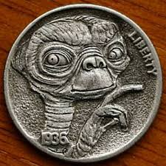
Example: Alien coins
Suppose our data are the result of a coin flipping experiment
Suppose this is an alien coin with some magnetic properties on one side that distorts the probability of observing a particular side (i.e., heads or tails) away from 0.5
Your goal is to estimate the probability of observing a “head” outcome given a fixed set of coin flips
Notes:
Unobtainium from avatar

Slide 4

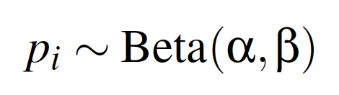
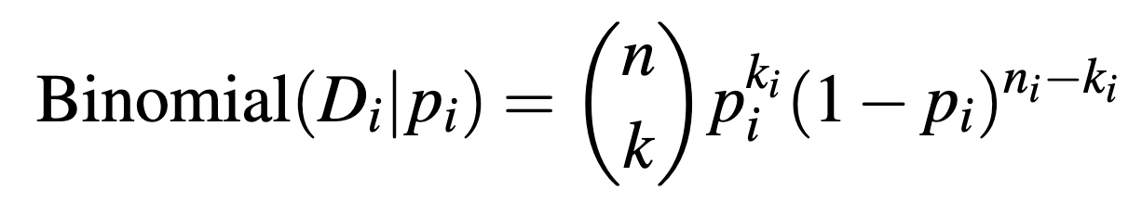

Graphical Diagram

Slide 5
Graphical Diagram

Slide 6


Graphical Diagram

Slide 7
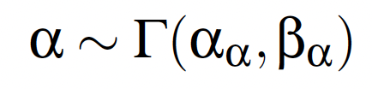
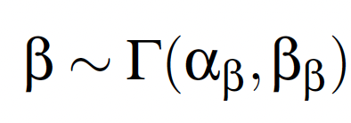
Graphical Diagram

Slide 8




Graphical Diagram

Slide 9
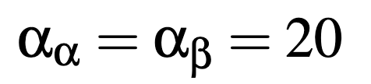
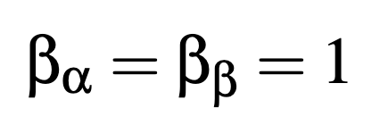
Graphical Diagram

Slide 10
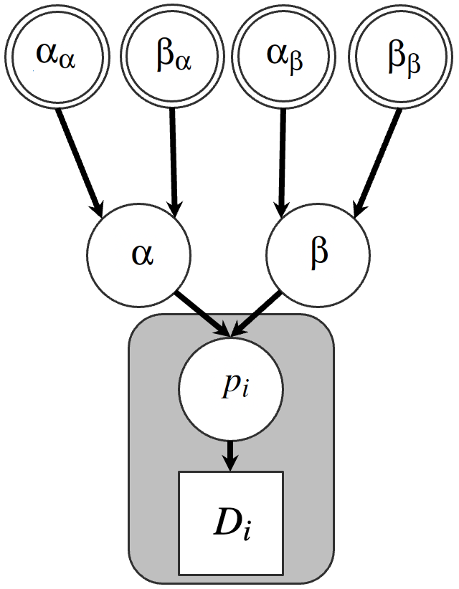
Graphical Diagram

Slide 11
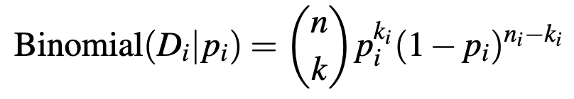
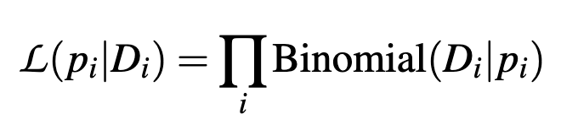
Graphical Diagram

Slide 12

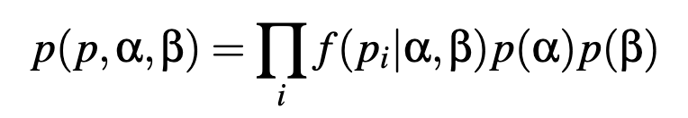
Graphical Diagram

Slide 13
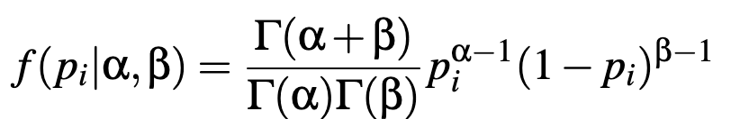
Graphical Diagram

Slide 14
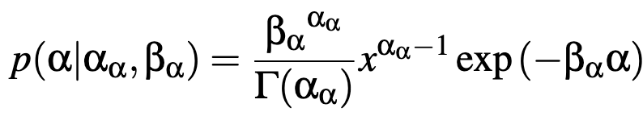
Graphical Diagram

Slide 15
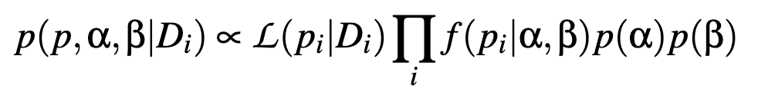
Graphical Diagram

Slide 16
Graphical Diagram

Slide 17
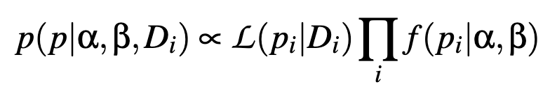
Graphical Diagram

Slide 18
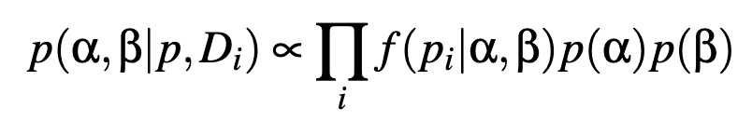
Graphical Diagram
Open up “binomial_Bayes_hier.R”

