Slide 1
Growing Decision Trees
#sg_agile_squad presents
ML MARATHON: EPISODE 7
with @Bharath Bhambore

Slide 2
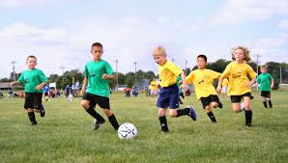



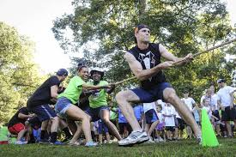





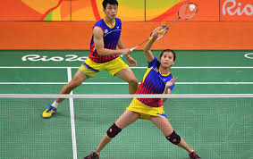



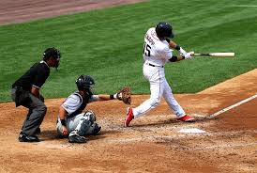




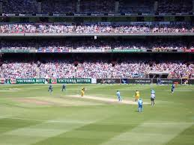
Let’s play

Slide 3
Different viewpoint
x₂
Q1
Q2
Q2
x₁
Q1
Decision Tree

Slide 4
Regression Trees

Slide 5
What questions to ask?
x₂
x₂ < b₁
x₂ < b₂
x₂ < b₃
x₂ < b₄
b₄
b₃
b₂
x₁ < a₁
x₁ < a₂
x₁ < a₃
x₁ < a₄
b₁
x₁
a₁
a₂
a₃
a₄

Slide 6
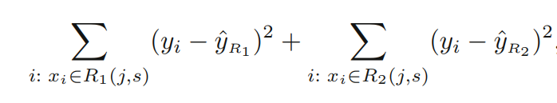
Which question to ask?
x₂
Avg₁
Avg₂
Metric: RMSE, MSE, MAE
Choose j, s that minimizes:
x₁
a₂ (s)

Slide 7
Iterate
x₂
x₁ < a₂
x₂ < b₃
b₃
x₁
a₂

Slide 8
How to test?
Weight (kg)
Height < 140cm
Yes
No
70
Weight < 65kg
65
Height (cm)
140
165

Slide 9
Classification Trees

Slide 10
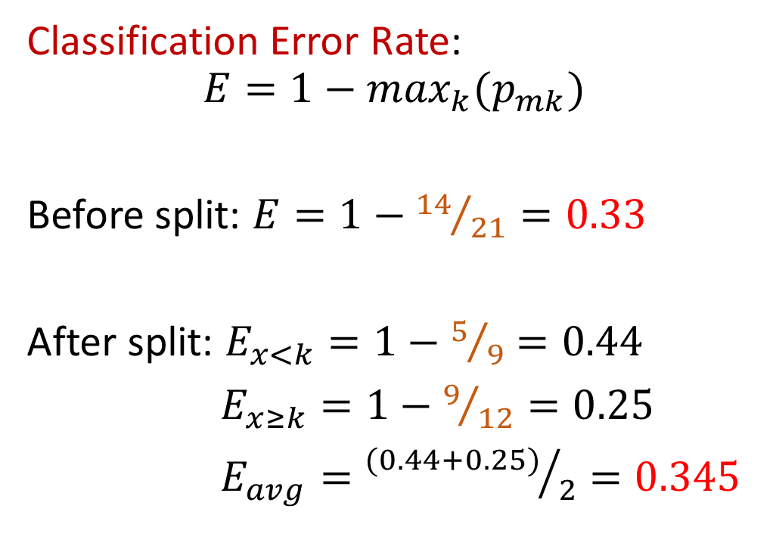
Criterion for splits
Classification Error Rate:
$$E=1−\max_{k}(p_{mk})$$
Before split: $E=1−{14}/{21}=\text{0.33}$
After split: $E_{x<k}=1−5/9=0.44$
$E_{x≥k}=1−9/{12}=0.25$
$E_{avg}={(0.44+0.25)}/2=0.345$
k

Slide 11
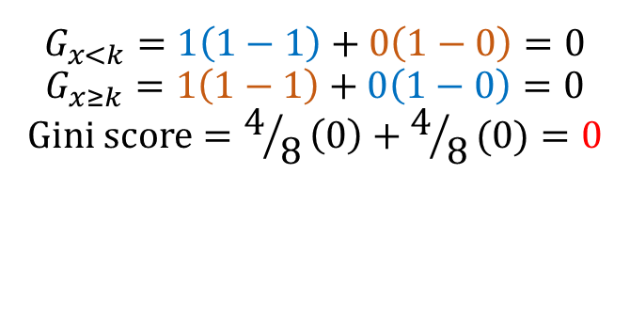
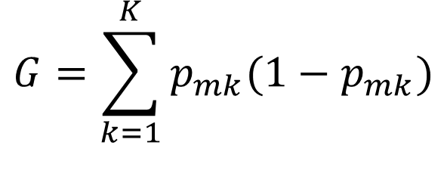
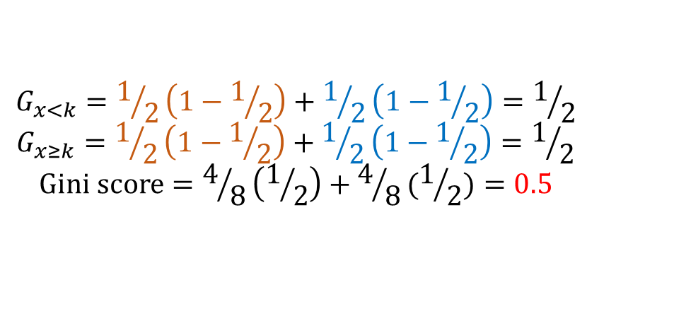
Gini Index
$$G=\sum_{k=1}^{K}{p_{mk}(1−p_{mk})}$$
Lower the gini score,
the better
$$G_{x<k}=1\left(1−1\right)+0\left(1−0\right)=0$$
$$G_{x≥k}=1\left(1−1\right)+0\left(1−0\right)=0$$
$$Gini score=4/8\left(0\right)+4/8(0)=0$$
$$G_{x<k}=1/2\left(1−1/2\right)+1/2\left(1−1/2\right)=1/2$$
$$G_{x≥k}=1/2\left(1−1/2\right)+1/2\left(1−1/2\right)=1/2$$
$$Gini score=4/8\left(1/2\right)+4/8(1/2)=0.5$$

Slide 12
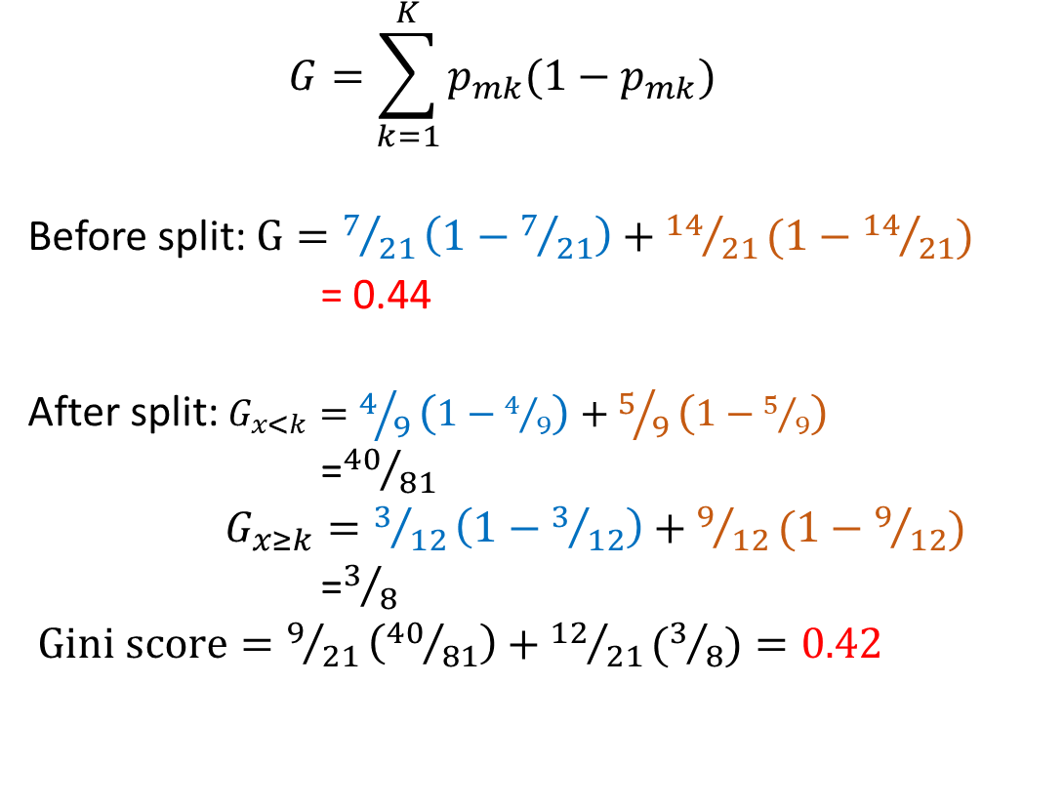
Gini Index
$$G=\sum_{k=1}^{K}{p_{mk}(1−p_{mk})}$$
Before split: $G=7/{21}\left(1−7/{21}\right)+{14}/{21}(1−{14}/{21})$
= 0.44
After split: $G_{x<k}=4/9\left(1−4/9\right)+5/9\left(1−5/9\right)$
=${40}/{81}$
$G_{x≥k}=3/{12}\left(1−3/{12}\right)+9/{12}(1−9/{12})$
=$3/8$
$Gini score=9/{21}\left({40}/{81}\right)+{12}/{21}(3/8)=0.42$
k

Slide 13
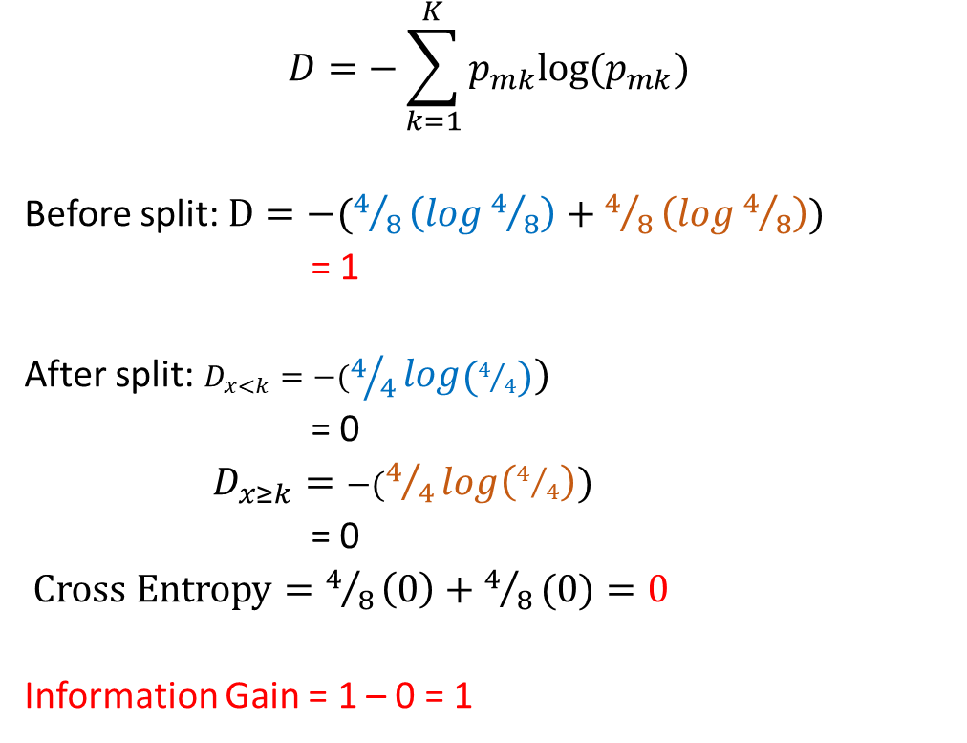
Cross Entropy
$$D=−\sum_{k=1}^{K}{p_{mk}log⁡(p_{mk})}$$
Before split: $D=−(4/8\left(log4/8\right)+4/8\left(log4/8\right))$
= 1
After split: $D_{x<k}=−(4/4log\left(4/4\right))$
= 0
$D_{x≥k}=−(4/4log\left(4/4\right))$
= 0
$Cross Entropy=4/8\left(0\right)+4/8(0)=0$
Information Gain = 1 – 0 = 1
k

Slide 14
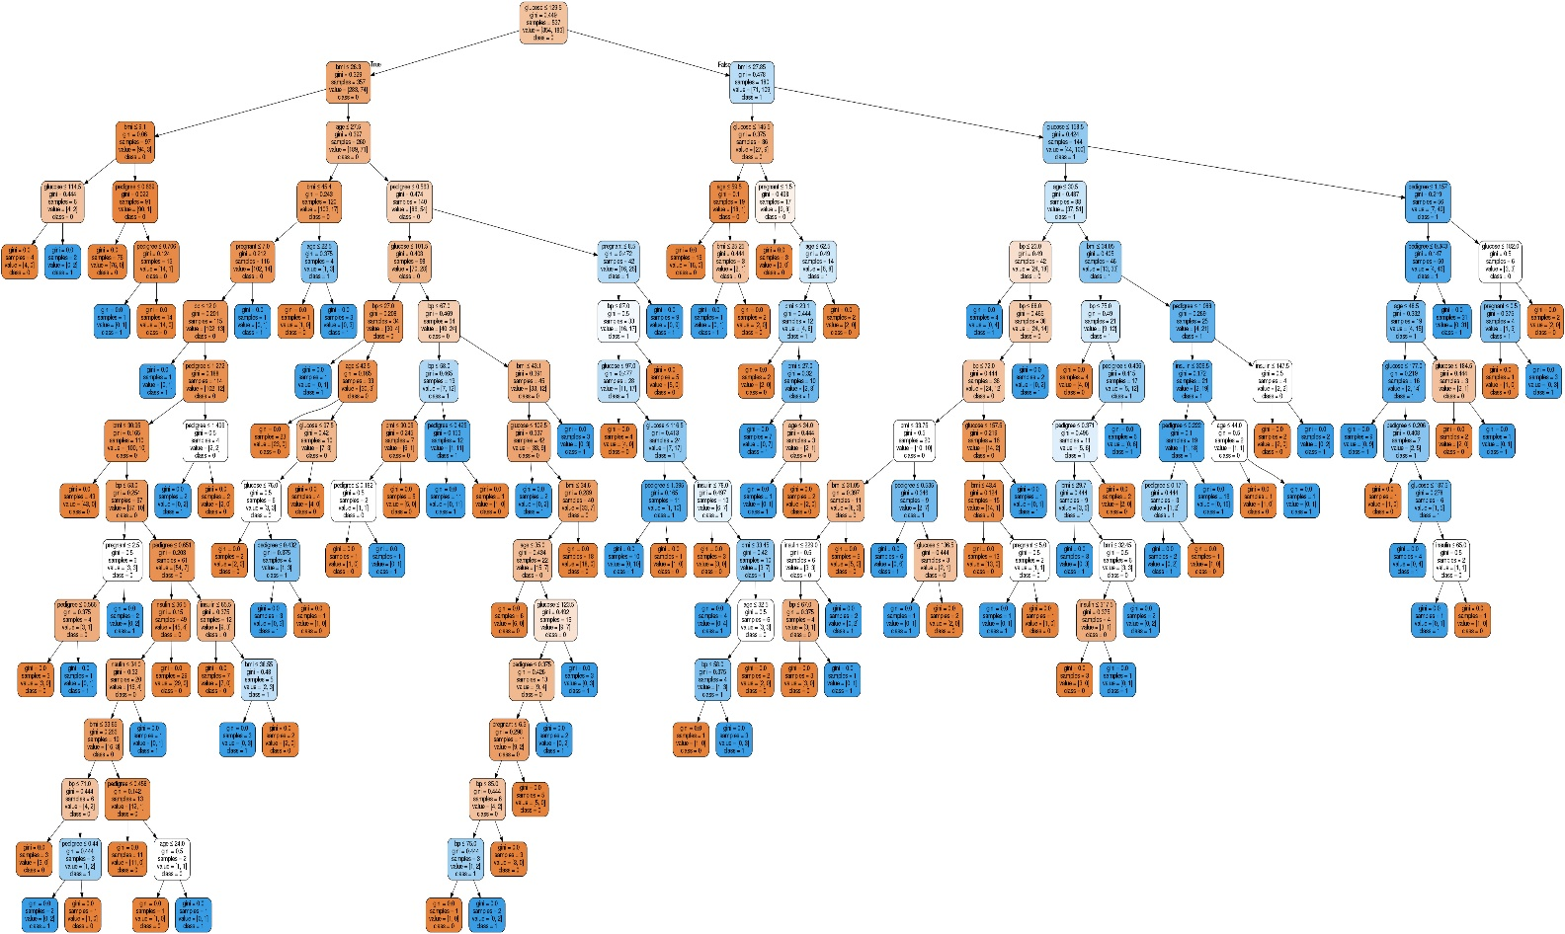
Challenge

Slide 15
Pruning

Slide 16
Pre-pruning
Post-pruning
Control the depth of the tree
Perform the split only if the gain in entropy is greater than the threshold
Define the minimum samples required to split the node
Grow the entire tree
Identify sub-trees that can be removed

Slide 17
Scikit-learn

Slide 18
Basics
Scikit-learn
Pre-processing
Model Selection
Tree
Metrics
SVM
Linear Model
…
MinMaxScaler
StandardScaler
OneHotEncoder
TrainTestSplit
GridSearchCV
DecisionTreeClassifier
DecisionTreeRegressor
Accuracy_Score
Precision_Score
MeanSquaredError
…

Slide 19
DecisionTreeClassifier / DecisionTreeRegressor
max_depth
min_samples_split
min_samples_leaf
min_impurity_decrease
ccp_alpha
DecisionTreeClassifier - https://scikit-learn.org/stable/modules/generated/sklearn.tree.DecisionTreeClassifier.html
DecisionTreeRegressor - https://scikit-learn.org/stable/modules/generated/sklearn.tree.DecisionTreeRegressor.html

Slide 20
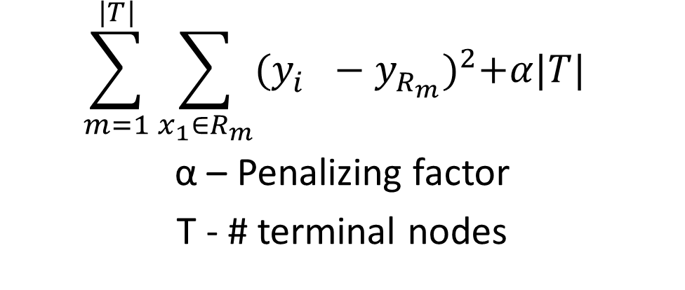
ccp_alpha -> Regularization
$$\sum_{m=1}^{|T|}{\sum_{x_{1}∈R_{m}}{{(y_{i}^{}−y_{R_{m}}^{})}^{2}+α|T|} }$$
α – Penalizing factor
T - # terminal nodes

Slide 21
Python Implementation

