Slide 1




Versaa Tech delivers innovative and result-driven human capital solutions to help organizations grow.
Your Trusted Partner for All Human Capital Services!
Copyright © 2025 Versaa Tech

Slide 2
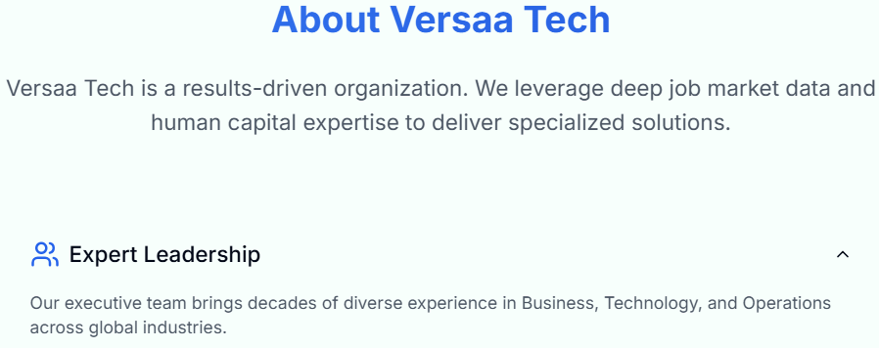

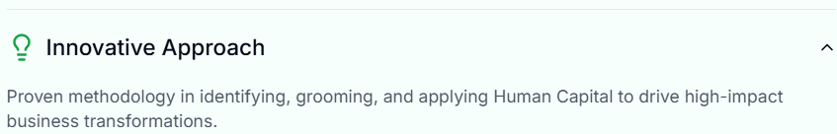



Copyright © 2025 Versaa Tech
8

Slide 3

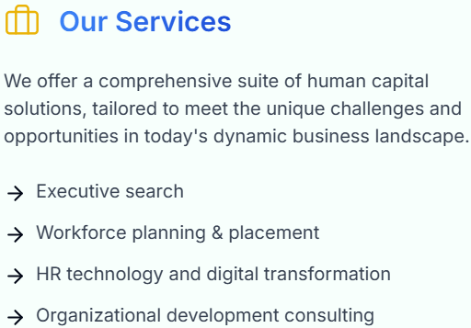
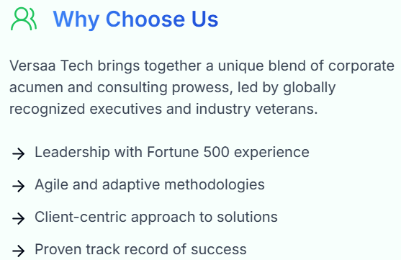
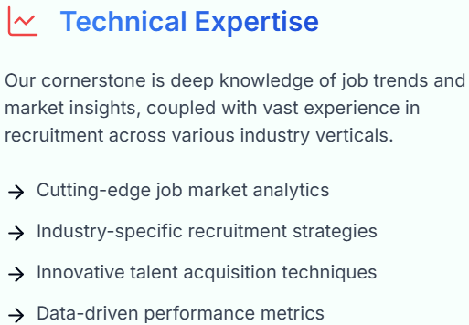
Copyright © 2025 Versaa Tech
3

Slide 4




Copyright © 2025 Versaa Tech
4

Slide 5
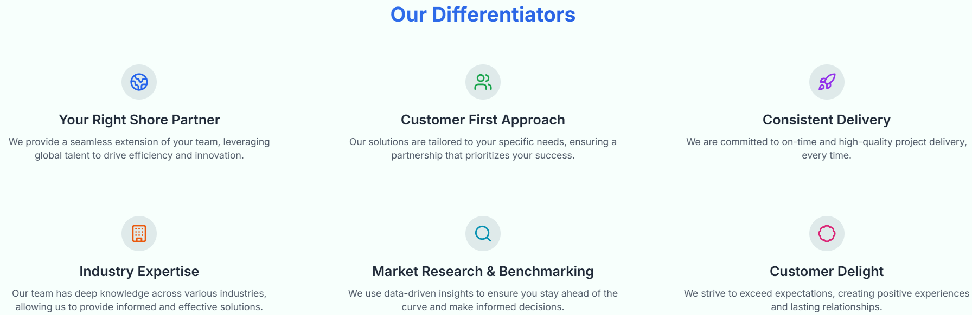

Copyright © 2025 Versaa Tech
5

Slide 6
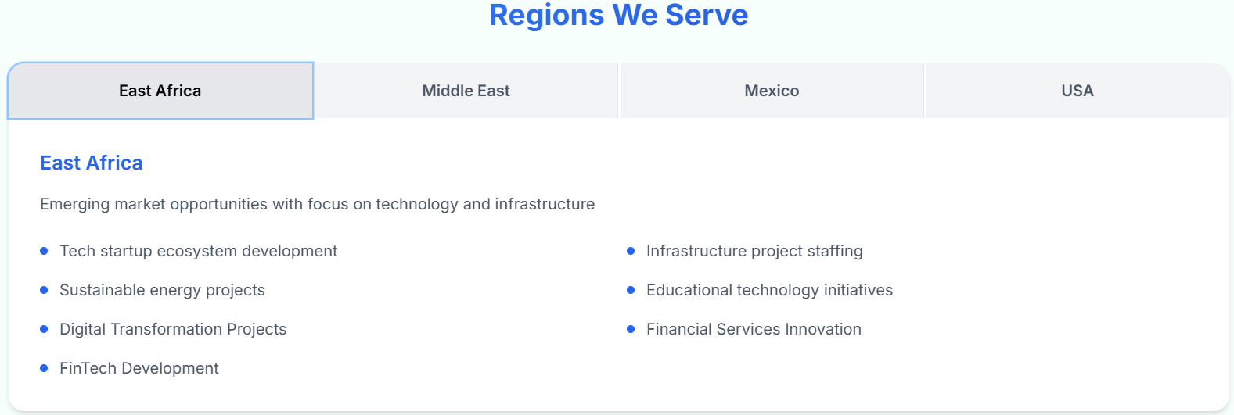
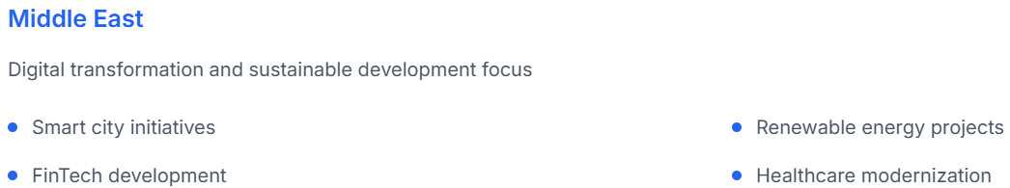
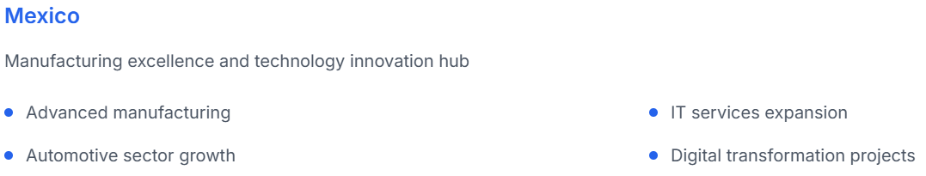
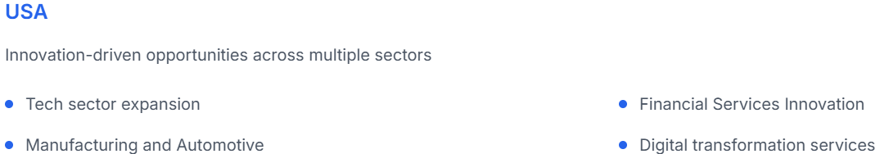
Copyright © 2025 Versaa Tech
7

Slide 7
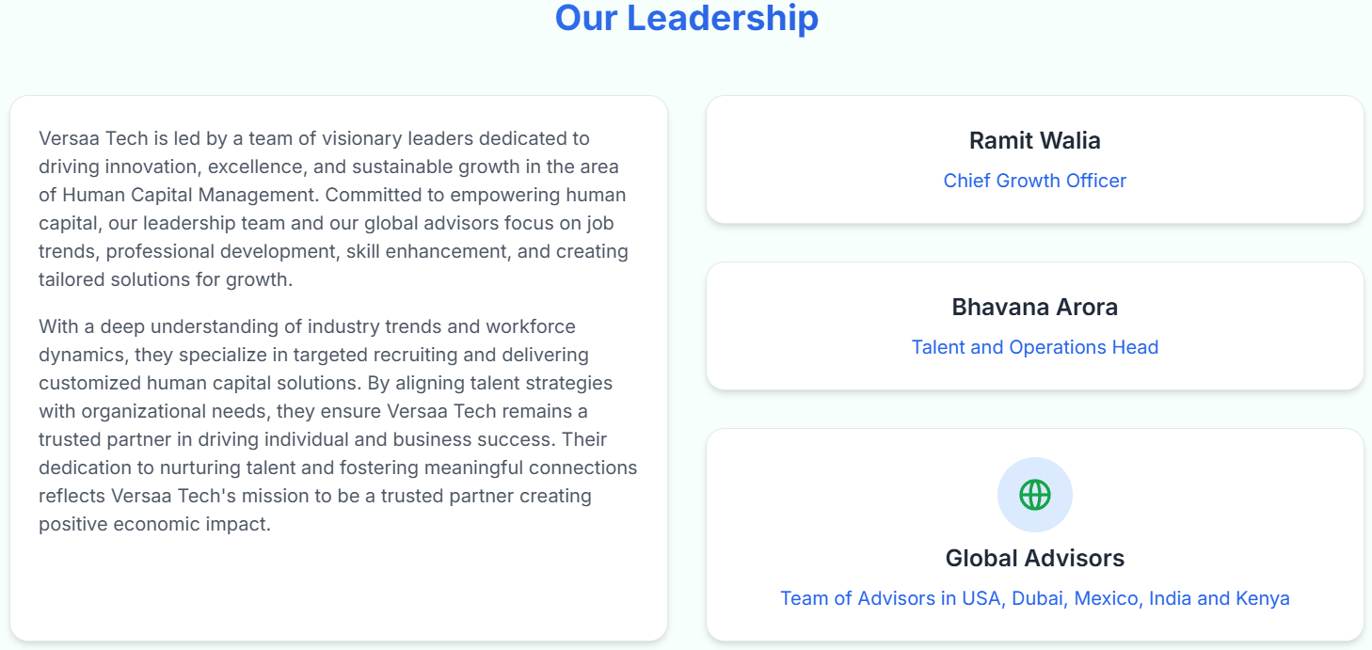
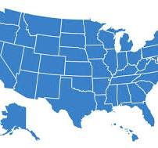

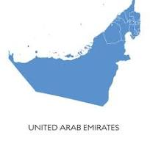

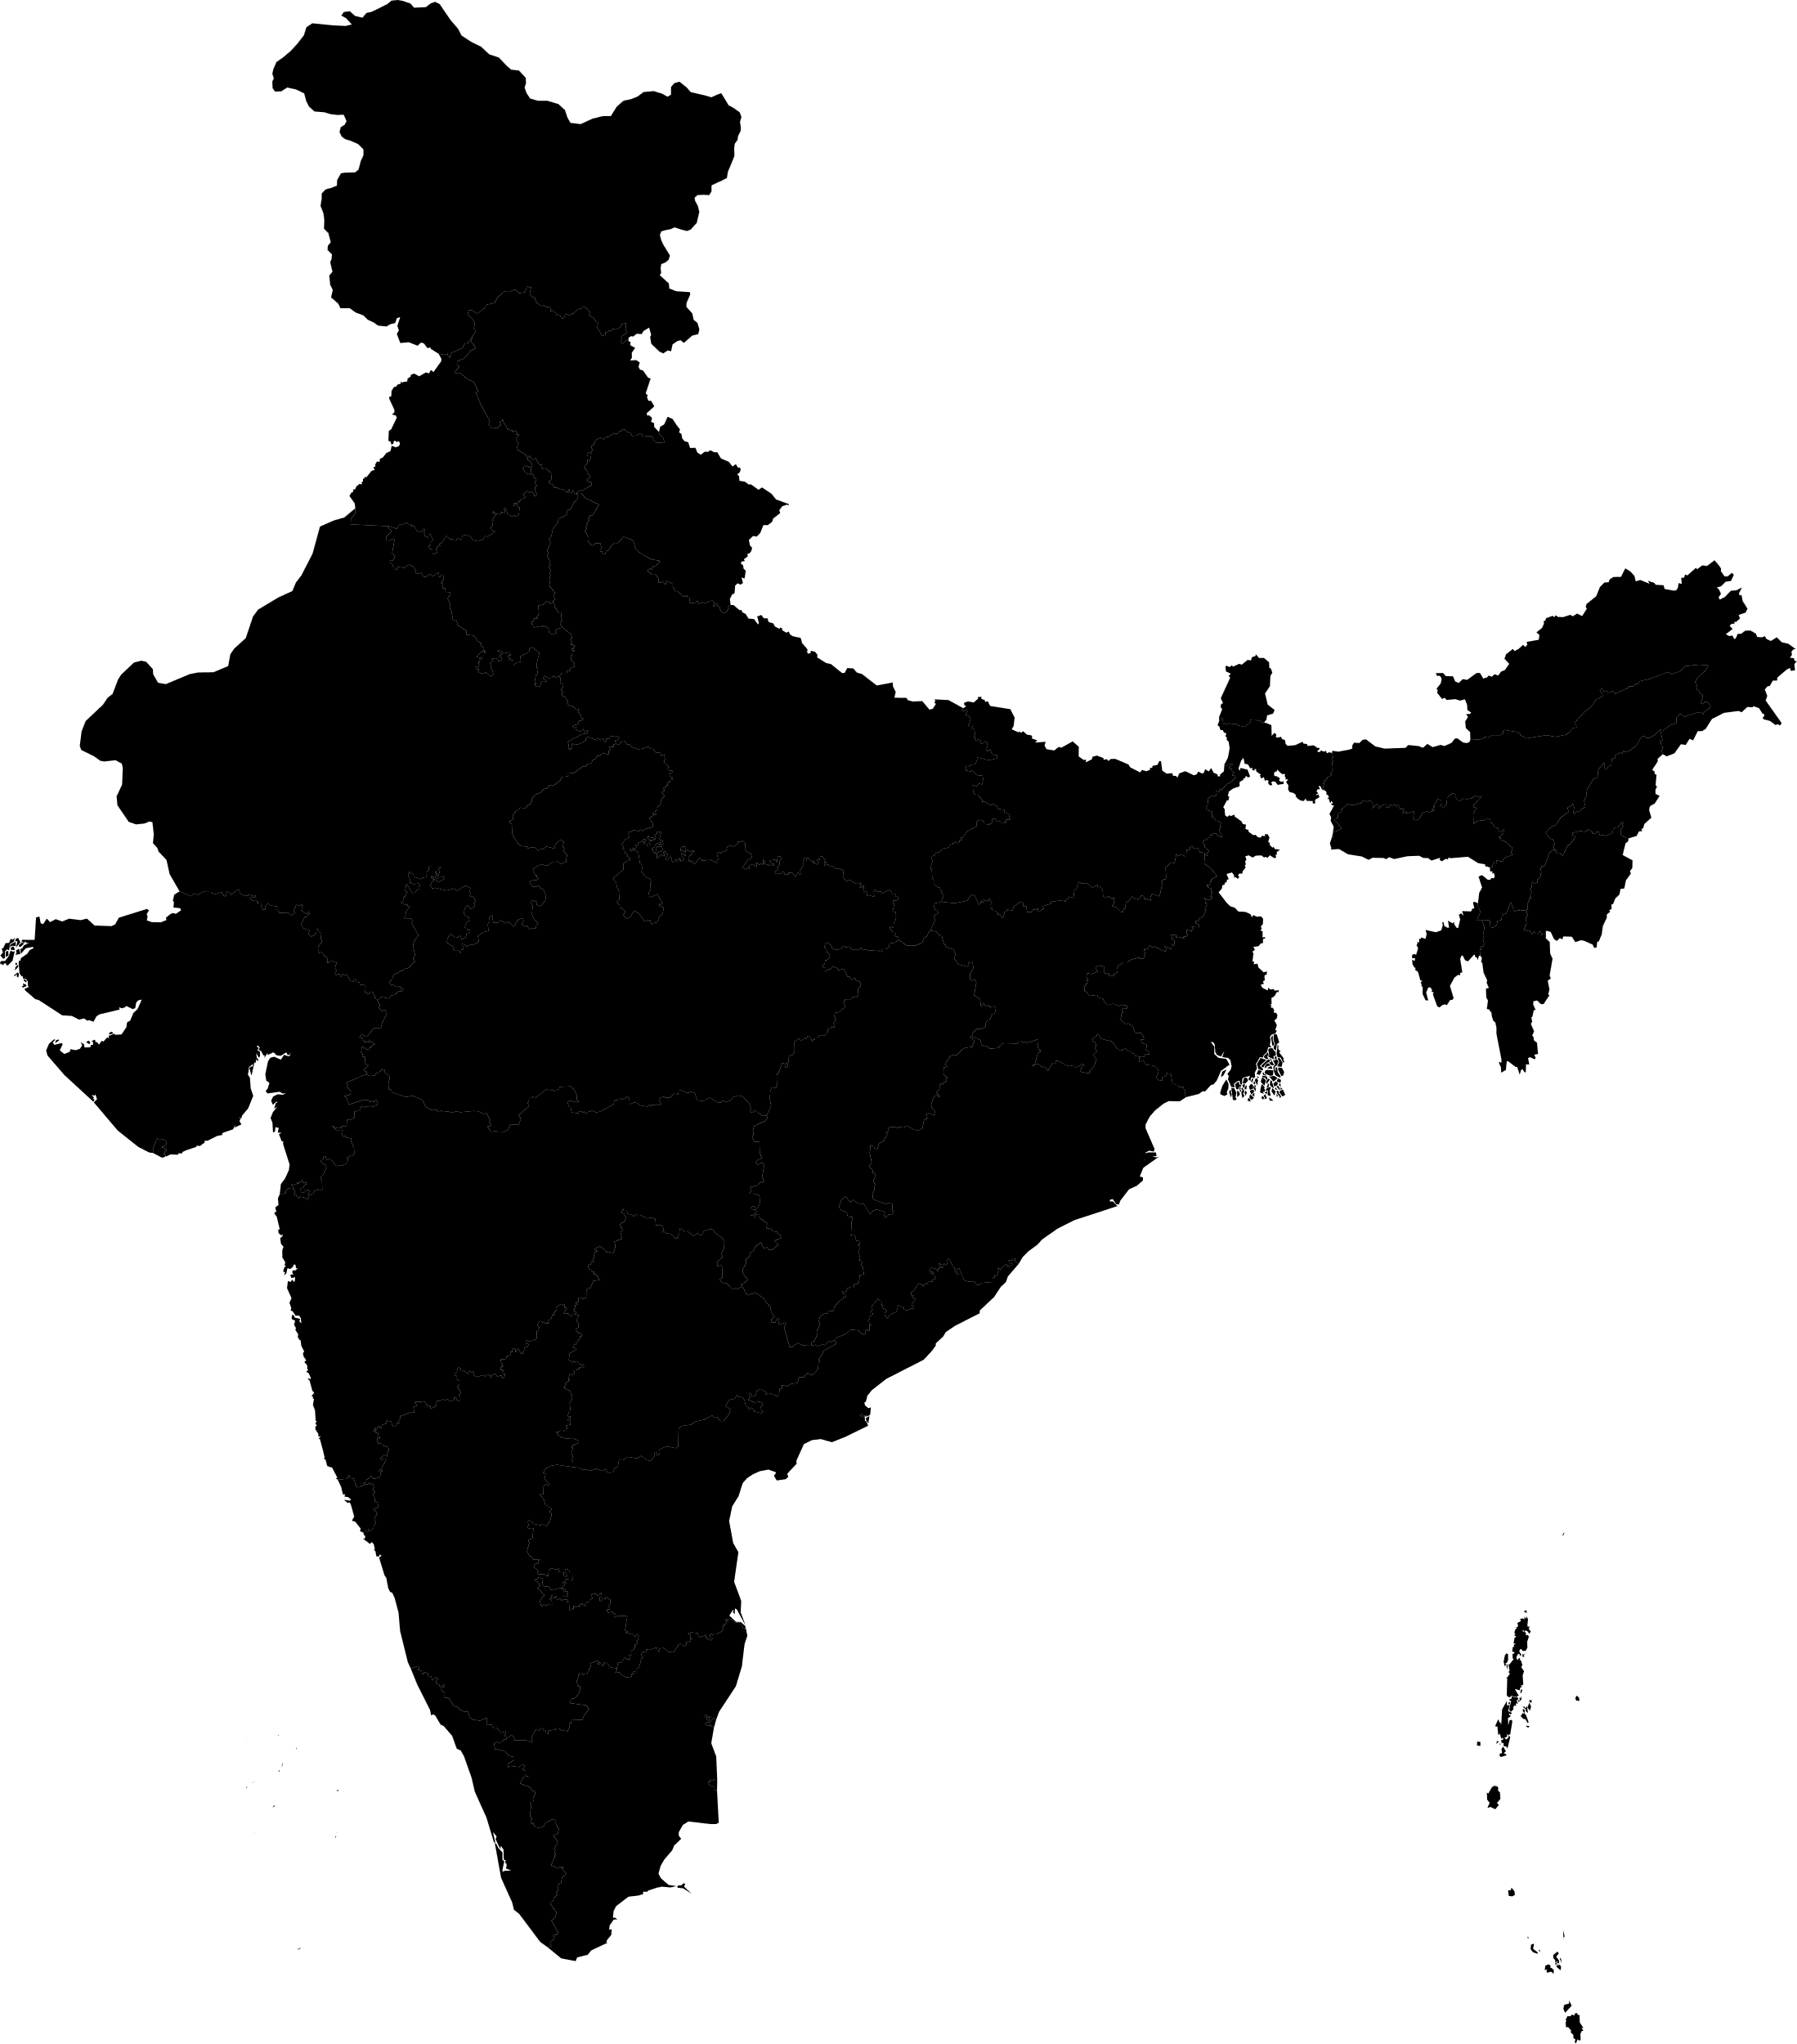
Our Presence
Michigan
USA
Mexico City
Mexico
Dubai
UAE
Nairobi
Kenya
Bangaluru
India
Copyright © 2025 Versaa Tech
7

Slide 8


https://www.versaatech.com
Copyright © 2025 Versaa Tech
9

Slide 9


Thank You! Your Trusted Partner for All Human Capital Services!
www.VersaaTech.com info@VersaaTech.com
Your Trusted Partner for All Human Capital Services!
Copyright © 2025 Versaa Tech
10

