Slide 1
POC WME Structures with Omaha Taxonomy SMem DG.
^command
C2
Omaha Taxonomy SMem KB Structure
L1
Stock SOAR WME’s
^result
R3
(state <s> ^name omaha_taxonomy_smem ^current-item <root>)
(<root> ^omahasignsymptom <oss>)
(<oss> ^name <oss_name>)
(<oss> ^name |Impotency|) # Example
(<oss> ^code <oss_code>)
(<oss> ^omahaproblem <opbm>)
(<opbm> ^name |reproductivefunction|) # Example
(<opbm> ^name <opbm_name>)
(<opbm> ^prioritization <prioritization>)
(<prioritization> ^name <pri_name>)
(<prioritization> ^name |physical|) # Example
(<prioritization> ^priority <pri_value>)
(<prioritization> ^priority 1) # Example
# Below: Each OSS has 1 or more "touples" = "Intervention".
(<oss> ^imp_intervention-1 <intervention>)
(<intervention>
^category.name surveillance <category_name>
^category.value <category_value>
^target.name signssymptomsphysical <target_name>
^target.value <target_value>
^caredescriptor.name erectiledysfunction <caredescriptor_name>
^caredescriptor.value <caredescriptor_value>)
^smem
Omaha Taxonomy WME’s + Priority
topstate
S1
oss
opbm
prioritization
^omahasighsymptom
^omahaproblem
^prioritization
^code
^name
^name
^priority
^name
impotency
imp
reproductivefunction
physical
1
….
^imp_intervention-1
^name
surveillance
category
^value
Surveillance
^category
intervention
^name
signssymptomsphysical
Additional WME’s to implement
Care Plan “Interventions”.
^target
^value
target
Signs/Symptoms-Physical
^caredescriptor
^name
erectiledysfunction
caredescriptor
^value
Erectile Dysfunction

Slide 2
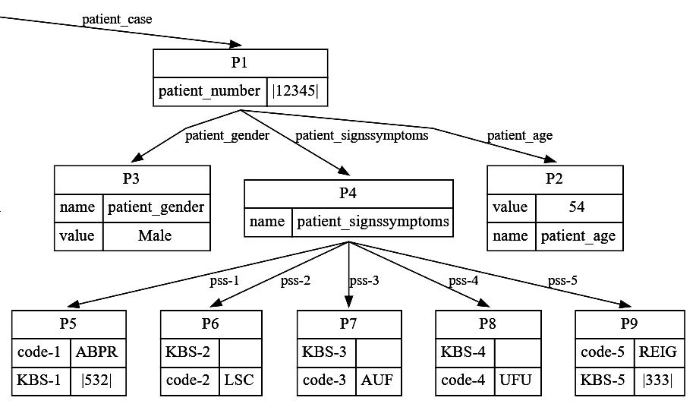
POC WME Structures with Patient WME Structure.
MEMBER # 123456
AGE: 54
Gender: M
ABPR: Abnormal Blood Pressure Reading: Circulatory KBS 532
LSC: Limited Social Contact
AUF: Apprehension/Undefined Fear
UFU: Urgency/Frequency (Urination): KBS 333
RIEG: RACE - ethnicity of identified known risk group
Omaha Taxonomy Patient Use-Case
Knowledge Base Structure
Patient Record - Example
(<s> ^patient_case <patientcase>)
(<patientcase> ^patient_number <patient_number>
^patient_age <patient_age>
^patient_gender <patient_gender>
^patient_signssymptoms <patient_signssymptoms>)
(<patient_number> ^name patient_number ^value |12345|)
(<patient_age> ^name patient_age ^value 54)
(<patient_gender> ^name patient_gender ^value |Male|)
(<patient_signssymptoms> ^name patient_signssymptoms ^pss-1 <pss-1>
^pss-2 <pss-2>
^pss-3 <pss-3>
^pss-4 <pss-4>
^pss-5 <pss-5>)
(<pss-1> ^code-1 |ABPR| ^KBS-1 |532|)
(<pss-2> ^code-2 |LSC| ^KBS-2 ||)
(<pss-3> ^code-3 |AUF| ^KBS-3 ||)
(<pss-4> ^code-4 |UFU| ^KBS-4 ||)
(<pss-5> ^code-5 |REIG| ^KBS-5 |333|)

Slide 3
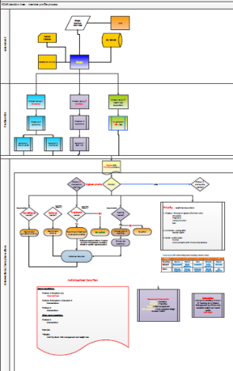
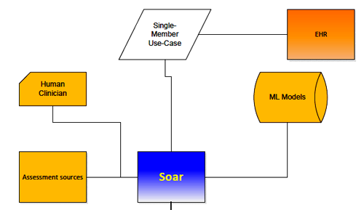
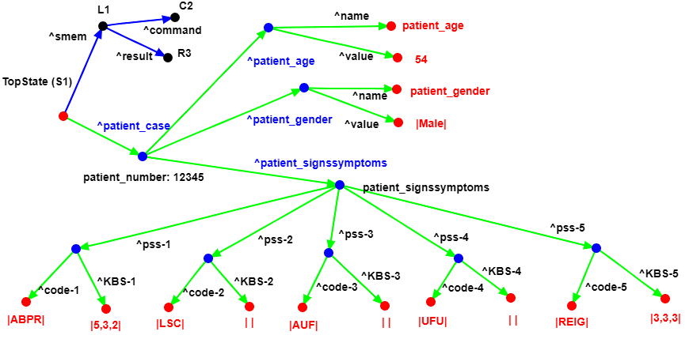
POC WME Structures, Flow, and Mods #1.
SCOTTY Phase #1
SCOTTY Phase #1
The SOAR Agent ingests a patient use-case and instantiates that into Working Memory. The resulting WM structure (in green) of that patients use-case is below. Note: Some S&S might not have a KBS associated.
MEMBER # 123456
AGE: 54
Gender: M
ABPR: Abnormal Blood Pressure Reading: Circulatory KBS 532
LSC: Limited Social Contact
AUF: Apprehension/Undefined Fear
UFU: Urgency/Frequency (Urination): KBS 333
RIEG: RACE - ethnicity of identified known risk group
Patient Record - Example
WME’s Directed Graph of example patient use-case.
SOAR WME’s Directed Graph of a patient use-case.

Slide 4
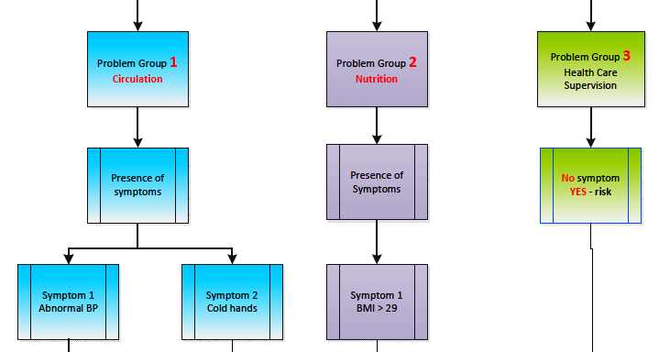
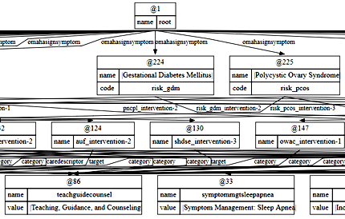
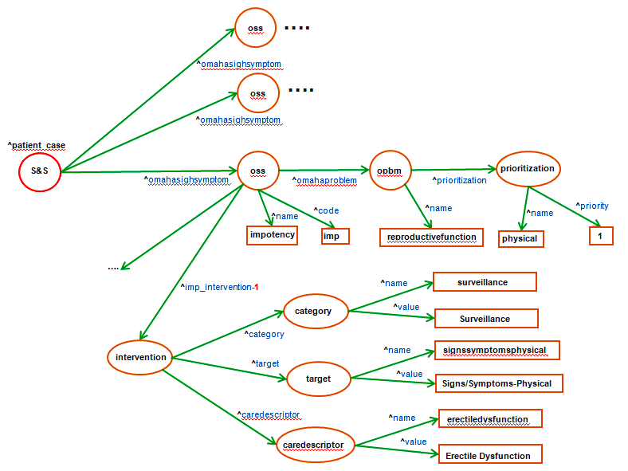
POC WME Structures, Flow, and Mods #2a.
SCOTTY Phase #2
SCOTTY Phase #2
1. For Each Patient S&S in WM, match them with Omaha Taxonomy S&S via the SMem Root Node in WM to fetch the corresponding Omaha Problem DG and it's corresponding Priority.
2. Curate the results of that into a new WM structure that can be easily located, retrieved, and sorted / ranked.
SOAR SMem of the Omaha Taxonomy Pre-diabetes knowledge.
MEMBER # 123456
AGE: 54
Gender: M
ABPR: Abnormal Blood Pressure Reading: Circulatory KBS 532
LSC: Limited Social Contact
AUF: Apprehension/Undefined Fear
UFU: Urgency/Frequency (Urination): KBS 333
RIEG: RACE - ethnicity of identified known risk group
Patient Record - Example
SOAR WME’s Directed Graph of example patient use-case.

Slide 5
POC WME Structures, Flow, and Mods #2b.
….
SCOTTY Phase #2
oss
^omahasighsymptom
….
oss
^omahasighsymptom
^patient_case
S&S
^omahasighsymptom
oss
^omahaproblem
opbm
prioritization
^prioritization
^name
^code
^name
^name
^priority
impotency
imp
reproductivefunction
physical
1
….
^imp_intervention-1
^name
surveillance
category
^value
Surveillance
^category
intervention
^name
signssymptomsphysical
^target
^value
target
Signs/Symptoms-Physical
^caredescriptor
^name
erectiledysfunction
caredescriptor
^value
Erectile Dysfunction

Slide 6
POC WME Structures, Flow, and Mods #3.
SCOTTY Phase #3
- TBD -

