Slide 1
Tutorial – Problem Space Navigation
Example to learn SOAR Problem Spaces.

Slide 2
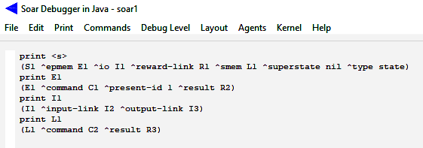
Tutorial – Problem Space Navigation
Working Memory Directed Graph: ^Edges and Nodes
1
C1
^present-id
^command
Nil
E1
^result
R2
^superstate
^epmem
^command
C2
^smem
L1
^result
R3
S1
^io
I1
^input-link
^reward-link
I2
^type
R1
^output-link
State
I3

Slide 3
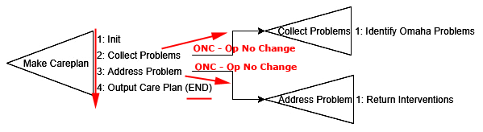
Tutorial – Problem Space Navigation
POC Problem Space Example
POC Problem Space Design
Order of Processing
Initialize Problem Space
Collect Problems
SubSpace: Identify Omaha Problems
Address Problem
SubSpace: Return Interventions
Output Care Plan
“ONC” is the Vehicle for creating substates.
Proposals w/out a corresponding APPLY.
Impasse Resolution Vehicle:
The return of the ^problem-data structure from the Substate.

Slide 4
Tutorial – Problem Space Navigation
POC Problem Space Example
TS: make-careplan
SS: collect-problems
O: collect-problems
Re: -^problem-data
Misc WMEs
Create SS =>
<= Return from SS
AP: identify-omaha-problems
R: +^problem-data
O: address-problems
Re: -^intervention-portfolio
SS: address-problems
Create SS =>
<= Return from SS
AP: return-interventions
R: +^intervention-portfolio

Slide 5
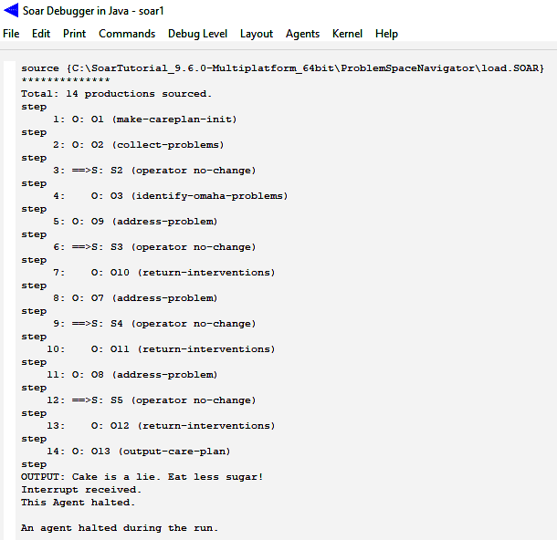
Tutorial – Semantic Memory
Notice the ORDER
of execution and how that is controlled by the ONC technique.

Slide 6
Tutorial – Semantic Memory
Example to learn SOAR Semantic Memory.

Slide 7
Tutorial – Problem Space and SubGoals
Metacognition involves “stepping back” and have a separate state from which to reason (without disrupting original reasoning)
Whenever an impasse arises, SPAR automatically creates a new (sub)state.
The purpose of this state is to provide a context for selecting and applying operators to resolve the impasse.
An impasse arises if there is insufficient/conflicting procedural knowledge to select an operator
• when no operator is proposed.
– [state no‐change]
• when multiple operators are proposed by insufficient preferences to select between them?
– [operator tie]
• when an operator is selected, but it can’t be applied by a single rule?
– [operator no‐change]
• when multiple operators are proposed, but the preferences conflict.
– [operator conflict]
Once a substate is created, operators can be selected and applied just as they are in the original state. These operators can change the local state, but they can also change the contents of original state (S1) by modifying the original state directly or indirectly. An impasse can also arise in the substate, which then leads to a stack of states.

Slide 8
Tutorial – Problem Space and SubGoals
Operator no-change impasses are resolved when the current operator is no longer preferred in the original state (S1 in the trace above). That can be because either the proposal for the current operator is retracted (the rule creating the proposal no longer matches), or because of the set of operator preferences changes so that another operator is preferred.
State no-change impasses are resolved when an operator has been proposed (with an acceptable preference), so that there is at least one candidate operator.
Tie and Conflict impasses are resolved when sufficient preferences have been created so that the decision procedure can select an operator.
The processing in a substate can lead to the creation of structures that are part of the original state (the
superstate). These are called results.
All of the states in working memory are “active” in that rules can fire for any level – it is not the case that processing in the top state comes to a halt while the processing goes on in the substate.
In fact, it is the ability of the processing in the original state to start up that often resolves the impasse and leads to the termination of the subgoal.
When the impasse is resolved, the substate is automatically removed from working memory – it has
served its purpose and is no longer needed. However, all of the results that were created in the subgoal can still persist. This is important because the results are changes to the superstate and are usually responsible for eliminating the impasse.

Slide 9
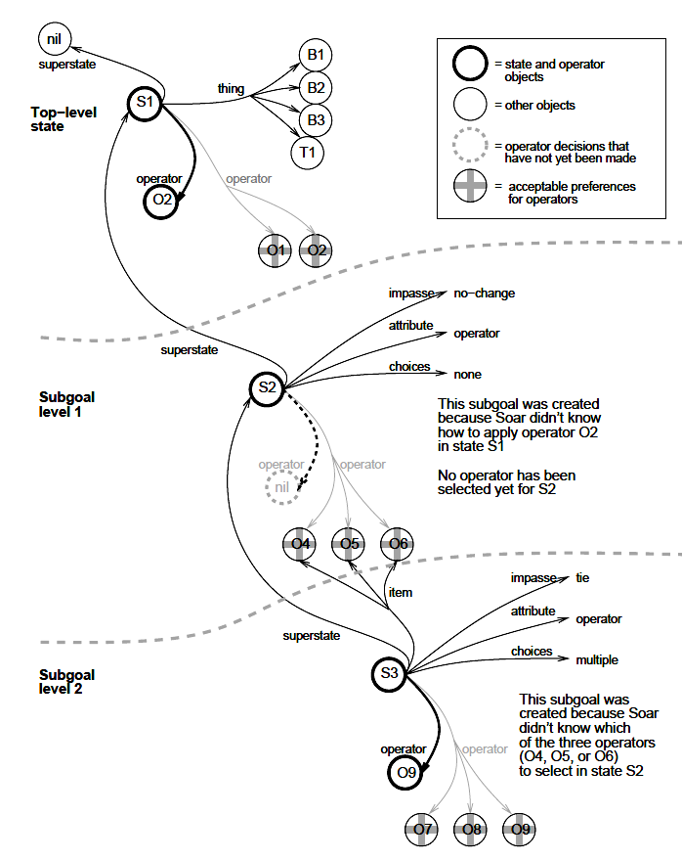
Tutorial – Problem Space and SubGoals
Some results receive i-support, while others receive o-support.
The type of support received by a result is determined by the function it plays in the superstate, and not the function it played in the state in which it was created.
RESULTS:
In order to resolve impasses, subgoals must generate results that allow the problem solving at higher levels to proceed. The results of a subgoal are the working memory elements and preferences that were created in the substate, and that are also linked directly or indirectly to a superstate (any superstate in the stack).
Linked:
These working memory elements and preferences will not be removed when the impasse is resolved because they are still linked to a superstate, and therefore, they are called the results of the subgoal.
A result has either i-support or o-support; the determination of support is described in the graph.
Whenever a substate is removed, all working memory elements and preferences that were
created in the substate that are not results are removed from working memory.
An impasse is resolved when processing in a subgoal creates results that lead to the selection of a new operator for the state where the impasse arose.

Slide 10
Tutorial – Problem Space and SubGoals
Here are possible approaches for resolving specific types of impasses are listed below:
Tie impasse | A tie impasse can be resolved by productions that create preferences that
prefer one option (better, best, require), eliminate alternatives (worse, worst,
reject, prohibit), or make all of the objects indifferent (indifferent).
Conflict impasse | A conflict impasse can be resolved by productions that create preferences
to require one option (require), or eliminate the alternatives (reject, prohibit).
Constraint-failure impasse | A constraint-failure impasse cannot be resolved by additional
preferences, but may be prevented by changing productions so that they create
fewer require or prohibit preferences. A substate can resolve a constraint-failure
impasse through actions that cause all but one of the conflicting preferences to retract.
State no-change impasse | A state no-change impasse can be resolved by productions
that create acceptable or require preferences for operators.
Operator no-change impasse | An operator no-change impasse can be resolved by productions that apply the operator, change the state so the operator proposal no longer
matches, or cause other operators to be proposed and preferred.
Decision Cycles & Substates:
The main change when there are multiple substates is that at each phase of the decision cycle, Soar goes through the substates, from oldest (highest) to newest (lowest), completing any necessary processing at that level for that phase before doing any processing in the next substate.
Thus, whenever a level in the state stack is reached, all production activity is guaranteed to be consistent with any processing that has occurred at higher levels.

