Slide 1
テンプレート置き場
テキスト
テキスト
①
①
②
②
③
③
④
④
⑤
⑤
⑥
⑥
⑦
⑦
⑧
⑧
⑨
⑨
テキスト
枠
矢印

Slide 2
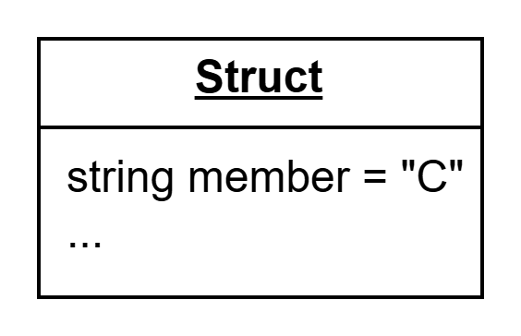
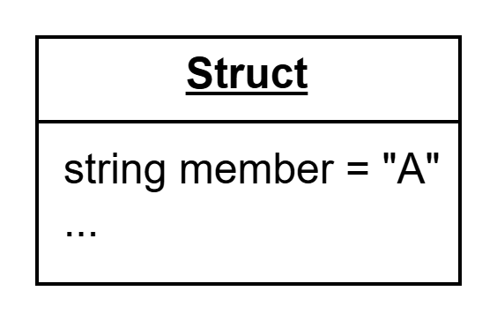
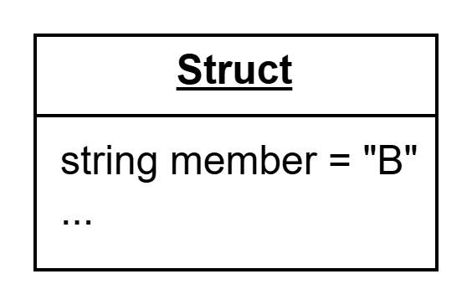
What can you do?
You can sort an array of any type in the blueprint according to the order of the comparison functions you specify.
A typical use case is a structure type.
For example, you can sort a structure according to the order of its member.
Here is an example:
Sort
by the string member
An array of three structures
Then, it will be rearranged according to the order of the strings.

Slide 3
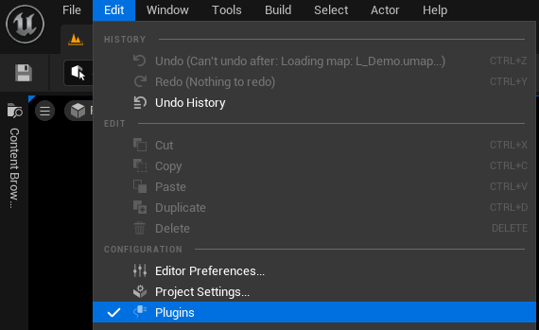
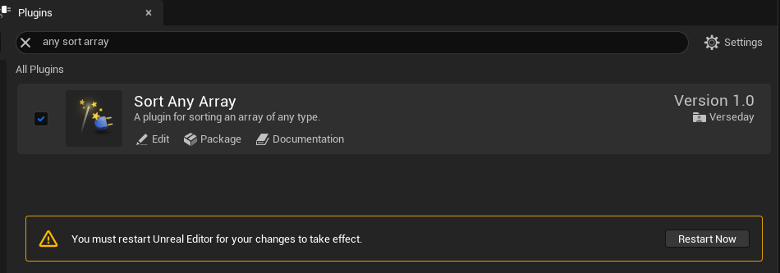
How to use?
First of all, please install this plugin. Then, open the project where you want to use this plugin and activate the plugin by referring to the following image.
Open “Plugins” window
Search for “Sort Any Array,” check the box, and press “Restart Now” at the bottom.

Slide 4
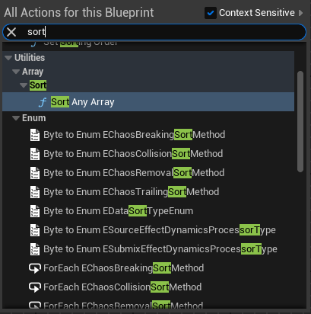
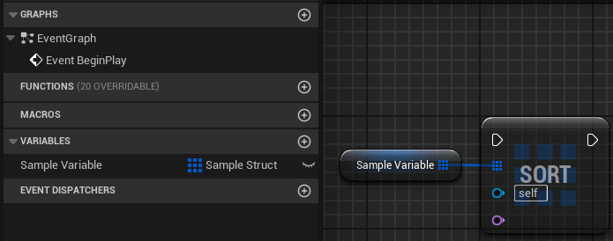
How to use?
① Open the Blueprint Editor, right-click and search for “Sort Any Array.”
② Then connect an array of any type you wish to sort to the array pin.

Slide 5
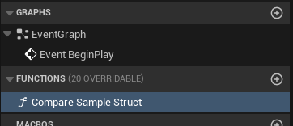
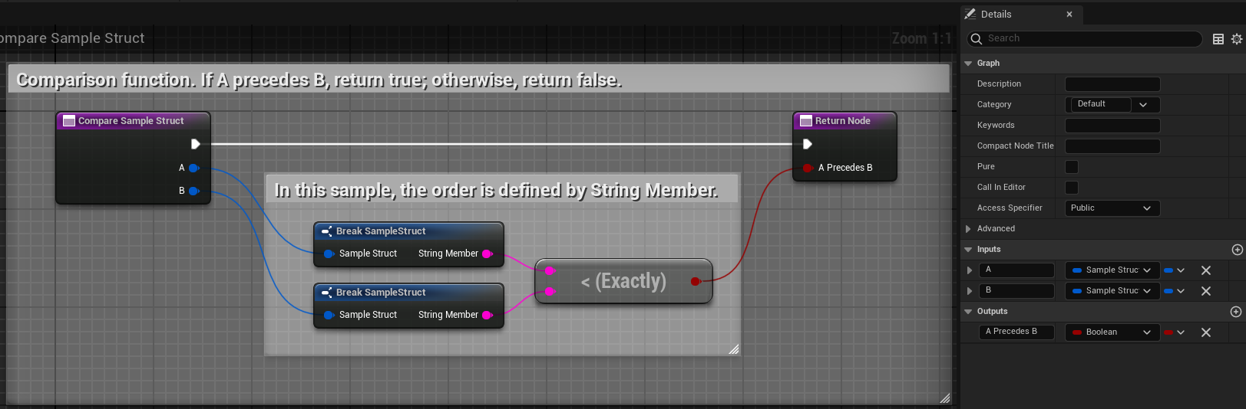
How to use?
③ Create a function to determine the sort order. Set Inputs to two pins with the type of the array elements and Outputs to one pin of type Boolean. In the figure below, if you want A to precede B, return true; otherwise, return false.

Slide 6
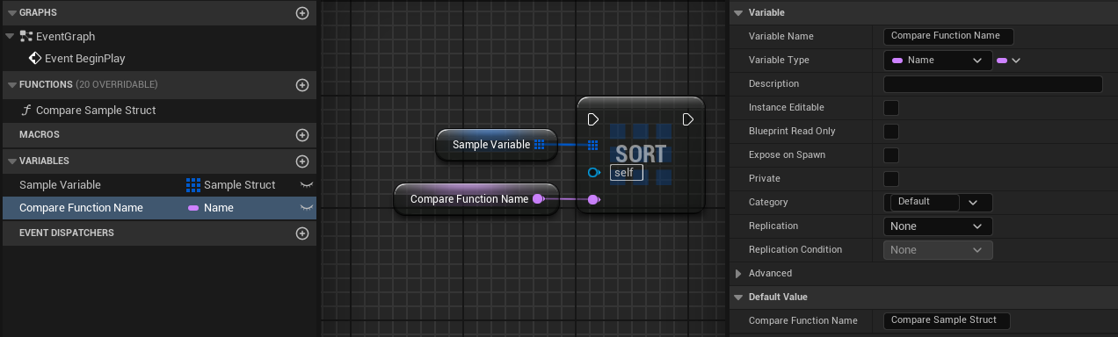
How to use?
④ Finally, pass the comparison function name to the Sort node. In the example below, I want to pass the function name “Compare Sample Struct,” so I prepared a variable of type Name that stores the function name, and pass it to the Sort node.

