Slide 1
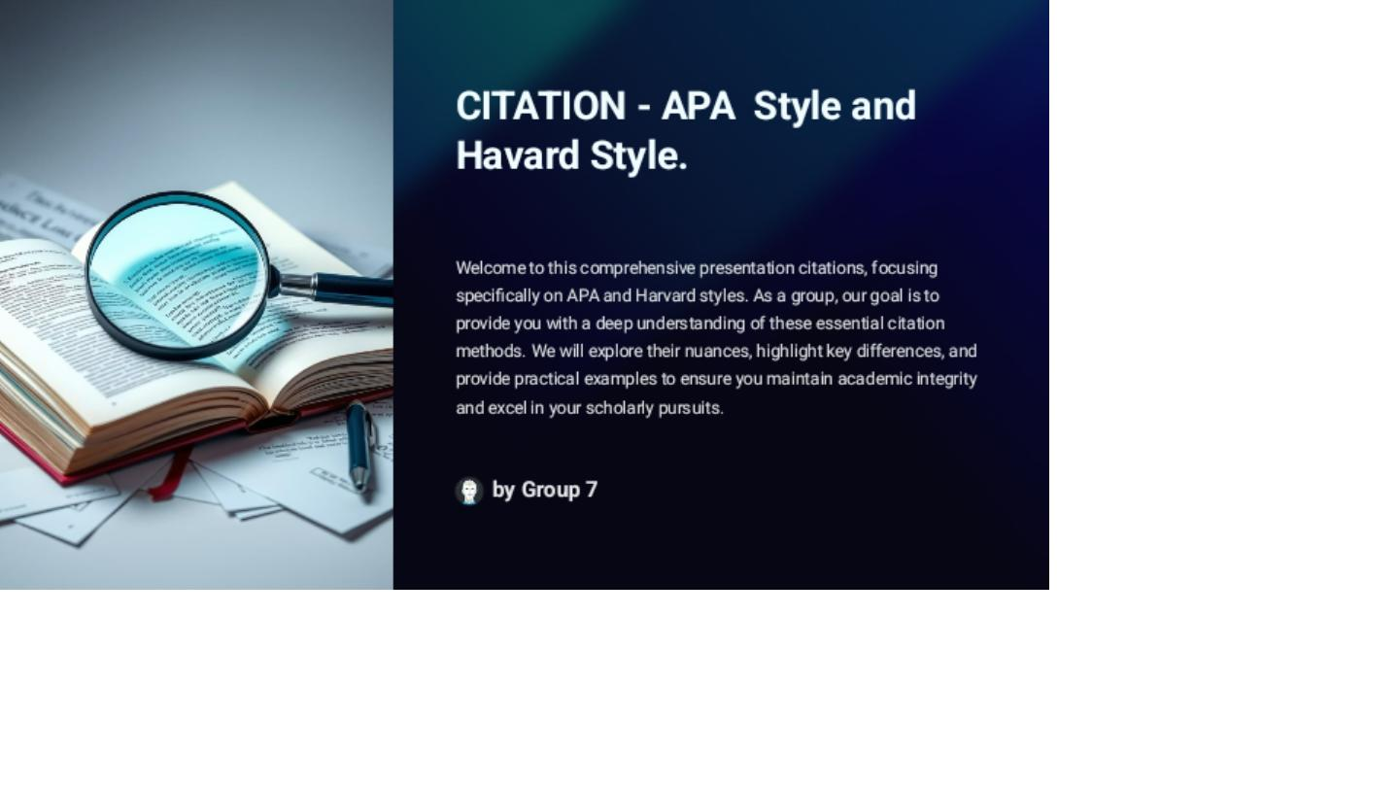

Slide 2
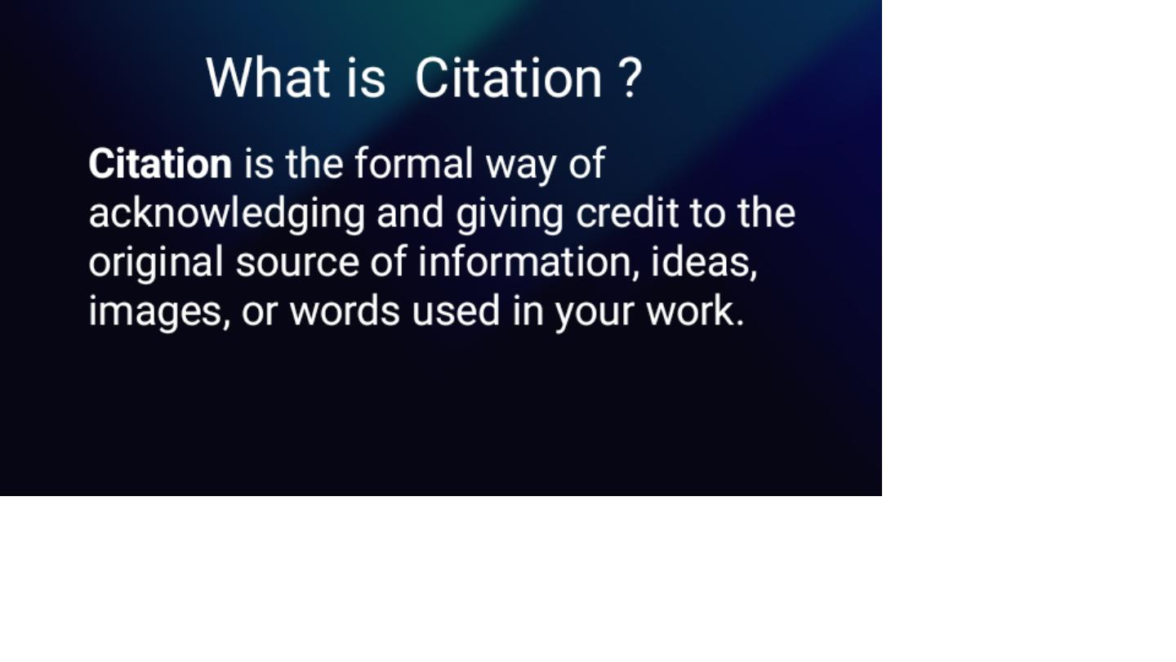

Slide 3


Slide 4
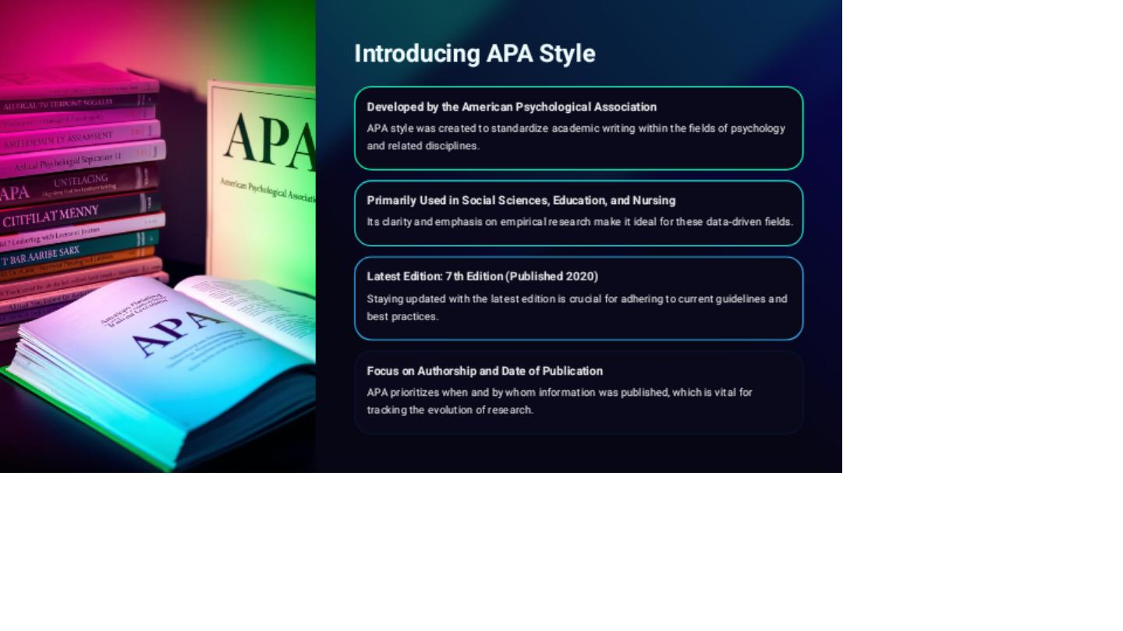

Slide 5
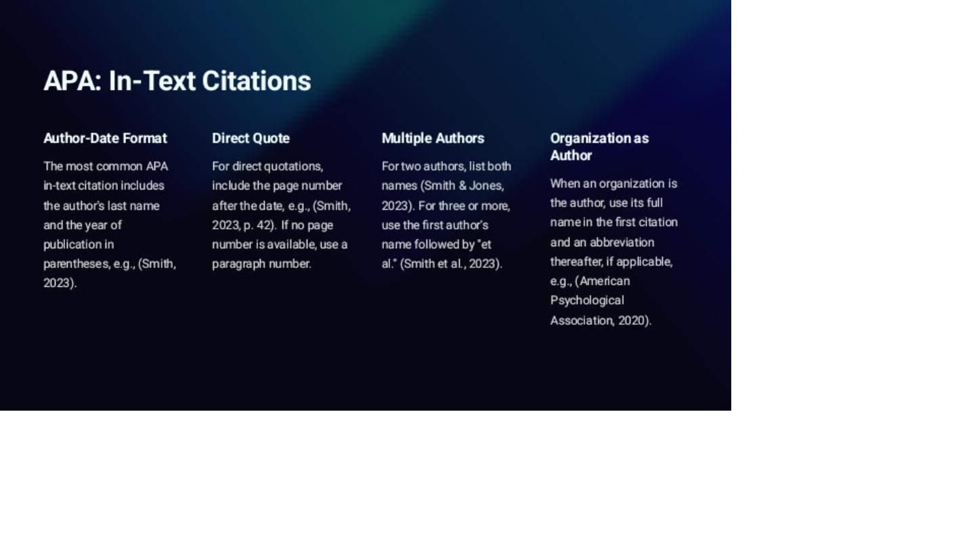

Slide 6
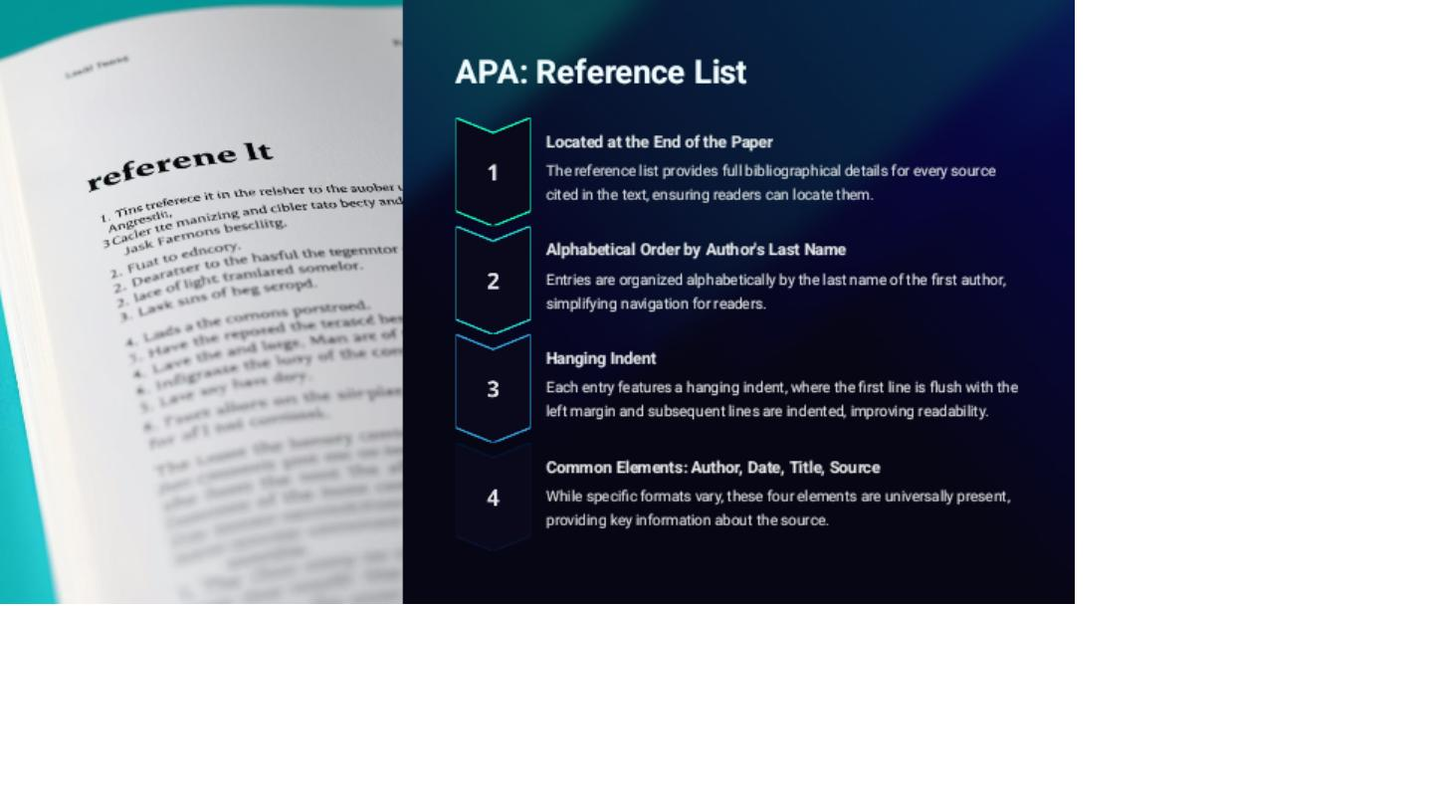

Slide 7
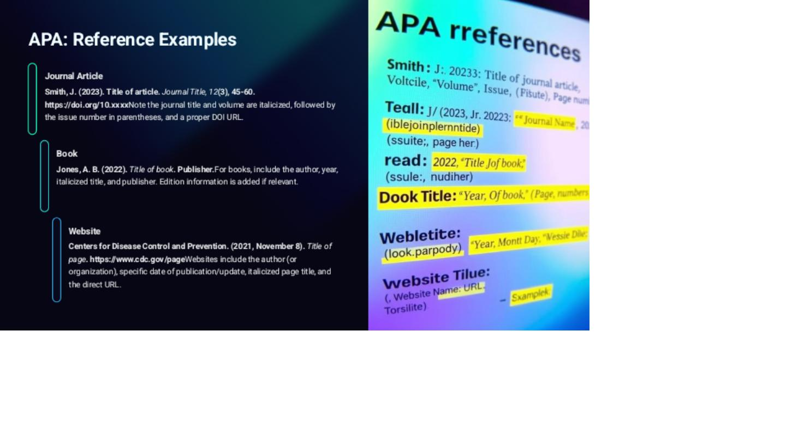

Slide 8


Slide 9
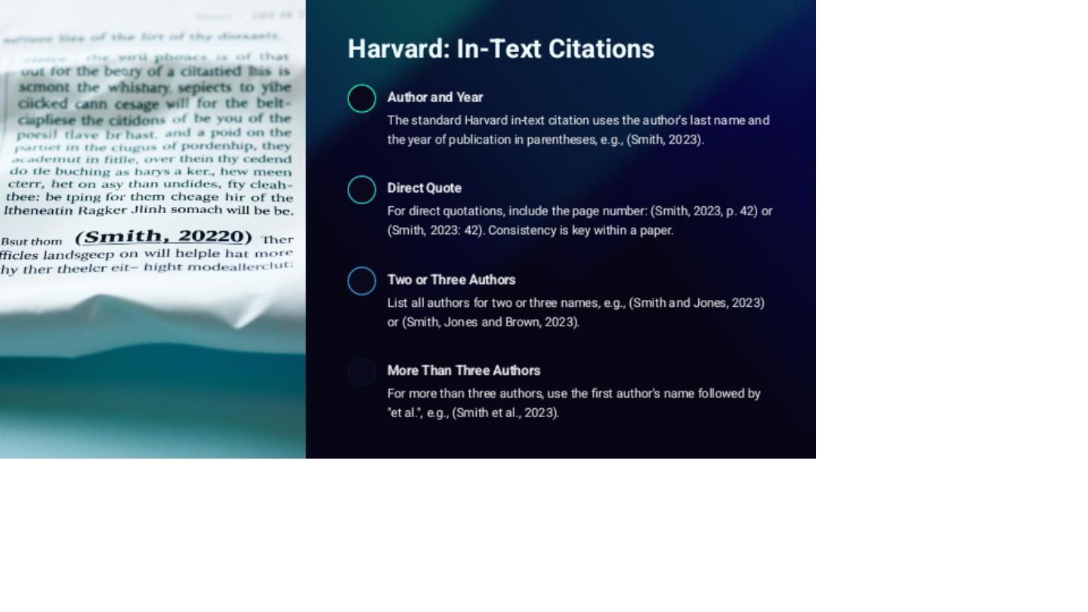

Slide 10
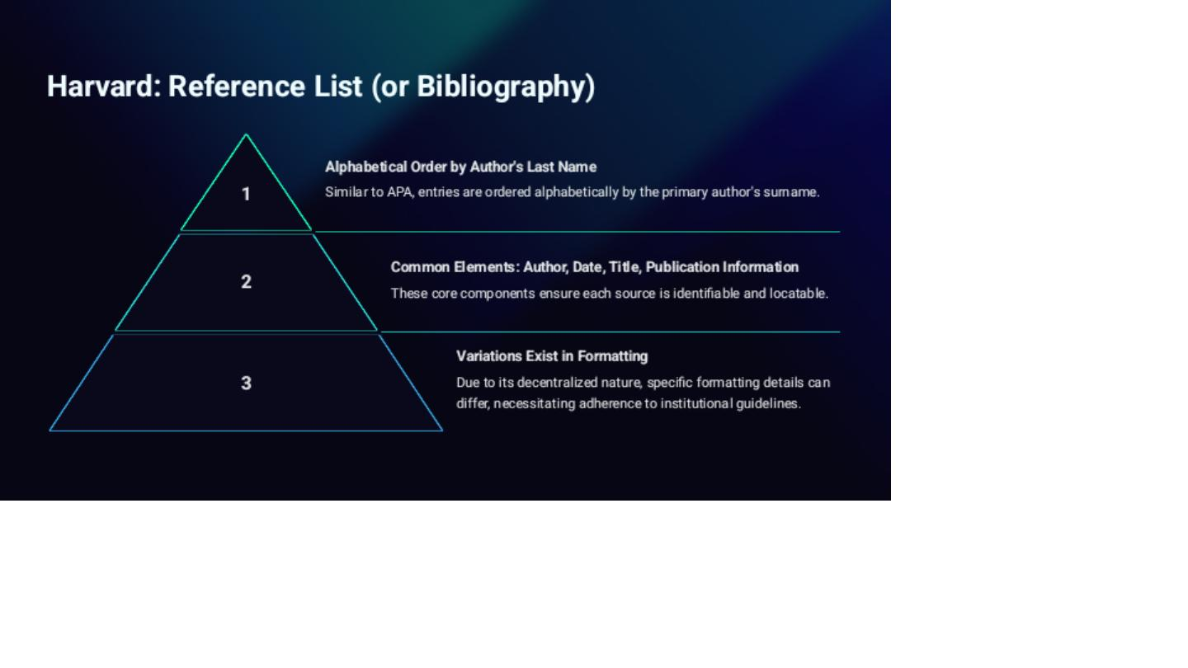

Slide 11
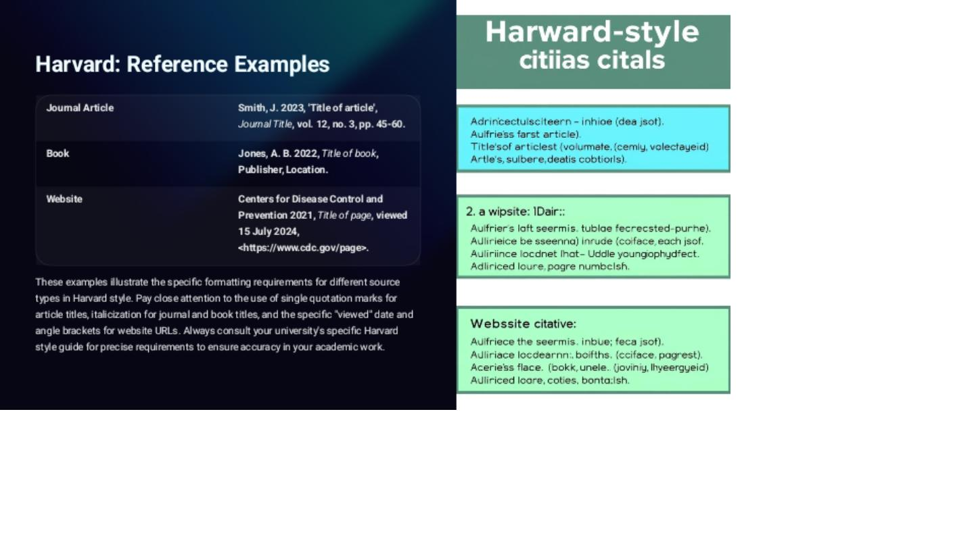

Slide 13
REFERENCES
Shanahan, J. G., Qu, Y., & Wiebe, J. (2005). Computing Attitude And Affect In Text: Theory And Applications. Springer Science & Business Media.
Pears, R., & Shields, G. (2010). Cite Them Right: The Essential Referencing Guide. Palgrave Macmillan.
Henson, K. T. (2007). Writing For Publication. Phi Delta Kappan, 88(10), 781–786. Https://Doi.Org/10.1177/003172170708801018

