Slide 1
NETWORK THEOREMS
LECTURER: Dr. Ruhiya Abubakar
Faculty Of Engineering
Department Of Electrical And Electronics Department

Slide 2
Overview
A network is a collection of interconnected electrical components. In general, the electrical networks are made to exchange the energy between different elements.
These electrical networks can be constructed either by using Resistors or Inductors or Capacitors or combination of these elements.
Network analysis is the process of finding the voltage response or the current response for any element in the network by using the available techniques
Aside the use of Ohm’s law, Kirchhoff’s law to solve complex electrical circuits, there are many circuit analysis theorems using which we can calculate the current and voltage at any given point in a circuit. Among the various circuit theorems.

Slide 3
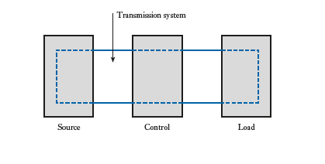
The Electricity System

Slide 4
NETWORK THEOREMS
In practice, it is surprising how many circuits can be considered by simply applying principles and techniques that will better develop them so that one can easily analyse any network no matter how complicated it is.
There are quite variety of techniques , and often one cant say that, one technique is the correct one for a particular problem. Rather it is for a person to decide which approach is preferable.
By the end of this session, we shall be able to analysis the performance of almost any network we may meet in practice even if it were to involve a hundred resistors. We shall also be able to readily determine the performance of a single component in such a network even to the point of determine the maximum power which it can dissipate. Finally we shall be able to compete exercises using these methods of networks analysis

Slide 5
Introduction
A large
complex circuits
Simplify
circuit analysis
Circuit Theorems
‧Thevenin’s theorem ‧ Norton theorem
‧Circuit linearity ‧ Superposition
‧Source transformation ‧ max. power transfer
Star Delta, Delta Star transformation

Slide 6
INTRODUCTION TO THEVENINS AND NORTONS THEOREM
These theorems involves replacing what may be a complicated network of sources and linear impedances with a simple equivalent circuit.
A set procedure may be followed when using each theorem, the procedures themselves requiring a knowledge of basic circuit theory.

Slide 7
THEVENIN’S THEOREM
The current through a resistor R connected across any two points A and B of an active network(i.e. A network containing one or more sources of e.m.f.) is obtained by dividing the p.d. between points A and B , with R disconnected, by (R+r), where r is the resistance of the network measured between points A and B with R disconnected and the sources of e.m.f replaced by their internal resistance.
THEVENIN’S THEOREM states that an active network having two terminals A and B can be replaced by a constant – voltage source having an e.m.f. E and internal resistance r. The value of E is equal to the open-circuit p.d. Between A and B, and r is the internal resistance of the network measured between A and B with the load disconnected and the sources of emf replaced by their internal resistances.

Slide 8
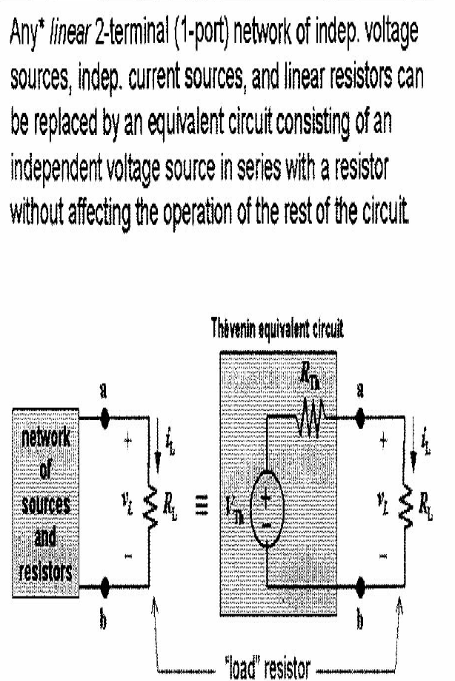
THEVENIN EQUIVALENT CIRCUIT
The theorem applies to any linear active network ‘linear’ meaning that the measured values of circuit components are independent of the direction and magnitude of the current flowing in them, and ‘active’ meaning that it contains a source, or sources, of e.m.f.

Slide 9
STEPS INVOLVED IN APPLYING THEVENINS THEOREM TO A CIRCUIT
The following four-step procedure can be adopted when determining, by means of Thévenin’s theorem, the current flowing in a branch containing impedance ZL of
an active network:
(i) remove the impedance ZL from that branch;
(ii) determine the open-circuit voltage E across the break;
(iii) remove each source of e.m.f. and replace it by its
internal impedance (if it has zero internal impedance
then replace it by a short-circuit), and then determine
the internal impedance, z, ‘looking in’ at the break;
(iv) determine the current from the Thévenin equivalent
Circuit.

Slide 10
NORTONS THEOREM
When a branch in a circuit is open- circuited the remainder of the cct. can be represented by one source of e.m.f in series with a resistor(THEVENINS EQUIVALENT).
The current that flows in any branch of a network is the
same as that which would flow in the branch if it were
connected across a source of electrical energy, the short-circuit current of which is equal to the current that would flow in a short-circuit across the branch, and the internal impedance of which is equal to the impedance which appears across the open-circuited branch terminals.

Slide 11
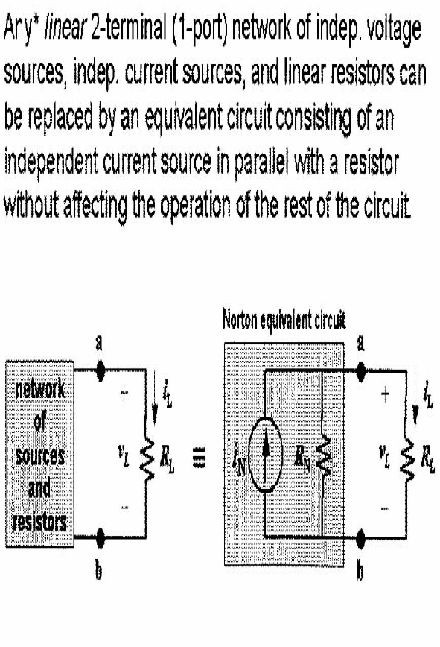
NORTON’S THEOREM

Slide 12
STEPS INVOLVED IN APPLYING NORTONS THEOREM IN CIRCUITS
The following four-step procedure may be adopted
when determining the current flowing in an impedance ZL of a branch AB of an active network, using Norton’s theorem:
(i) short-circuit branch AB;
(ii) determine the short-circuit current ISC;
(iii) remove each source of e.m.f. and replace it by its internal impedance (or, if a current source exists, replace with an open circuit), then determine the impedance, z, ‘looking in’ at a break made between A and B;
(iv) determine the value of the current iL flowing in
impedance ZL from the Norton equivalent network

Slide 13
WORKED EXAMPLE
Notice that there is no current flowing in the 4 Ω resistor (A-B) is open. Thus there can be no voltage across the resistor.

Slide 14
We now deactivate the sources to the left of A-B and find the resistance seen looking in these terminals.
R_{TH} = 12||6 + 4 = 8 Ω

Slide 15
Note that Ix= 10/2+8=1A

Slide 16
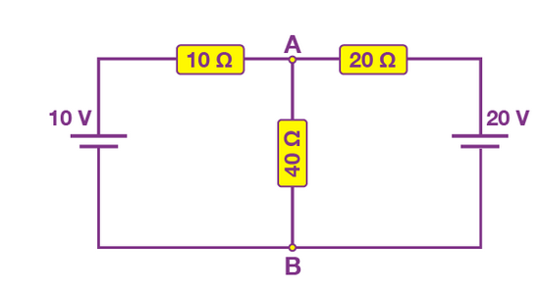
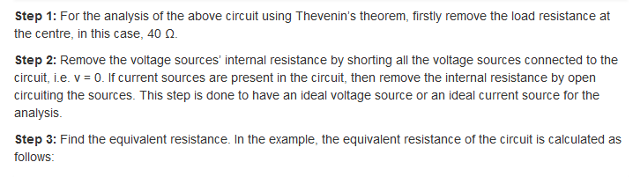
EXAMPLE 2

Slide 17
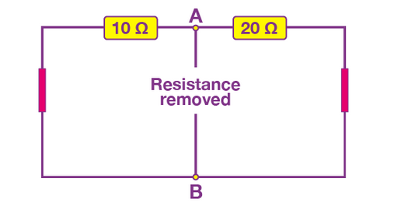

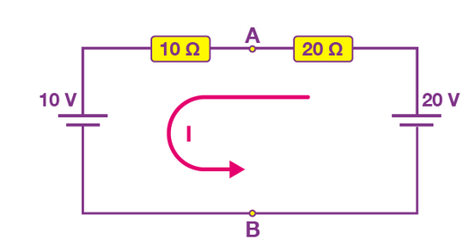
With the load resistance removed and the voltage sources shorted, the equivalent resistance of the circuit is calculated as follows:
The resistor 10 Ω is parallel to 20 Ω, therefore the equivalent resistance of the circuit is:
Step 4: Find the equivalent voltage.

Slide 18

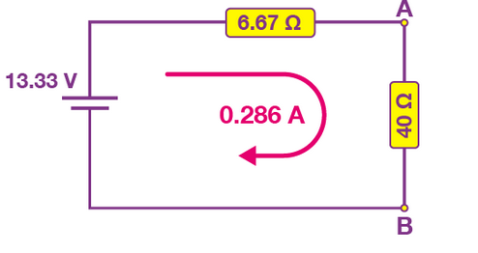
To calculate the equivalent voltage, reconnect the voltage sources back into the circuit. V_{s} = V_{AB}, therefore the current flowing around the loop is calculated as follows:
The calculated current is common to both resistors, so the voltage drop across the resistors can be calculated as follows:
V_{AB} = 20 – (20 Ω x 0.33 A) = 13.33 V
or,
V_{AB} = 10 + (10 Ω x 0.33 A) = 13.33 V
The voltage drop across both resistors is the same.
Step 5: Draw the Thevenin’s equivalent circuit. The Thevenin’s equivalent circuit consists of a series resistance of 6.67 Ω and a voltage source of 13.33 V.

Slide 19

The current flowing in the circuit is calculated using the formula below:
NB: USING NORTONS THEOREM CALCULATE THE CURRENT THROUGH THE
SAME LOAD RESISTOR.

Slide 20
NORTON’S THEOREM
Norton’s theorem states that a linear two
terminal circuit can be replaced by equivalent
circuit consisting of a current source I_{N} in parallel
with a resistor R_{N} where I_{N} is the short-circuit
current through the terminals and R_{N} is the
input or equivalent resistance at the terminals
when the independent source are turn off and replaced by their internal resistances.

Slide 21
SUPERPOSITION THEOREM
Used to find the solution to networks with two or more sources that are not in series or parallel.
The current through, or voltage across, an element in a network is equal to the algebraic sum of the currents or voltages produced independently by each source.
Since the effect of each source will be determined independently, the number of networks to be analyzed will equal the number of sources.

Slide 22
SUPERPOSITION THEOREM
Superposition Theorem States:
In any network made up of linear resistances and containing more than one source of e.m.f., the resultant current flowing in any branch is the algebraic sum of the currents that would flow in that branch if each source was considered separately, all other sources being replaced at that time by their respective internal resistances.
This method allows us to determine the current through or the
voltage across any resistor or branch in a network.
The advantage of using this approach instead of mesh analysis
or nodal analysis is that it is not necessary to use determinants or matrix algebra to analyze a given circuit

Slide 23
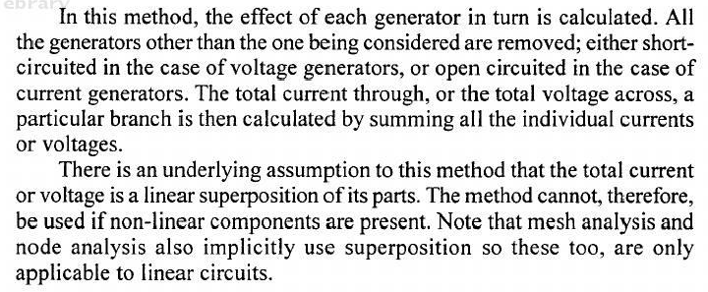
CONT…

Slide 24
Cont….
In order to apply the superposition theorem it is necessary to remove all sources other than the one being examined. In order to “zero” a voltage source, we replace it with a short circuit, since the voltage across a short circuit is zero volts.
A current source is zeroed by replacing it with an open circuit, since the current through an open circuit is zero amps.
If we wish to determine the power dissipated by any resistor, we must first find either the voltage across the resistor or the current through the resistor.

Slide 25
Cont…
NOTE THAT:
The superposition theorem does not apply to power, since power is not a linear quantity, but rather is found as the square of either current or voltage.

Slide 26
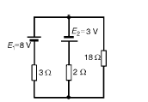
EXAMPLE
Question: Using superposition theorem, find that current through the 18Ω resistor and also the p.d across it.

Slide 27
STEPS INVOLVED IN APPLYING SUPERPOSITION THEOREM TO A CIRCUIT
Step - 1
Replace all but one of the sources by their internal resistances.
Step - 2
Determine the currents in various branches using simple Ohms law.
Step - 3
Repeat the process using each of the sources turn - by turn as the sole source each time.
Step - 4
Add all the currents in a particular branch due to each source. This the desired value of current at that branch when all the sources acting on the circuit simultaneously.

Slide 28
RECIPROCITY THEOREM
In many electrical network it is found that if positions of voltage source and ammeter are interchanged, the reading of ammeter remains same. Suppose a voltage source is connected to a passive network and an ammeter is connected to other part of the network to indicate the response.
Now any one interchanges the positions of ammeter and voltage source, making the voltage source to be connected at the part of the network where the ammeter was connected and also connect the ammeter to that part of the network where the voltage source was connected. The current through the ammeter would be same in both cases.
This is where the property of reciprocity comes in the circuit. The particular circuit which has this reciprocal property is called reciprocal circuit and therefore perfectly obeys reciprocity theorem.

Slide 29
POINTS TO NOTE
The voltage source and the ammeter used in this theorem must be ideal. That means the internal resistance of both voltage source and ammeter must be zero.
The reciprocal circuit may be a simple or complex network. But every complex reciprocal passive network can be simplified to a simple network.
As per reciprocity theorem in a linear passive network, supply voltage V and output current I are mutually transferable. The ratio of V and I is called the transfer resistance.

Slide 30
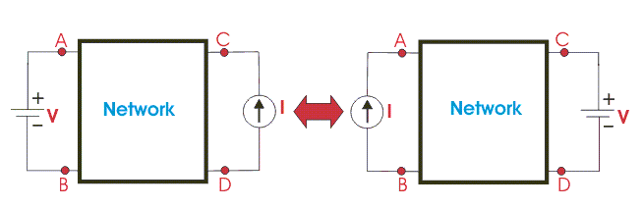
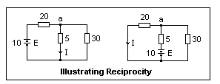
ILLUSTRATION

Slide 31
MAXIMUM POWER TRANSFER
The maximum power transfer theorem states:
The power transferred from a supply source to a load is at its maximum when the resistance of the load is equal to the internal resistance of the source.
Typical practical applications of the maximum power
transfer theorem are found in stereo amplifier design,
seeking to maximize power delivered to speakers, and
in electric vehicle design, seeking to maximize power
delivered to drive a motor.

Slide 32
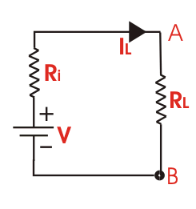
Cont…
Suppose we have a voltage source or battery whose internal electrical resistance is R_{i} and a load resistance R_{L} is connected across this battery.
Maximum Power Transfer Theorem determines the value of resistance R_{L} for which the maximum power will be transferred from source to it. Actually the maximum power, drawn from the source, depends upon the value of the load resistance.

Slide 33


ILLUSTRATION
Power delivered to the load resistance,
To find the maximum power, differentiate the above expression with respect to resistance R_{L} and equate it to zero. Thus,
Thus in this case, the maximum power will be transferred to the load when load resistance is just equal to internal resistance of the battery.

Slide 34
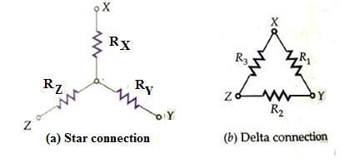
Star to Delta and Delta to Star Transformations
Many a times circuits have to be transformed from Star to equivalent Delta and Delta to equivalent Star configurations such that the net terminal Resistances ( Impedances)across the terminals are the same

Slide 35
Delta to Star Transformation
The circuit configurations are identical provided the net resistances across the terminal pairs XY, YZ and ZX in both connections are the same. In Star Connection they are:
RX-Y = RX+RY........................... (1)
RY- Z = RY+RZ.......................... (2)
RZ-X = RZ+RX................................(3)

Slide 36
Delta to Star Transformation

Slide 37
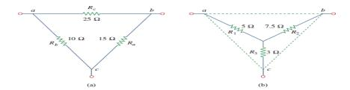

EXAMPLE
1) Convert the Delta network in a) Fig.(a) to an equivalent star network
Solution

Slide 38
THANKS!

