Slide 1






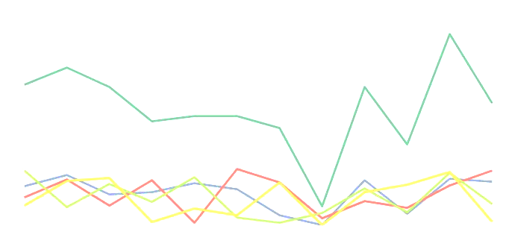


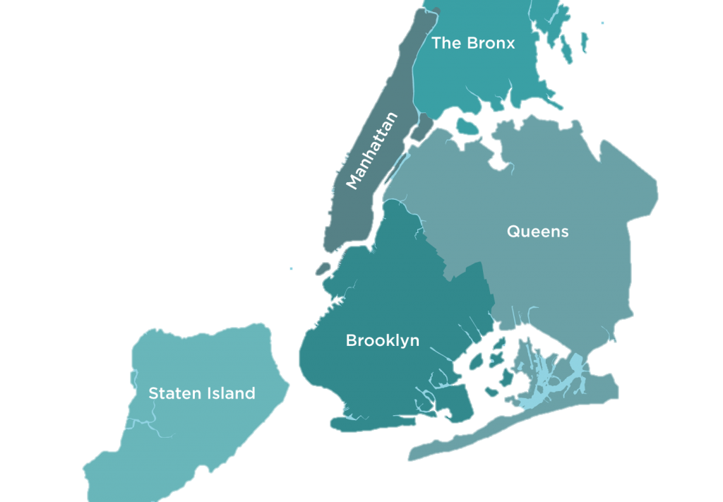

Looking to invest in NYC?
Brooklyn
Bronx
Manhattan
What type of property are you looking for?
What type of property are you looking for?
Select
Select
What is your budget range?
Select
Are you interested in a specific borough?
Select
Enter
Staten Island
Based on your budget & property type you can invest here:
Address 1
Address 2
Address 3
Queens
Sales Prices through years in NY Boroughs
Here is what the sale price of the property looks like for next 5 years
Address:
Postal Code:
Sale Price:
Property Type:
Sales trendline through years for different boroughs
Sales trendline through years for different boroughs

