Slide 1

WhoRU?
AI for Professional Networking

Slide 2

Problem
Entrepreneurs and salespeople struggle to remember key details about people from networking events, making follow-up difficult and leading to missed opportunities and inefficient network management.

Slide 3
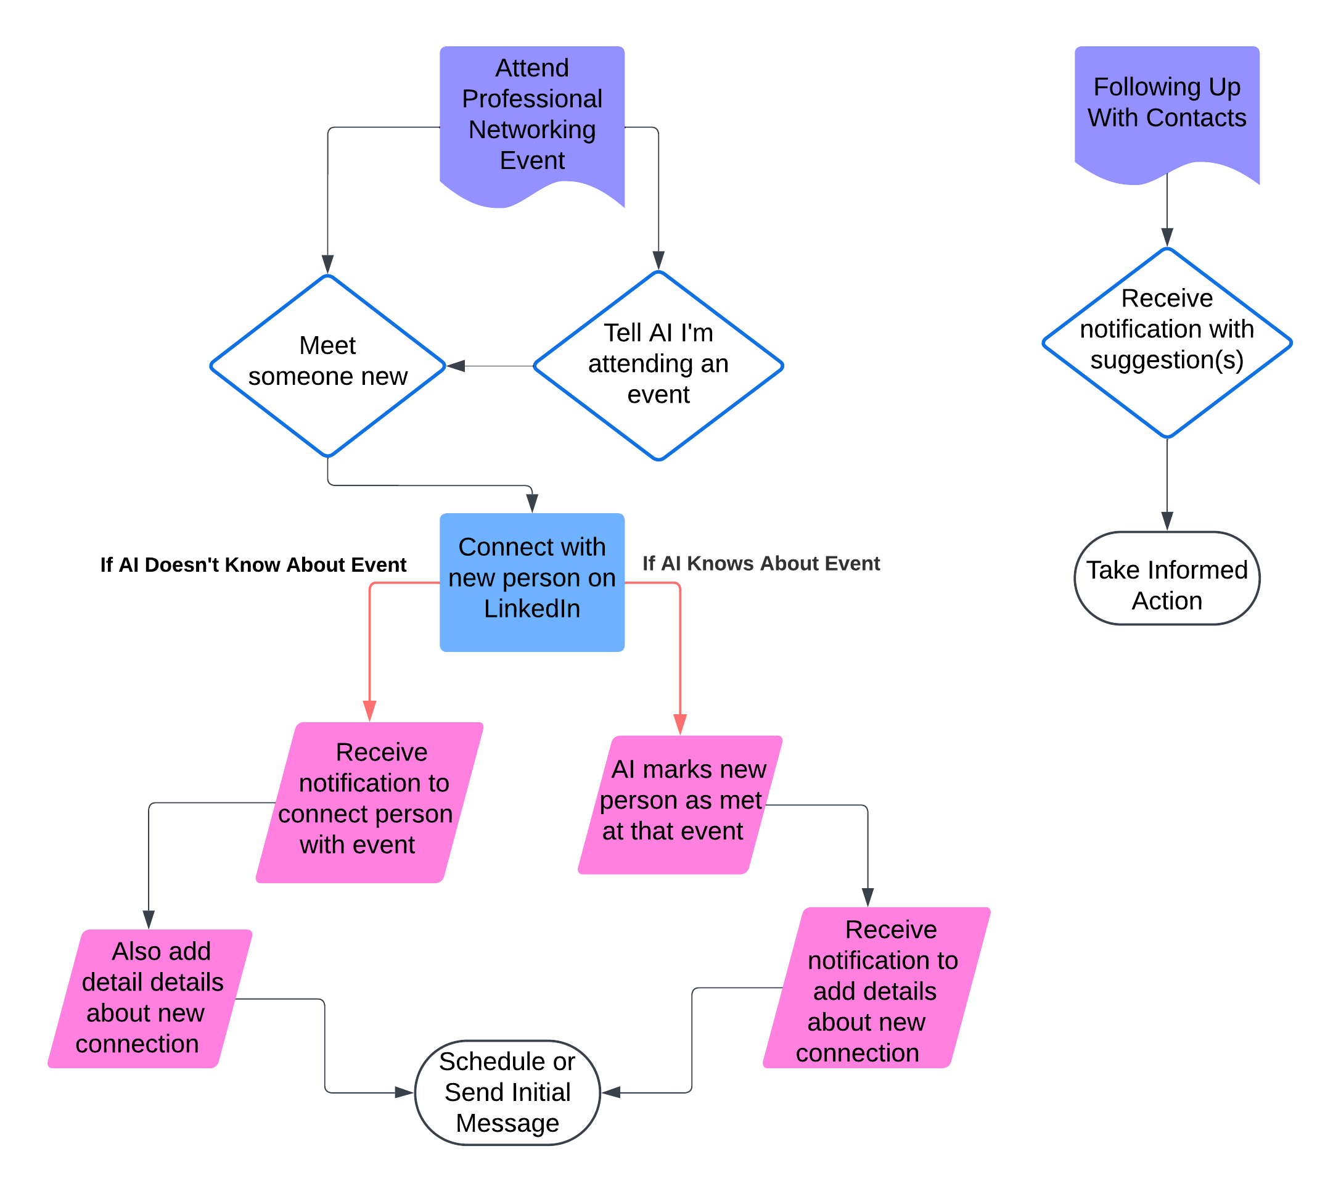
What WhoRU? Does

Slide 4

