Slide 1

Lake House Reference Architecture

Slide 2
Introductions ___________________________________________ Nilanjan Sen Clarke Bishop Devin Wilson Gopal Tetali Arvind Sharma

Slide 3
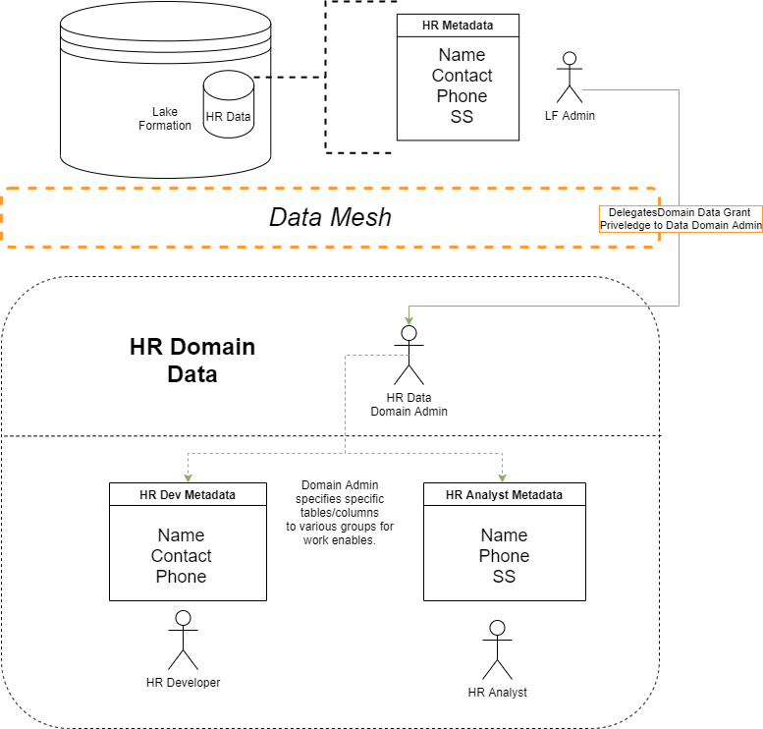
Data Mesh Concept

Slide 4
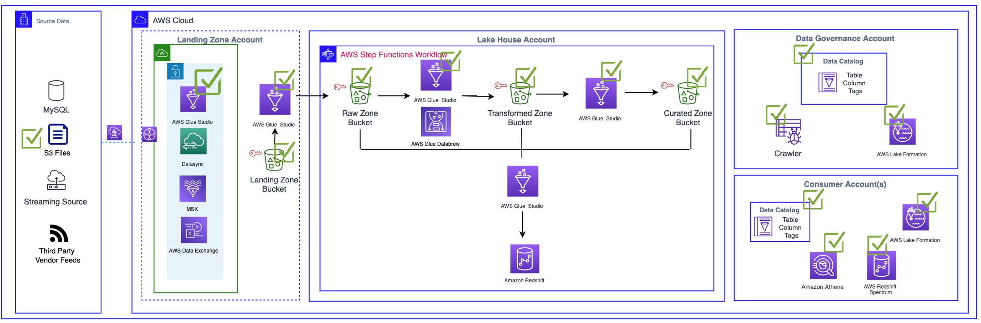
Current-State Architecture

Slide 5

Questions
Step-Function vs. Glue Workflow
Inclusion of Traditional Redshift
Lake Formation & Cloudformation
Planning further support?
Automation recommendation?
Access Configuration Ops Improvement
Inclusion into traditional SDLCs

Slide 6
Demo ___________________________________________

Slide 7
Questions? ___________________________________________ Next steps..

