Slide 1
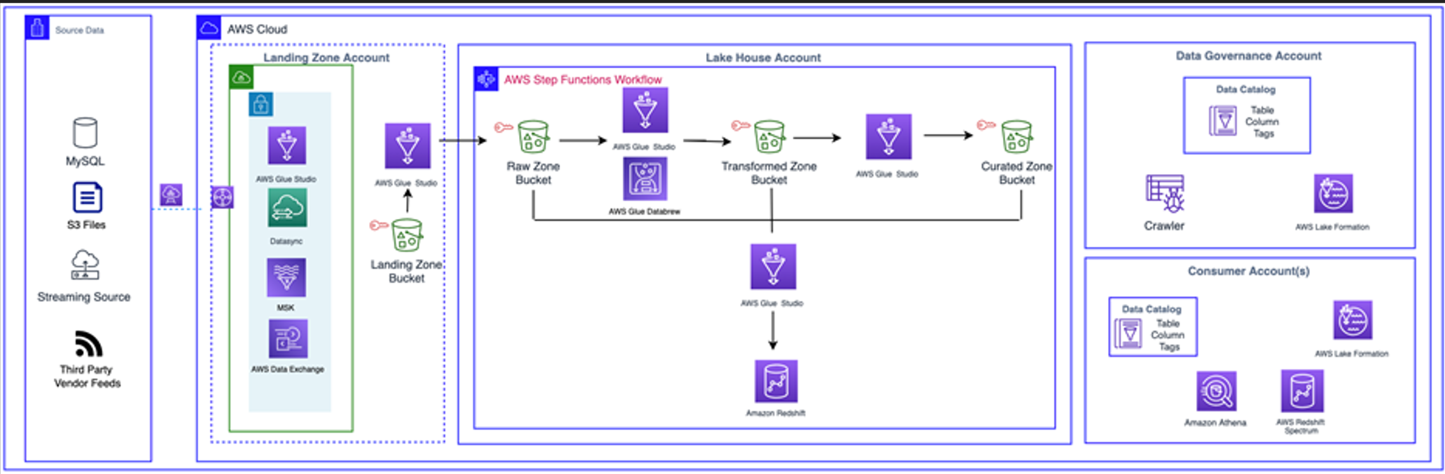
Lake House Solution

Slide 2
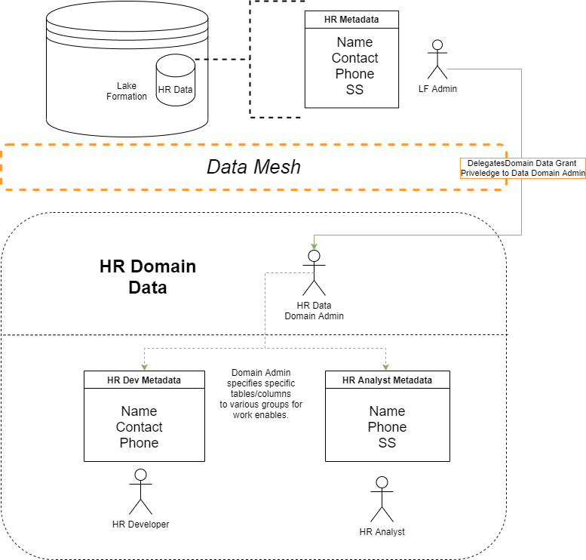
Data Mesh Architectures

Slide 3
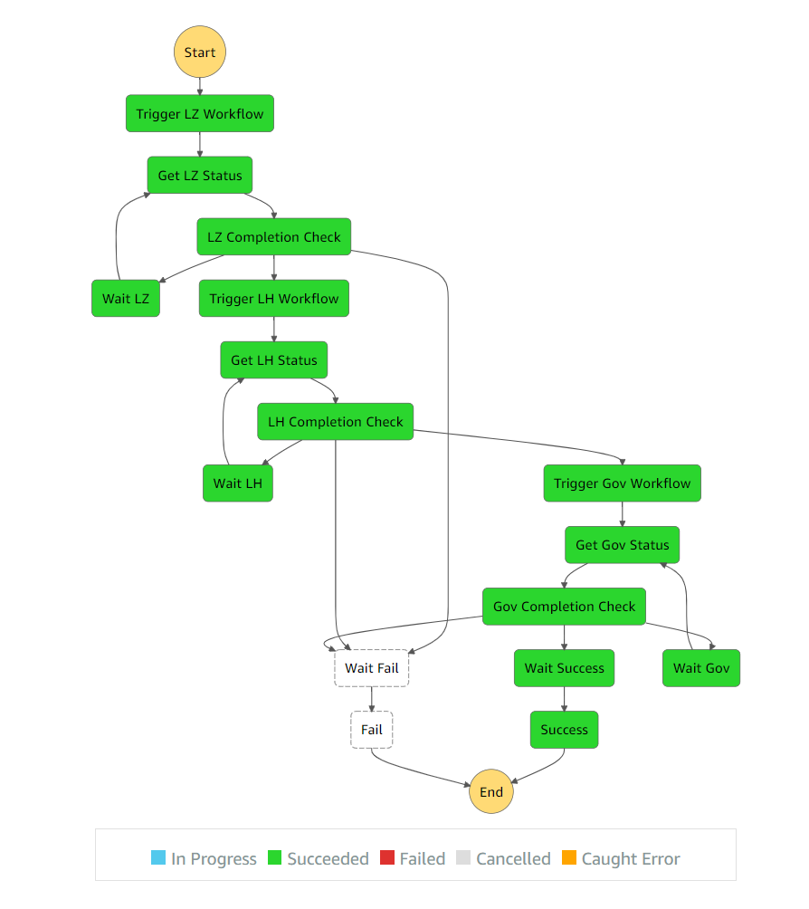
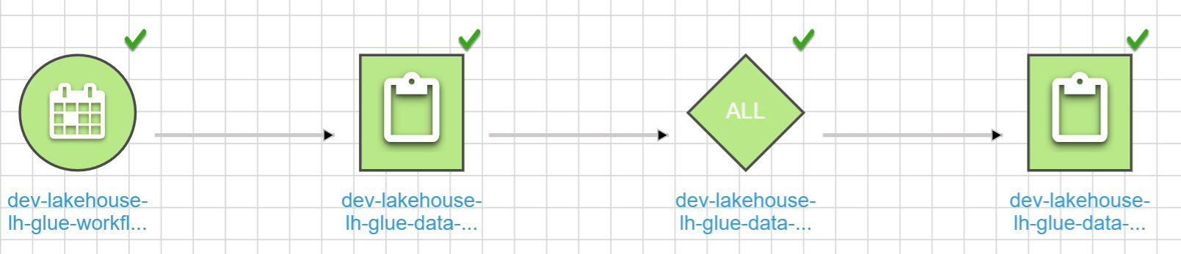
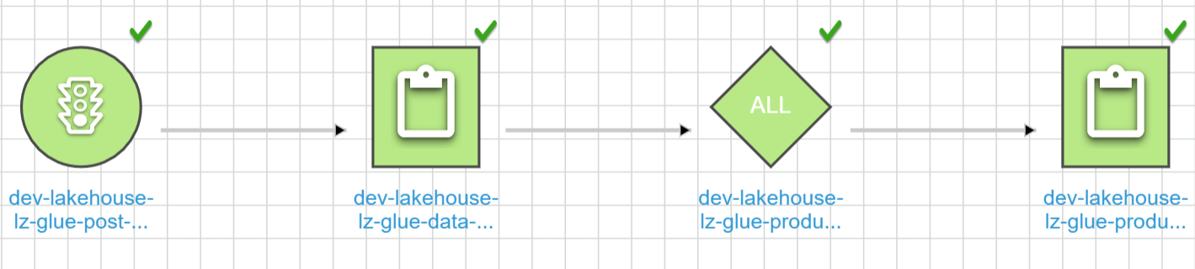
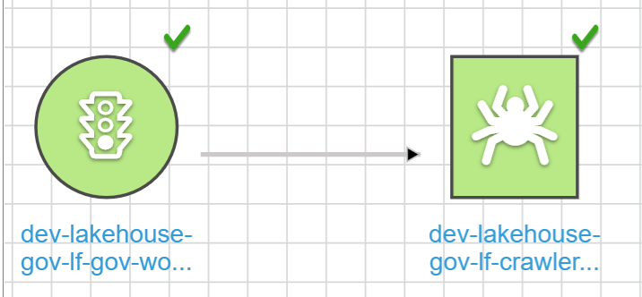


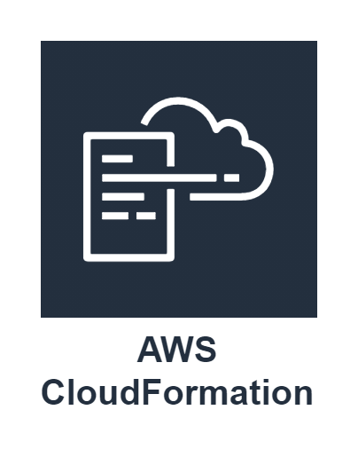




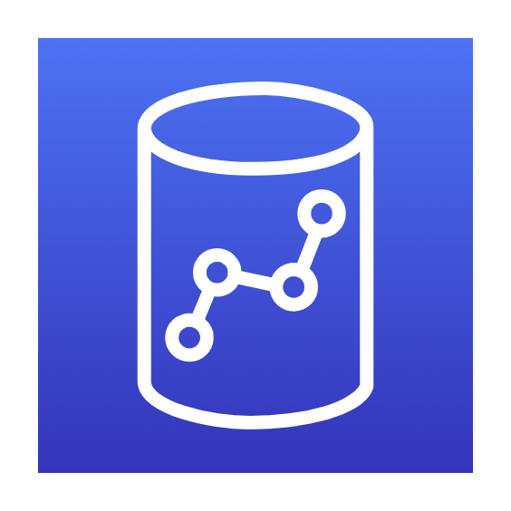
Lake House Solution
Solution Overview
Outcomes
Showcase the benefits and usage of a modern-day Data Lake House Architecture.
Implement Lake House infrastructure and deployments across 4 accounts, in 2 separate regions.
Exhibit Cross-Account Data Governance
Exhibit the concept of a Data Mesh
Perform data lake ingestion, curation, and catalog components.
Orchestrate the entire process from data ingestion to catalog exposure, from end-to-end.
Cross-account data queries performed directly against a Lake Formation Data Lake through Redshift Spectrum External Tables and Athena. No need for a traditional data warehouse.
Table and Column-Level access granularity achieved through Lake Formation Permissions.
Data Lake Governance enabled through Lake Formation Resource Shares.
Multi-regional, parameterized, infrastructure-as-code deployments.
Full data flow & processing pipeline with Glue Jobs, orchestrated by a single Step Function.

