Slide 1


Slide 2
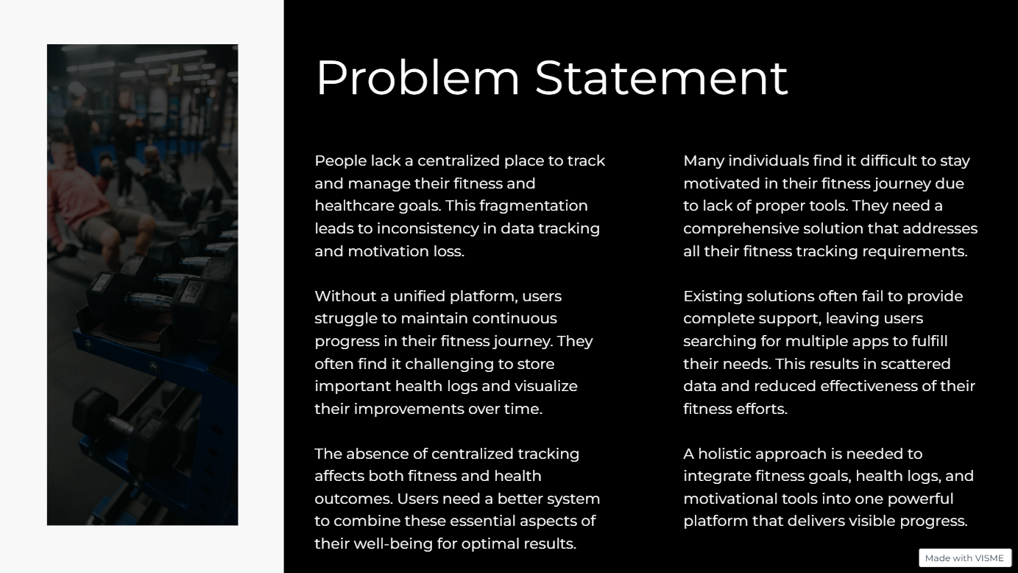

Slide 3
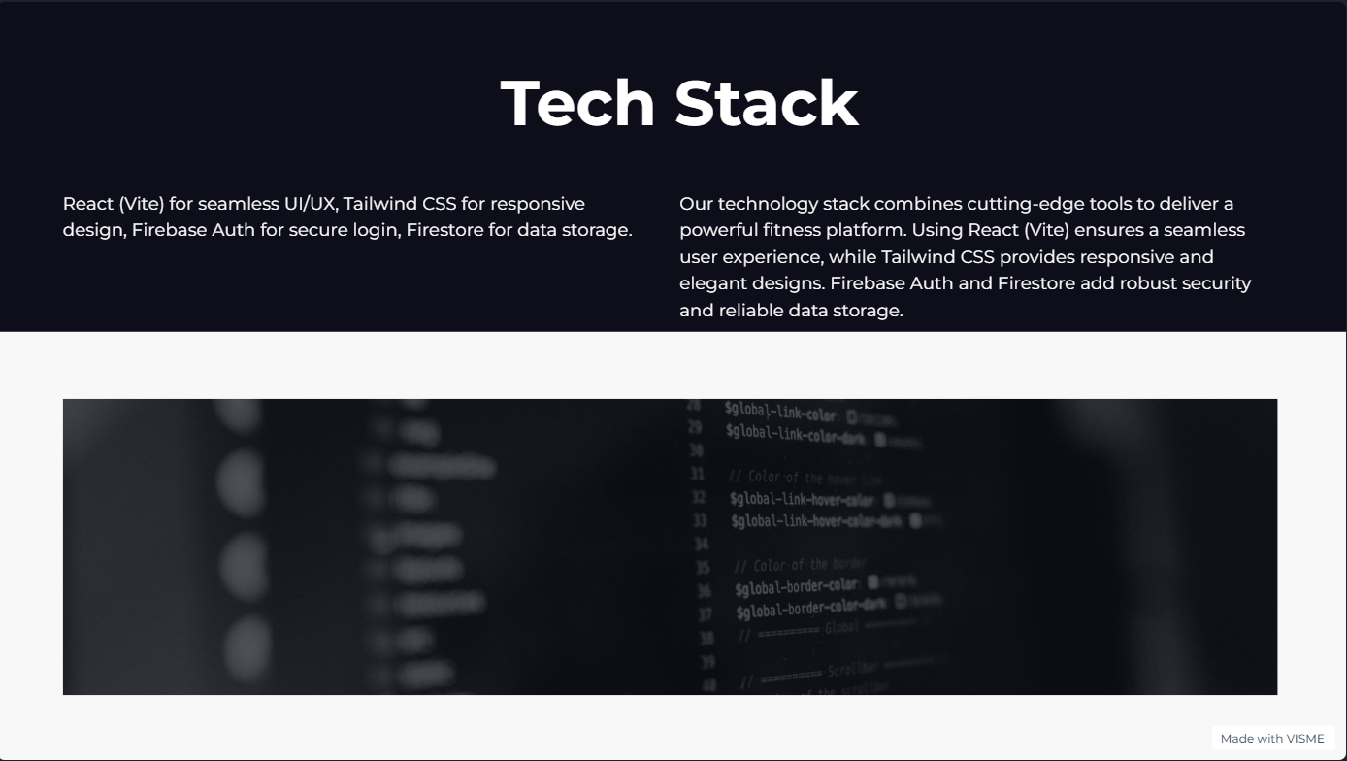

Slide 4
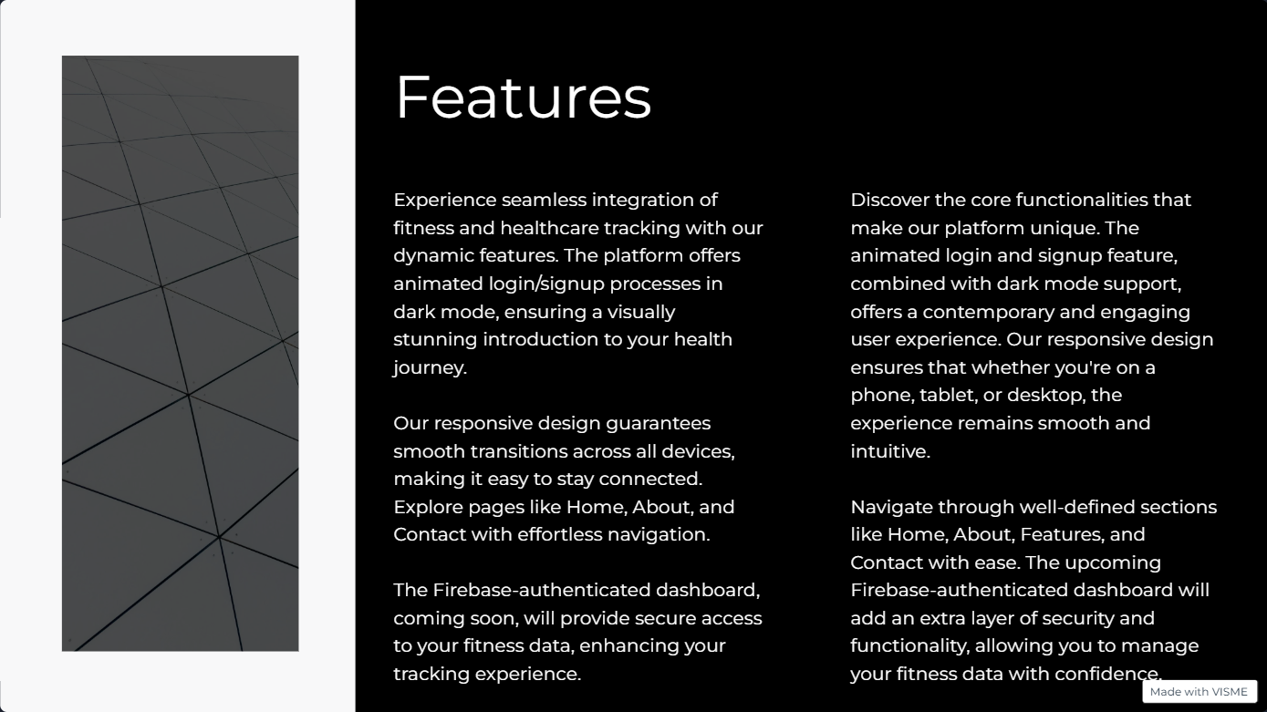

Slide 5


Slide 6
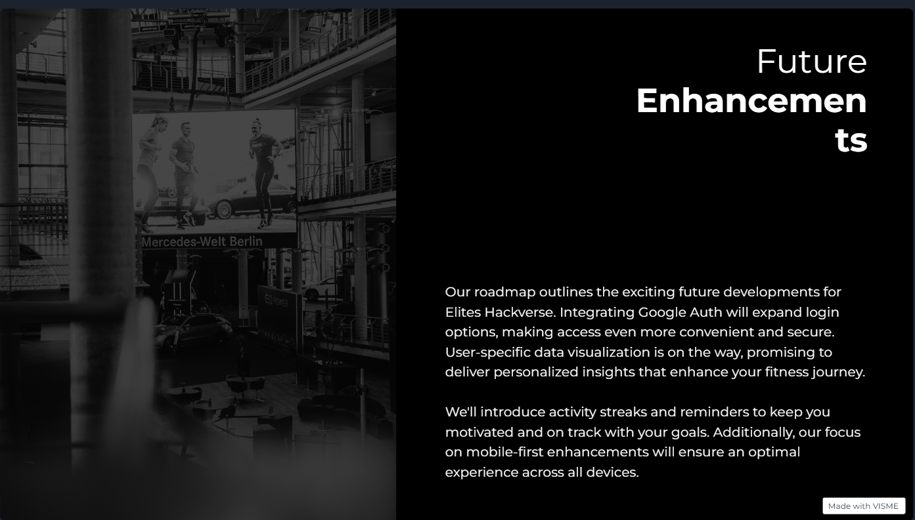

Slide 7

Collaborators
Rudra Pratap Singh
Vanshika Bhadani
Chaitanya Verma
Manav Kathuriya
(Frontend and Design)
(Backend and Dashboard)
(Backend and Dashboard)
(Frontend)

Slide 8
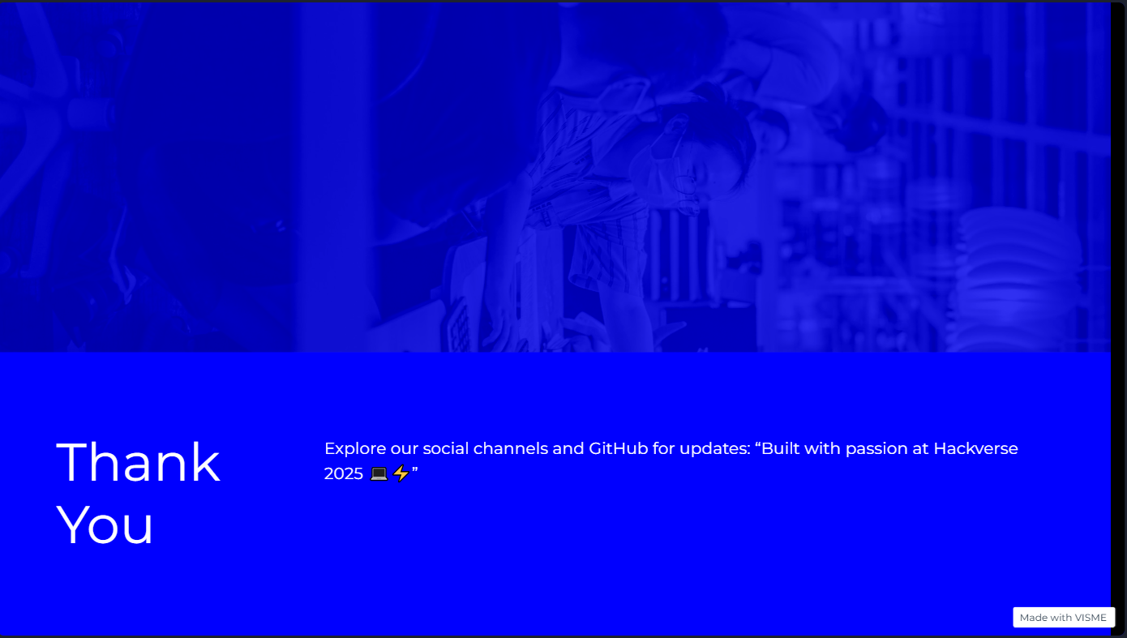

Slide 9
