Slide 1
Inequality and the trade balance: an uneven connection?
Asher Stout
Notes:
The slides for this presentation are designed to be minimalistic. Accompanying them will be a hand-in-hand presentation with the finished R project, as well as a verbal discussion of each slide. At the end will be a section for questions, comments, and other concerns.

Slide 2
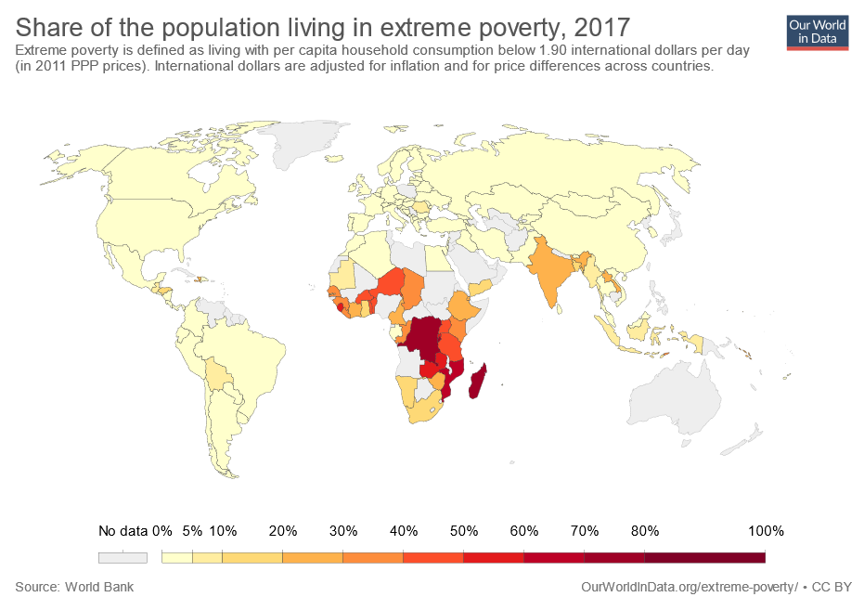
PURPOSE AND DATA

Slide 3
Measures of inequality
GINI Index
Income share held by wealthiest 10%
Poverty Headcount Ratio (at national lines)

Slide 4

Measures of trade
Trade Balance
Exports
Imports
Goods
Services
Goods
Services
…
…

Slide 5
Project Results

Slide 6
Where do we go from here?

Slide 7
region specific analysis
Prolonged trade deficits/surplus
Other inequality indicators
Urban versus rural inequality
New Zealand’s trade and
Educational inequality

Slide 8
Questions comments concerns
Thank You!

