Slide 1
Team 10 · J · CSE 484 / CSE 654 · Mid-project, 12 November 2026
With 750 labelled tweets, does fine-tuning beat a calibrated open LLM?
RESEARCH QUESTION (UNCHANGED FROM THE PROPOSAL)
THE ANSWER IS NO IF
If we only have 750 labelled tweets, does fine-tuning BERTurk on them give a higher macro-F1 on the official OffensEval-TR 2020 test set (3,528 tweets) than prompting an open LLM (Gemma-2-9B-it or Qwen3-8B) that uses the same 750 tweets: 8 as examples in its prompt, and the other 742 to choose its decision threshold?
against either LLM, BERTurk’s average over 10 runs is not at least 0.02 higher than the LLM’s average over 3 runs, or a paired bootstrap test says the gap could be chance.
0.763
60
0.794
TF-IDF baseline on the frozen test set (95% CI 0.745–0.779)
baseline errors audited, grouped into categories with counts
Gemma-4-12B few-shot dev macro-F1 after threshold calibration
Vesile Han · Gürkan Göztepeli (CSE 654, research leads) · Mert Uğur · Utku Gökçek (CSE 484)
Talk: 8 slides + 4 Project Card appendix slides (graded, not presented).
Team 10 · J · CSE 484 / CSE 654 · Mid-project, 12 November 2026
1
Notes:
Research question first, as the rubric requires. The answer is 'no' under two pre-registered conditions: a gap below 0.02 macro-F1, or a paired bootstrap that cannot rule out chance. We report the baseline on the frozen test set because the mid-project rubric asks for test-set numbers; method results stay on dev until the final freeze.

Slide 2
2 · Data as loaded
30,000 train / 1,756 dev / 3,528 frozen test; 19.3% offensive
File / split | Tweets | NOT | OFF | OFF %
Official training file | 31,756 | 25,625 | 6,131 | 19.3
Our train (seed 42) | 30,000 | 24,208 | 5,792 | 19.3
Our dev (never tuned on) | 1,756 | 1,417 | 339 | 19.3
Official test (frozen) | 3,528 | 2,812 | 716 | 20.3
REAL EXAMPLE, LABEL OFF (TRAIN ID 33518)
“Kırmızı ağır karar Allah belanı versin”
“A red card is a harsh call, God damn you.” Swearing at a decision, not at a person: the label is still OFF because the annotation guidelines treat the curse as offensive.
CONTRAST EXAMPLE, LABEL NOT
“…annem alacağı arabadan kaç kere vazgeçti ya kahretsin zalım trafik”
OffensEval-TR 2020 (Çöltekin, LREC 2020). Turkish tweets, annotations CC BY 2.0. The released files already mask @USER and URLs; we add no cleaning. Nine duplicate texts inside train; one test tweet also appears in train (0.03%).
“How many times my mum gave up on buying a car, damn this cruel traffic.” Cursing at traffic is not offensive; target matters.
WHY THESE COUNTS MATTER
Only 19.3% of training tweets are offensive. A model that always says “not offensive” is 80.7% accurate but scores 0.447 macro-F1, so accuracy would hide the failure; we use macro-F1. Rules: test frozen since the split; dev is for code checks and mid-project numbers; no method setting is chosen by a dev score; every system uses the saved subsets (seed 42 + k).
Team 10 · J · CSE 484 / CSE 654 · Mid-project, 12 November 2026
2
Notes:
Counts are from our own load of the official zip (SHA-256 checked). 31,756 official train tweets split into 30,000 train and 1,756 dev, stratified, seed 42. The test set has 3,528 tweets and is frozen. The two examples show why the task is subtle: a curse at a referee is OFF, a curse at traffic is NOT.

Slide 3
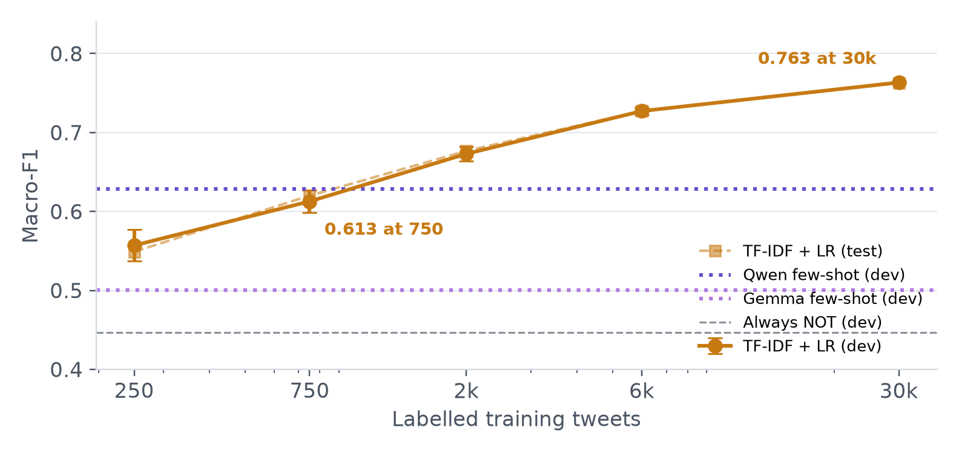
3 · Baseline on the frozen test set
TF-IDF + logistic regression reaches 0.763 macro-F1 on test, but 0.620 with 750 labels
System | Test macro-F1 | OFF P | OFF R | Spread
Always “not offensive” | 0.500 | — | 0.000 | deterministic
TF-IDF + LR, 750 labels | 0.620 ± 0.012 | — | — | sd over 10 samples
TF-IDF + LR, 30,000 labels | 0.763 | 0.589 | 0.673 | 95% CI [0.745, 0.779]
Dev curve (solid) and test curve (dashed) for the same TF-IDF runs. The LLM lines are flat because the LLM always gets 750 labels. BERTurk joins this chart after the final runs.
WHAT THIS MEANS FOR THE RESEARCH QUESTION
At 750 labels, the cheap baseline is 0.620 on test and 0.613 on dev: that is the floor BERTurk and the LLMs must beat. At 30,000 labels the same model reaches 0.763, about 0.05 below the published BERTurk score (0.816, KUISAIL), so the full-data ceiling is not the target of the 750-label question.
Team 10 · J · CSE 484 / CSE 654 · Mid-project, 12 November 2026
3
Notes:
This is the baseline row the rubric asks for: frozen test set, spread shown. The full-data TF-IDF is deterministic, so its uncertainty is only test-set luck, measured by a 10,000-resample bootstrap: [0.745, 0.779]. At 750 labels the uncertainty is which 750 tweets were labelled, so we show the standard deviation over ten random samples. The test set was scored once for this deterministic baseline; no method run has touched it.

Slide 4
4 · Error analysis
275 dev errors; a 60-error audit shows where a word model fails
False alarms (166) — category | n
No insult; spurious word/char cue | 9
Political or religious criticism | 10
Sports criticism or banter | 5
Personal criticism not judged offensive | 3
Sarcasm or irony | 1
Label noise or genuinely ambiguous | 2
Missed offensive (109) — category | n
Implicit insult, no profanity | 8
Masked or abbreviated profanity | 5
Veiled threat or violence | 3
Political or religious insult | 4
Institutional or sports criticism | 3
Label noise or not offensive | 7
Counts are in the 60-error audit (30 per direction, seed 42), not over all 275 errors. Both tables therefore sum to 30.
False alarm · F2 · id 35124
Miss · M1 · id 43325
Miss · M2 · id 15069
“Hırsız tabloyu çalarken Işık’ları yakan ev sahibi gibisin İmamoğlu…”
“…bundan daha parazit canlı türü yok”
“…bakanlık seçimi kaldı amkk”
Political accusation; no target insult. Conflict vocabulary fires.
“No more parasitic species”: an insult with no swear word.
Masked profanity (“amkk”) is unseen by the word/char model.
Lesson: false alarms cluster on political conflict vocabulary and character n-grams; misses cluster on implicit insults and masked profanity. Roughly one in seven audited errors is label noise or a genuinely ambiguous tweet — no threshold can fix that. We will use this audit to choose prompt examples and to report an annotation-noise ceiling.
Team 10 · J · CSE 484 / CSE 654 · Mid-project, 12 November 2026
4
Notes:
We audited 30 false alarms and 30 misses, sampled with seed 42 within each direction. The categories and counts are in the appendix. The main finding: the model reacts to conflict vocabulary, not to whether a person is insulted. It also misses implicit insults and masked swearing. Almost 15% of the audited errors are label noise, so the achievable ceiling is below 1.0.

Slide 5
5 · Method status
The LLM arm runs end-to-end: 8 examples + 742 calibration labels
1
750 labelled tweets
Controlled change: baseline trains weights on the 750 labels; the LLM uses the identical 750 labels to pick 8 examples and a threshold. Nothing else differs except how the labels are used.
One random sample, shared with every system
2
8 prompt examples
System (dev, 1,756 tweets) | Macro-F1 | Runs | Threshold
TF-IDF + LR, 750 labels | 0.613 ± 0.015 | 10 | —
Qwen3-8B, zero-shot | 0.162 | 1 | 0
Qwen3-8B, 8 examples + 742 | 0.628 | 3 | 3.13, 2.75, 2.50
Gemma-2-9B, zero-shot | 0.412 | 1 | 0
Gemma-2-9B, 8 examples + 742 | 0.500 | 3 | 0.63, 0.25, 0.88
BERTurk, 750 labels | running | 10 | —
4 offensive, 4 not; fixed per run
3
742 calibration tweets
The LLM scores these too; choose the threshold with best macro-F1
4
Apply to dev
Score = log P(A) − log P(B); A = offensive, B = not
Gemma-2-9B runs in 4-bit on an L4 with float16-compatible settings; Qwen3-8B runs with thinking mode off. Both use the same Turkish instructions and answer options. BERTurk joins when the 10 runs finish.
Team 10 · J · CSE 484 / CSE 654 · Mid-project, 12 November 2026
5
Notes:
This is the method-progress slide. The LLM never writes a free answer: we read the probability of A versus B at the answer token. The 8 examples are drawn from the same 750 tweets, and the other 742 choose the threshold. That makes the label budget identical to BERTurk's. We have first dev numbers for Qwen and Gemma, zero-shot and few-shot; BERTurk is running.

Slide 6
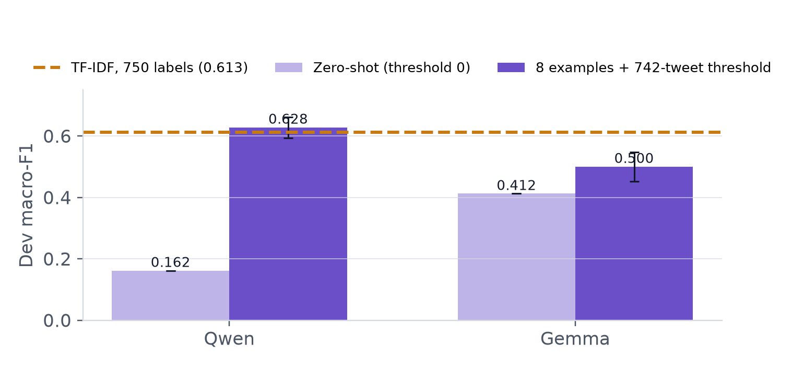
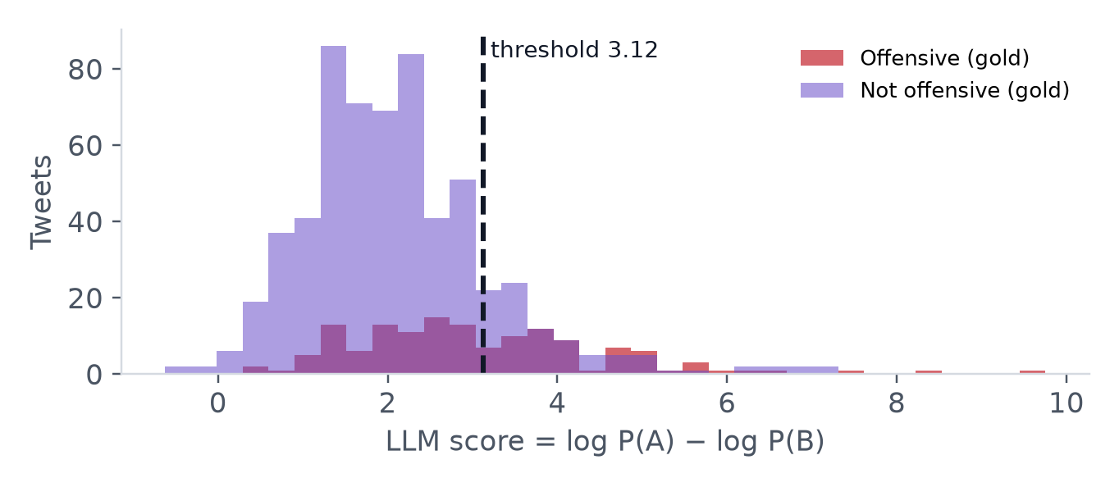
6 · First comparison on dev
First comparison on dev: calibration moves both LLMs; BERTurk is still running
Comparison (dev) | Macro-F1 | vs TF-IDF 750
TF-IDF, 750 labels | 0.613 ± 0.015 | —
Qwen3-8B, zero-shot | 0.162 | -0.451
Qwen3-8B, calibrated | 0.628 | +0.015
Gemma-2-9B, zero-shot | 0.412 | -0.201
Gemma-2-9B, calibrated | 0.500 | -0.113
WHAT WE CAN AND CANNOT SAY
Calibration changes the LLM result by +0.466 (Qwen) and +0.088 (Gemma) against zero-shot. Neither is a BERTurk comparison: BERTurk’s 750-label runs are still running. These are dev numbers; the test-set answer is computed only after all methods are frozen. The paired bootstrap is fixed in advance and will be applied to the final test predictions.
One Qwen3-8B run: scores on the 742 calibration tweets. The chosen threshold sits between the two gold classes; this is the only use of those 742 labels.
Team 10 · J · CSE 484 / CSE 654 · Mid-project, 12 November 2026
6
Notes:
Two findings so far. First, threshold calibration is necessary: zero-shot scores are poorly centred because the examples are balanced while the data are not. Second, after calibration the LLMs are still below the cheap 750-label baseline on dev. That is a method-status result, not the answer to the research question: BERTurk is the other side of the comparison and is still running.

Slide 7
7 · Stronger models and why Qwen separated the classes
Stronger multilingual models close the gap; Gemma 4 12B reaches 0.794
Model (dev) | Zero-shot | Calibrated | Δ | Calib-set F1
Qwen3-8B | 0.162 | 0.628 ± 0.034 | +0.466 | 0.640
Gemma-2-9B | 0.412 | 0.500 ± 0.048 | +0.088 | 0.492
Qwen3-14B | 0.171 | 0.778 ± 0.001 | +0.607 | 0.786
Gemma-4-12B | 0.763 | 0.794 ± 0.004 | +0.031 | 0.814
THREE CANDIDATES, ONE RULED OUT
1. Tokenizer fertility is not the explanation: on 500 dev tweets Gemma tokenizers are more compact than Qwen (32.3 vs 37.9 tokens/tweet), yet Qwen calibrates better.
2. Pretraining language is plausible: Qwen3 is pretrained on 119 languages including Turkish; Gemma 2 is English-centred. [INFERENCE from model cards, not a controlled ablation.]
3. Score geometry: Qwen’s zero-shot scores are shifted but more linearly separable; one threshold recovers more (0.65 vs 0.48 calibration-set macro-F1).
Dev, 1,756 tweets. Three runs for the 8B/9B pair, two for the stronger pair; zero-shot is one deterministic pass. Calib-set F1 is macro-F1 on the 742 threshold-selection tweets.
The stronger-model rows test whether scale and newer multilingual data close the gap. They do not isolate one cause: pretraining, alignment and answer-token priors are confounded.
WHAT THIS SHOWS AND WHAT IT DOES NOT
It shows that the value of 742 calibration labels is model-dependent: Qwen3-8B turns them into +0.47, Gemma-2 into +0.09, while Qwen3-14B reaches 0.778 and Gemma-4-12B 0.794 (two runs each; Gemma-4 zero-shot is already 0.763). It does not show that Turkish pretraining alone causes the gap. The clean test would compare two checkpoints from the same family, identical size and alignment, one Turkish-heavy and one English-heavy, or continue pretraining on Turkish. That is out of scope for the mid-project; we report it as a hypothesis with the evidence above.
Team 10 · J · CSE 484 / CSE 654 · Mid-project, 12 November 2026
7
Notes:
This slide answers why Qwen looked better. The tokenizer explanation is ruled out by direct measurement: Gemma is more compact on these tweets. The remaining candidates are pretraining language and score geometry. We are explicit that this is a hypothesis, not a controlled ablation; the new Qwen3-14B and Gemma-4-12B rows test scale and newer multilingual data.

Slide 8
8 · Cost and throughput
One dev pass on an L4: 3–5 tweets/s with examples, 10–18 without
System | Params | Dev scoring | Throughput | Peak VRAM | Notes
TF-IDF, 750 | — | 0.6 s | ~3,100/s | CPU | fit 1.0 s
TF-IDF, 30,000 | — | 0.6 s | ~3,100/s | CPU | fit 14.6 s
Qwen3-8B, few-shot | 8.2B | 355 s | 5.0/s | — | 3 runs
Gemma-2-9B, few-shot | 9.2B | 430 s | 4.1/s | — | 3 runs
Qwen3-14B, few-shot | 14.8B | 644 s | 2.7/s | — | 2 runs
Gemma-4-12B, few-shot | 12.0B | 579 s | 3.0/s | — | 2 runs
Qwen3-14B, zero-shot | 14.8B | 180 s | 9.8/s | 10.7 GB | load 157 s · 1,290 tok/s
All times are for scoring the 1,756 dev tweets; model download and load are excluded unless stated. Few-shot throughput is 3–4× lower than zero-shot because each prompt adds 8 examples (~600 tokens).
Measured on one L4, 4-bit NF4, batch 6–8. Qwen3-14B zero-shot: load 157 s, 1,290 prompt tokens/s, peak 10.7 GB. Gemma-4-26B-A4B exceeded 22 GB and could not load. Reported runs: 8.8 Colab units (~2.3 L4-hours); 9.7 units including allocation probes.
Team 10 · J · CSE 484 / CSE 654 · Mid-project, 12 November 2026
8
Notes:
The cost view the user asked for: scoring throughput, wall time, load time and peak memory. Few-shot is much slower because the prompt repeats 8 examples for every tweet. TF-IDF is four orders of magnitude cheaper but 0.17 macro-F1 behind Gemma-4-12B.

Slide 9
9 · Plan to the final
Every remaining run has a date; owners will be confirmed by the team
Date | Experiment | Owner | Status
12 Nov | Mid-project talk; freeze this deck | TBD | today
13–16 Nov | BERTurk 750 (10 runs) and 30,000 (3 runs) on dev | TBD | running
17–20 Nov | Ablation A: BERTurk vs XLM-R-base, 750 labels, 10 runs | TBD | planned
21–24 Nov | Ablation B: Gemma with English instructions, 3 runs | TBD | planned
25–27 Nov | Zero-shot references + test-contamination check | TBD | planned
28–30 Nov | Freeze methods; open test; final runs for every system | TBD | planned
1–5 Dec | Paired bootstrap, final error analysis, paper draft | TBD | planned
8 Dec | Final report (short research paper) | TBD | planned
BIGGEST RISK
A 26B+ model may not fit the L4: Gemma 4 26B-A4B OOM’d at 22 GB, so we used the 12B dense model. Fallback: Qwen3-14B alone. Every run writes one CSV and a JSON, so a lost session costs one run, not the experiment.
RESULT RISK
The lines may never cross. The 750-label question still has a clear answer; the learning curve is descriptive, with no significance test at the other sizes.
Response to proposal feedback: the rubric asks for baseline numbers on the frozen test set, so we scored the deterministic TF-IDF baseline once on test and kept all method results on dev. The research question and the 0.02 / bootstrap rules are unchanged.
Team 10 · J · CSE 484 / CSE 654 · Mid-project, 12 November 2026
9
Notes:
The plan keeps one controlled change per experiment. Ablation A isolates Turkish-only pretraining: BERTurk versus multilingual XLM-R at 750 labels. Ablation B isolates instruction language for Gemma, the English-centred model. The test set opens only after methods are frozen, to avoid tuning on it. The fallback is Qwen alone if Gemma becomes unusable.

Slide 10
10 · Takeaways
What we know, what we do not, and what comes next
0.763
test macro-F1 for the TF-IDF baseline at 30,000 labels; 95% CI [0.745, 0.779]. At 750 labels it falls to 0.620 ± 0.012.
0.794
Gemma-4-12B dev macro-F1 after calibration; zero-shot is 0.763. Qwen3-14B reaches 0.778.
pending
BERTurk-750 is the missing row. The 10 BERTurk runs will decide the research question; the comparison and bootstrap are already fixed.
The mid-project answer is a baseline and a working method, not the final verdict. What we do not have yet: BERTurk’s 750-label numbers and any test-set method result. What is fixed: the frozen test set, the metric, the 0.02 threshold and the paired bootstrap.
Questions welcome — any member can answer any part.
Team 10 · J · CSE 484 / CSE 654 · Mid-project, 12 November 2026
10
Notes:
Close with the three numbers: the baseline floor on test, the first calibrated LLM number on dev, and the missing BERTurk row. The final answer will use the frozen test set and the paired bootstrap fixed in the proposal. Thank you.

Slide 11
Project Card · appendix (graded, not presented)
Fields 1–3: title and abstract, research question, contributions
1 · TITLE AND ABSTRACT
Working title: Fine-tuning BERTurk vs threshold-calibrated open LLMs for Turkish offensive language with 750 labels
Small Turkish platforms can label only a few hundred tweets. We ask whether fine-tuning BERTurk on 750 labelled OffensEval-TR tweets beats an open LLM that uses the same 750 labels as 8 prompt examples and 742 calibration tweets for its decision threshold. The TF-IDF + logistic-regression baseline scores 0.763 macro-F1 on the frozen 3,528-tweet test set, but 0.620 with 750 labels. We implemented the LLM arm end-to-end: Qwen3-8B and Gemma-2-9B score each tweet as log P(A) − log P(B), and the threshold is chosen on the 742 held-out labels. On dev, calibration moves Qwen3-8B from 0.162 to 0.628 and Gemma-2-9B from 0.412 to 0.500. [GAP: BERTurk-750 test result, pending.] The final paper reports the paired bootstrap gap and the label count at which fine-tuning overtakes the LLM line.
2 · RESEARCH QUESTION
3 · CONTRIBUTIONS (TESTABLE CLAIMS)
Unchanged from the proposal. With 750 labelled tweets, does fine-tuning BERTurk beat prompting Gemma-2-9B-it or Qwen3-8B that uses the same 750 tweets (8 examples, 742 threshold labels), on macro-F1 over the official 3,528-tweet test set?
C1. At 750 labels, BERTurk’s mean test macro-F1 is at least 0.02 above each LLM’s, and a paired bootstrap rejects chance. This is the core claim and is currently pending BERTurk.
C2. Choosing the threshold on the 742 non-example labels improves each LLM’s dev macro-F1 over zero-shot by a measurable margin; we report the per-model delta and its run-to-run spread.
“No” result: against either LLM, BERTurk’s mean over 10 runs is not ≥0.02 higher than the LLM’s mean over 3 runs, or the paired bootstrap says the gap could be chance (p ≥ 0.05).
C3. The learning curve places the label count where fine-tuning overtakes the LLM line between 250 and 6,000; if the lines never cross, the 750-label answer still stands.
Change: none. The data and method forced no change; the mid-project rubric added a test-set baseline, which is reported separately and does not alter the question.
Team 10 · J · CSE 484 / CSE 654 · Mid-project, 12 November 2026
11
Notes:
Project Card fields 1-3. The abstract is under 150 words and marks the one missing number, BERTurk's result. The research question is unchanged; the rubric's test-set baseline is additive.

Slide 12
Project Card · appendix
Fields 4–5: related work and data
4 · RELATED WORK (5–8 REFERENCES; ONE LINE ON THE DIFFERENCE)
5 · DATA
Zampieri et al. (2020). SemEval-2020 Task 12: Multilingual Offensive Language Identification in Social Media (OffensEval 2020).
Source: OffensEval-TR 2020, “A Corpus of Turkish Offensive Language” (Çöltekin, LREC 2020), https://coltekin.github.io/offensive-turkish/. Licence: annotations CC BY 2.0. Language: Turkish tweets; @USER/URL already masked in the release.
Top Turkish systems fine-tune transformers on the full training data; no label-budget comparison.
Çöltekin (2020). A Corpus of Turkish Offensive Language. LREC 2020.
The dataset we use; provides labels but no fine-tuning-vs-prompting comparison.
Zampieri et al. (2023). OffensEval 2023: Offensive Language Identification in the Age of Large Language Models. Natural Language Engineering.
Split | Tweets | OFF | OFF %
Official train | 31,756 | 6,131 | 19.3
Our train | 30,000 | 5,792 | 19.3
Dev | 1,756 | 339 | 19.3
Test (frozen) | 3,528 | 716 | 20.3
Zero-shot LLMs; Turkish only Flan-T5-large (0.451). No examples and no threshold calibration.
Dehghan & Yanıkoğlu (2024). Evaluating ChatGPT’s Ability to Detect Hate Speech in Turkish Tweets. CASE 2024, pp. 54–59.
ChatGPT with 7 examples vs fine-tuned BERTurk on one Turkish hate dataset; one training size.
Pecher, Srba & Bielikova (2025). Comparing Specialised Small and General Large Language Models on Text Classification. EMNLP 2025, pp. 165–184.
English break-even near 100 labels; we test a noisy Turkish two-class task with run variance.
After preprocessing: only the released @USER/URL masking; no lowercasing or deletion. 9 duplicate texts in train; 1 test/train overlap. Example (OFF, id 33518):
Schmitt & Schweter (2025). SindBERT, arXiv:2510.21364.
Turkish encoders on OffensEval-TR with full data only; no LLMs or small label budgets.
“Kırmızı ağır karar Allah belanı versin”
Şeker, Uludoğan, Önal & Özgür (2025). HATECAT-TR: A Turkish Hate Speech Dataset. Findings of EMNLP 2025.
“A red card is a harsh call, God damn you.”
Turkish span-level hate; BERTurk 0.59 vs LLaMA-3.3-70B 0.53. We classify whole tweets and score probabilities.
Karakaş & Şimşek (2026). arXiv:2606.29614.
No labelled data of our own; no agreement study needed.
Zero-shot LLMs vs BERTurk on Turkish sentiment at one size; we add examples, calibration and a label curve.
Team 10 · J · CSE 484 / CSE 654 · Mid-project, 12 November 2026
12
Notes:
Fields 4 and 5. Eight references, each with the specific gap. The data counts are after our stratified split; the test set is the official one.

Slide 13
Project Card · appendix
Fields 6–9: method, protocol, results so far, error analysis
6 · METHOD AND BASELINE
7 · EVALUATION PROTOCOL
Baseline as run: TF-IDF word 1–2-grams + char_wb 2–5-grams, min_df=2, sublinear, Turkish-aware lowercasing; logistic regression C=1.0, class_weight=balanced, max_iter=5000. Test 0.763 [0.745, 0.779].
Macro-F1; frozen 3,528-tweet test; 10 BERTurk runs at 250/750/2,000 and 3 at 6,000/30,000; 3 LLM runs at 750. Paired bootstrap, 10,000 resamples: a gap is real only if BERTurk wins on ≥95% and the mean gap is ≥0.02. Fixed before method results; dev is for code checks only.
Method implemented: Qwen3-8B and Gemma-2-9B in 4-bit; Turkish instructions, A/B options, 8 examples (4+4), score log P(A) − log P(B); threshold maximises macro-F1 on the other 742 labels. One change vs baseline: labels train weights vs choose examples and a threshold.
Compute used: about 2.3 L4-hours (8.8 Colab units) for 14 LLM passes; about 18 GPU-hours needed for the final (proposal), free Colab only.
8 · RESULTS SO FAR (MEAN ± SD OR 95% INTERVAL)
System | Dev | Test
Always NOT | 0.447 | 0.500
TF-IDF, 750 | 0.613 ± 0.015 | 0.620 ± 0.012
TF-IDF, 30,000 | 0.763 [0.739, 0.787] | 0.763 [0.745, 0.779]
Qwen3-8B zero-shot | 0.162 | —
Qwen3-8B calibrated | 0.628 ± 0.034 | —
Qwen3-14B zero-shot | 0.171 | —
Qwen3-14B calibrated | 0.778 ± 0.001 | —
System | Dev | Test
Gemma-2-9B zero-shot | 0.412 | —
Gemma-2-9B calibrated | 0.500 ± 0.048 | —
Gemma-4-12B zero-shot | 0.763 | —
Gemma-4-12B calibrated | 0.794 ± 0.004 | —
BERTurk, 750 | running | —
9 · ERROR ANALYSIS — 60 AUDITED OF 275 DEV ERRORS, ONE EXAMPLE PER CATEGORY
False alarms (166) | n | Example
No insult / spurious cue | 9 | 12420 · fan poll; no insult
Political/religious criticism | 10 | 35124 · “Hırsız… İmamoğlu”
Sports criticism/banter | 5 | 13105 · “padişahlık zannediyor”
Personal criticism | 3 | 22409 · “fake hesapları sevmiyorum”
Sarcasm/irony | 1 | 28737 · “Ha bi sen eksiktin”
Label noise/ambiguous | 2 | 33218 · “Seni cehennem paklar”
Missed offensive (109) | n | Example
Implicit insult | 8 | 43325 · “parazit canlı türü yok”
Masked profanity | 5 | 15069 · “…kaldı amkk”
Veiled threat/violence | 3 | 35789 · “idam edicem”
Political/religious insult | 4 | 25929 · “Gerici yobazlar”
Institutional/sports criticism | 3 | 20333 · “ÖSYM… güvenmeyebilir”
Label noise / not offensive | 7 | 10001 · “veteriner okumaya…”
Team 10 · J · CSE 484 / CSE 654 · Mid-project, 12 November 2026
13
Notes:
Fields 6-9. The results table has the baseline rows filled and method rows on dev only; BERTurk is marked running. Field 9 gives one example per category, as the rubric asks.

Slide 14
Project Card · appendix
Fields 10–12: research lead, plan and risk, reproducibility
10 · RESEARCH LEAD SECTION — VESILE HAN (CSE 654), FINE-TUNING SIDE; GÜRKAN GÖZTEPELI (CSE 654), PROMPTING SIDE
Vesile Han. (1) Pecher, Srba & Bielikova, EMNLP 2025: small fine-tuned models catch up with general LLMs after about 100 labels on average, but need more on two-class tasks and once run variance is counted; all eight datasets are English. We test Turkish, a suffix-heavy language, on a noisy two-class task with 19.3% offensive tweets. (2) Schmitt & Schweter, SindBERT, arXiv:2510.21364 (2025): compare Turkish encoders on OffensEval-TR only with full training data, no LLMs and no small sizes. We add both. Ablation A: BERTurk vs multilingual XLM-R-base at 750 labels, 10 runs each. Published comparison: KUISAIL reports plain fine-tuned BERTurk at 0.816 on this test set; our 30,000-label run should reproduce it.
Gürkan Göztepeli. (1) Şeker, Uludoğan, Önal & Özgür, HATECAT-TR, Findings of EMNLP 2025: fine-tuned BERTurk (0.59 F1) beat LLaMA-3.3-70B with a few examples (0.53) on Turkish hate-span detection; one training set, span labels. We classify whole tweets, vary the label budget, and read probabilities so every answer is valid. (2) Karakaş & Şimşek, arXiv:2606.29614 (2026): zero-shot open LLMs vs fine-tuned BERTurk on Turkish review sentiment at one size. We add examples, threshold calibration and a label curve. Ablation B: Gemma-2-9B with English instructions, same examples and threshold method, 3 runs.
11 · PLAN AND RISK
12 · REPRODUCIBILITY
13–16 Nov: BERTurk 750 (10) + 30k (3). 17–20 Nov: Ablation A XLM-R. 21–24 Nov: Ablation B English instructions. 25–27 Nov: zero-shot + contamination check. 28–30 Nov: freeze methods, open test, final runs. 1–5 Dec: bootstrap, error analysis, paper. 8 Dec: final report. Owners to be confirmed.
Repository: github.com/paysis/offenseval-tr-midproject (code, splits, saved predictions, results JSON). One command: bash scripts/reproduce.sh gpu. Seeds: split 42, subsets 42+k, bootstrap 42. Versions: Python 3.13.16 on Colab (3.14.8 local), scikit-learn 1.9.1, transformers 5.22.1, torch 2.14.1, bitsandbytes 4-bit NF4.
Biggest risk: a 26B+ model may not fit the L4; Gemma-4-26B-A4B OOM’d at 22 GB, so we used the 12B dense model. Fallback: Qwen3-14B alone. Result risk: the lines may never cross; the 750-label answer still stands. Contamination: give each LLM the first 200 test tweets and report exact completions. Proposal feedback: rubric asked for a test-set baseline; we scored the deterministic baseline once and kept methods on dev.
Roles: not decided yet; the team will assign them. AI tools: a coding assistant was used for code, analysis and drafting; every number in this deck is read from the saved result files and was checked by the team.
Team 10 · J · CSE 484 / CSE 654 · Mid-project, 12 November 2026
14
Notes:
Fields 10-12. Both research leads wrote their own section. The reproducibility line names the repo, one command, seeds, versions, roles and AI use.

