Slide 1
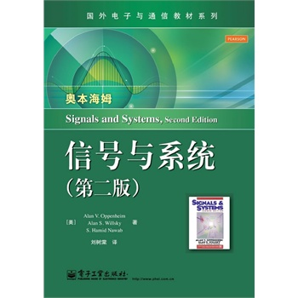
Signals and Systems
---L21
何春 电子科技大学 通信与信息工程学院

Slide 2
Chapter 7
Sampling

Slide 3
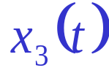


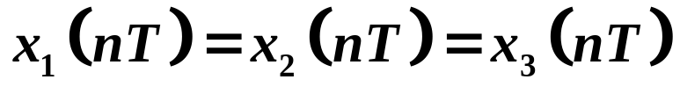
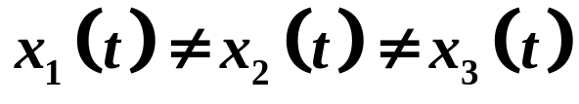
Continuous
Signal
sampling
Discrete
Signal
Code
Digital
Signal
Continuous
Signal
D/A
DSP
-T 0 T 2T t

Slide 4
Contents
The concept of sampling and the sampling theorem
The process of reconstructing a continuous-time signal from its samples

Slide 5


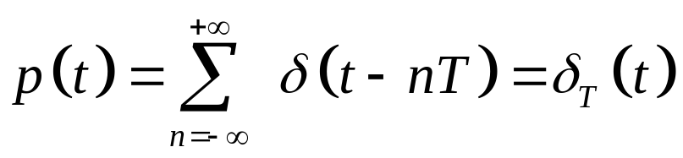



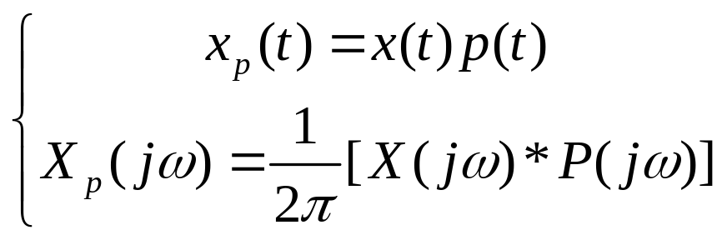
7.1 Representation of a Continuous-time Signal by
its Samples: The Sampling Theorem
7.1.1 Impulse-train Sampling
-3T -2T -T 0 T 2T 3T 4T t

Slide 6
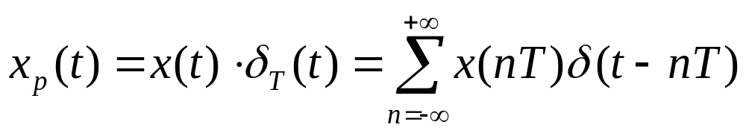
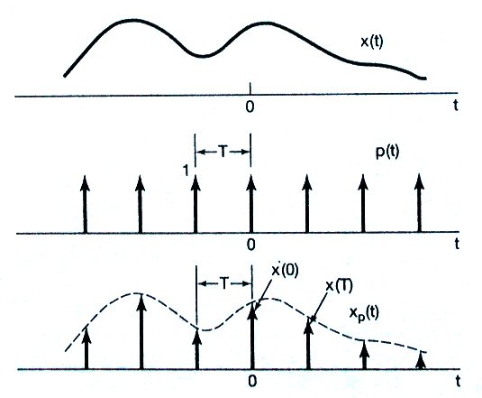
Time domain:

Slide 7
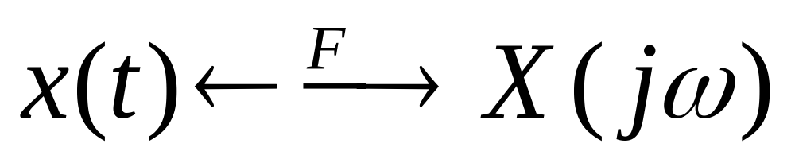
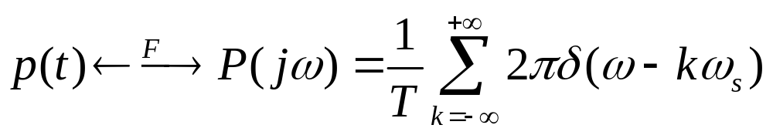
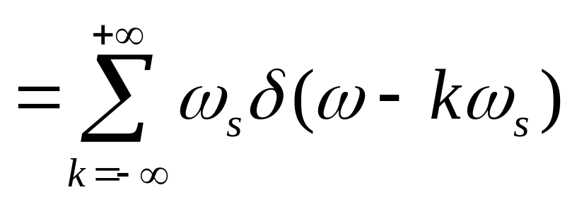
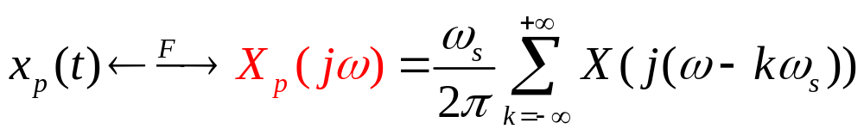
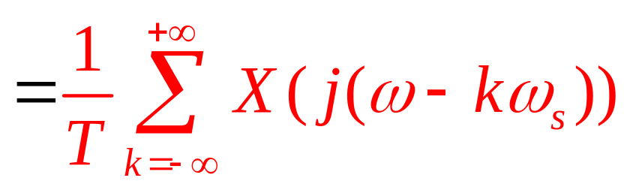
Frequency domain:

Slide 8
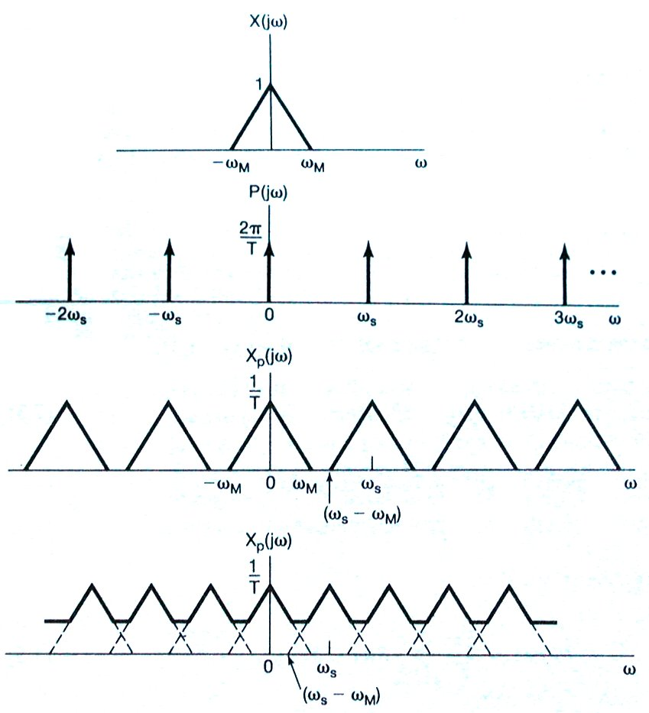
Frequency domain:

Slide 9
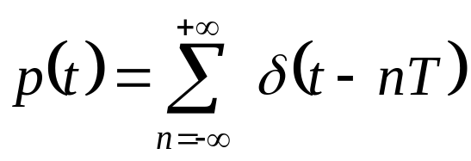


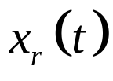





(2) (Shannon) Sampling theorem
Let x(t) be a band-limited signal with
X(j ω)=0 for |ω|> ω_{M} . Then x(t) is uniquely determined by its samples x(nT),n=0,±1,±2,…, if
ω_{s}>2 ω_{M}, where ω_{s}=2π/T .
Note: 2ω_{M} is called Nyquist Rate.
( Minimum distortionless sampling frequency )
Reconstruction
Sampling

Slide 10
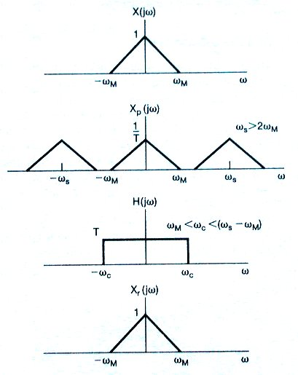
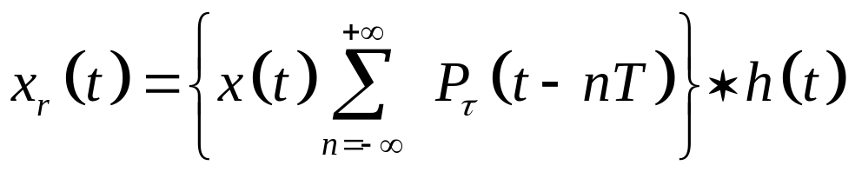
(3) Recovery
Normally,
ω_{c}= ω_{s} / 2

Slide 11
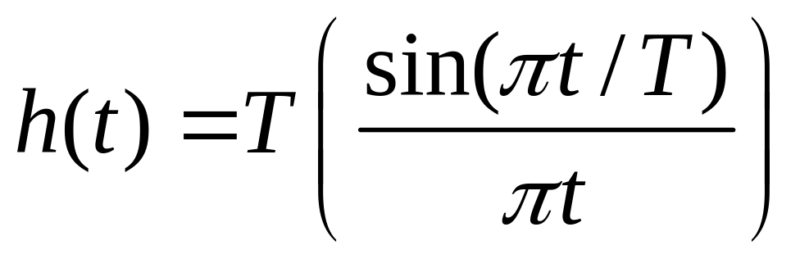
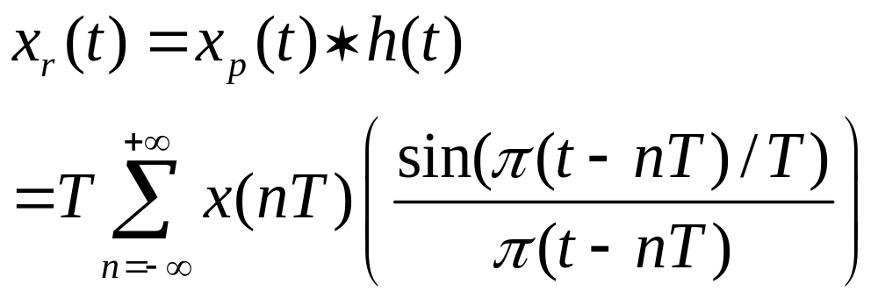
When
ω_{c}= ω_{s} / 2,
From (4.19),we know

Slide 12
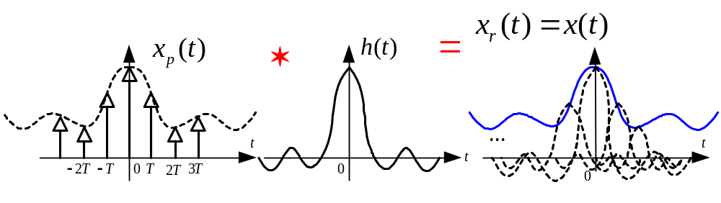
It is called as interpolation.

Slide 13
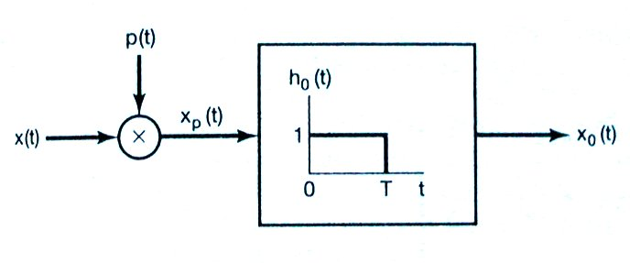
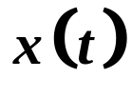
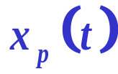
7.1.2 Sampling with a Zero-order Hold
(1) Sampling system construction:
-3T -2T -T 0 T 2T 3T 4T t

Slide 14
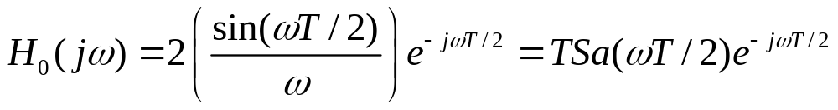
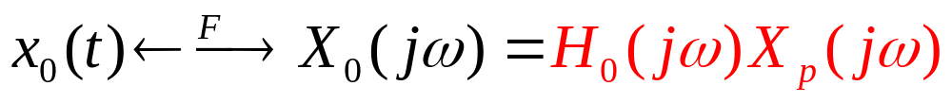
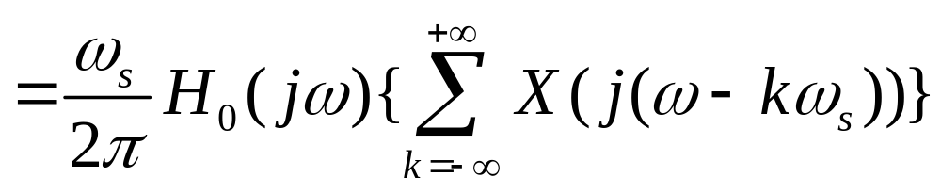
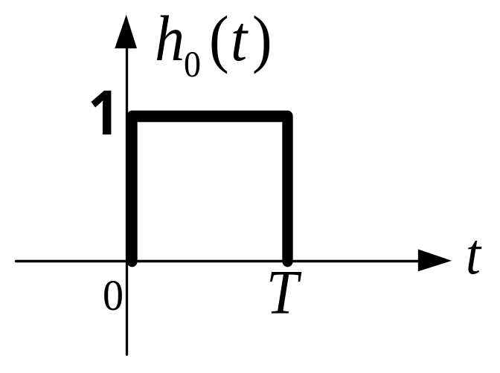
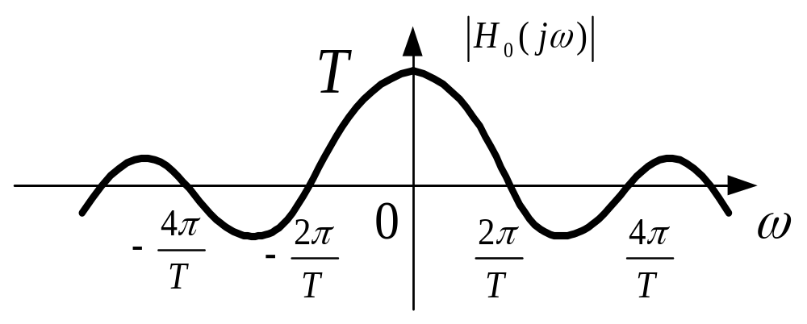

Slide 15









(2) Signal Recovery
Reconstruction
Filter
Zero-Order
Hold
LPF
Impulse-Train
Sampling

Slide 16
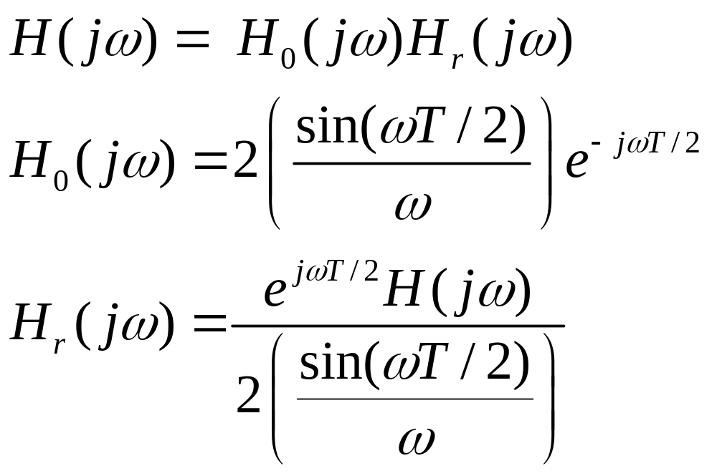

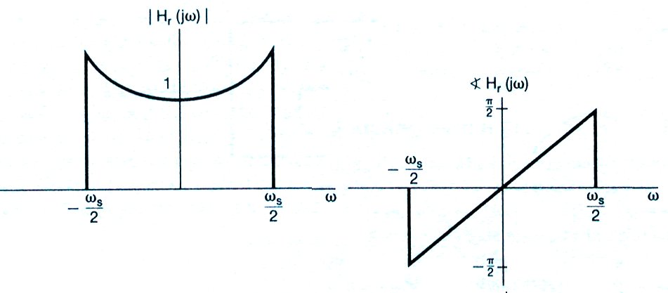
Magnitude and phase response of

Slide 17
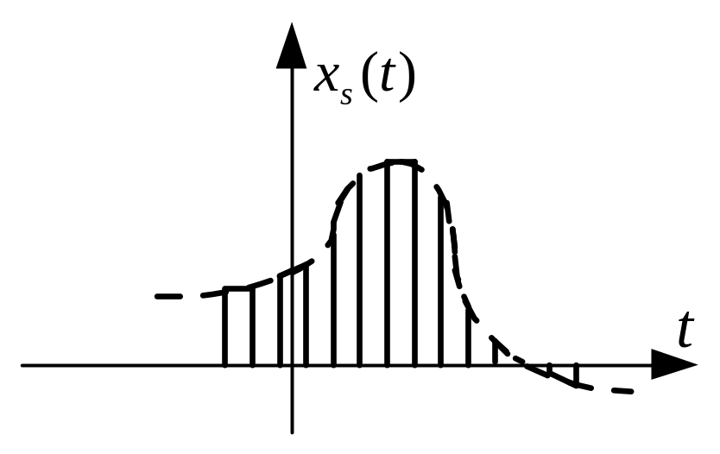
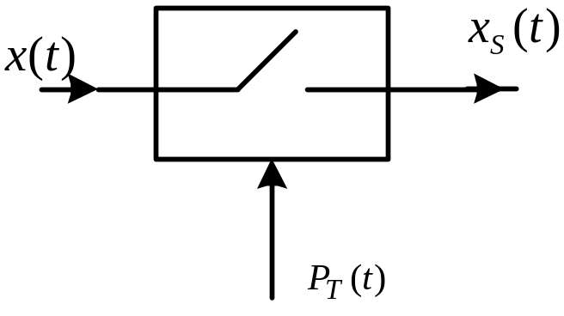
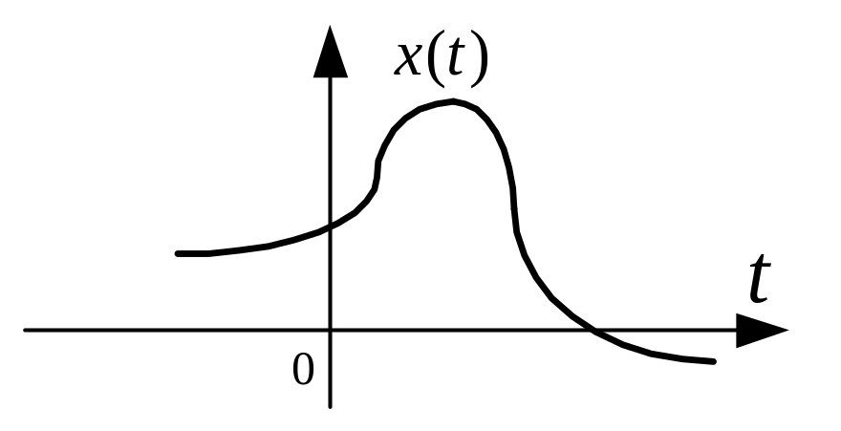
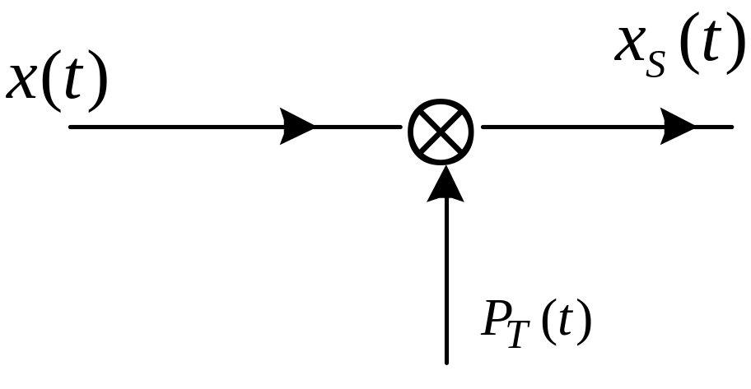
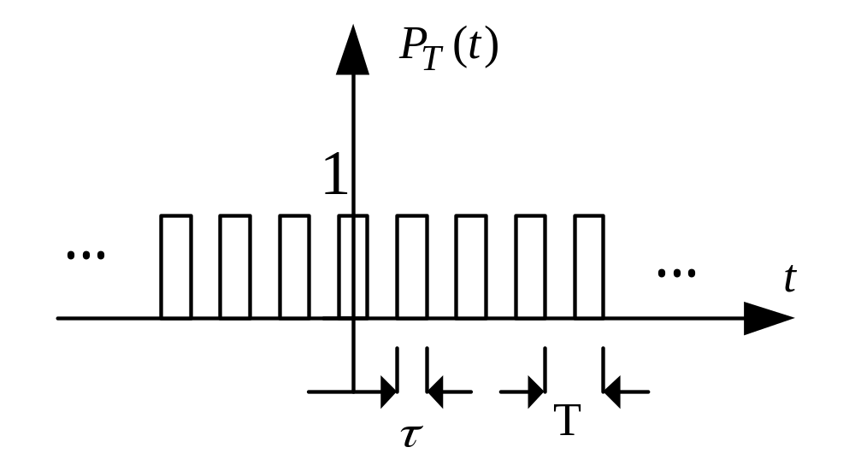
Note: Actually sampling

Slide 18
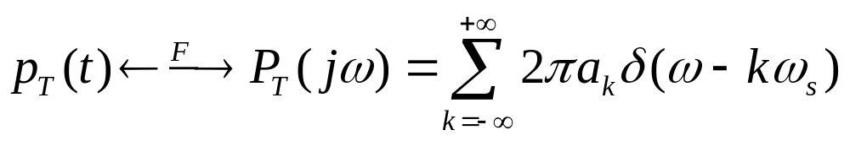
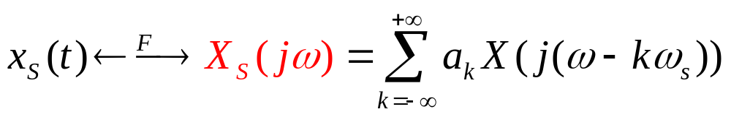

The sampling theory should be hold as before.
ω_{s}>2 ω_{M}, where ω_{s}=2π/T .
Reconstruction

Slide 19
7.2 Reconstruction of a signal from its samples using interpolation
Interpolation (内插) is the fitting of a continuous signal to a set of sample values.
Interpolation is commonly used to reconstructing a function, either approximately or exactly, from samples.

Slide 20
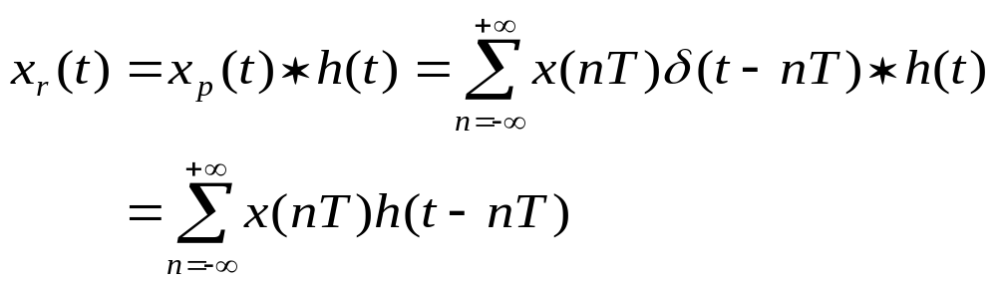
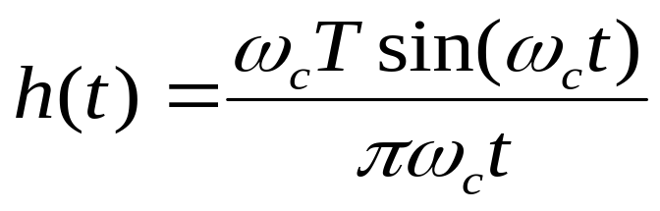
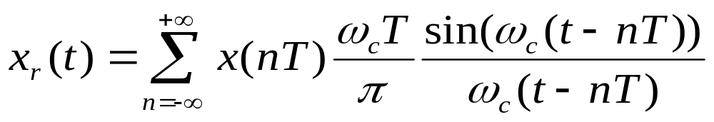
Sampling
Reconstruction
band-limited interpolation

Slide 21
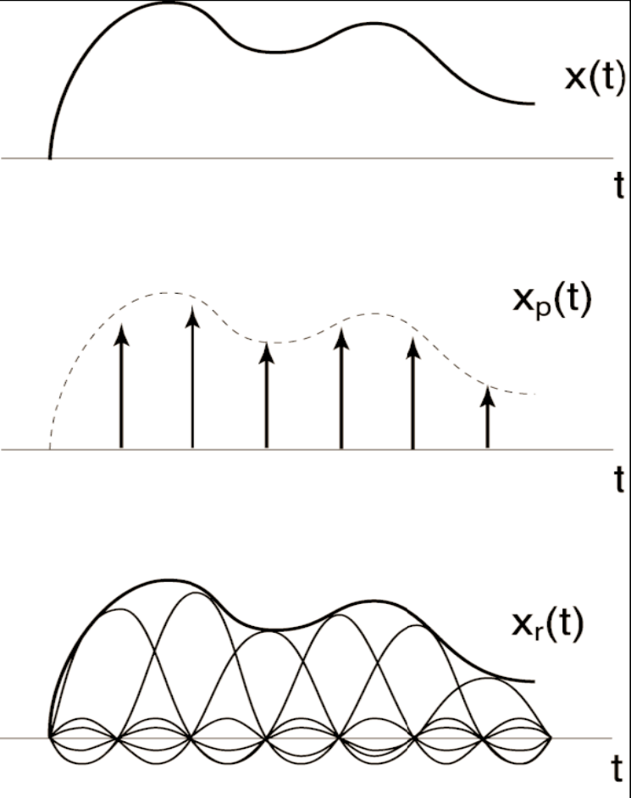
Graphic Illustration of Time-domain Interpolation
Original CT signal
After sampling
The LPF smoothes out sharp edges and fill in the gaps.
After passing the LPF

Slide 22
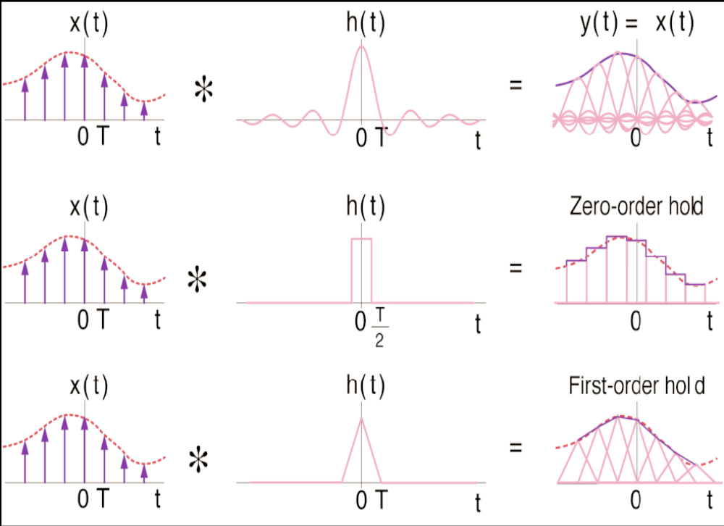
Commonly Used Interpolation Methods
Bandlimited Interpolation
• Zero-Order Hold (E.g. movie projection)
• First-Order Hold —Linear interpolation, Commonly used in plotting.
The zero-order hold of interpolation is a rough interpolation;
Higher order holds can be a smoother interpolation strategy.

Slide 23

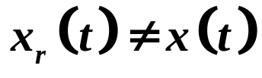
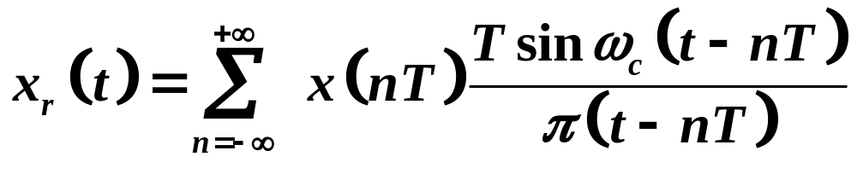
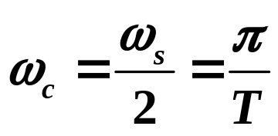
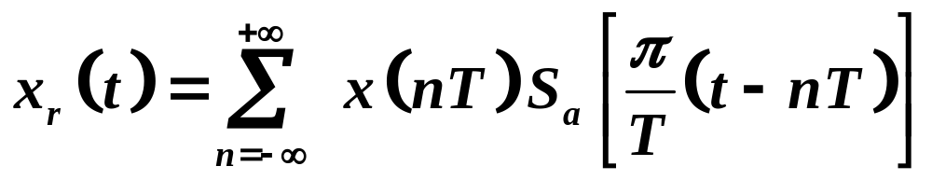
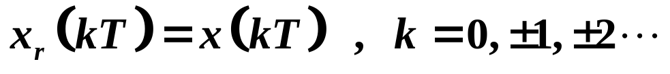
7.3 The Effect of Undersampling: Aliasing
Let

Slide 24
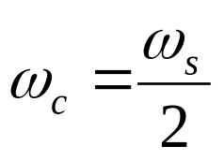
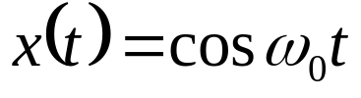











1. Consider a sinusoidal signal
Fix , change
Figure (a)

Slide 25



Slide 26




Figure (b)

Slide 27






Figure (c)

Slide 28







Figure (d)

Slide 29




Slide 30





When aliasing occurs,
2. Consider a sinusoidal signal

Slide 31









Slide 32








3.

Slide 33



Application Example: Strobe Effect
Rotating
disc
Figure 7.18
Strobe
The speed of rotation of the disc is perceived correctly.
The rotation appears to be at a lower frequency than is
actually the case.
Furthermore, because of phase reversal, the disc will appear
to be rotating in the wrong direction.

Slide 34


Slide 35
Chapter 7
Sampling
HW7: 7.1 7.2 7.3 7.6 7.9

