Slide 1

VesselAI, 2022: Information Extraction from PDFs, User Guide
This project has received funding from the European Union’s Horizon 2020 research and innovation programme under grant agreement No 957237.

Slide 2
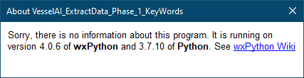
Trying to find marine engine specs & manuals from Internet sources (PDF format)
We want to test how automatic extraction of information from PDF files would work
The PDF files describe the performance of ship engines
This presentation describes 4 Python programs, 3 first of which together implement a workflow for such information extraction from PDF files; NN version is separate
VesselAI_ExtractData_1.py
VesselAI_ExtractData_2.py
VesselAI_ExtractData_3.py
VesselAI_ExtractData_NN.py
The programs were written using Anaconda Python, and wxPython UI library
Introduction / general information in slides 2-12, the workflow & programs are described in slides 13-19, and installation instructions are in slides 20-22.

Slide 3
PDFs from largest ship engine manufacturers
It was decided that we start with the 3 largest marine engine companies: Wärtsilä, MAN, and Caterpillar
We downloaded all “technical looking” PDFs that consider marine engines
From Wärtsilä we downloaded 14 PDFs
From MAN we downloaded 22 PDFs
Alas, for Caterpillar / CAT there were no PDF specifications that could be freely downloaded…
To make sure that our code is versatile enough, we later searched for PDF files in WinGD and HHI (Hyundai Heavy Industries) web pages also
Google search: engine specification “pdf” site:www.wingd.com
Google search: engine specification “pdf” site:english.hhi.co.kr
We downloaded 27 files from WinGD, and 11 files from HHI
This was our test material!

Slide 4
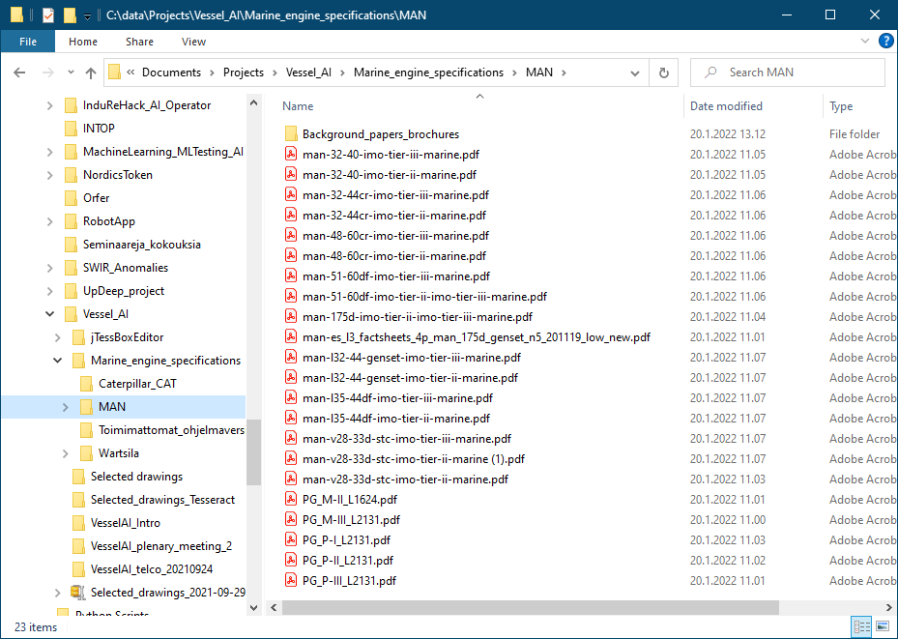
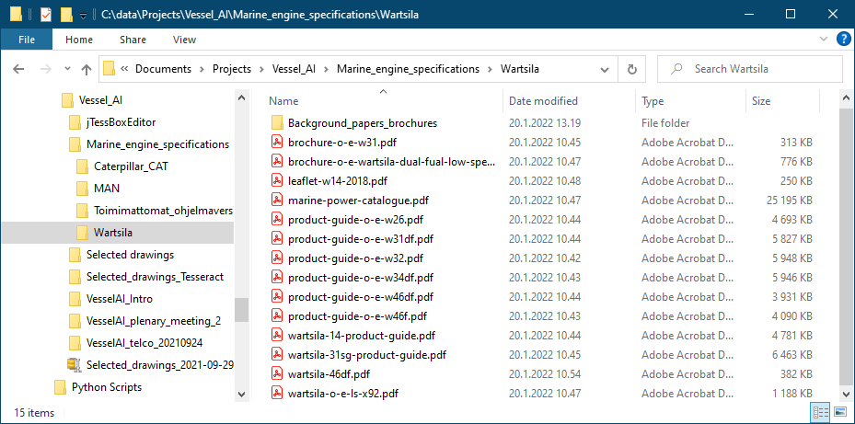
PDF specifications from Wärtsilä and MAN
These are the Wärtsilä and MAN PDF files that we considered:
22 PDFs from MAN, 14 from Wärtsilä…
27 files from WinGD, 11 files from HHI

Slide 5
PDF files NOT included!
There are 73 PDF files in total, containing 18 019 pages
These files are (or at least were in spring 2022) publicly available
However, due to copyright issues we cannot distribute them
Lists of these files are presented in the next slides
You must try to find them from the vendors’ web sites and download them yourself
Google searches for MAN, Wärtsilä, HHI, WinGD PDF files (or: “engine manual”…):
engine specification “pdf” site: www.man-es.com/marine/
engine specification “pdf” site: www.wartsila.com
engine specification “pdf” site:english.hhi.co.kr
engine specification “pdf” site:www.wingd.com
Save the found files into subfolders ‘MAN’, ‘Wartsila’, ‘Hyundai_HHI’, and ‘WinGD’
However, the Python programs contain hard-wired lists of the files to be processed. If you cannot find all these listed files, you must modify these lists
But the NN (neural network) program version also contains the indices of documents and pages that the human expert considered relevant (“Ground Truth”). These index lists must be modified also, which is tedious…

Slide 6
PDF files NOT included! MAN files to find
MAN/man-175d-imo-tier-ii-imo-tier-iii-marine.pdf
MAN/man-32-40-imo-tier-ii-marine.pdf
MAN/man-32-40-imo-tier-iii-marine.pdf
MAN/man-32-44cr-imo-tier-ii-marine.pdf
MAN/man-32-44cr-imo-tier-iii-marine.pdf
MAN/man-48-60cr-imo-tier-ii-marine.pdf
MAN/man-48-60cr-imo-tier-iii-marine.pdf
MAN/man-51-60df-imo-tier-ii-imo-tier-iii-marine.pdf
MAN/man-51-60df-imo-tier-iii-marine.pdf
MAN/man-es_l3_factsheets_4p_man_175d_genset_n5_201119_low_new.pdf
MAN/man-l32-44-genset-imo-tier-ii-marine.pdf
MAN/man-l32-44-genset-imo-tier-iii-marine.pdf
MAN/man-l35-44df-imo-tier-ii-marine.pdf
MAN/man-l35-44df-imo-tier-iii-marine.pdf
MAN/man-v28-33d-stc-imo-tier-ii-marine.pdf
MAN/man-v28-33d-stc-imo-tier-iii-marine.pdf
MAN/PG_M-III_L2131.pdf
MAN/PG_M-II_L1624.pdf
MAN/PG_P-III_L2131.pdf
MAN/PG_P-II_L2131.pdf
MAN/PG_P-I_L2131.pdf

Slide 7
PDF files NOT included! Wärtsilä files to find
Wartsila/brochure-o-e-w31.pdf
Wartsila/brochure-o-e-wartsila-dual-fual-low-speed.pdf
Wartsila/leaflet-w14-2018.pdf
Wartsila/marine-power-catalogue.pdf
Wartsila/product-guide-o-e-w26.pdf
Wartsila/product-guide-o-e-w31df.pdf
Wartsila/product-guide-o-e-w32.pdf
Wartsila/product-guide-o-e-w34df.pdf
Wartsila/product-guide-o-e-w46df.pdf
Wartsila/product-guide-o-e-w46f.pdf
Wartsila/wartsila-14-product-guide.pdf
Wartsila/wartsila-31sg-product-guide.pdf
Wartsila/wartsila-46df.pdf
Wartsila/wartsila-o-e-ls-x92.pdf

Slide 8
PDF files NOT included! HHI files to find
Hyundai_HHI/2016_HHI_en.pdf
Hyundai_HHI/2017_HHI_en.pdf
Hyundai_HHI/2018_HHI_en.pdf
Hyundai_HHI/2019_HHI_en.pdf
Hyundai_HHI/2020_KSOE_IR_EN.pdf
Hyundai_HHI/2021_KSOE_IR_EN.pdf
Hyundai_HHI/HHI_EMD_brochure2017_1.pdf
Hyundai_HHI/HHI_EMD_brochure2017_2.pdf
Hyundai_HHI/HHI_EMD_brochure2017_3.pdf
Hyundai_HHI/HHI_EMD_brochure2019_1.pdf
Hyundai_HHI/speclal_NSD2020.pdf

Slide 9
PDF files NOT included! WinGD files to find
WinGD/16-06-pres-kit_x92.pdf
WinGD/cimac2016_120_kyrtatos_paper_thedevelopmentofthemodern2strokemarinedieselengine.pdf
WinGD/cimac2016_173_brueckl_paper_virtualdesign-and-simulation-in2strokemarineenginedevelopment.pdf
WinGD/cimac2016_233_ott_paper_x-df.pdf
WinGD/dominikschneiter_tieriii-programme.pdf
WinGD/Fuel-Flexible-Injection-System-How-to-Handle-a-Fuel-Specturm-from-Diesel_CIMAC2019_paper_404_Andreas-Schmid.pdf
WinGD/marcspahni_generation-x-engines.pdf
WinGD/MIM_WinGD-RT-flex48T-D.pdf
WinGD/MIM_WinGD-X72.pdf
WinGD/MM_WinGD-RT-flex58T-D.pdf
WinGD/MM_WinGD-X35-B_2021-09.pdf
WinGD/MM_WinGD-X52.pdf
WinGD/MM_WinGD-X72.pdf
WinGD/MM_WinGD-X72DF.pdf
WinGD/MM_WinGD-X82-B.pdf
WinGD/Motorship-May-2018-VP-R-D-Leader-Brief.pdf
WinGD/OM_WinGD-X62_2021-09.pdf
WinGD/OM_WinGD-X72DF_2021-09.pdf
WinGD/OM_WinGD-X82-B.pdf
WinGD/OM_WinGD_RT-flex50DF.pdf
WinGD/WinGD-12X92DF-Development-of-the-Most-Powerful-Otto-Engine-Ever_CIMAC2019_paper_425_Dominik-Schneiter.pdf
WinGD/wingd-paper_engine_selection_for_very_large_container_vessels_201609.pdf
WinGD/WinGD-WiDE-Brochure.pdf
WinGD/WinGD_Engine-Booklet_2021.pdf
WinGD/wingd_moving-inlet-ports-concept-for-optimization-of-2-stroke-uni-flow-engines_patrick-rebecchi.pdf
WinGD/X-DF-Engines-by-WinGD.pdf
WinGD/X-DF-FAQ.pdf

Slide 10
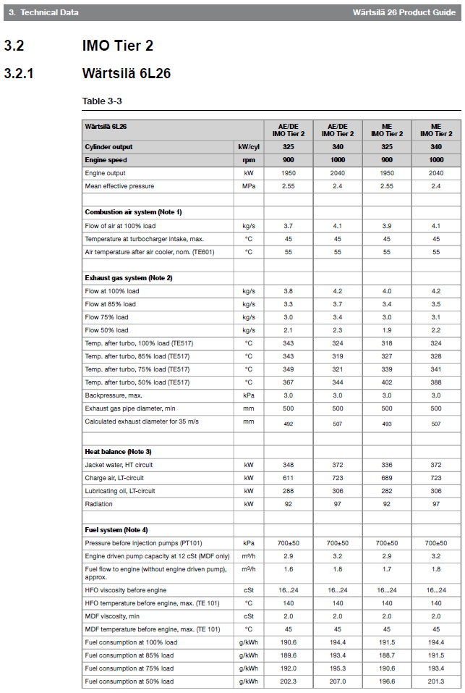
Wärtsilä PDF files: Relevant tables
Then a few of the Wärtsilä PDF files were inspected
The first one that contains relevant numerical information was ‘product-guide-o-e-w26.pdf’
It contains many tables of the same format
The page that contains the first such table is shown here:
The four last lines give fuel consumption at 100% / 85 % / 75 % / 50 % engine load [g/kWh]
The four first lines in group “Exhaust gas system” give exhaust gas flow at 100% / 85 % / 75 % / 50 % engine load [kg/s]
There was no charge air flow; however, the first line in group “Combustion air system” gives “Flow of air at 100 % load” [kg/s]; we will use these numbers instead
Header data above is crucial; we want to know the engine model etc. to which the numbers apply!

Slide 11
PDF files: Relevant tables
After much testing we settled for the following rules:
We first search for these keywords (can be inside () or []):
g/kWh
kJ/kWh
kg/s
kg/kWh
But with two upper keywords the following other words must also be found in the same page:
fuel AND consumption
OR sfoc OR bsfc
And with two lower keywords the following other words must also be found in the same page:
charge air OR combustion air OR exhaust gas
AND flow
This produced good enough results!

Slide 12
PDF files: Learning Program
Another version of the original Python program was written
Instead of selecting keywords (e.g. “kJ/kWh”, “fuel”, “consumption”; see previous slide) we select a few of our data pages as “Model Pages”
For example, some Model Pages could be related to fuel consumption, some to charge air / exhaust gas / heat balance
Then the program computes the relative frequencies of all the words in each Model Page
And when a candidate page is processed, a similar word frequency histogram is computed, and compared to the frequency histograms of all the Model Pages
Words that can be converted to floating-point numbers are excluded from the diff. sums
If the best difference is small enough (e.g. <=0.5), i.e. that candidate page matches at least one of the Model Pages, then that candidate page is accepted

Slide 13
PDF files: Whole workflow
New versions of the Python programs discussed previously were written, so that together the new programs create a whole workflow for information extraction:
We extend the first version of our program (using keywords) so that the user enters some keywords (e.g. fuel consumption). Then the program finds those *.pdf file pages that match these keywords. Optionally the user can eliminate some (irrelevant) pages. The remaining pages go to phase 2.
We cluster the found pages into groups (i.e. clusters); group center pages will be the proposed Model Pages. Optionally the user can eliminate some (irrelevant) Model Pages. The remaining pages go to phase 3.
We extend the second version of our program (learning version) to use these Model Pages, and then to find more of similar pages within the PDF files. Besides, for each model page the user can define rules for lines where the relevant data values are, thus reducing the amount of irrelevant information even further.
And now we have a toolchain that can extract information from a large number of PDF files: Return desired parameter values for desired marine engine types.

Slide 14
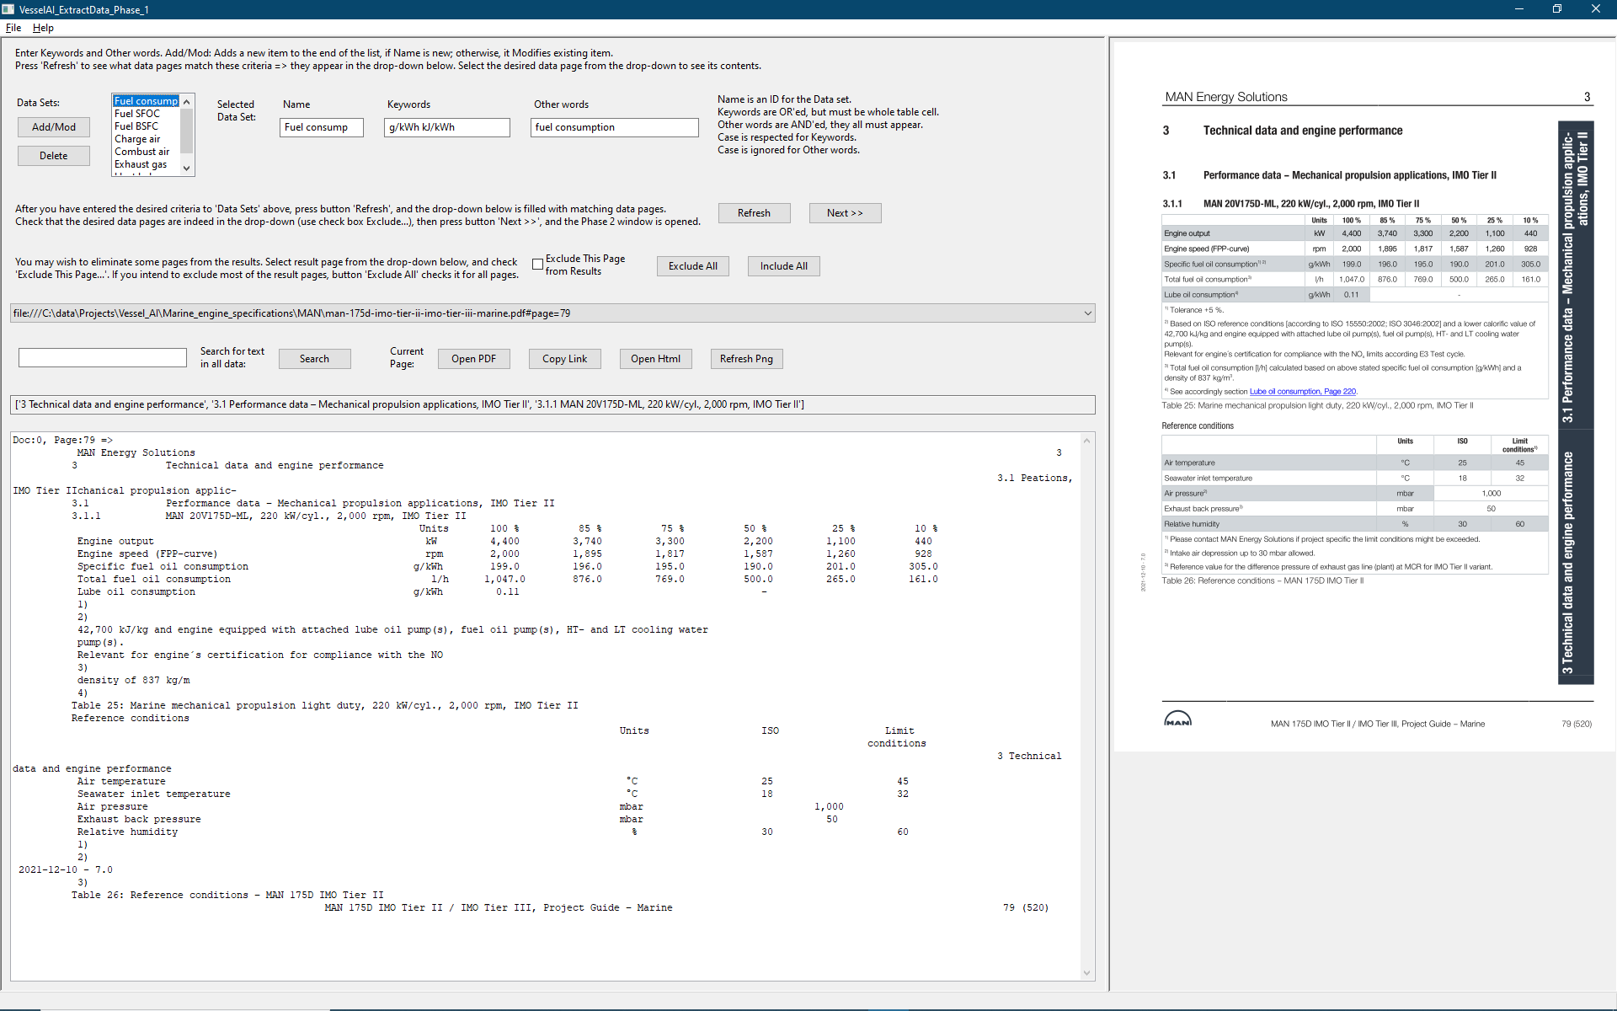
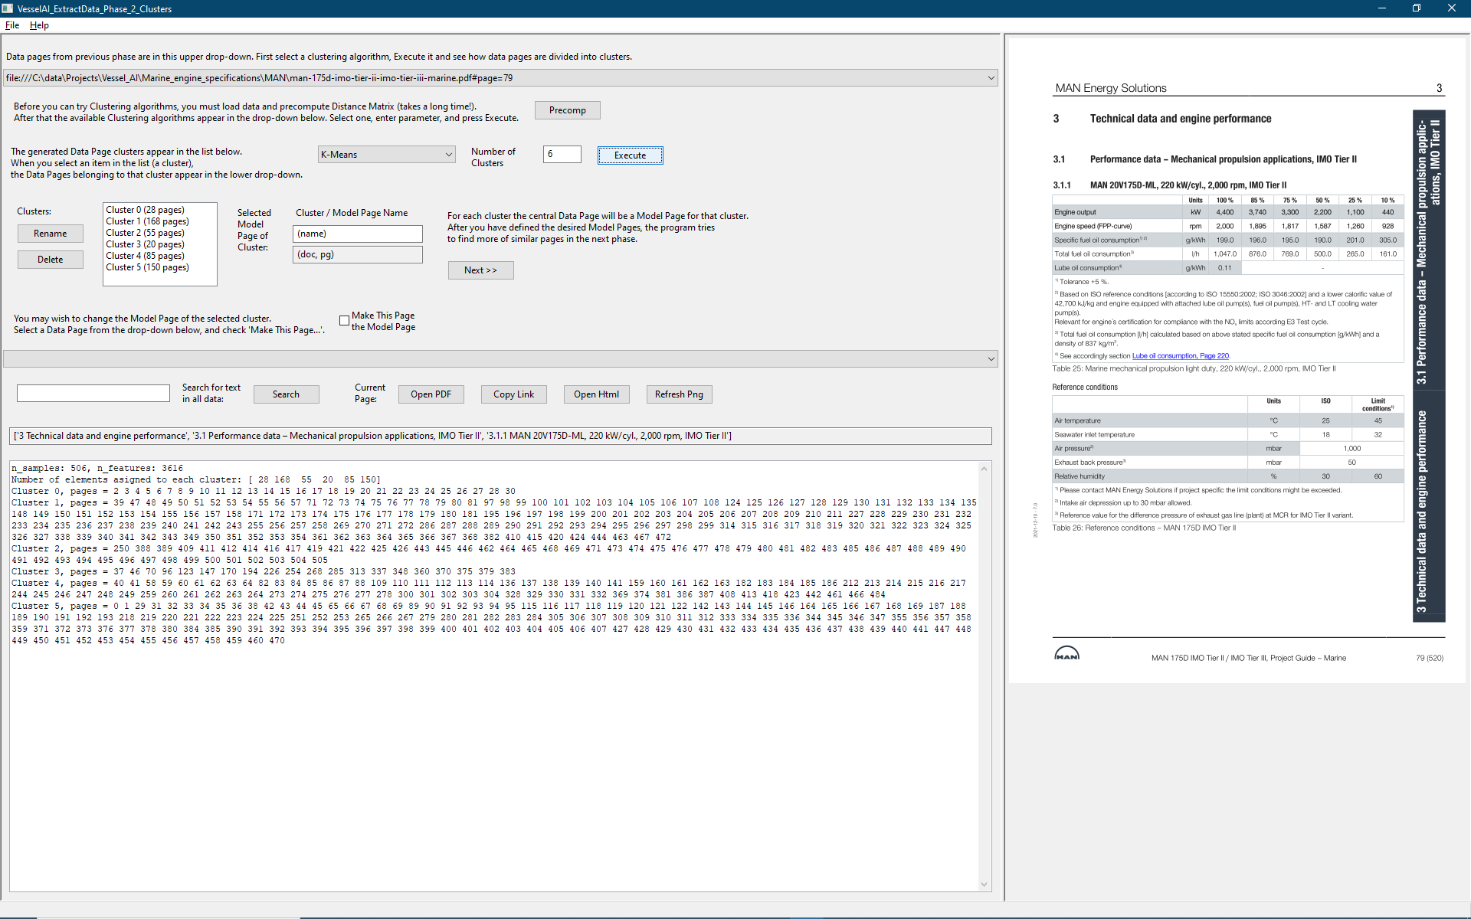
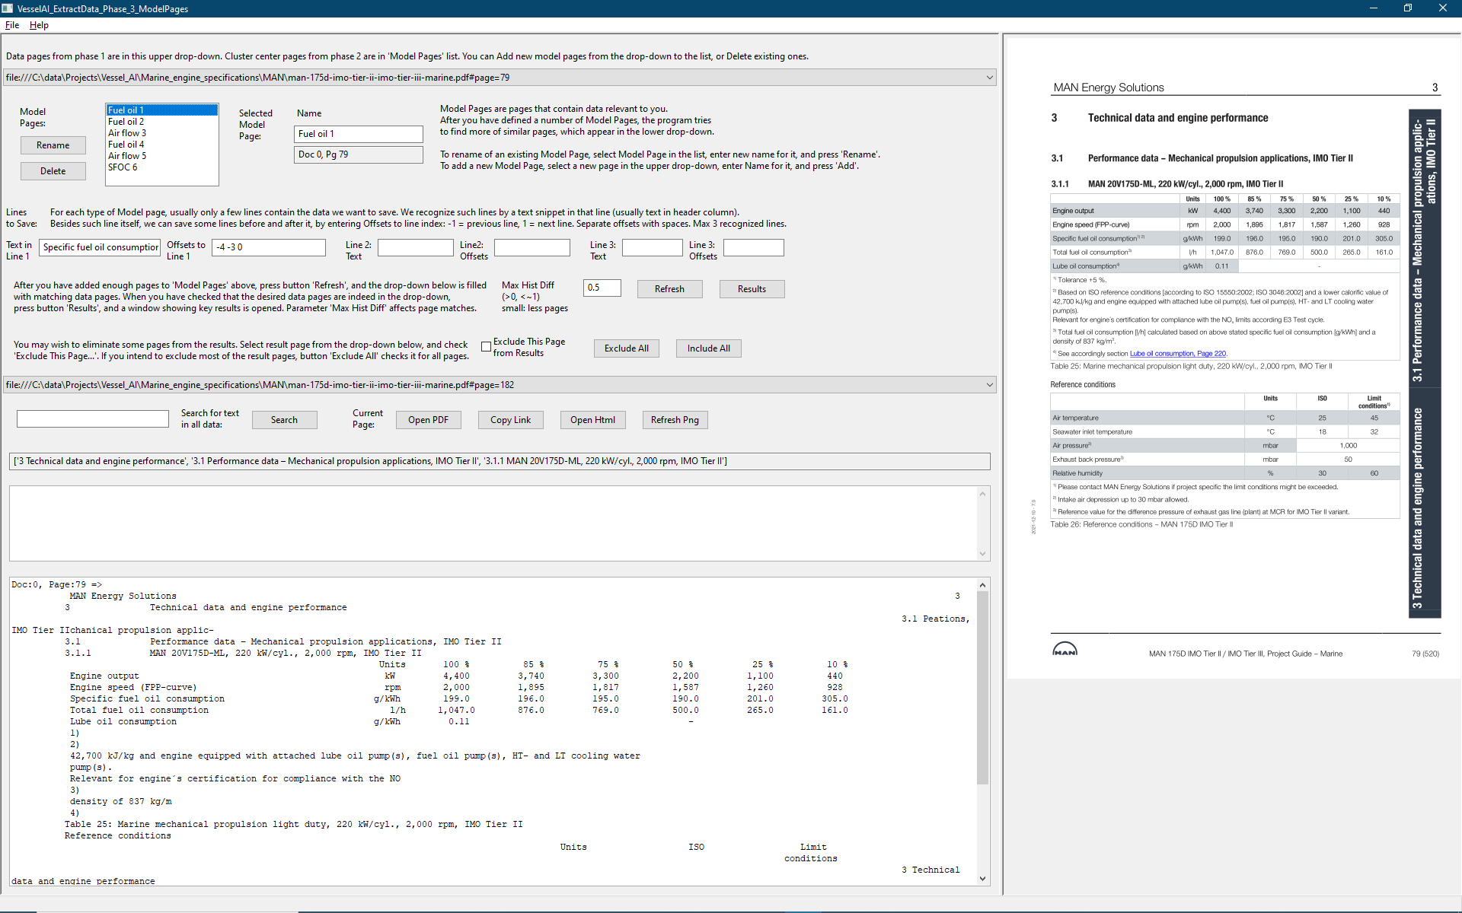
Implementation of the workflow (1/4)
Still using our set of downloaded PDF files
Can be later extended to web crawlers…
Three separate Python programs to realize the workflow:
VesselAI_ExtractData_1.py
VesselAI_ExtractData_2.py
VesselAI_ExtractData_3.py
In Phase 1 the user enters keywords and other words, and the program finds the matching files/pages; links to these files/pages are saved
The Phase 2 program reads these files, and tries to group into clusters (4 algorithms); central page in each cluster is saved as a Model Page
In Phase 3 the user can edit this set of Model Pages; and then the program tries to find more of similar pages, as well as extract relevant lines

Slide 15
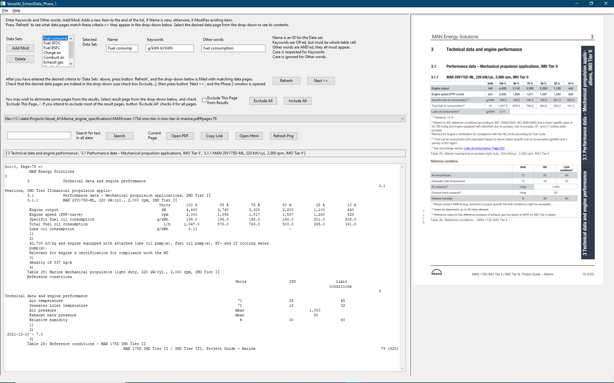
Implementation of the workflow (2/4): Phase 1
The user enters a number of Data Sets, each contains Name (=ID for DS), Keywords, Other words; the list of defined Data Sets is shown
The Data Set definitions are saved for next use. At first use: reasonable default values
The algorithm of this program is executed with button ‘Refresh’, and the found files/pages are shown in a drop-down, and the selected page can be seen as an image and as text
User can exclude some of the result pages from results
Phase 2 program is started with button ‘Next >>’

Slide 16

Implementation of the workflow (3/4): Phase 2
The program tries to group Phase 1 result pages into clusters
The central page of each cluster becomes a Model Page for Phase 3
At first two algorithms for page clustering were available: K-means and DBSCAN; both from scikit learn (a.k.a. sklearn) program library:
https://scikit-learn.org/stable/auto_examples /text/plot_document_clustering.html#sphx-glr-auto-examples-text-plot-document-clustering-py
(“Clustering text documents using k-means”)
https://programmer.group/61755e726f9b3.html
(“Self defined distance measurement method of clustering algorithm in scikit learn Library”)
Later AffinityPropagation and SpectralClustering algorithms from scikit learn were also added!
A lengthy Precomputation step is necessary before the 4 algorithms can be tried, but clustering itself is fast

Slide 17
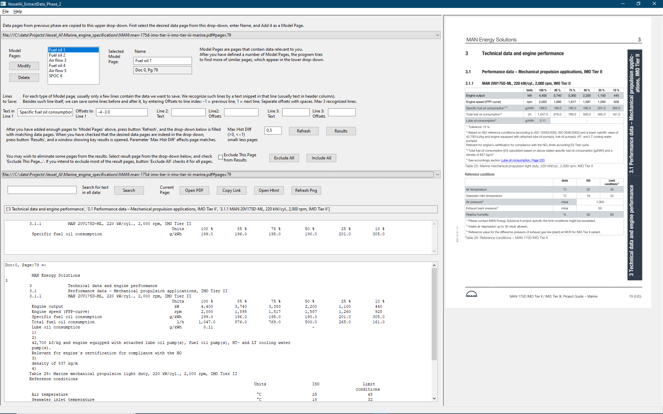
Implementation of the workflow (4/4): Phase 3
The user selects a number Phase 2 result pages as Model Pages, each contains Name (=ID for MP) and rules for lines of relevant data; the list of defined Model Pages is shown
The contents of this list comes from Phase 2 (no data: reasonable default contents)
For each Model Page, the user must define the lines where relevant data values are found
The algorithm of this program is executed with button ‘Refresh’, and the found files/pages are shown in a drop-down, and the selected page can be seen as an image and as text. Data in relevant lines shown separately
User can exclude some of the result pages from results
Result data (=relevant lines) are shown with button ‘Results’. New Notepad window is opened

Slide 18
Notes
Please note that when you open the window of the next phase (button ‘Next >>’), a new window is opened, but the original window remains open behind this new window; however, because the new window uses the same Python/wxPython environment as the original one, the original window remains inactive until the new window is closed
Lengthy operations (e.g. ‘Precomp’ in Phase 2, ‘Refresh’ in Phases 1 and 3) are executed in the main thread, so the UI is frozen until the operation is completed. Progress is shown in the bottom subwindow, but this window is not always updated properly; especially if you move the focus into another window, the UI becomes frozen until the computation ends
The programs have been tested in Windows 11, Anaconda Python; in other environments (e.g. Linux) there may be problems…

Slide 19
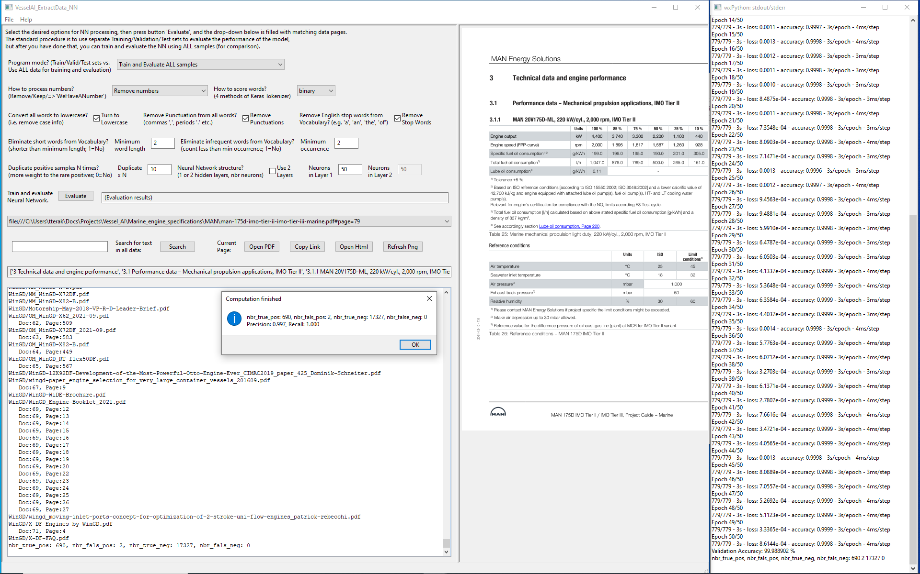
Neural network program
Ground truth of relevant pages by human expert: 690 pages were deemed relevant
NN program: many settings were tried, results of best one
Precision = 0.998, Recall = 0.979, Accuracy = 0.999
NN produced much better results than either Phase 1 or Phase 3
However, for new data (e.g. new marine engine manufacturer) both NN and Phase 3 are likely to fail
But Phase 1 could still work: SI units (our keywords) and technical terms (our other words) are the same

Slide 20
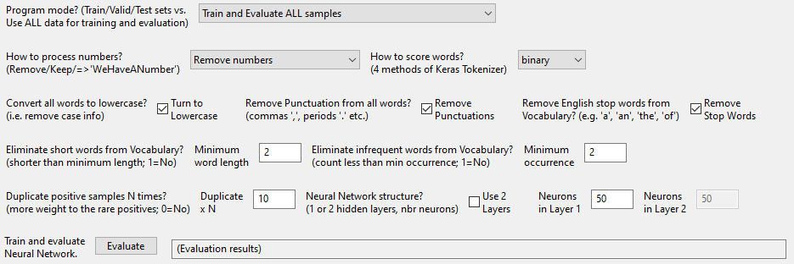
Neural network program, notes
The NN program uses a rather simple NN, only one or two hidden layers, and Bag of Words model, ref. https://machinelearningmastery.com/deep-learning-bag-of-words-model-sentiment-analysis/
There are many options to reduce the amount of text that must be processed; see check boxes and numerical entries in the screen dump below
Program mode tells whether to divide the 18 019 input PDF pages randomly into Training (60 % of pages), Validation (20 %), and Test (20 %) samples, or to use all pages as Training, Validation, and Test samples. The previous mode (“Train/Valid/Test sets”) is recommended, it is the standard method
For number processing there are 3 alternatives: The words that are numbers can be removed, kept, or replaced with a fixed string ‘WeHaveANumber’

Slide 21
Neural network program, notes
Keras Tokenizer has 4 different modes, when text entries are converted into number vectors (vector size = vocabulary size): Modes ‘binary, ‘count’, ‘tfidf’ and ‘freq’
Usually data sets have an equal number of positive and negative entries. However, in our data there are much less relevant/positive (=Ground Truth) pages than irrelevant/negative pages. We have only 690 relevant pages of 18 019 pages, less than 4 %. The simplest way to handle this imbalanced data set is to duplicate the positive samples in the Training set
Different numbers of hidden neurons can be tried, as well as 1 or 2 hidden layers

Slide 22
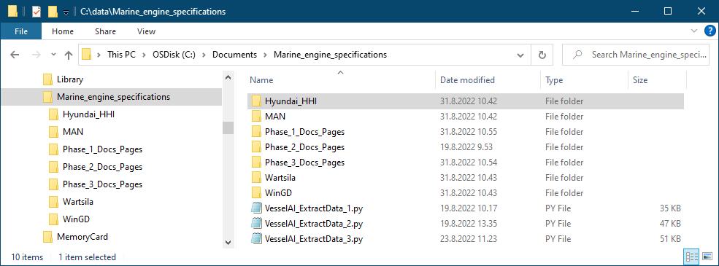
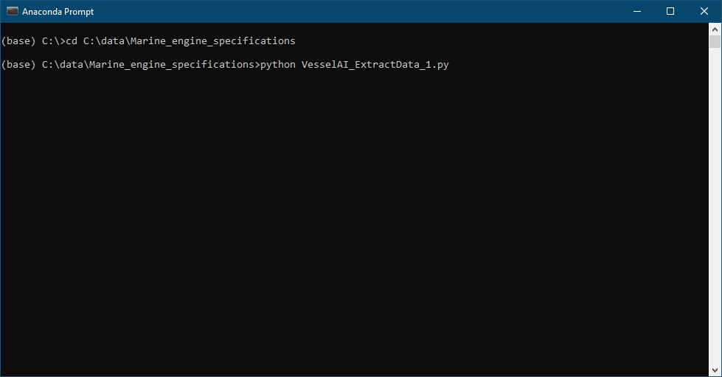
Installation
The *.zip file contains a folder ‘Marine_engine_specifications’
This folder contains 4 Python files:
VesselAI_ExtractData_1.py
VesselAI_ExtractData_2.py
VesselAI_ExtractData_3.py
VesselAI_ExtractData_NN.py
…and also subfolders for PDF files (Hyundai_HHI, MAN, Wartsila, WinGD) as well as empty subfolders where result data will be written (Phase_?_Docs_Pages)
The PDF files must be downloaded from Internet, see slides 5-9

Slide 23
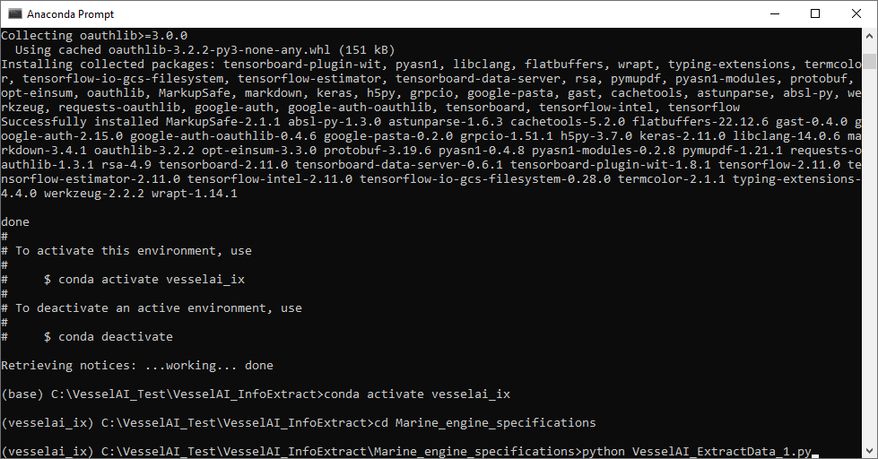
Installation, continued
Extract the contents of the *.zip file into a local folder, and then go to the folder ‘VesselAI_InfoExtract’ (inside the new folder) with your Python Prompt
In Anaconda Python environment, enter command:
conda env create -f env.yml
This will create Anaconda environment ‘vesselai_ix’, containing the necessary Python program libraries; then activate this new environment:
conda activate vesselai_ix
Go to subfolder ‘Marine_engine_specifications’
cd Marine_engine_specifications
Remember that subfolders ‘MAN’, ‘Wartsila’, ‘Hyundai_HHI’, and ‘WinGD’ must contain PDF files you have downloaded, as instructed earlier
Start the Phase 1 program, *_1.py
python Vesselai_ExtractData_1.py

Slide 24
Installation, continued
If you do not have the Anaconda Python, this will probably fail at first, because you have not installed all the necessary libraries to your Python environment
But when starting the python program fails, the name of the missing library is shown. Then install this library (pip install <name_of_lib>). Continue until *_1.py starts
Close this *_1.py immediately. Then try *_2.py and *_3.py. Continue installing missing libraries until all 3 programs start
Then try to go through the whole workflow with default values: start *_1.py:
>python VesselAI_ExtractData_1.py
*_Phase_1: Maximize, move vertical slider right, press ‘Refresh’, (wait…), press ‘Next >>’
*_Phase_2: Maximize, move vertical slider right, press ‘Precomp’, (wait…), select algorithm ‘DBSCAN’ from the drop-down, press ‘execute’, press ‘Next >>’
*_Phase_3: Maximize, move vertical slider right. Next you should enter relevant line definitions for each cluster, the press ‘Refresh’, (wait…), press ‘Results’.
=> However, because this is tedious (DBSCAN produces 41 clusters!), delete all the files in folder ‘Phase_3_Docs_Pages’, and then start ‘VesselAI_ExtractData_3.py’ directly. And now:
*_Phase_3: Maximize, move vertical slider right, press ‘Refresh’, (wait…), press ‘Results’
And now Notepad shows file ‘Phase3_key_results.txt’, containing relevant data lines only!

