Slide 1

A Comparative Analysis of Distance Measures for Ordinal Data in K-Medoids Clustering
Segmenting Hotel Guests Based on Service Feature Perceptions in Sri Lanka
Vestika Weerachandra | COHNDDS241P-003
Notes:
0:00-0:20 - Introduce yourself and the topic in one sentence.
1

Slide 2
INTRODUCTION
Background
Sri Lanka's tourism industry is a major contributor to GDP, foreign exchange, and employment, with tourist arrivals recovering strongly through 2024-2025.
Online customer reviews have become a key source for understanding traveller preferences and satisfaction.
Machine learning enables large-scale analysis of this feedback, but ordinal rating data (Unacceptable to Excellent) requires clustering methods and distance measures that respect category order, not just magnitude.
3,230
Customer Reviews
161
Hotels Covered
12
Nationalities
2
Notes:
0:20-1:15 - Background: tourism growth, importance of reviews, why ordinal data needs careful handling.
2

Slide 3
INTRODUCTION
Research Problem & Gap
Ordinal service ratings are frequently clustered using distance measures (e.g. Euclidean) that assume evenly-spaced, interval-scaled data. It is an assumption that does not hold for ordinal categories.
Limited Research
Distance Measure Gap
Practical Need
Few studies examine structured, ordinal hotel service data specifically within Sri Lanka's hospitality sector.
Little empirical comparison exists between ordinal-appropriate distance measures (Gower, Podani, GDM2) on real hospitality data.
Businesses need a reliable, statistically valid way to segment guests by service perception to prioritise improvements.
3
Notes:
1:15-2:15 - Explain the research problem and gap concisely - summarise each card in one sentence, don't read verbatim.
3

Slide 4
INTRODUCTION
Research Questions & Objectives
Research Questions
Objectives
  How can customers be segmented using K-Medoids clustering on ordinal service ratings?
  Which distance measure - Gower, Podani, or GDM2 - produces the most valid, interpretable segments?
  Do the identified segments differ significantly in their service feature perceptions?
  Apply K-Medoids clustering using three ordinal-appropriate distance measures.
  Compare distance measures using Silhouette Score and Davies-Bouldin Index.
  Apply the Kruskal-Wallis test to confirm significant differences between segments.
4
Notes:
2:15-3:15 - State the 3 research questions and objectives briefly - these set up everything that follows.
4

Slide 5
METHODOLOGY
Data Source & Preparation
Secondary data from House of Travels & Tourism (Pvt) Ltd's customer feedback database (2024-2025).
1
2
3
4
>
>
>
Merge feedback, hotel & booking data
Remove duplicates (Booking No + Hotel ID)
Treat placeholder values as missing; impute with mode
Ordinally encode ratings (Unacceptable=0 to Excellent=4)
Sample: All available reviews used (comprehensive collection, not a drawn sample) | Features: 6 ordinal service ratings + Overall Rating + Nationality
5
Notes:
3:15-4:15 - Explain data source, sample size, and preprocessing steps quickly.
5

Slide 6
METHODOLOGY
Conceptual Framework
Input
Distance
Computation
K-Medoids
Clustering
Validity
Comparison
Best Distance
Selected
>
>
>
>
Ordinal service
ratings + EDA
Gower, Podani,
GDM2 matrices
Applied per
distance measure
Silhouette Score &
Davies-Bouldin Index
Segment profiling &
Kruskal-Wallis test
The clustering algorithm (K-Medoids) is held constant across all three distance measures, isolating the choice of distance measure as the single variable under test.
6
Notes:
4:15-5:45 - Walk through the conceptual framework left to right - this is your methodology in one picture.
6

Slide 7
METHODOLOGY
Three Ordinal-Appropriate Distance Measures
Gower Distance
Podani's Ordinal Gower
GDM2 (Walesiak)
Range-normalised absolute difference on raw ordinal codes, averaged across features.
Ranks each variable first (tie-corrected), then applies Gower's formula - depends only on order.
Kendall's Tau-based measure purpose-built for ordinal item-battery survey data.
General-purpose
Rank-based
Purpose-built for ordinal data
7
Notes:
5:45-7:15 - Briefly explain what each of the 3 distances does differently - keep it conceptual, not mathematical.
7

Slide 8
DATA ANALYSIS
Exploratory Data Analysis - Snapshot
Service Feature | Mean | Median | Mode
Welcome / Check-in | 3.64 | 4.0 | Excellent
Standard of the Room | 3.44 | 4.0 | Excellent
Cleanliness | 3.51 | 4.0 | Excellent
Restaurant Service | 3.50 | 4.0 | Excellent
Quality Meals | 3.41 | 4.0 | Excellent
Attentiveness / Friendliness | 3.63 | 4.0 | Excellent
Overall Rating | 3.45 | 4.0 | Excellent
Spearman Correlation (Ordinal-Appropriate)
Restaurant Service correlates most strongly with Overall Rating (r=0.74) and Quality Meals (r=0.73).
Top Nationalities
German (1,332) and British (1,261) dominate the sample, followed by Dutch, French, Italian, Belgian, Swiss, Danish, Austrian and Spanish guests (12 nationalities total).
Median/mode consistently show Excellent - mean is shown for reference only, given the ordinal scale.
8
Notes:
7:15-8:15 - Quick EDA highlights - don't dwell, just set context for the results.
8

Slide 9
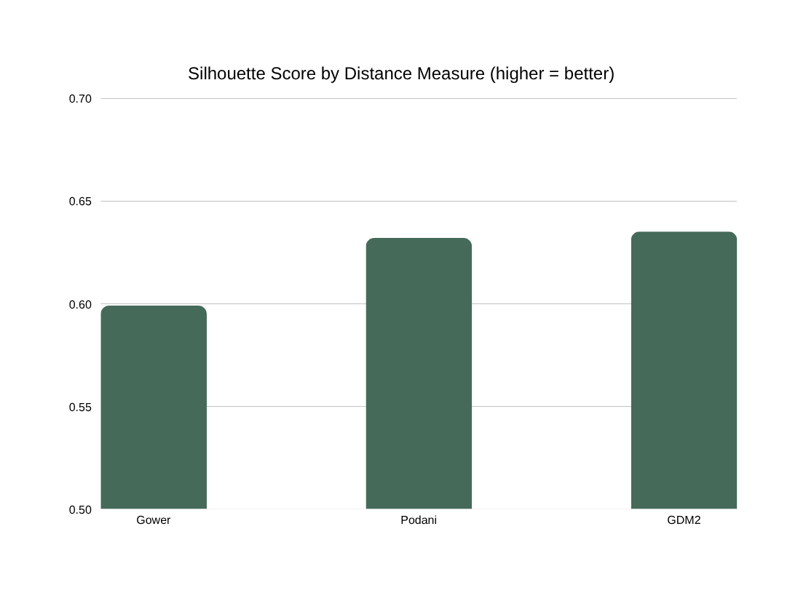
DATA ANALYSIS
Distance Measure Comparison
Distance | k | Silhouette | DBI (approx.)
Gower | 2 | 0.5991 | 0.9645
Podani | 2 | 0.6321 | 0.9870
GDM2 | 2 | 0.6352 | 0.9654
0.6321
0.6352
0.5991
GDM2 Selected
Purpose-built for ordinal item-battery data; achieved the highest, most reliably-computed Silhouette Score across all three measures.
9
Notes:
8:15-9:45 - THIS IS A KEY SLIDE - explain why GDM2 won and what the Silhouette Score means practically.
9

Slide 10
DATA ANALYSIS
Two Customer Segments Identified (GDM2, k=2)
Segment 0 - Highly Satisfied
Segment 1 - Moderately Satisfied
60.9%
39.1%
1,966 reviews
1,264 reviews
  Median/Mode: Excellent on every feature
  Overall Rating mean: 3.90 (median 4)
  Median/Mode: Good on every feature
  Overall Rating mean: 2.75 (median 3)
Overall Rating tracks consistently with feature-level ratings in both segments - strong internal validation that the clustering is meaningful.
10
Notes:
9:45-10:45 - Introduce the two segments in plain language - Highly Satisfied vs Moderately Satisfied.
10

Slide 11
DATA ANALYSIS
Which Features Differentiate the Segments Most?
Top-Box % (rating Good or Excellent) by segment - the ordinal-appropriate alternative to a mean-based gap:
Service Feature | Segment 0 | Segment 1 | Gap
Quality Meals | 98.6% | 69.2% | 29.4 pp
Standard of the Room | 98.8% | 72.2% | 26.6 pp
Restaurant Service | 99.6% | 74.3% | 25.3 pp
Cleanliness | 99.6% | 78.6% | 21.0 pp
Attentiveness/Friendliness | 99.7% | 84.5% | 15.2 pp
Welcome/Check-in | 99.4% | 86.3% | 13.1 pp
Key Insight
Dining experience (Quality Meals, Restaurant Service) shows the largest gap between segments.
Check-in and staff friendliness remain strong even in the less-satisfied segment.
11
Notes:
10:45-12:15 - Explain the Top-Box gap table - which features matter most for service improvement.
11

Slide 12
DATA ANALYSIS
Kruskal-Wallis Test: Are the Segments Significantly Different?
Service Feature | p-value | Effect Size
Overall Rating | < 0.001 | 0.653 (Large)
Restaurant Service | < 0.001 | 0.609 (Large)
Cleanliness | < 0.001 | 0.533 (Large)
Quality Meals | < 0.001 | 0.497 (Large)
Standard of the Room | < 0.001 | 0.475 (Large)
Attentiveness/Friendliness | < 0.001 | 0.475 (Large)
Welcome/Check-in | < 0.001 | 0.439 (Large)
All 7 tests significant (p<0.001)
Effect sizes all exceed 0.14 - the 'large effect' threshold - confirming substantial, not just statistically detectable, differences.
H0 Rejected
Segments differ significantly across every feature and Overall Rating - the alternative hypothesis (H1) is accepted.
12
Notes:
12:15-13:45 - Explain Kruskal-Wallis findings - emphasise effect size, not just p-values.
12

Slide 13
DISCUSSION
Discussion
1
Theory Confirmed Empirically
Silhouette Score improved monotonically: Gower to Podani to GDM2, matching each measure's increasingly rigorous treatment of ordinality.
2
Structure is Robust
All three distance measures independently converged on a two-segment structure, though the exact customer assignment shifted with the distance measure used.
3
Dining Drives Dissatisfaction
Quality Meals and Restaurant Service are the clearest differentiators - check-in and staff friendliness remain consistently strong.
13
Notes:
13:45-14:15 - Discussion - tie findings back to theory in 2-3 sentences.
13

Slide 14
RECOMMENDATIONS
Recommendations
Prioritise Quality Meals & Restaurant Service improvements - largest impact on overall satisfaction
1
Adopt GDM2 as the preferred distance measure for future ordinal hospitality segmentation studies
2
Extend future research to examine segment association with nationality, and explore Latent Class Analysis as a model-based alternative
3
14
Notes:
14:15-14:45 - Recommendations - state clearly and confidently.
14

Slide 15
CONCLUSION
GDM2 identified the most valid, interpretable customer segments
Two robust segments confirmed across all three distance measures and validated by Kruskal-Wallis testing (large effect sizes throughout).
Provides House of Travels & Tourism (Pvt) Ltd with an empirically grounded basis for prioritising service improvements.
Contributes methodological guidance on ordinal distance measure selection for future hospitality analytics research.
15
Notes:
14:45-15:00 - Conclusion - close strong, then invite questions.
15

Slide 16
Thank You
Questions & Discussion
Vestika Weerachandra | COHNDDS241P-003 | NIBM
Notes:
16

