Slide 1
Sales Review
Mo’men Mohamed

Slide 2
Sales Review For 2018-2019

Slide 3
including Compariaons between the Potential Accounts
The First thing to pay attention to is to compare between the two years in Total sales Value as following:

Slide 4
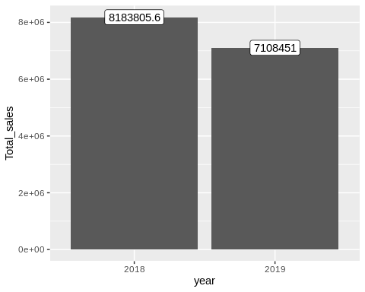

Slide 5
As we See there are like 1 million and 800 thousands difference between two years , so we need to break the sales down do analyse the gap and know where is the problem!
So, lets see each sector in the two years :

Slide 6
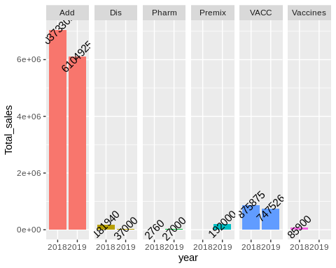

Slide 7
As we see in the previous chart , the gap shrinked from 1800000 EGP to 900000 EGP.
we need to know the the precise factor which dropped the sales like that , and also know the area of growth if it exists!
To know that lets First see the Accounts arranged in term of Total sales and see the relative importance of every one in 2019 !

Slide 8
Customer | Sales
Dina | 1672500
Copenhagen | 1184000
Delta Misr | 1030000
Enma’a | 894350
Reta Keriasy | 477700
Al Safa ( Al Maikana ) | 400000
Al- Pramos | 276750
Gaber | 153750
Al Nakheil | 144000
Danone | 140000
Al Orouba | 94500
Marimena | 82500
Anba Beshoy | 77728
Al Andalus | 69375
Milkyes | 56100
Madona Al Nehesy | 55000
Ahmed Al Sheikh | 46000
Farm Stars | 40000
Al Sayad | 38808
Goda | 33540
Hassan Hashem | 30000
Alex Land | 18000
The Farm | 16500
Izdehar | 15750
Rashad Fathalla | 15750
Hassan Hefnawy | 15350
Al - Alamia | 8000
Al Safa | 7500
Al Zomor | 7500
Mohamed Ibrahim | 6000
Al Ateba’a | 1500

Slide 9
NOW im going to throw the spot light on each singl Account of the most Potential one.
The aim is :
To see the drop in sales Product by Account
To see the growth also Product by Account

Slide 10
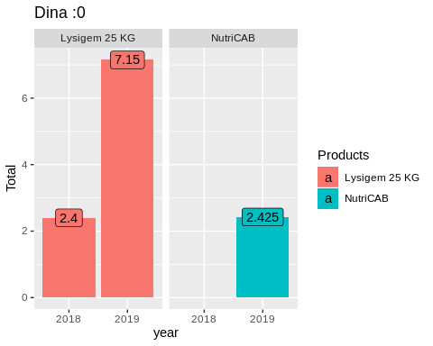

Slide 11
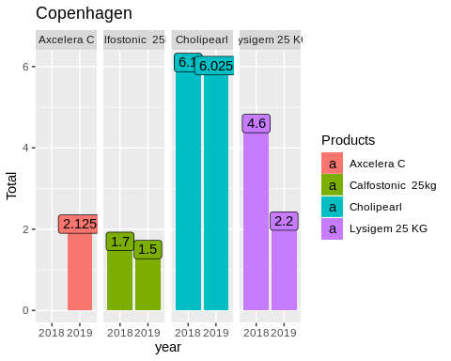

Slide 12
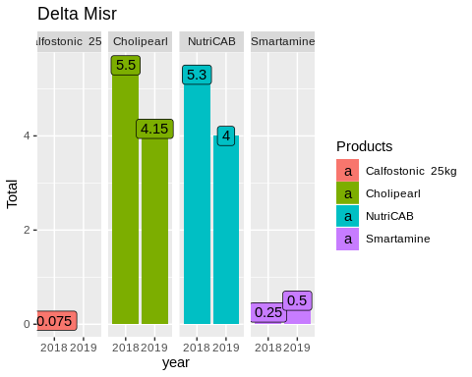

Slide 13
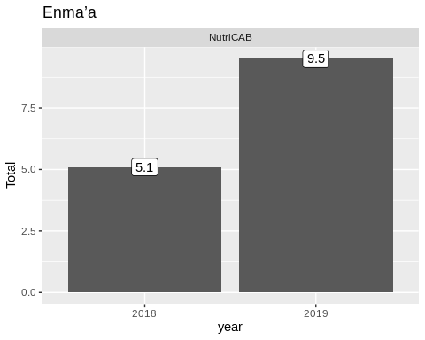

Slide 14
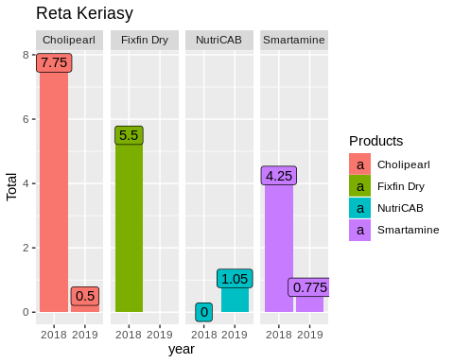

Slide 15
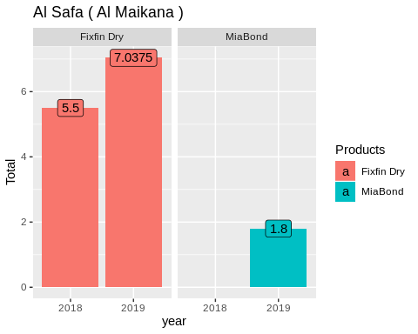

Slide 16
