Slide 1
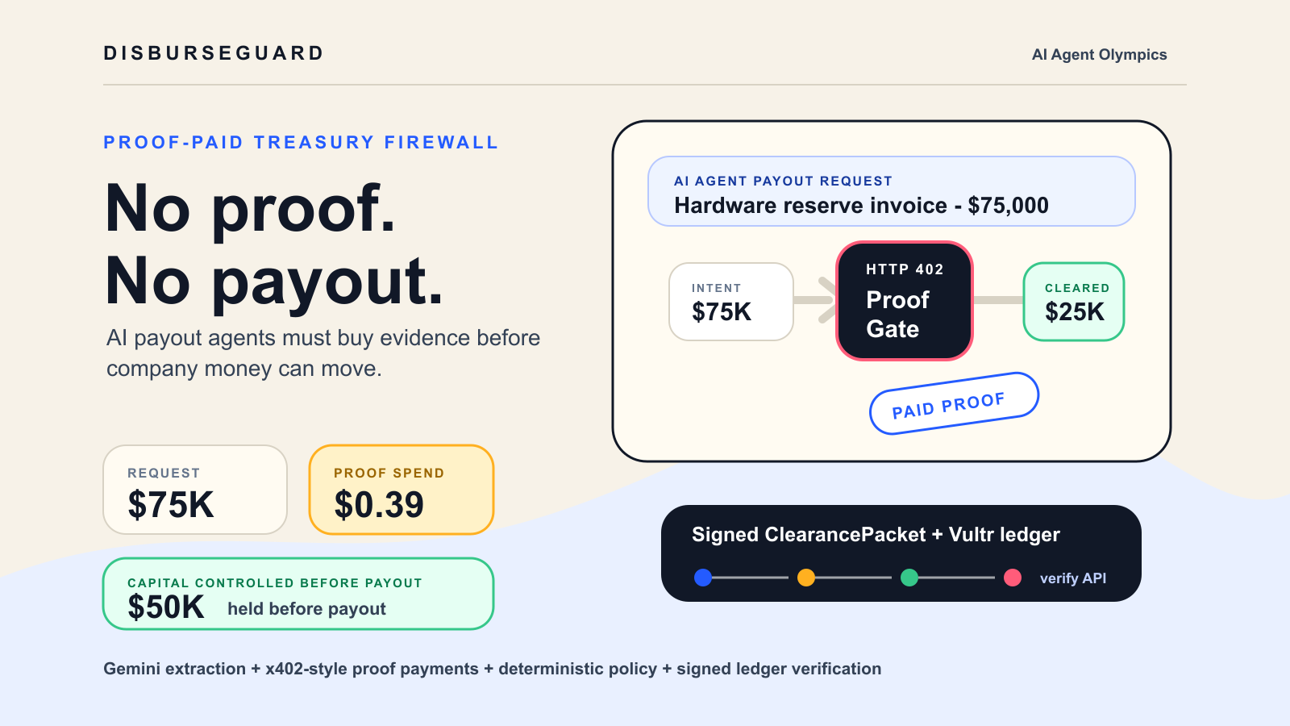

Slide 2
02 / THE GAP
Dashboards explain risk after money already left.
- Agent summaries are not evidence
- Human queues do not scale
- Treasury needs machine-verifiable proof
Autonomous finance needs enforcement before payout, not a prettier audit view after the agent has acted.
before
control moves in front of the payout
2 / 7

Slide 3
03 / PAID PROOF
Evidence is a paid gate, not a trusted checkbox.
- vendor-risk
- recipient-match
- sanctions-screen
- delivery-attestation
Protected proof endpoints deny access with HTTP 402. The Payment Agent must create receipts before evidence can influence the treasury decision.
402
payment required before proof access
3 / 7

Slide 4
04 / AGENT LOOP
The demo acts through a full clearance chain.
- Extract
- Plan
- Pay
- Decide
- Sign and ledger
Intake Agent, Proof Agent, Payment Agent, Policy Guard, and Audit Agent complete one verifiable payout loop instead of only displaying status.
5
agents in the clearance loop
4 / 7

Slide 5
05 / LIVE RESULT
$0.39 of proof spend controls $50K of exposure.
- requested: $75K
- proof spend: $0.39
- approved: $25K
- held: $50K
In the high-value reserve scenario, DisburseGuard limits a $75,000 request to $25,000 and keeps the remaining $50,000 blocked until stronger proof arrives.
$50K
capital controlled before payout
5 / 7

Slide 6
06 / VERIFIABLE LEDGER
Every decision becomes a public verification object.
- production-key signing mode
- append-only event hashes
- /api/clearance/:id/verify
The ClearancePacket carries proof hashes, policy version, expiry, rationale, public key, and signature. The Vultr Postgres ledger chains every event hash.
valid
packet signature and event chain
6 / 7

Slide 7
07 / WHY IT WINS
A payment primitive for agentic finance, not a generic dashboard.
- x402: proof purchase primitive
- Gemini: structured intake
- Vultr: deployed ledger
- FinOps: payout control
DisburseGuard aligns the strongest hackathon surfaces: x402 paid proof gates, Gemini extraction, Vultr deployment, B2B FinOps, compliance, and a multi-step agent workflow.
live
public Vultr deployment
7 / 7

