Slide 1
Minor project (6th Sem)
Hand Gesture Detection using 3D CNN
Mentor:
Mr. Amit Baghel
(Assistant Prof.)
By:
Vikram Shishupalsingh Bais (18103059)
Vetcha. Yaswanthi
(18103058)

Slide 2
Index
About Project
Tools Used
Structure of CNN model
Execution
Result
Applications
Future Aspects

Slide 3
About Project
Created a model which uses 3D Convolutional Neural Networks for detecting the hand gestures of a person standing in front of a camera.
For this particular model we have used The 20BN-jester Dataset V1.

Slide 4
Tools Used
Language : Python
Libraries : Tensorflow, Keras, cv2, Matplotlib
Dataset : The 20BN-jester Dataset V1

Slide 5
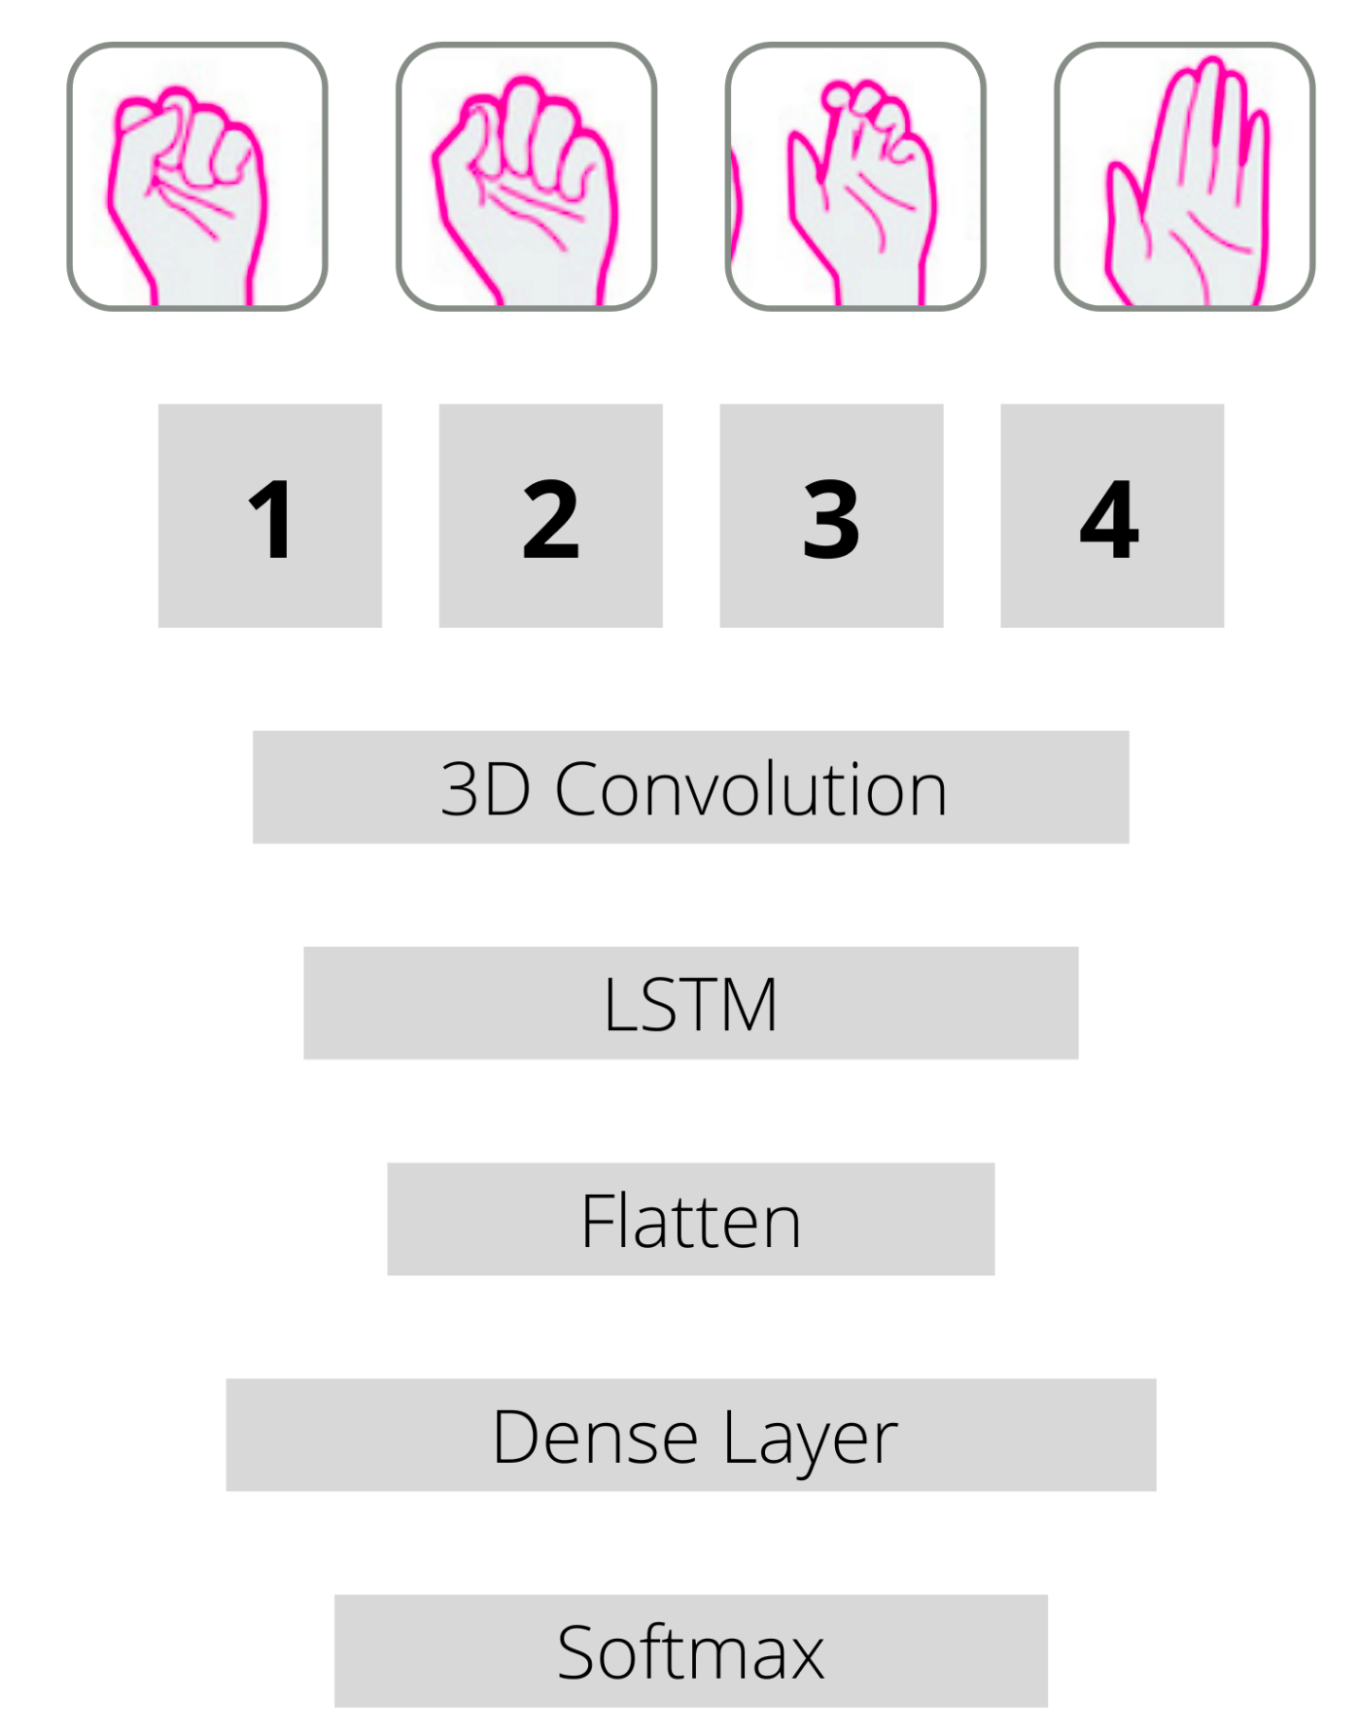
Structure Of Model
Frames
3D Convolutionals

Slide 6
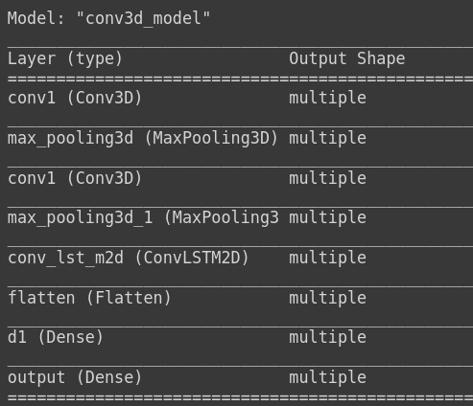
Details of Model

Slide 7
Result
Total training data = 4*160
Total testing data = 4*10
Accuracy = 60%

Slide 8
Future Aspect
We can increase the size of our dataset so that we can guess more different gestures with better accuracy.
We can predict human pose using different dataset so that it can be used for human pose estimation.
We will integrate this model to software, then that software can be controlled using gesture.

Slide 9
Thankyou

