Slide 1
Tetris in Python
Lavrov Rodion 10-1

Slide 2
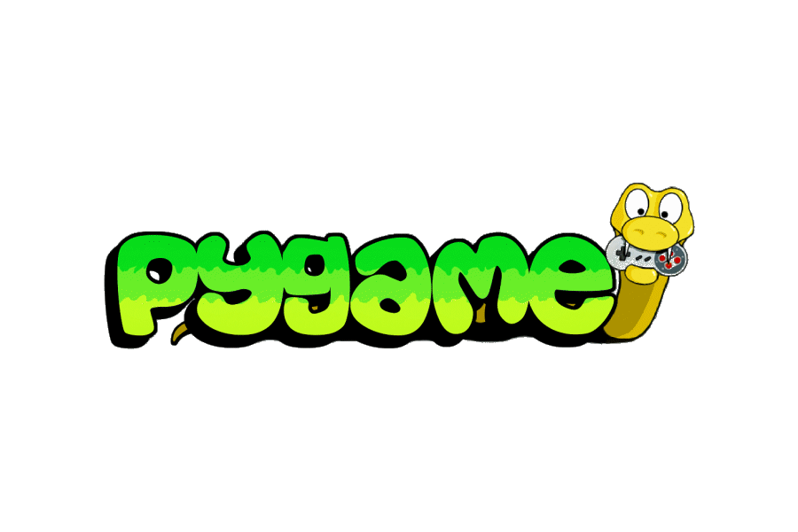
Pygame
Pygame is a free and open-source cross-platform library for the development of multimedia applications like video games using Python.
Pygame have a lot of tools to create all most every 2d game and even can be used to create 3d game.

Slide 3
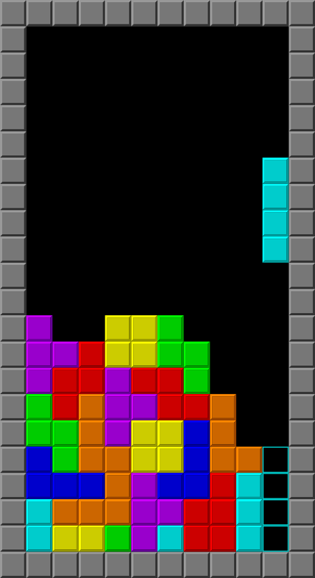
Tetris
Tetris is primarily composed of a field of play in which pieces of different geometric forms, called “tetrominoes”, descend from the top of the field. During this descent, the player can move the pieces and rotate them until they touch the bottom of the field or land on a piece that had been placed before it. The player can neither slow down the falling pieces nor stop them but can accelerate them in most versions. The objective of the game is to use the pieces to create as many horizontal lines of blocks as possible. When a line is completed, it disappears, and the blocks placed above fall one rank. Completing lines grants points and accumulating a certain number of points or lines cleared moves the player up a level.

Slide 4
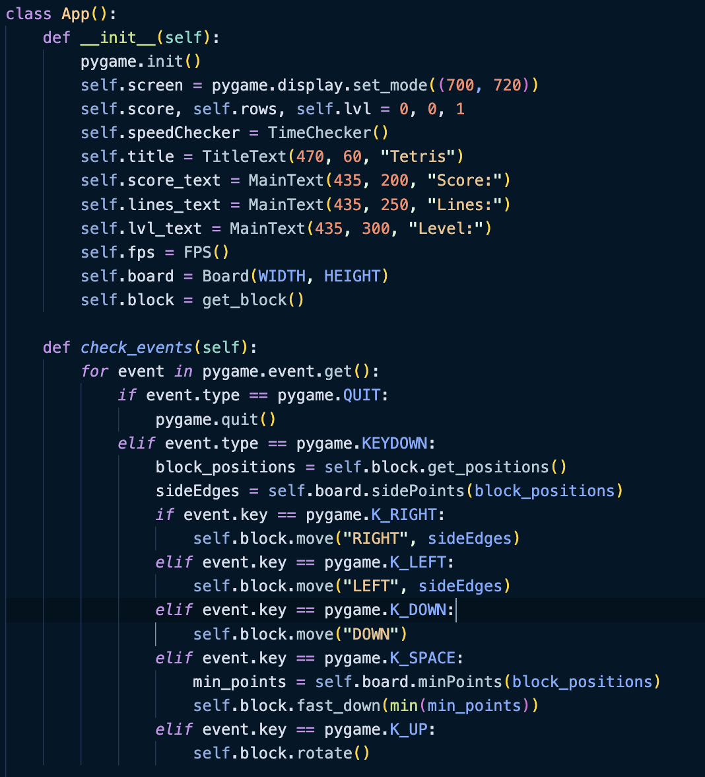
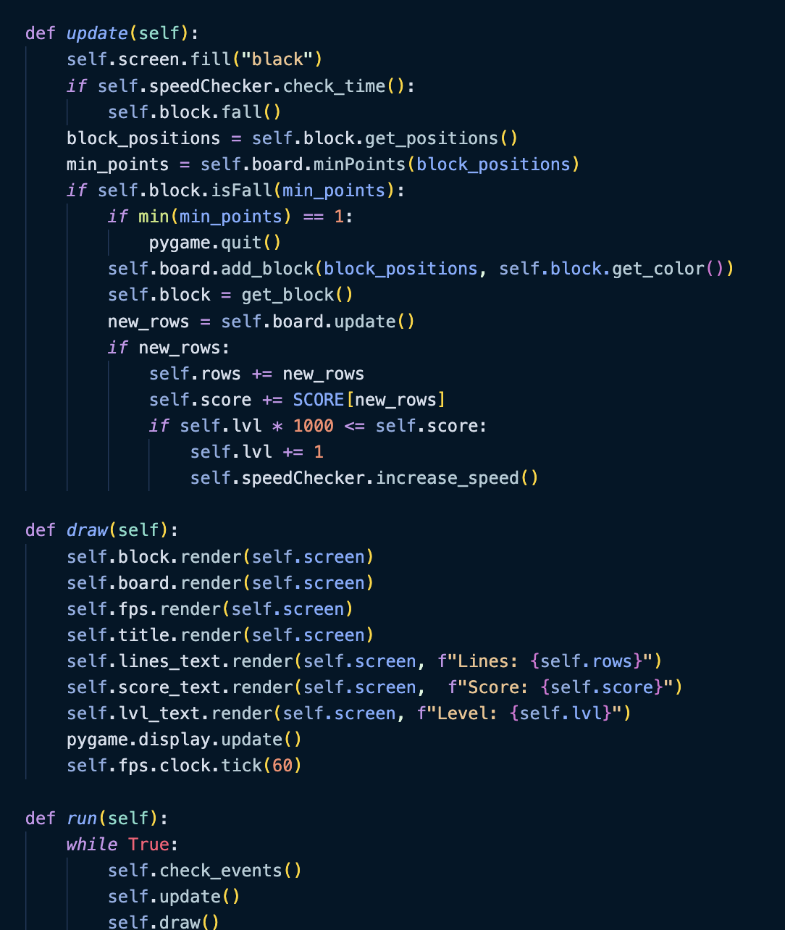
Life-cycle of the game
initialization of game
Tracking event (quit app, click on button, etc)
Tracking game’s status
Render all elements

Slide 5
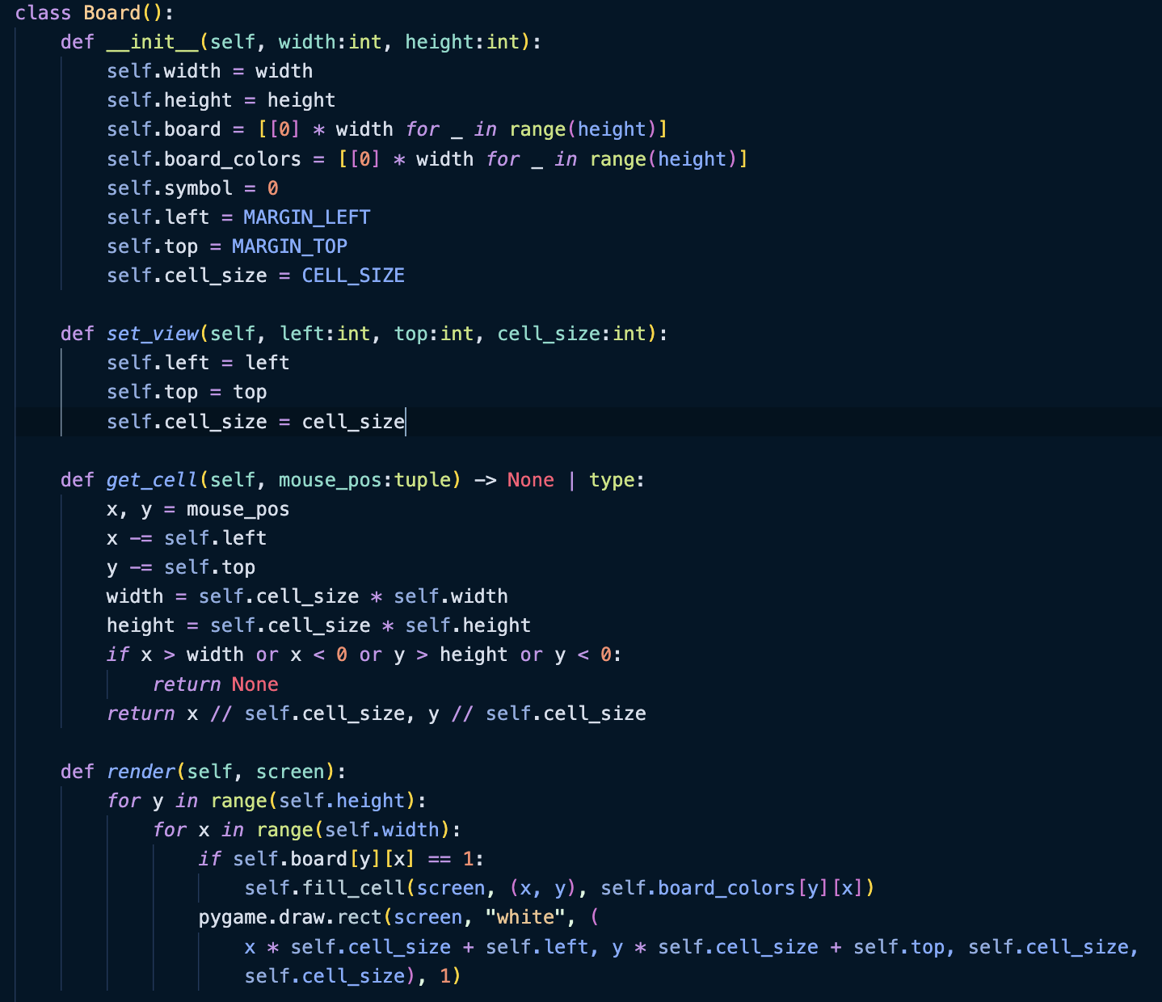
Board class
Board contain two-dimensional array, that describe status of board
Return coordinates of cell
Render board on the screen

Slide 6
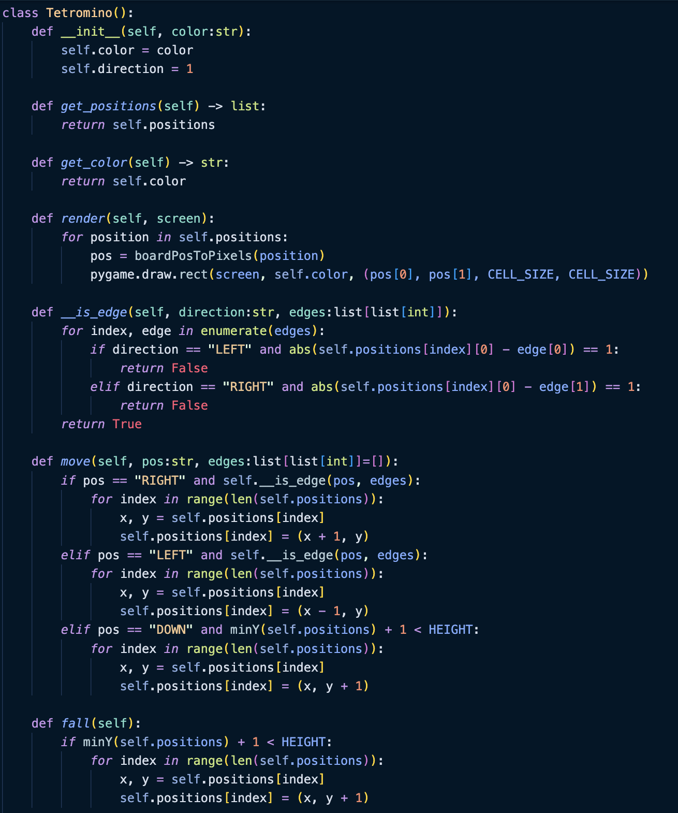
Tetromino class
Draw tetromino
Move tetromino
Fall tetromino

Slide 7
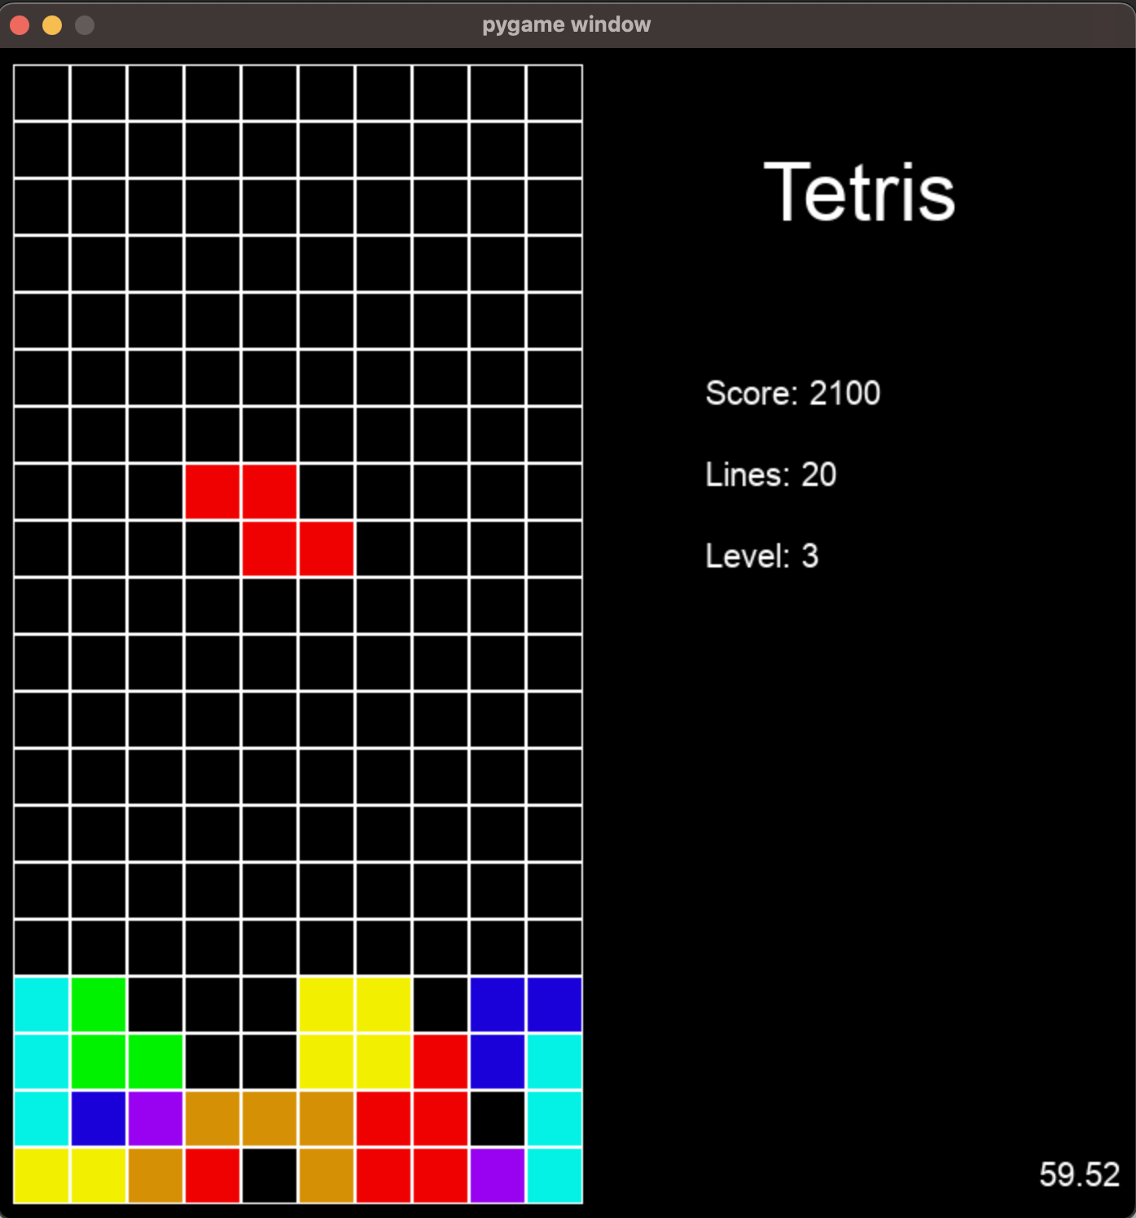
Result

