Slide 1
Premier League Advertisement Value Prediction
Identifying the Best Teams for Advertisement Investment
Name:Trevor Ouma

Slide 2

Introduction
Objective: The goal of this project is to determine which Premier League teams are the best candidates for advertisement investment based on their performance and fan engagement.
Why It Matters: Effective advertising can significantly boost brand visibility, and choosing the right team ensures maximum reach and impact.

Slide 3

The Data
Sources:Player performance data (e.g., goals scored, assists)
Match results (e.g., wins, losses, goals)
Fan engagement metrics (e.g., Instagram followers)
Purpose: These data sources help us understand both the performance of the teams and their popularity among fans.

Slide 4

Key Metrics
Performance Metrics: Goals scored, wins, expected goals (xG)Engagement Metrics: Instagram followers, player popularity, and interaction points
Why These Metrics?: They represent both the on-field success and the off-field fan following, both crucial for advertising.

Slide 5
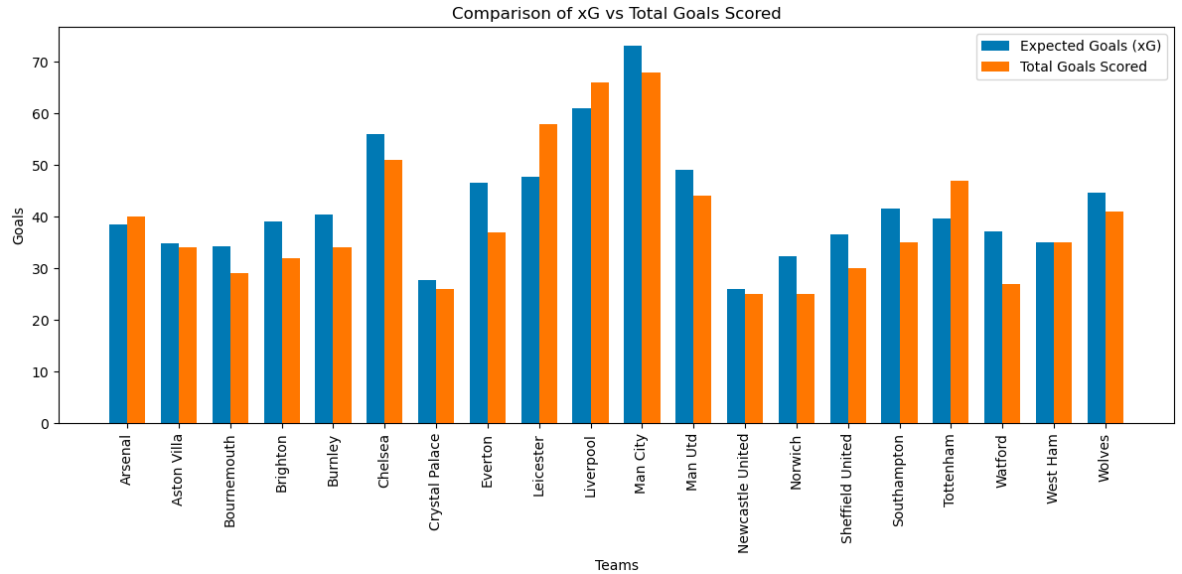

Slide 6

xG and Its Role in Determining Team Play and Popularity
What is xG?
Definition: xG, or "expected goals," is a metric used in football to estimate the quality of scoring chances and the likelihood that any given shot will result in a goal.
How It’s Calculated: xG considers several factors, including the location of the shot, the type of assist, the angle of the shot, and the player’s position. Each shot is assigned an xG value, which represents the probability of it being converted into a goal.

Slide 7

Influence of xG on Popularity
Entertainment Value: Teams with high xG are often more exciting to watch because they create a lot of goal-scoring opportunities. This excitement can attract more fans, increasing the team's popularity.
Fan Engagement: Fans generally prefer teams that play attacking football and score goals, leading to higher fan engagement on social media and increased followership.
Success and Popularity: While defensive teams can be successful, attacking teams often gain more attention and media coverage, further boosting their popularity.

Slide 8

How We Analyzed the Data
Method: We combined performance data with engagement metrics to create a score that indicates a team's advertisement value.
The Process: Data cleaning, merging datasets, and calculating composite scores.

Slide 9
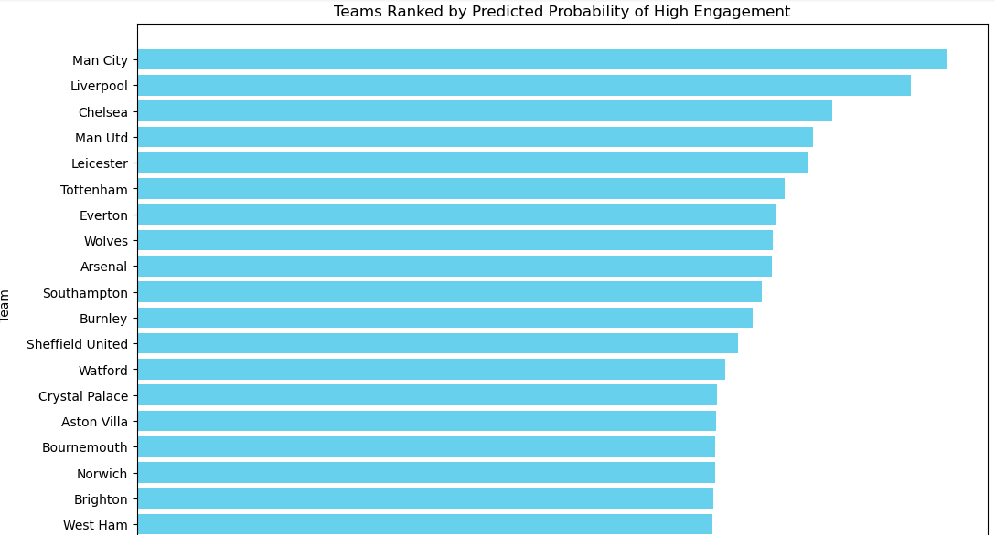
Model results

Slide 10

Next Steps
Improving Predictions: Future work could involve adding more data like TV viewership and exploring other predictive models.
Practical Application: Using this model, advertisers can better target their investments, and teams can strategize to enhance their appeal to sponsors.

Slide 11
Conclusion
Summary: This project shows that a combination of performance and fan engagement metrics can effectively predict which Premier League teams offer the best advertising opportunities.

Slide 12
Thank You:
Open for questions.

