Slide 1

CAN Bus Programming
Vetri Vijay | MSU SRT

Slide 2
Defining the can bus
The CAN bus is a way to communicate amongst different systems using a wire. Data is sent via “frames”.
The bus can accommodate different participants (Teensy, Arduino, Raspberry Pi, BMS).
The system refreshes very frequently (>10,000 times per second)

Slide 3

Terminology
CAN: Controller Area Network
Bus: The wire which carries the signals
Node: A device on the network
Frame: A unit of data sent on the network

Slide 4
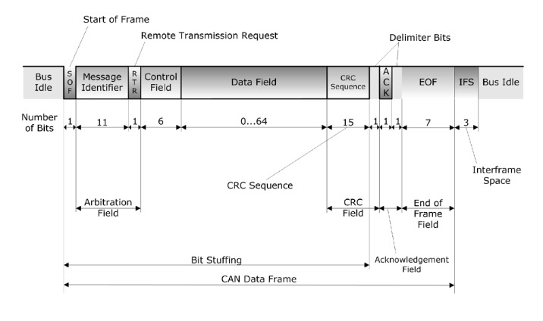
frame structure
The two attributes which we care about:
Frame ID: Used to determine if a node should read the message. Think of this as a subscription.
Data Field: The actual message we are sending.
Frames can be sent and received by nodes on the CAN bus.
The full CAN message frame. You don’t need to understand it.

Slide 5
Writing CAN Code
Template code is present on the SRT GitHub. You need to be added to view
https://github.com/MSU-Solar/can_test/blob/main/can_receive/can_receive.ino
CAN buses are represented as objects and need to instantiated in setup()
The “due_can” library must be installed on the Arduino IDE.
Data is represented in hex (0x48)

Slide 6
CAN Code Snippets
Start the CAN bus: Can0.begin(CAN_BPS_250K);
Creating a CAN frame: CAN_FRAME frame;
Getting the latest CAN frame from the bus: Can0.read(frame);
Writing to a CAN frame:
Create a CAN frame: CAN_FRAME frame;
Set the ID: frame.id = 0x400; hex data
Set the data: frame.data.bytes[0] = 0x48; byte
Sending the frame onto the CAN bus: Can0.sendFrame(frame);
Reading a CAN frame:
Accessing the frame ID: frame.id hex data
Accessing the data: frame.data.bytes[0] byte array
Other topics: Message priority, extended messages, message length.

Slide 7
Misc. Information
In the past season, the car’s CAN system ran at a rate of 250,000 hertz.
CAN buses are used in most modern vehicles for system integration.
This year’s CAN system has been overhauled and is much more complex, there will be a lot more organization needed to manage the system. CAN code is generally not difficult to write but managing all the data writes and reads can be challenging.

Slide 8
Writing code from a schematic
SENSE: Input pin
IND: Output pin
For practice create the pins as constants, and set the outputs to turn on/off according to their inputs
Zoom into the schematic for those details
Reference last week’s slides if needed

