Slide 1

Microcontroller Programming MSU SRT
Vetri Vijay

Slide 2
What do we program?
Microcontrollers on THE circuit boards
The CAN communication bus

Slide 3
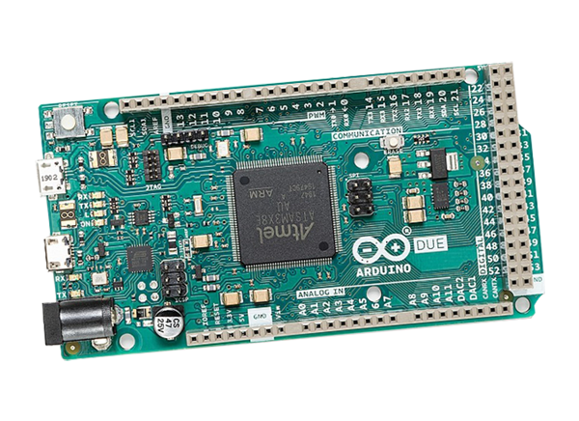
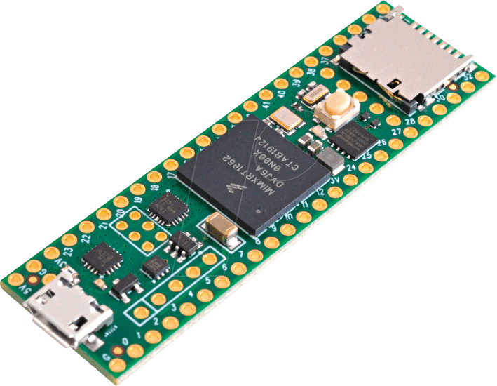
Development Platform
All microcontroller programming is done in C/C++ in the Arduino IDE
Boards:
Teensy 4.1
Arduino Due (Legacy)

Slide 4
Our Task
Take an electrical board schematic and develop code to implement it’s logic
Being able to read a schematic is essential to accomplish this, with a basic understanding of some electrical concepts
Set up the CAN communication channels between the different boards and components

Slide 5
Software Qualifications
We are assuming you have zero experience and will teach you all these concepts
Language: Arduino C/C++
Programming concepts:
Variables
Conditional statements
Loops
Functions

Slide 6
Variables
The components of a variable:
Type: what type of data the variable holds
Name: how to refer to the specific variable
Value: the data the variable holds
An example of a variable initialization:
“const byte BRAKE_LIGHT_PIN = 46;”
A list of types:
byte: value between 0 and 255
int: Integer value, can be negative (-)
double: Value with decimal in it (-)
float: Smaller double (-)
bool: Value is either true or false
const: Used with another type, makes the variable unchangeable after being created

Slide 7
Conditional Statements
Code block: A section of code contained in two curly braces {}. This can be across multiple lines
Conditional: A statement which is either true or false, usually used inside the ()
if statement: Runs a code block {} if the conditional inside the () is true.
In the example if the code inside line 1 is true (The input at the pin is high) line 2 is run.
Use cases: Updating output pins, starting and ending processes.
1|if(digitalRead(INPUT_PIN) == HIGH){
2| digitalWrite(OUTPUT_PIN, HIGH);
3|}

Slide 8
Loops
A while loop will keep running the code block if the conditional is true.
Replacing the “if” in the previous code with “while” will make the code repeatedly run until the conditional is false.
Use cases: Run the same code multiple times like in the example which runs until the car is turned off. The conditional can also be some code.
/* Main loop */
while(true) {
CheckMotorState();
AdjustThrottleVoltage();
SendSpeedRequest();
CruiseControlPedalInterruption();
cruiseToggleSignalCorrector = 0;
cruiseAccelSignalCorrector = 0;
cruiseDecelSignalCorrector = 0;
UpdateExternalLighting();
delay(DELAY);
}
1|while(digitalRead(INPUT_PIN) == HIGH){
2| digitalWrite(OUTPUT_PIN, HIGH);
3|}

Slide 9
Functions
Functions run the same code with different starting variables. They have a few parts:
Name: A way to specify the function
Parameters: The starting values for the code
Specify variable type. Function can have no parameters.
Return type: The function’s output
Specified by return keyword in the code block.
void: No function output
/*
* Updates the headlights, brakelights,
* turn signals, and hazard lights
*/
void UpdateOutPin(byte INPUT_PIN, byte OUTPUT_PIN){
if(digitalRead(INPUT_PIN) == HIGH){
digitalWrite(OUTPUT_PIN, HIGH);
} else {
digitalWrite(OUTPUT_PIN, LOW);
}
}

Slide 10
Frequently Used Code
Setting a constant digital pin ID: const byte FAULT_LED_PIN = 30;
Setting a constant analog pin ID: const byte THROTTLE_INPUT_PIN = A0;
Setting Arduino/Teensy baud rate: Serial.begin(115200);
Updating pin mode: pinMode(GEAR_SELECT_NEUTRAL_PIN, INPUT);
INPUT: HIGH when there is current detected in the wire
INPUT_PULLUP: HIGH when no current is detected
OUTPUT: creates a current in the wire
https://docs.arduino.cc/learn/microcontrollers/digital-pins
Reading digital pins: digitalRead(INPUT_PIN); //Outputs HIGH for current detected, LOW otherwise
Setting the output of a digital pin digitalWrite(OUTPUT_PIN, HIGH); //Can outputs HIGH or LOW
Print to console: Serial.println("Turned off cruise control because driver is pressing on pedals");

Slide 11
Misc. C/C++ Notes
Code statements end with a semicolon ( ; )
Comments (document your code):
Single line: use double slashes ( // )
Multiline: check the previous slide’s code ( /* */ )
Error messages are very hard to read (unlike python), ask for help with your code.
The #include statements at the top are used to link different files to one another

Slide 12
Concepts not covered
Object oriented programming
CAN bus
PID controller
These concepts are not beginner friendly, and a lot of programming can be done with the basics. We will likely cover them in the future when it is required for the car.

Slide 13

GitHub Access
Send us your GitHub username to Grant or Vetri so we can add you to the team’s private organization. You can view our code base from here.

