Slide 1
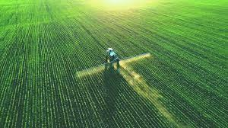
20IT928 PRIEE PROJECT
20IT928 PRIEE PROJECT
NUTRIGUIDE-AI
NUTRIGUIDE-AI
“FERTILISER RECOMMENDATION SYSTEM FOR DISEASE PREDICTION”
“FERTILISER RECOMMENDATION SYSTEM FOR DISEASE PREDICTION”

Slide 2
TEAM INTRODUCTION
1
VETRIVEL M
2
YEGNESHWARAN B
3
HEMANTH KRISHNA
4
SATHYAMOORTHY S
5
UDHAYAN N

Slide 3
Abstract:
Food security and sustainable farming practices depend heavily on agricultural productivity and crop health. In recent years, advancements in artificial intelligence (AI) have revolutionized the agricultural sector by enabling sophisticated prediction models for fertilizer recommendation and disease detection. This paper provides an overview of AI-driven methods for recommending fertilizers. AI methods use real-time and historical data on crop types, weather, and soil characteristics to make recommendations for fertilizers. To analyze the intricate connections between input features and nutrient needs, several machine learning algorithms like linear regression and random forest methods are used in this system, which enable accurate comparison, assist farmers in suggesting fertilizer, and detect plant disease. The outcome of the learning process is used by farmers for corrective measures for yield optimization.

Slide 4
THANK YOU…

