Slide 1

Automated Logistics and Access Security Gate with Monitoring and Behavioral Analysis
ISTE730 - Foundations of IoT
By,
Vetrivel Maheswaran
vm6923@rit.edu

Slide 2
Problem, Motivation & Goal
Problem
Motivation
Goal
Traditional access systems only authenticate users and lack logging, monitoring, and behavioral analysis for detecting suspicious access patterns.
Need a low-cost system combining access control with real-time monitoring and basic intelligence for improved security and visibility.
Develop an IoT-based system for RFID authentication, real-time logging, dashboard monitoring, and simple anomaly detection.

Slide 3
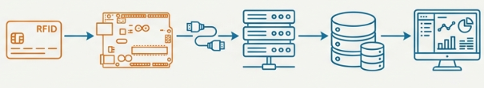
System Architecture
RFID Card → Arduino → Serial → Backend → Database → Dashboard
Arduino (edge): authentication + gate control
Backend: logging + analysis + visualization
Real-time data pipeline using serial communication
Fully local system (no cloud dependency)
Auto-refresh every 5 seconds (polling)
SQLite with SQLAlchemy ORM
Serial reader runs INDEPENDENT of API layer
No HTTP call between serial and database

Slide 4
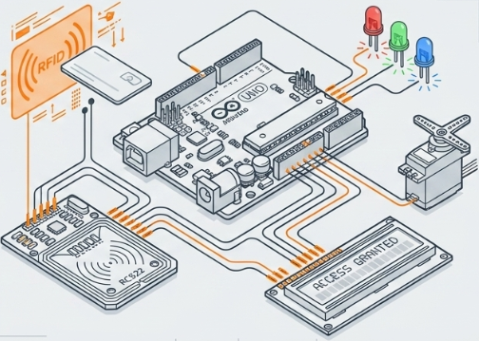
Hardware & Design
Components:
Arduino UNO, RC522, Servo, LEDs, LCD RFID via SPI (UID-based authentication)
Servo controls gate (open/close)
LEDs + buzzer + LCD for feedback
IN/OUT state tracking per user

Slide 5
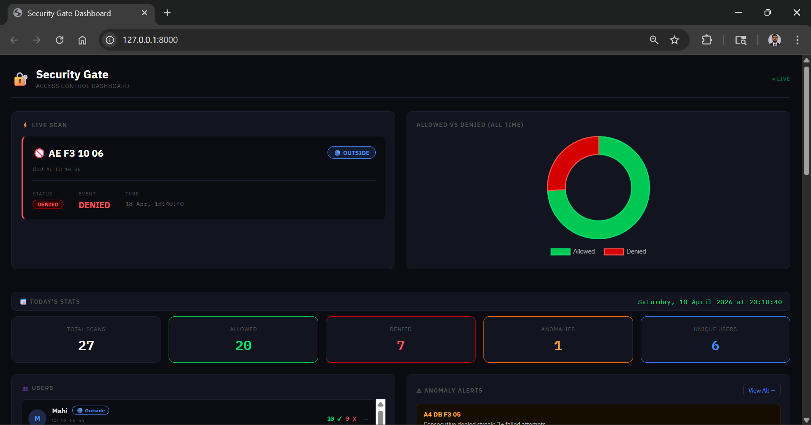
Backend & Dashboard
→ Serial never calls API routes — clean separation
→ 5 API endpoints + 2 analytical endpoints
→ Dashboard = pure static HTML/JS
→ Per-user behavioral page with hourly bar chart + stay durations
Backend: FastAPI + SQLite + PySerial
Data flow: Serial → Service → Database → API
Clean architecture
(Config, Repository, Service, API)
Dashboard features:
Real-time logs
User presence (IN/OUT)
Filtering + statistics

Slide 6
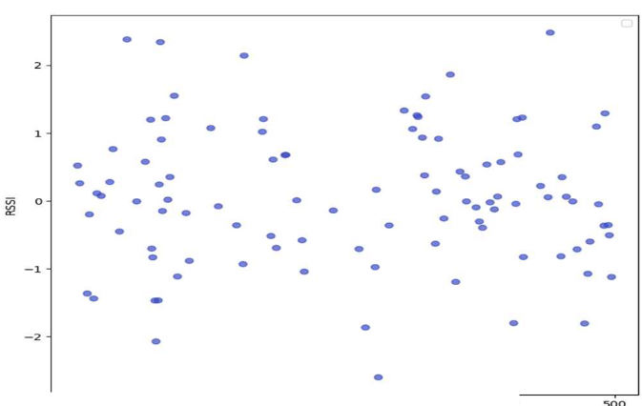

Anomaly Detection
Rule-Based Detection
Machine Learning
Off-hours
→ configurable window (10AM–3PM)
Sliding window algorithm
→ 5 scans / 60 seconds
Streak detection
→ last 3 DB records per UID
Isolation Forest model
(Unsupervised Model)
Feature: time of access
Detects unusual behavior patterns
Fig. 1. Anomaly detection using isolation forest
iTRAC: Intelligent Tracking and Real-Time Analysis on Cloud Using RFID and MQTT
Hybrid approach = simple + intelligent detection

Slide 7



Results, Challenge & Future Work
Real-time system (~1–2 sec delay)
Accurate logging and monitoring
Anomalies detected successfully
Results
RC522 instability
Serial port conflicts
Power limitations
Challenges
Replace Arduino with ESP32 (WiFi)
Dynamic user management (DB-based)
Improve ML features
Future Work

Slide 8


