Slide 1

Automated Logistics and Access Security Gate with Monitoring and Behavioral Analysis
ISTE730 - Foundations of IoT
By,
Vetrivel Maheswaran
vm6923@rit.edu

Slide 2

Problem
Gates authenticate — but never monitor
No audit trail, no behavioral visibility
Suspicious patterns go undetected
Enterprise solutions exist — but remain largely inaccessible to small facilities

Slide 3
Motivation & Goal
Motivation
Goal
Industry is moving toward behavioral gate intelligence
EAIGLE, Opendock, ASSA ABLOY — proven at enterprise scale
Personally, I wish to experience this IoT with ML end-to-end
Prove intelligence does not require enterprise budget
RFID authentication at the edge (Arduino)
Full digital audit trail → SQLite database
Real-time live dashboard → localhost
Behavioral analysis per user
Hybrid anomaly detection → Rules + Isolation Forest ML
Low cost. Fully local. No cloud.

Slide 4
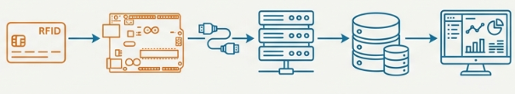
System Architecture
RFID Card → Arduino → Serial → Backend → Database → Dashboard
Arduino (edge): authentication + gate control
Backend: logging + analysis + visualization
Real-time data pipeline using serial communication
Fully local system (no cloud dependency)

Slide 5

Hardware & Design
Components:
Arduino UNO, RFID RC522 (13.56 MHz)
Servo controls gate (open/close)
LEDs + buzzer + LCD for feedback
IN/OUT state tracking per user

Slide 6
Backend & Dashboard
→ Serial never calls API routes — clean separation
→ 5 API endpoints + 2 analytical endpoints
→ Dashboard = pure static HTML/JS
→ Per-user behavioral page with hourly bar chart + stay durations
Backend: FastAPI + SQLite + PySerial
Data flow: Serial → Service → Database → API
Clean architecture
(Config, Repository, Service, API)
Dashboard features:
Real-time logs
User presence (IN/OUT)
Filtering + statistics

Slide 7
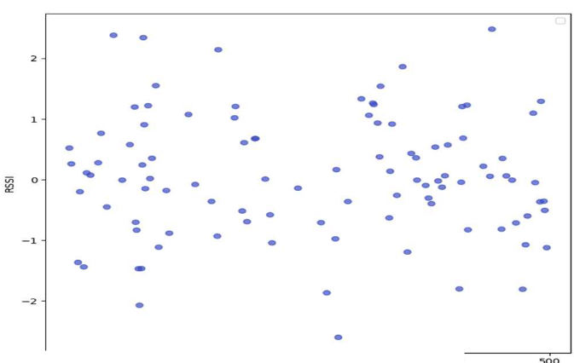

Anomaly Detection
Rule-Based Detection
Machine Learning
Off-hours
→ configurable window (10AM–3PM)
Sliding window algorithm
→ 5 scans / 60 seconds
Streak detection
→ last 3 DB records per UID
Isolation Forest model
(Unsupervised Model)
Feature: time of access
Detects unusual behavior patterns
Fig. 1. Anomaly detection using isolation forest
iTRAC: Intelligent Tracking and Real-Time Analysis on Cloud Using RFID and MQTT
Hybrid approach = simple + intelligent detection

Slide 8
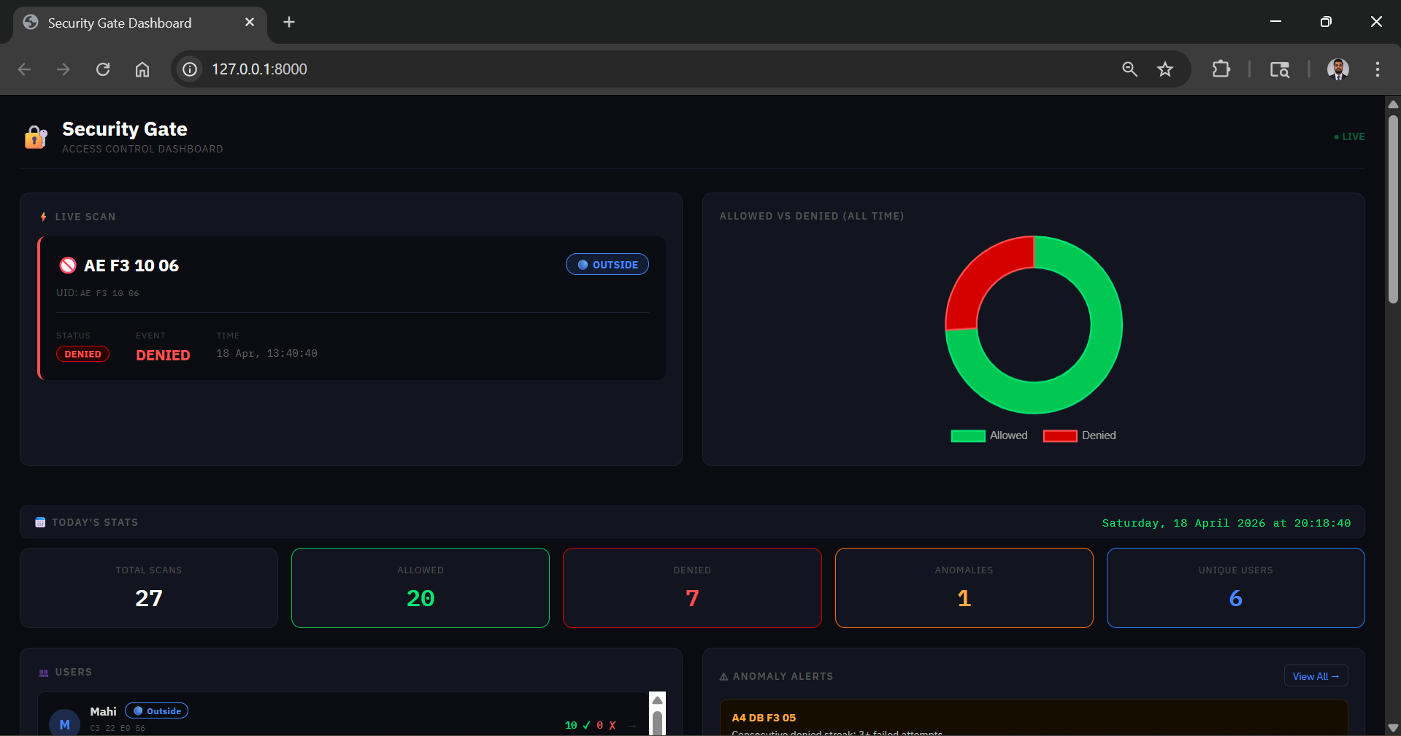
Dashboard

Slide 9

Demo

Slide 10



Results, Challenge & Future Work
Real-time system (~1–2 sec delay)
Accurate logging and monitoring
Anomalies detected successfully
Results
RC522 instability
Serial port conflicts
Power limitations
Challenges
Upgrade to PostgreSQL — production-grade database
Collect more data — improve ML model accuracy
Expand Isolation Forest features
Future Work

Slide 11


