Slide 1
Reducing Hallucination in RAG Using Hybrid Vector–Graph Retrieval with Evidence Grounding
ISTE 793 – Spring 2026
By, Vetrivel Maheswaran

Slide 2

Agenda
1
Introduction
2
Motivation
3
Prior Work
4
Methodology
5
Experiments & Results
6
Demonstration
7
Conclusion
8
Future Work

Slide 3

Problem
Large Language Models are widely used for document-based question answering and enterprise search.
However, they often generate hallucinated responses that are fluent but not supported by factual evidence.
This limits reliability in high-stakes applications.

Slide 4
Why Current RAG Fails in Practice
Multi-hop Query Failure
→ Answers require combining information from multiple sections, but vector retrieval often returns only partial evidence
Why Current RAG Systems Are Not Enough?
Entity-Level Mismatch
Vector retrieval captures similarity but misses relationships across documents
This leads to incomplete evidence and unsupported answers in complex queries
→ Important terms like system components or entities are not matched precisely, even when they exist in documents
ML adds model-specific risks
→ When evidence is missing or incomplete, the model generates fluent but unsupported responses

Slide 5

Research Question
This work focuses on improving evidence grounding in document-based QA systems. We investigate whether combining semantic and structural retrieval improves reliability.
Can hybrid vector–graph retrieval reduce hallucination and improve grounding?
This project designs and evaluates a hybrid retrieval system with strict grounding constraints.

Slide 6
Prior Work
These papers are classified under Retrieval Methods
Blended RAG
Hybrid RAG
Document Knowledge Graph
Combines Dense and Sparse retrieval for better ranking
Improves query matching across different retrieval signals
Integrates vector retrieval with knowledge graph reasoning
Uses entity relationships to improve context understanding
Builds structured graph from document sections and entities
Enables linking of related information across documents
K. Sawarkar, A. Mangal and S. R. Solanki, “Blended RAG: ImprovingRAG Accuracy with Semantic Search and Hybrid Query-Based Retrievers,”2024 IEEE 7th Int. Conf. on Multimedia Information Processing andRetrieval (MIPR), 2024, pp. 155–161.
B. Sarmah et al., “HybridRAG: Integrating Knowledge Graphs and Vector Retrieval Augmented Generation for Efficient Information Extraction,” arXiv:2408.04948, August 2024.
S. Knollmeyer et al., “Document Knowledge Graph to Enhance QuestionAnswering with Retrieval Augmented Generation,” 2024 IEEE 29th Int.Conf. on Emerging Technologies and Factory Automation (ETFA), 2024,pp. 1–4.

Slide 7
Prior Work
These papers are classified under Hallucination Control
ReRAG
LRP4RAG
Conformal Abstention
Adjusts chunk size and retrieval settings using feedback
Improves alignment between retrieved evidence and answers
Uses relevance propagation to trace token influence
Identifies which evidence contributes to generation
Allows model to abstain when confidence is low
Provides statistical guarantees on hallucination risk
R. Koç, M. K. Gürkan and F. T. Yarman Vural, “ReRag: A New Archi-tecture for Reducing Hallucination by Retrieval-Augmented Generation,”2024 9th Int. Conf. on Computer Science and Engineering (UBMK), 2024,pp. 961–965.
H. Hu, C. He, X. Xie and Q. Zhang, “LRP4RAG: Detecting Halluci-nations in Retrieval-Augmented Generation via Layer-Wise RelevancePropagation,” arXiv:2408.15533, June 27, 2025.
Y. A. Yadkori et al., “Mitigating LLM Hallucinations via ConformalAbstention,” arXiv:2405.01563, April 2024

Slide 8
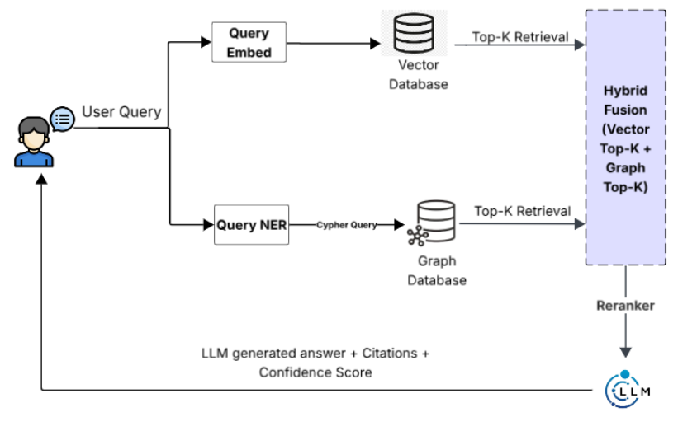
Methodology (System Overview)
Evidence-grounded RAG system with controllable reliability
End-to-end document-to-answer pipeline
Hybrid retrieval combines vector & graph
Enforces citation and abstention constraints
Fig 1. Hybrid Vector - Graph Retrieval Architecture The system follows a staged pipeline that transforms documents into an evidence-grounded question answering system.

Slide 9
Methodology (Document Ingestion & Extraction)
Reliable document parsing with structural extraction
Documents are assigned deterministic IDs using SHA256 hashing to ensure reproducibility and deduplication.
Documents are assigned deterministic IDs using SHA256 hashing to ensure reproducibility and deduplication.
PDFs are processed using native parsing with OCR fallback for complex layouts.
Documents are assigned deterministic IDs using SHA256 hashing to ensure reproducibility and deduplication.
DOCX files are converted into structured text while preserving document hierarchy.
Documents are assigned deterministic IDs using SHA256 hashing to ensure reproducibility and deduplication.

Slide 10
Methodology (Cleaning & Chunking)
Structure-aware text preprocessing
Text is normalized to improve embedding quality while preserving original text for citation.
Documents are split using structure-aware chunking instead of fixed-size windows.
Chunks retain metadata including section path, page number, and character offsets.
Documents are assigned deterministic IDs using SHA256 hashing to ensure reproducibility and deduplication.
Documents are assigned deterministic IDs using SHA256 hashing to ensure reproducibility and deduplication.
Documents are assigned deterministic IDs using SHA256 hashing to ensure reproducibility and deduplication.
1200 – 2200 chars
~450 chards overlap

Slide 11
Methodology (Embedding & Indexing)
Efficient embedding with cache-aware indexing
1
Chunk Input
Each chunk is embedded using BAAI/bge-m3 (1024-dimensional vectors).
A SQLite-based cache avoids recomputing embeddings for identical content - achieving up to 100% avoidance on re-ingestion.
Vectors are stored in a FAISS index with full metadata mapping for traceability.
6
2
Store & Index
Embedding text build
Embedding
5
3
Model Encoding
Cache Key Generation
4
Cache Lookup

Slide 12
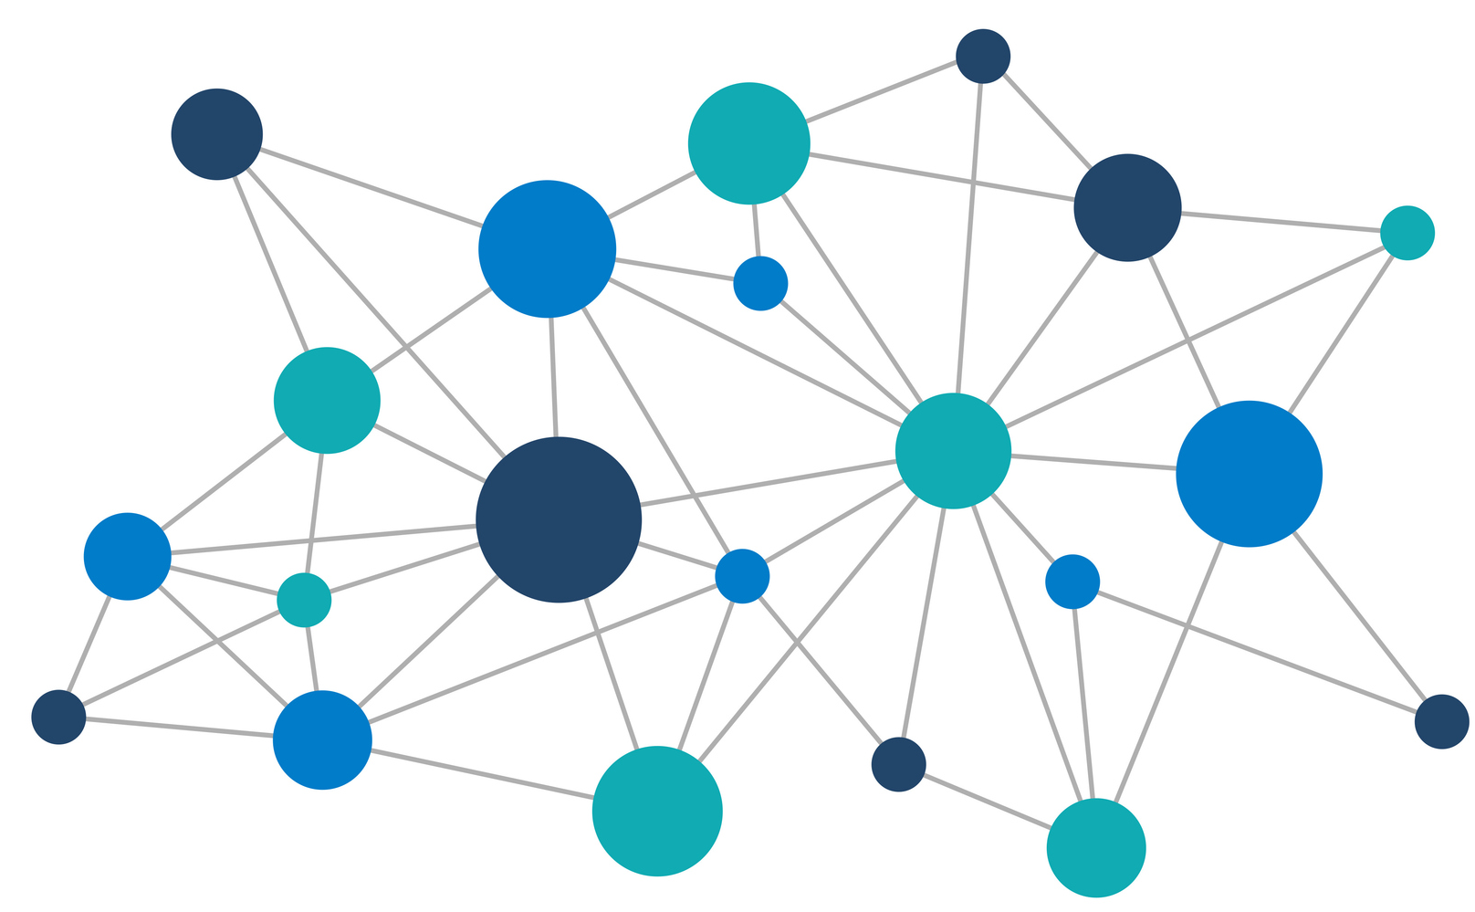
Methodology (Knowledge Graph Construction)
Efficient embedding with cache-aware indexing
A knowledge graph is built using Neo4j to capture entity relationships and structural connections.
Entity and relation extraction is performed using GPT-4o-mini via an LLM-based pipeline.
Graph nodes include documents, chunks, and entities connected through HAS_CHUNK, NEXT, and RELATES_TO edges.

Slide 13
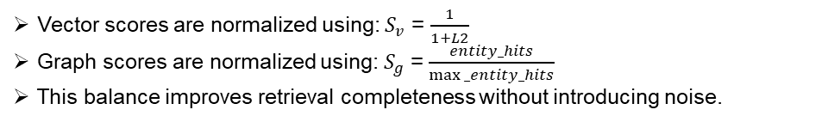
Methodology (Hybrid Retrieval)
Combining semantic and structural retrieval
Vector Retrieval
Graph Retrieval
Graph Retrieval
FAISS search
L2 distance
Top-10 Chunks
Semantic similarity
Entity matching
Relation link
Hit-count scoring
Structural context
Entity matching
Relation link
Hit-count scoring
Structural context
$S_{hybrid}$ = 0.75 × $S_{vector}$ + 0.25 × $S_{graph}$
Hybrid Scoring
Vector scores are normalized using: $S_{v}$ = $\frac{1}{1+L2}$
Graph scores are normalized using: $S_{g}$ = $\frac{entity_hits}{max⁡_entity_hits}$
This balance improves retrieval completeness without introducing noise.

Slide 14
Methodology (Grounded Generation)
Evidence-constrained answer generation with abstention
Answers are generated strictly from retrieved top-5 context chunks.
Every statement must be supported by citations [1]–[5] from source documents.
If sufficient evidence is not available, the system returns:
"Not found in documents."
This prevents hallucinated responses and is measured by Abstention Accuracy (87.3% on vector baseline).

Slide 15
Methodology (System Design Highlights)
Engineering decisions for scalable and reliable RAG
Document IDs use SHA-256 content hashing for reproducibility
→ same file always produces the same ID.
SQLite-backed content-addressed keys.
→ Embedding cache reduces redundant computation
Stamping post-graph build.
→ Graph and vector pipelines share unified chunk identity via chunk_id
Runtime query logging captures retrieved chunks, citations, and answers for offline evaluation.

Slide 16

Evaluation Setup
Standard PDF
A total of 102 queries were created covering 6 query types.
Distribution: 40 factual, 18 multi-chunk, 19 unanswerable, 10 cross-document, 9 entity-specific, 6 multi-hop.
Both vector-only and hybrid retrieval modes are evaluated on the same gold dataset.
IEEE paper
DOCX

Slide 17
Evaluation Metrics
How system performance is measured
Recall@10
Abstention Accuracy
Measures whether correct source chunks appear in top-k retrieval results. Shows how well the system retrieves relevant evidence.
Measures correct refusal for unanswerable queries. Shows how well the system avoids guessing without evidence.
Citation Precision
Answer F1
Measures how many cited sources are actually relevant to the query. Shows whether the model grounds answers on correct evidence.
Measures overlap between generated answer and reference answer. Shows overall end-to-end answer quality.
Unsupported Claim Rate
Graph Contribution Rate
Measures fraction of generated claims not supported by evidence. Directly indicates the level of hallucination in responses.
Measures how much final context comes from graph retrieval. Shows the added value of the knowledge graph.
Multihop Recall@10
Measures retrieval success for multi-hop queries. Shows ability to capture distributed evidence across documents.

Slide 18
Results
Vector vs hybrid performance across evaluation metrics
Metric | Vector | Hybrid
Recall@10 | 95.3% | 95.8%
Citation Precision | 74.0% | 74.6%
Abstention Accuracy | 87.3% | 88.5%
Unsupported Claim Rate | 12.7% | 12.7%
Answer F1 | 48.8% | 49.0%
Graph Contribution | N/A | 31.4%
Multihop Recall@10 | 74.1% | 74.9%

Slide 19
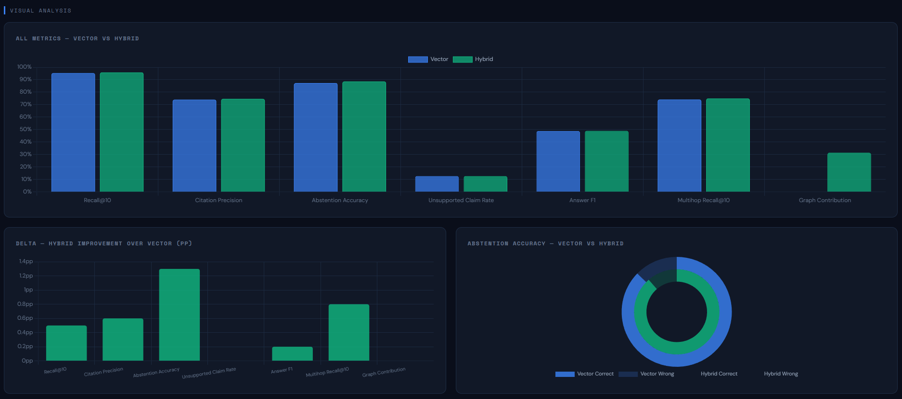
Comparison
Vector vs hybrid performance across evaluation metrics
Hybrid retrieval outperforms vector-only across 5 of 6 comparable metrics:
Recall@10 (95.8%),
Citation Precision (74.6%),
Abstention Accuracy (88.5%),
Answer F1 (49.0%),
Multihop Recall@10 (74.9%).
Graph Contribution Rate of 31.4% confirms the knowledge graph layer actively supplements vector retrieval in nearly one-third of all queries - not redundant, additive
Unsupported Claim Rate remains unchanged at 12.7% across both modes .

Slide 20

Demo

Slide 21

Conclusion
Key findings on improving grounded RAG reliability
Hybrid retrieval improves multi-hop performance and reduces missing evidence
Combining vector and graph retrieval strategies” signals increases retrieval completeness
Citation and abstention constraints effectively reduce hallucination
Hybrid outperforms vector-only across key evaluation metrics

Slide 22
Future Work
Focus on owned Domain based production grade with AI Models for training
Extend graph retrieval with multi-hop traversal.
Improve query understanding using rewriting techniques.
Replace API-based graph extraction with local models.

Slide 23
Thank
You…

