Slide 1

Predicting Boulder County Home Prices
Kevin Maher
MSDS692
Data Science Practicum
Regis University
June 2017

Slide 2
Overview
Goal is to Predict Sales Prices of Boulder County Colorado Home Prices
  2013 to 2016
Use Machine Learning to make predictions
  Improve over county assessor's estimate of home value by adding home features to the model
    Use both the assessor's estimate and home features in the model
  Data is from the county assessor's office

Slide 3
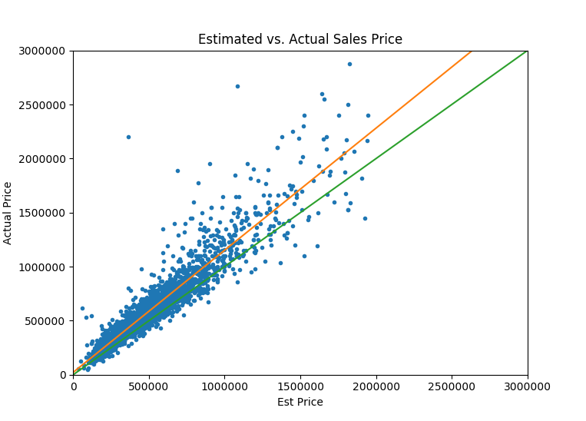
Assessor's Estimate
Provides a baseline value but tends to underestimate the sales price
Goal is to improve on this estimate
Green Line: Ideal Fit
Orange Line: Fit Baseline
When we look at the final model we will see the orange line much closer to the green line indicating a better model, also there will be less scatter in the prices

Slide 4
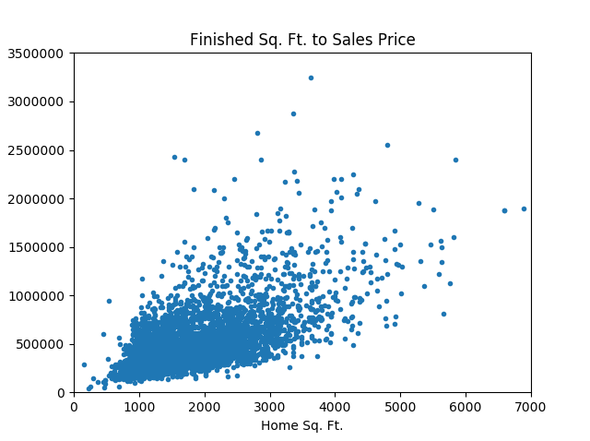
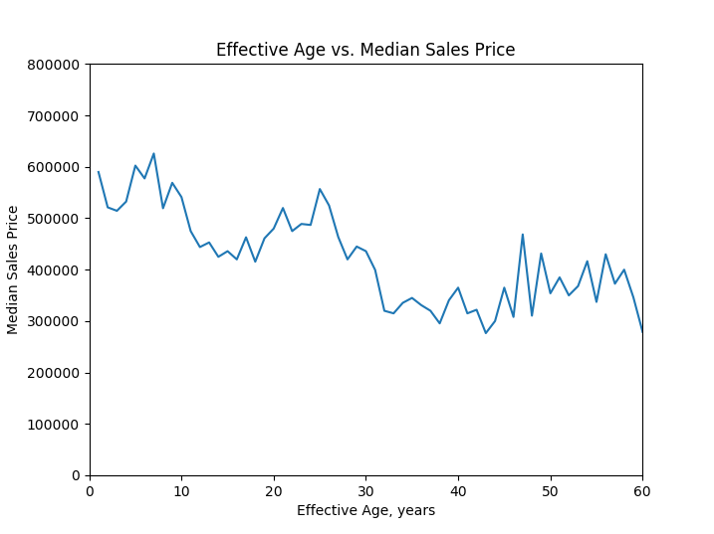
Exploratory Data Analysis
Sample of some of what was performed
Some trends in:
  Home Finished Size to Price
  Effective Home Age to Price

Slide 5
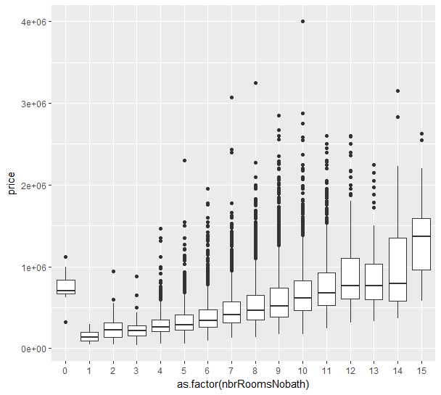
Exploratory Data Analysis
Relationship between number of rooms in a home and price
  The zeros could possibly be filled in but I did not observe an overall increase in model accuracy when they were replaced by 12-14

Slide 6
Metrics
Mean Absolute Percent Error
  Mean of the absolute value of percentage error
RMSE: Root Mean Squared Error
  Calculated using methods from Kaggle
  Uses log of home price so high priced homes don't dominate it
Gradient
  Check how well the model over or under estimates the value
  Shows the model underestimates value slightly
R-Squared, R-Squared Adjusted
  Standard statistical measure of linear regression fit between predicted and actual home prices

Slide 7
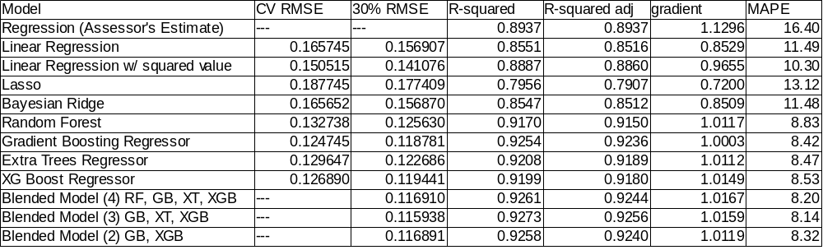
Model Results
For a Single Model: Gradient Boosting Performed Best
A Blended Model Was Best Overall
  Blended by averaging the results of the three best models
    Extra Trees, Gradient Boosting, XG Boost

Slide 8
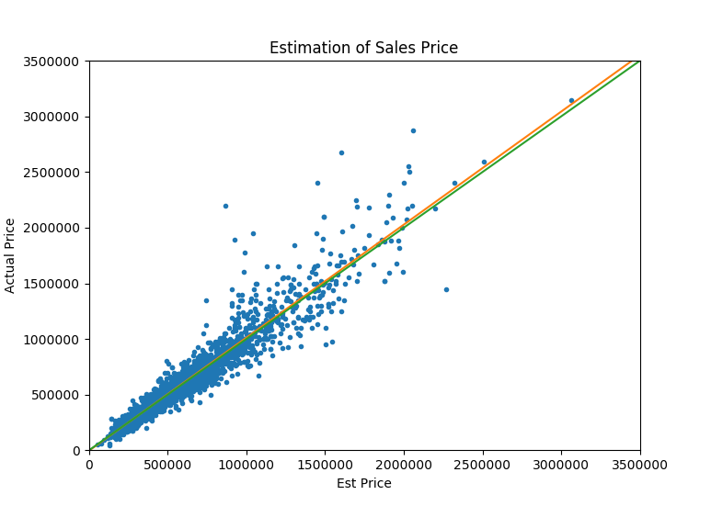
Final Model
Blend of Extra Trees, Gradient Boosting, XG Boost
  Note improvement in fit over the simple use of just the assessor's estimate
Green Line: Ideal Fit
Orange Line: Fit Achieved
Note improvements over simply using the assessor's estimate, orange line almost matches green line of ideal fit and less scatter in prices

Slide 9
Notes
GitHub Repository:
  https://github.com/Vettejeep/Boulder_County_Home_Prices
Data: From Boulder County Assessor's office, made available to students for free, but generally they charge for the data
Project Report and References:
  In the GitHub repository as:
  “Kevin Maher MSDS692 Boulder Housing Report.pdf”

