Slide 1

RESUME CLASSIFICATION
Group - 6
Mentor Name: Mr. Advaith
Group Members:
Mr. Syed Kaiser Mehmood
Neha Hussain
Ms. Fariha Hussain
Mr. Mueezur Rahmaan Shariff
Ms. Tazeen Rafique Khan
Mr. Kothapally Vevek

Slide 2
The document classification solution should significantly reduce the manual human effort in the HRM. It should achieve a higher level of accuracy and automation with minimal human intervention.
Business Objective

Slide 3
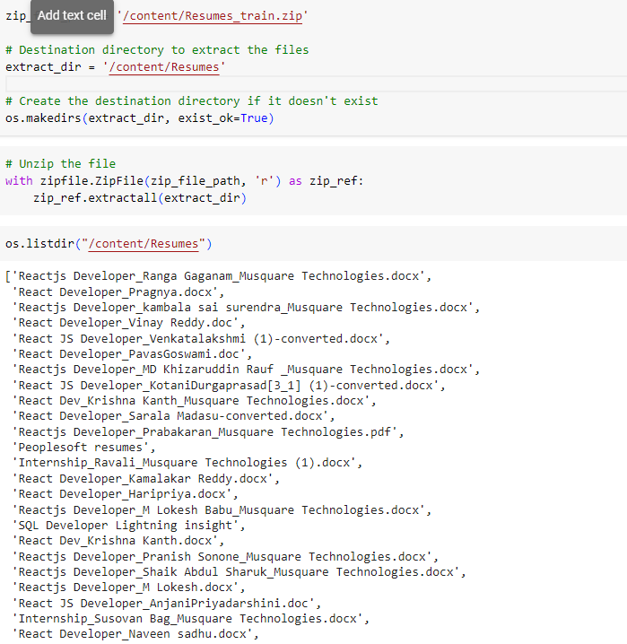
Unzipping the file

Slide 4
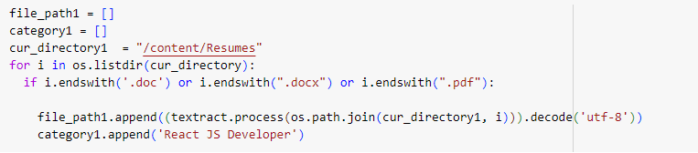
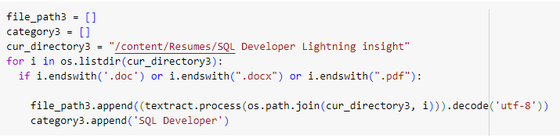
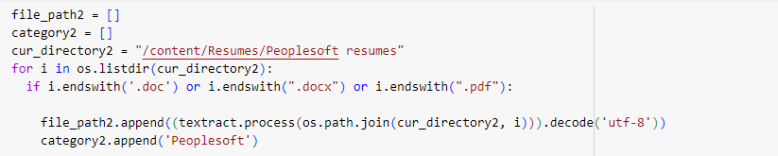
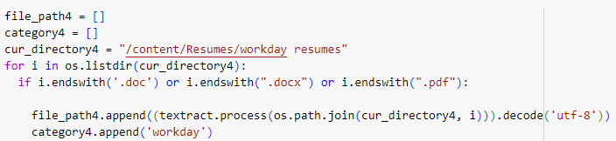
Categorizing the resumes

Slide 5
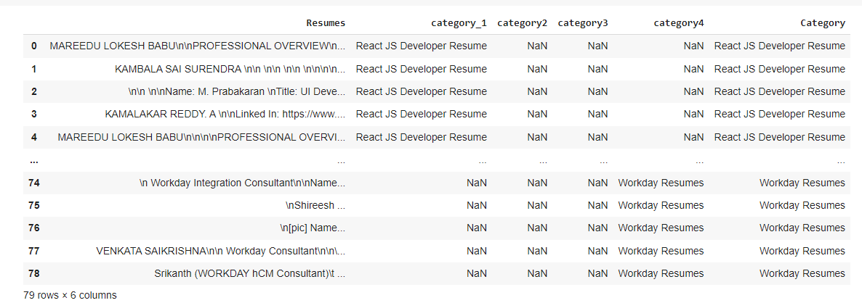
Merging all category files.

Slide 6

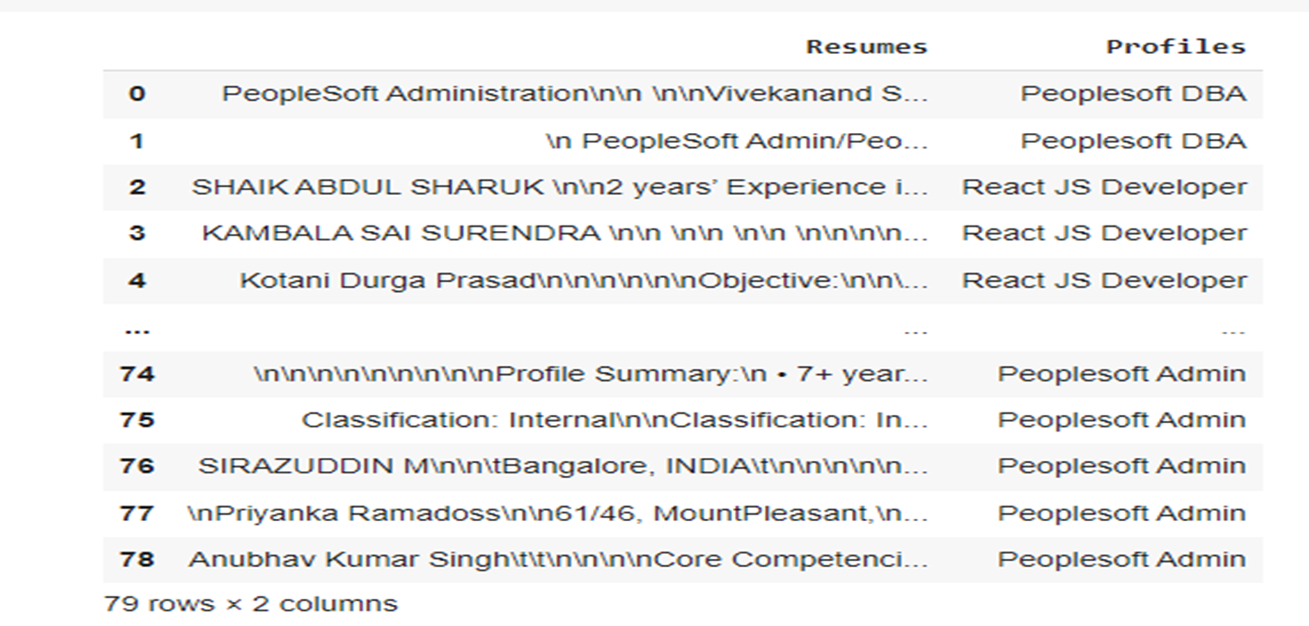
Converting text to .csv (Process)

Slide 7
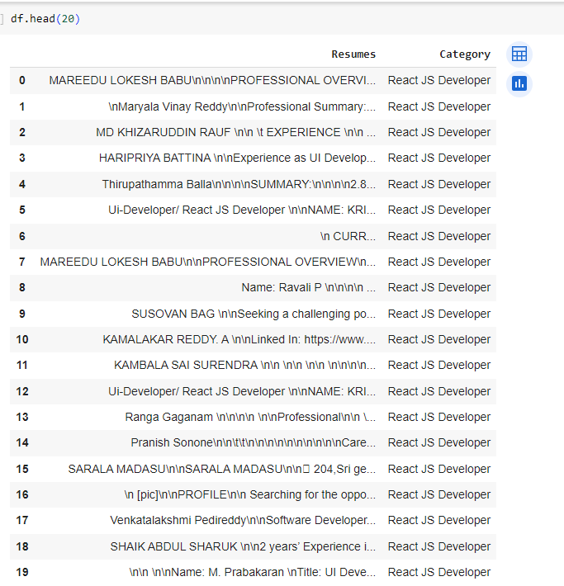
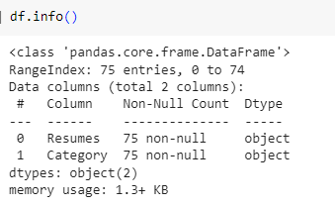
Data Set Details
After Extracting and Modifying the Dataset, given data contains a total of 4 Classes and 74 rows .

Slide 8
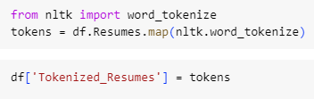
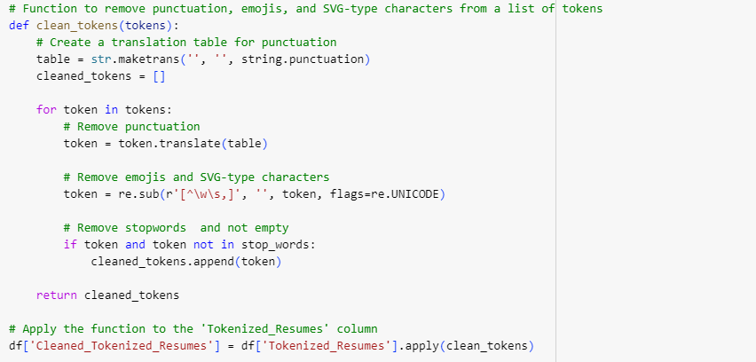
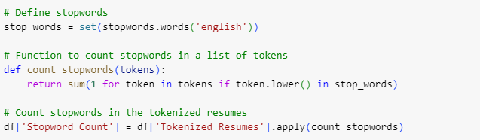
Removing All Unwanted Character’s
Unwanted Character’s like - \n \t, http links, tags, hashtags, HTML tags, converting to lowercase, removing white spaces etc.
Word Tokenization - Tokenization is essentially splitting a phrase, sentence, paragraph, or an entire text document into smaller units, such as individual words or terms. Each of these smaller units are called tokens.
Removing Stop-words - A stop word is a commonly used word (such as “the”, “a”, “an”, “in”) that a search engine has been programmed to ignore, both when indexing entries for searching and when retrieving them as the result of a search query.

Slide 9
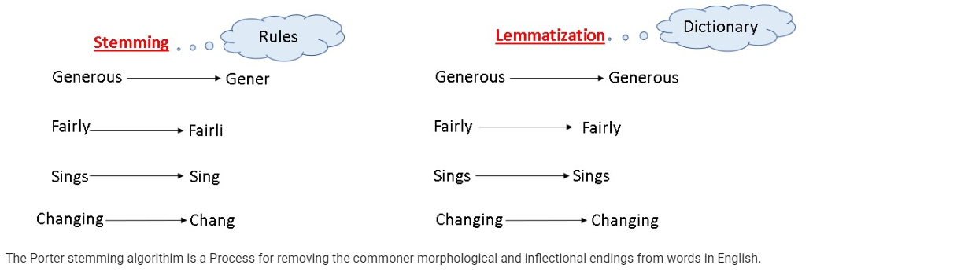
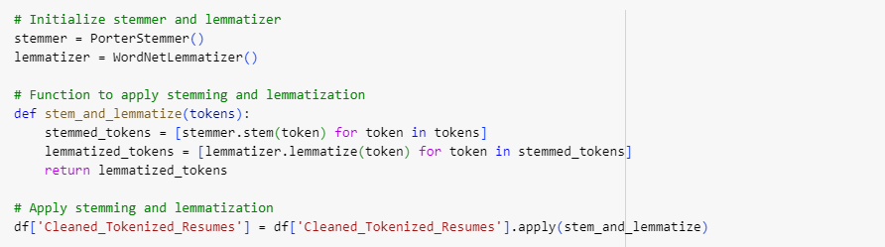
Stemming and Lemmatizing

Slide 10
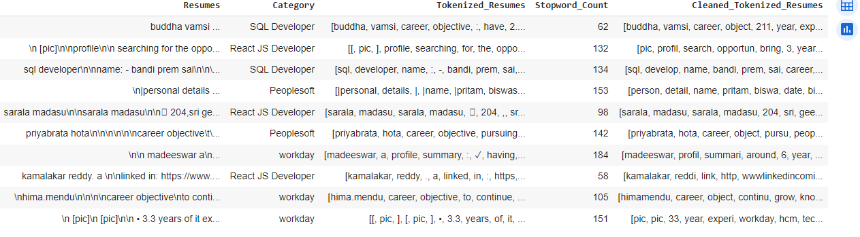
Text – Preprocessing
In natural language processing, text preprocessing is the practice of cleaning and preparing text data. NLTK and re are common Python libraries used to handle many text preprocessing tasks.
Before Text – Preprocessing After Text – Preprocessing
The Dataset contains 74 rows and 4Column
There are total four Classes – Peoplesoft, Workday, React JS Developer and SQL Developer.

Slide 11
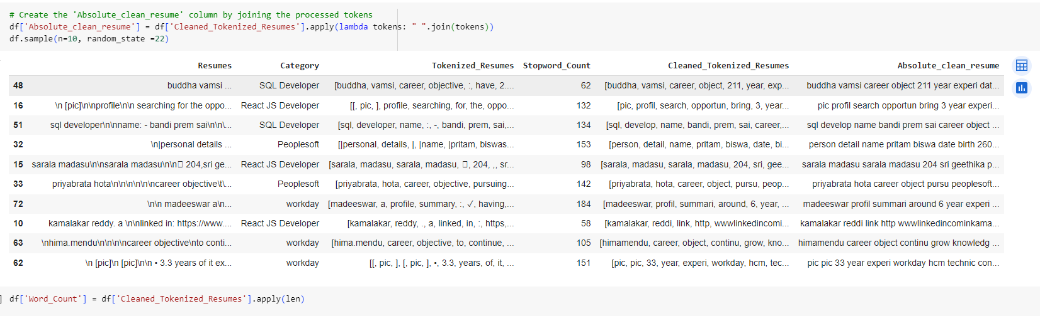
Joining the tokens

Slide 12
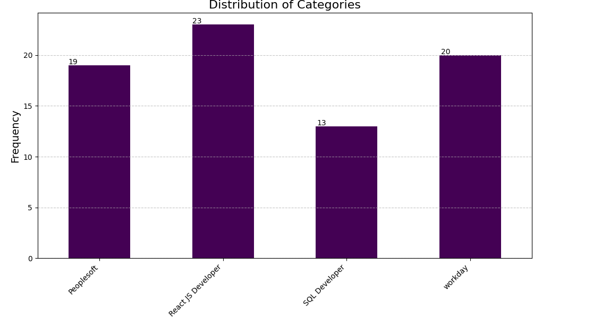

Slide 13
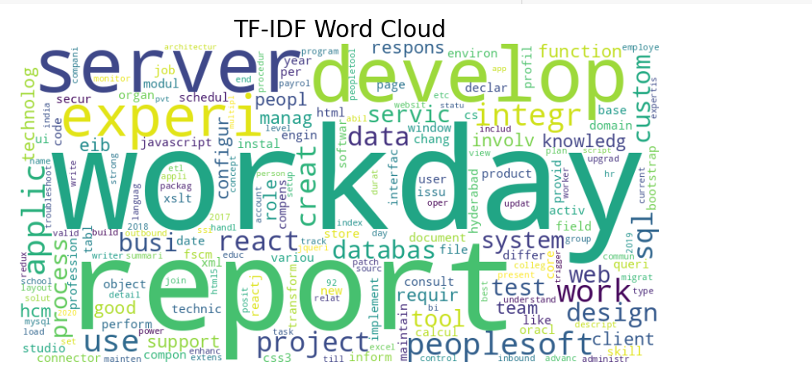
Word cloud

Slide 14
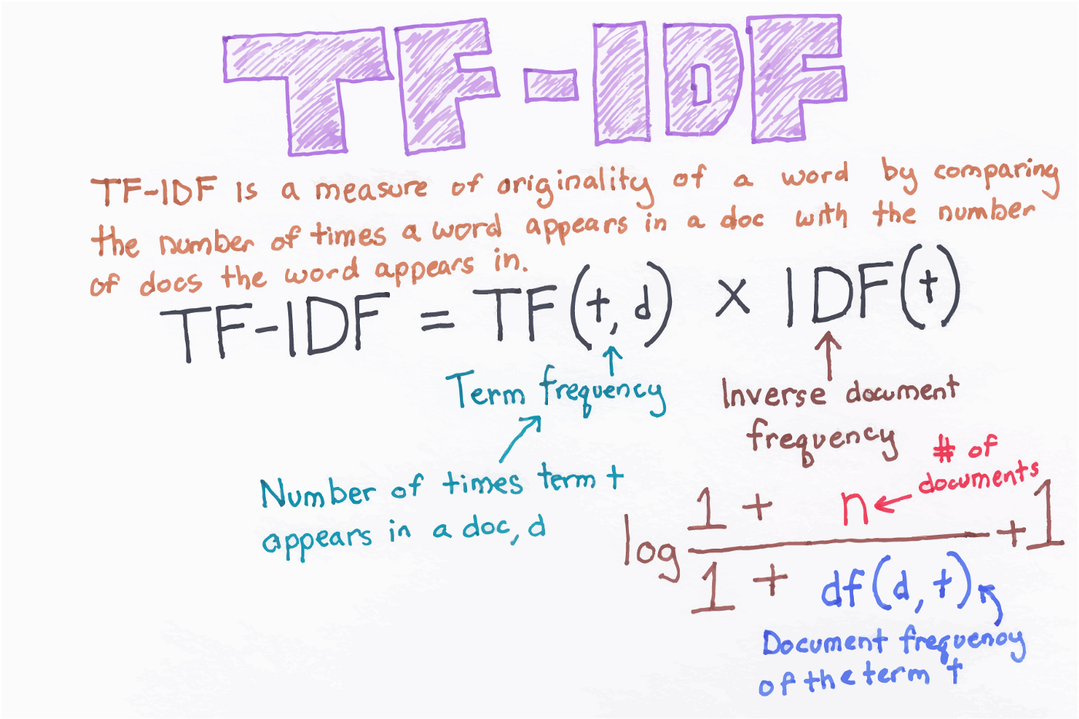
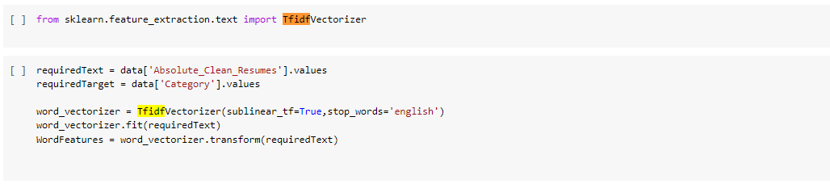
TF-IDF
TF-IDF is better than Count Vectorizers because it not only focuses on the frequency of words present in the corpus but also provides the importance of the words.
We can then remove the words that are less important for analysis, hence making the model building less complex by reducing the input dimensions.

Slide 15
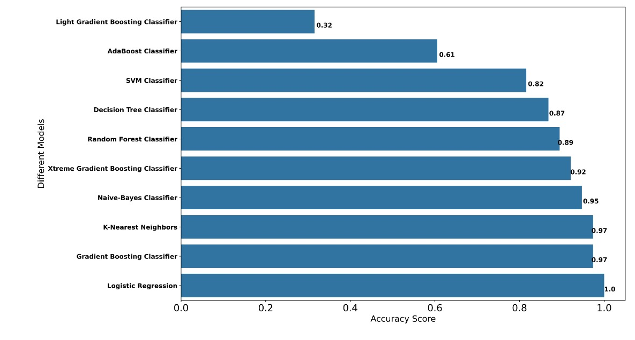
Model Evaluation

Slide 16
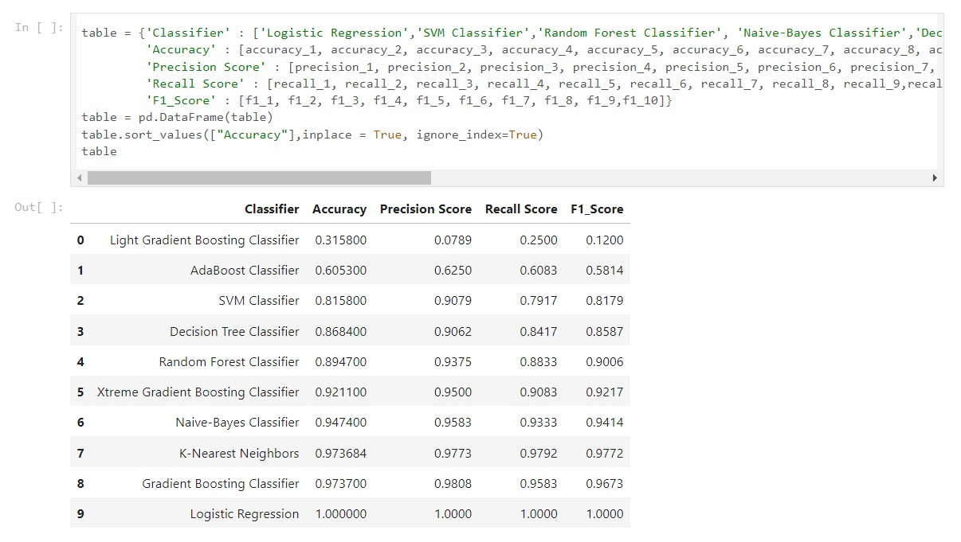
Model- Evaluation
Among these algorithms, 100% Accuracy, Precision, Recall and F1-score have been achieved.
Maximum accuracy is achieved by using the model Logistic Regression, Gradient Boosting Classifier and K nearest neighbours.

Slide 17
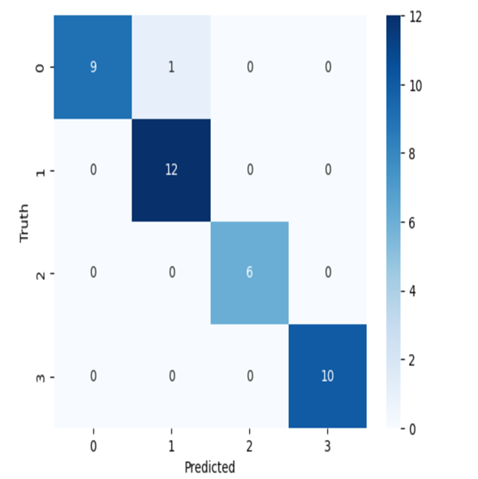
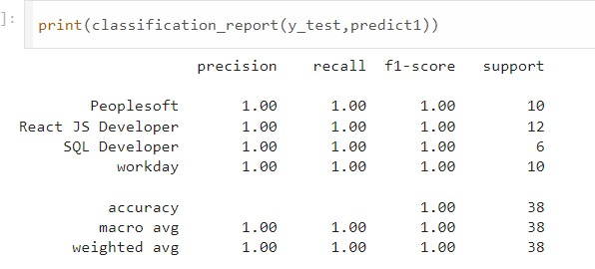
Model-Evaluation Report
Logistic Regression
Here, we have taken Logistic Regression.
100% Accuracy, Precision, Recall and F1-score have been achieved.
No overfitting or underfitting has been found. All classes are classified correctly and no misclassification.

Slide 18
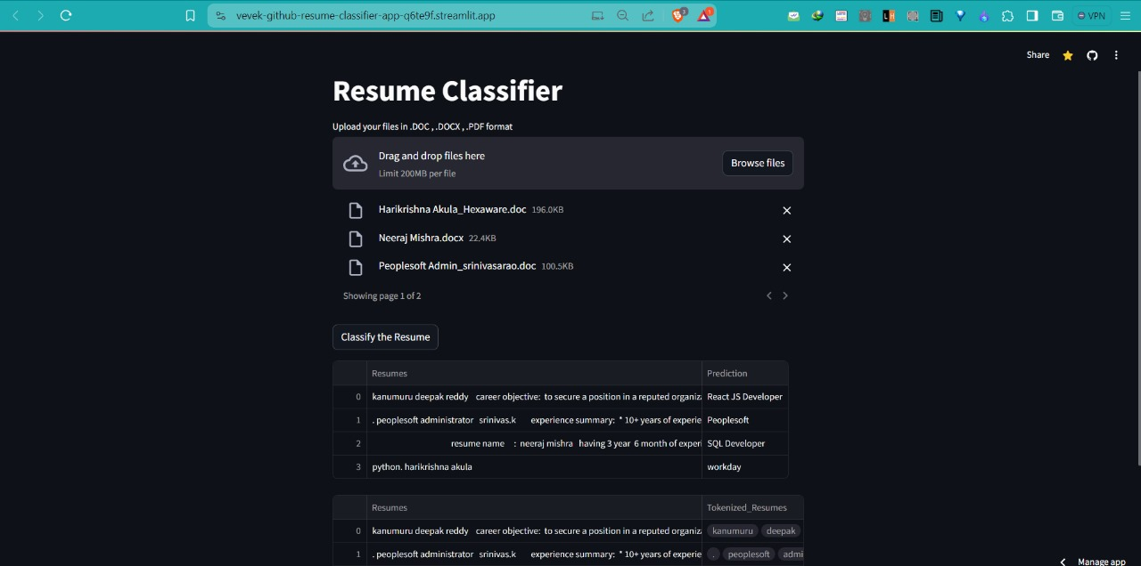
Deployment

Slide 19
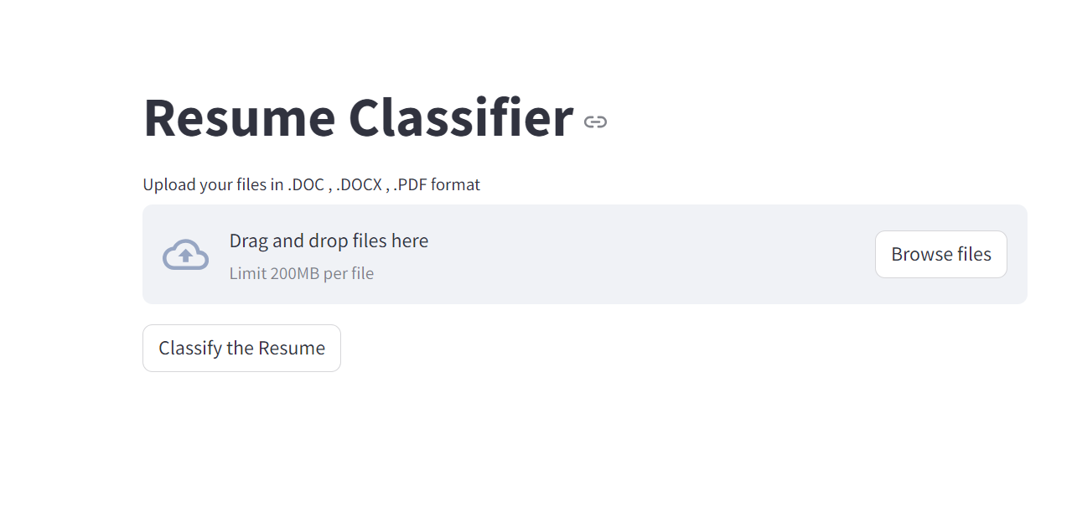
Deployment
Here, we have taken Logistic Regression as our Final Model algorithms for the deployment.
The algorithm has achieved 100% Accuracy, Precision, Recall and F1-score on testing data.
100% accuracy is achieved by using the model Logistic Regression no misclassification on validation set.
We have deployed the Resume Classification using Stream-lit as the platform

Slide 20
Thank you

