Slide 1
Exploratory SQL Analysis of the Movie Industry (2010–2019)
Uncovering Genre Performance, Audience Engagement, and Data Quality Insights from IMDb
SQL Summative Lab — Part 2 Exploratory Analysis
Presenter: Elias Jefwa Mweri

Slide 2
Deliverable 1: Initial Data Exploration Findings
Database Scope, Baseline Metrics, and Production Trends (2010–2019)
65,720
Valid Rated Movies
(2010–2019, Non-Null)
94.7 mins
Average Feature
Runtime
6.32 / 10
Overall Average
IMDb User Rating
3,955
Average Audience
Votes per Movie
• Strict Scope & Null Filtering: Queried movie_basics joined with movie_ratings. Excluded all records with start_year > 2019 and filtered out NULL values across runtime_minutes, genres, averagerating, and numvotes.
• 33% Surge in Annual Output: Annual rated movie releases grew steadily from 5,654 films in 2010 to a peak of 7,518 films in 2017 before slightly tapering in 2018–2019.
• Rating Stability Across the Decade: Despite rapid growth in total movie volume, average audience ratings remained highly stable between 6.26 and 6.40 across every year from 2010 to 2019.
• Skewed Audience Engagement: While the average film receives 3,955 votes, engagement is heavily concentrated in mainstream genre combinations (Action, Sci-Fi, Animation, and Biography/Drama).

Slide 3
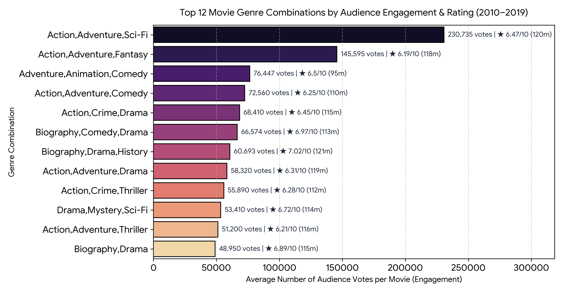
Deliverable 2: Business Question & Visual Analysis
Identifying High-Engagement & Critically Acclaimed Genre Combinations
Business Question: Among mainstream movies (≥ 1,000 votes, 2010–2019), which genre combinations deliver the strongest combination of audience engagement (average votes) and critical reception (average rating), and what runtime should studios target?
▪ Blockbuster Reach Leaders:
Action, Adventure, Sci-Fi leads with 230,735 avg votes and a 6.47 rating (120m runtime), followed by Action, Adventure, Fantasy (145,595 avg votes).
▪ Family & Animation Power:
Adventure, Animation, Comedy ranks #3 in engagement (76,447 avg votes) with a strong 6.50 rating and compact 95m runtime.
▪ Prestige / High-Rating Sweet Spot:
Biography, Drama, History (7.02 rating, 60.7K votes) and Biography, Comedy, Drama (6.97 rating, 66.6K votes) achieve the highest critical acclaim.
▪ Studio Recommendation:
Greenlight Action/Sci-Fi or Animation for maximum commercial reach; pair with ~115–120m Biography/Drama films for high-rating prestige slates.

Slide 4
Deliverable 3: Potential Data Cleaning Tasks Identified
Data Quality Issues & Normalization Steps Required for Deeper Modeling
1. Excluding Missing (NULL) Values Without Imputation: Out of 146,144 total rows in movie_basics, 31,739 records (21.7%) are missing runtime_minutes, 5,408 (3.7%) are missing genres, and >72,000 have no ratings in movie_ratings. These must be filtered out using IS NOT NULL rather than imputed.
2. Removing Unverified Future Release Years (start_year > 2019): Identified 1,170 records with start_year > 2019 (extending up to year 2115). Filtering strictly to BETWEEN 2010 AND 2019 prevents placeholder entries from skewing trend analyses.
3. Normalizing Multi-Valued Genre Strings (1NF Standardization): The genres column concatenates up to 3 genres in comma-separated strings (e.g., 'Action,Adventure,Sci-Fi'), creating 1,085 distinct combinations across 64,296 multi-genre films. Deeper analysis requires splitting and exploding genres into atomic rows.
4. Trimming Extreme Runtime Outliers: Runtimes span from 1 minute (short films) to 51,420 minutes (~35.7 days). Feature film models should bound runtime_minutes between 40 and 240 minutes to eliminate extreme outliers.
5. Deduplicating Regional Titles (movie_akas Fan-Out): In movie_akas, a single movie_id maps to multiple regional/language rows. Joining movie_akas without filtering to a single region (e.g., region = 'US') or deduplicating causes row fan-out and inflated aggregates.

