Slide 1
Final_Project_DAT_494
File created on: 12/3/23 2:46:52 PM MST

Slide 2
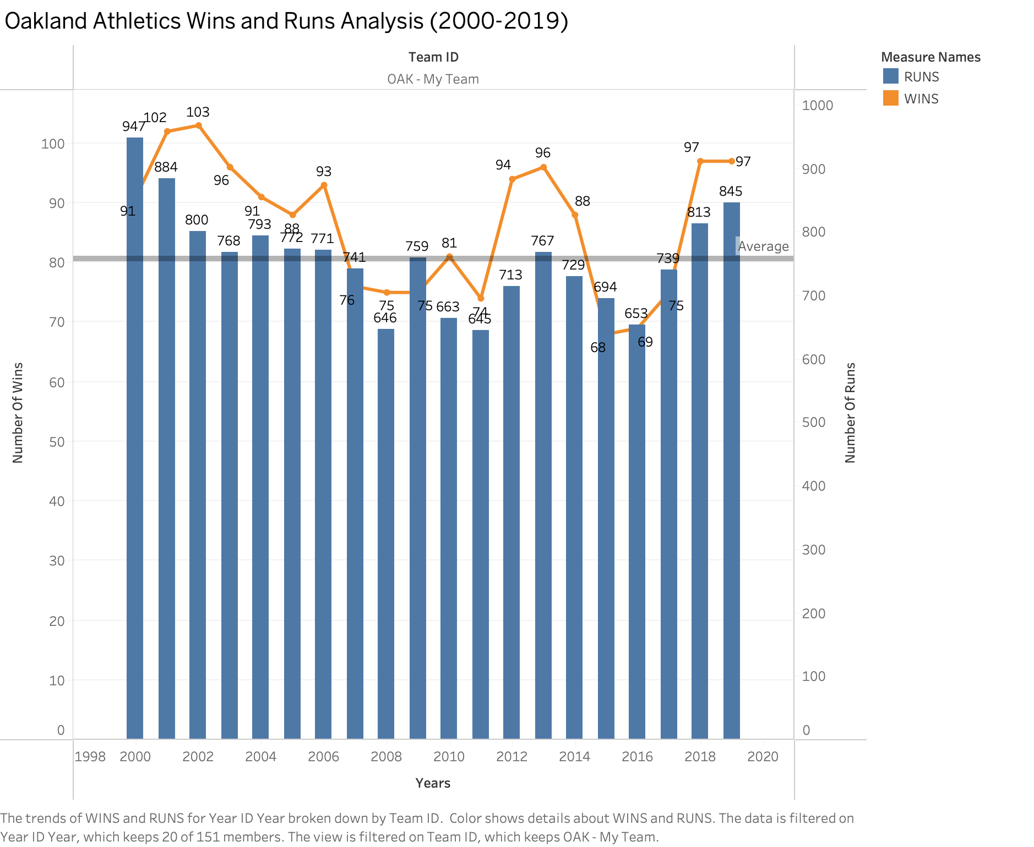

Slide 3
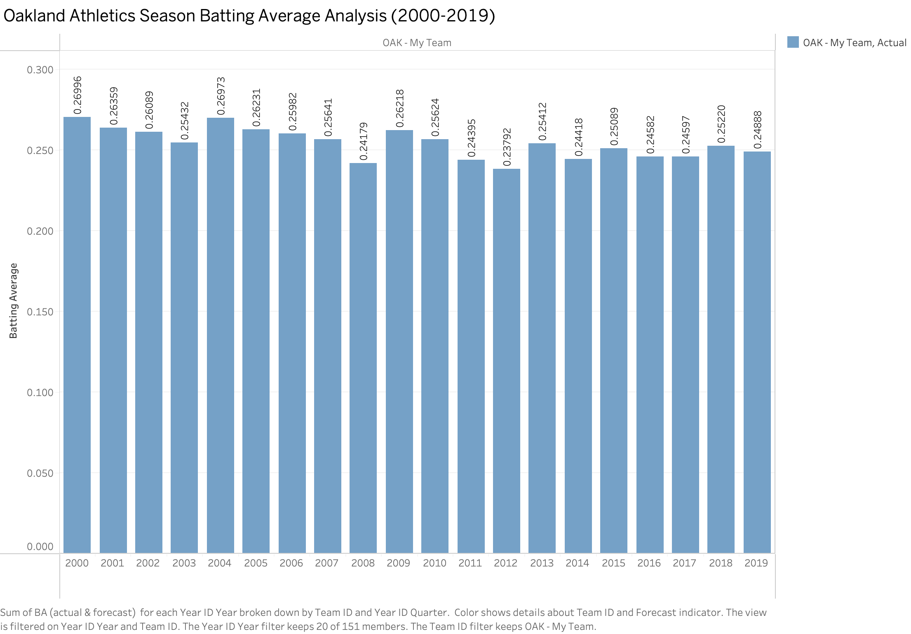

Slide 4
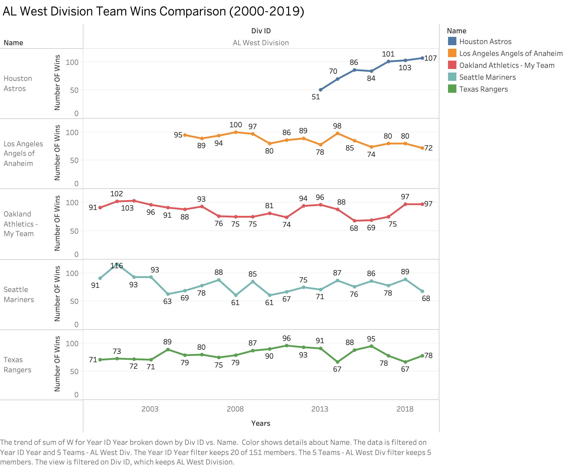

Slide 5
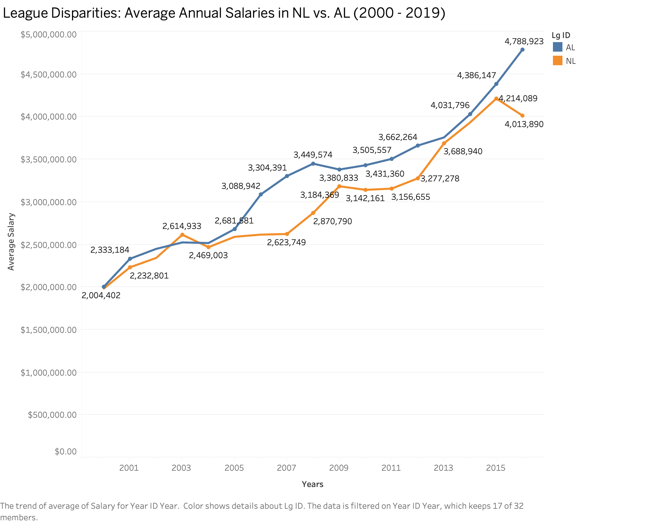

Slide 6
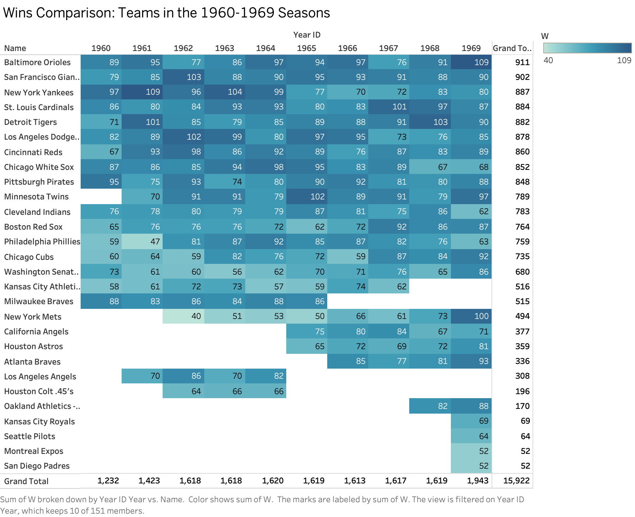

Slide 7
