Slide 1
MEDIPREDICT
Team name : Codestellars
Participents :
Manav Shah
Priyanshu Jani
Malhar Patel
Pratham Vyas

Slide 2
Our Mission :
Our hackathon project focuses on automated medical diagnosis. By inputting patient symptoms, our system predicts potential diseases and recommends suitable medications. Targeted at individuals seeking quick insights into their health, our user-friendly interface and algorithms empower informed healthcare decisions.

Slide 3
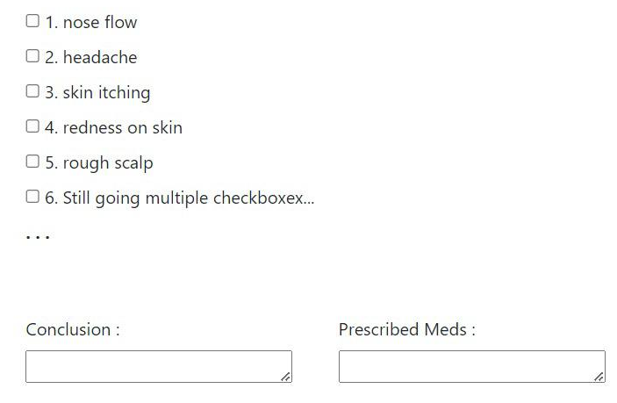
Layout :

Slide 4
Your Target Audience :
Patients: Individuals seeking preliminary insights into their health conditions.
Healthcare Professionals: Doctors and nurses looking for an additional diagnostic tool.
Remote Areas: People with limited access to immediate medical assistance.
Medical Students: Those interested in learning about symptom-disease correlations.
Healthcare Facilities: Clinics and hospitals interested in improving diagnostic accuracy.

Slide 5
Purpose of our project :
The purpose of our project is to revolutionize healthcare diagnostics through automation. By leveraging technology to predict diseases based on symptoms, we aim to provide quick and accurate preliminary insights to users.
Our goal is to empower individuals to make informed decisions about their health and facilitate healthcare professionals in improving diagnostic precision.

Slide 6
Basic Features of Project :
Data Privacy: We prioritize data security and privacy, ensuring confidentiality of user information.
Symptom Input: Users can input their symptoms through a user-friendly interface.
Disease Prediction: Our system employs algorithms to predict potential diseases based on input symptoms.
Quick Insights: Users receive rapid preliminary insights into potential health issues
Accurate Predictions: Our algorithms ensure accurate disease predictions, aiding both users and healthcare professionals.
User-Friendly Interface: The interface is designed for easy interaction, making it accessible to all users.

Slide 7
The Technologies that we are working upon :
Data Collection and Storage: Employing secure databases to collect and store medical data.
Machine Learning: Utilizing ML algorithms(eg. Linear regression) to analyze symptom
Data Privacy Tools: Integrating encryption and other privacy tools to ensure user data security.M-disease correlations and predict illnesses.
Cloud Services: Leveraging cloud platforms for scalability, data backup, and seamless access.
Programming Languages: Using languages such as python for backend development and web technologies for frontend

Slide 8
Thank You…

