Slide 1
GutBrain Task 6 Challenge: NER & RE models
ADVANCED TEXT ANALYTICS
Prof. Giorgio Maria di Nunzio SAMUEL PIRON 10/04/2025

Slide 2
OVERVIEW
Introduction
Data Overview
NER Model
Data Augmentation
RE Model
Model Evaluation
Conclusion and Future Work

Slide 3
1. Introduction

Slide 4
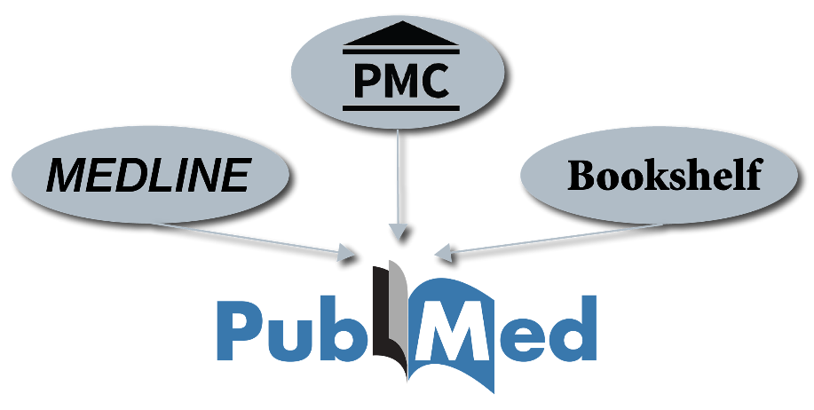
Introduction
PubMed is a popular website that offers a searchable database of citations and abstracts of biomedical and life sciences literature.
It comprises more than 38 million citations and abstracts.
From 1996, it has been maintained by the National Center for Biotechnology Information (NCBI).
Samuel Piron

Slide 5


Introduction (II)
The Gut Brain Challenge aims to foster the development of Information Extraction (IE) systems that support experts by automatically extracting and linking knowledge from scientific literature.
The challenge is divided into two main subtasks:
NER subtask: from PubMed abstracts, the participants are asked to extract named entities about the gut-brain interplay.
RE subtask: the participants are asked to identify binary and ternary relations between any pair of entities they extract within an abstract.
Samuel Piron

Slide 6
2. Data Overview

Slide 7
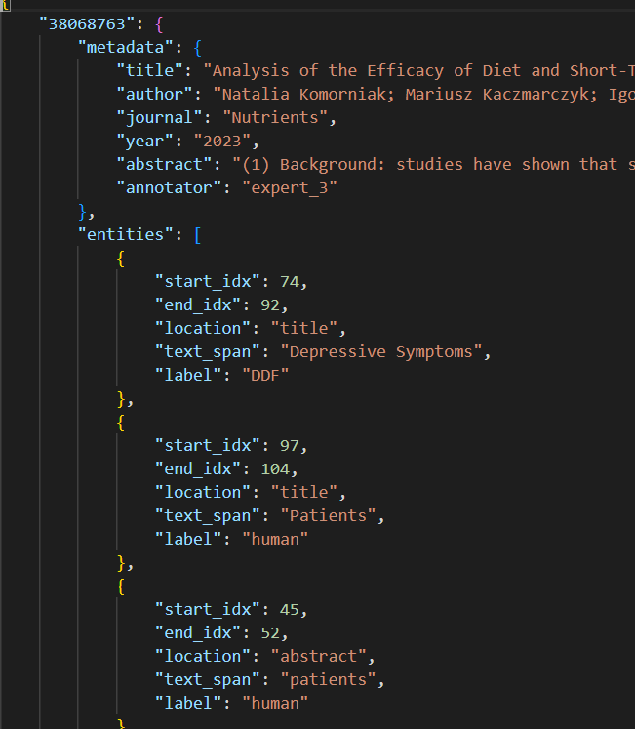
Gut Brain Dataset
The Gut Brain Dataset is composed of four Train collections and one Dev Collection:
Platinum Collection
Gold Collection
Silver Collection
Bronze Collection
Dev Dataset
Each collection is composed of NER-tagged entities with the label, text span, start index, and end index.
It is composed of relations between the NER-tagged entities, in particular binary tag based, ternary tag based, and ternary mention based.
Samuel Piron

Slide 8
3. NER Model

Slide 9
NER MODEL – GliNER (I)
GLiNER is a Named Entity Recognition (NER) model capable of identifying any entity type
using a Bidirectional transformer encoder (BERT-like).
It provides a practical alternative to traditional NER models, which are limited to
predefined entities, and Large Language Models (LLMs) that, despite their flexibility, are
costly and large for resource-constrained scenarios.
GLiNER paper can be found here:
https://arxiv.org/abs/2311.08526
Samuel Piron

Slide 10
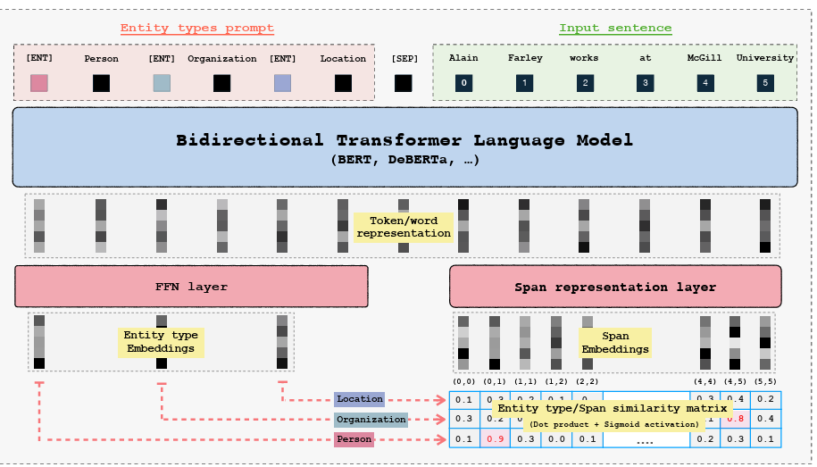
NER Model – GliNER (II)
Samuel Piron

Slide 11
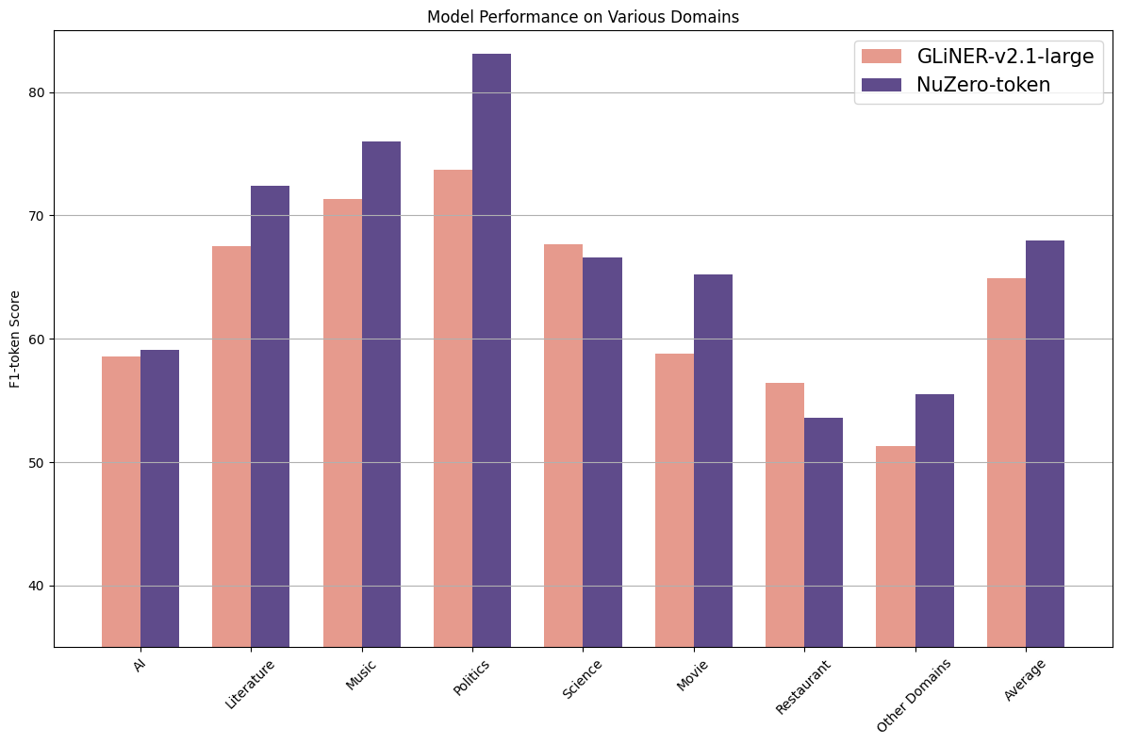
NER Model – GliNER (III)
The best model found to have a
better performance in terms of training loss is the numind/NuNER_Zero.
It is a zero-shot NER Model. It uses GLiNER architecture: its input are a concatenation of entity types and text.
It is a token classifier that allows the detection of arbitrarily long entities.
It is trained on numind/NuNER-v2.0.
Samuel Piron

Slide 12
NER Model - Implementation
The collections used to train the NER model:
Platinum
Gold
The silver dataset was used with both platinum and gold, but there were no improvements.
Tokenizer
The Tokenizer that was used during the data processing for the GLiNER model
with the merged dataset is the microsoft/deberta-v3-large.
The DeBERTa V3 large model (based on BERT) comes with 24 layers and a hidden size of 1024. It has 304M backbone parameters with a vocabulary containing 128K tokens, which introduces 131M parameters in the Embedding layer.
Samuel Piron

Slide 13

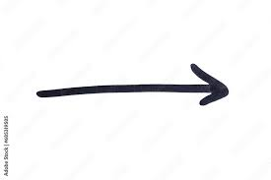
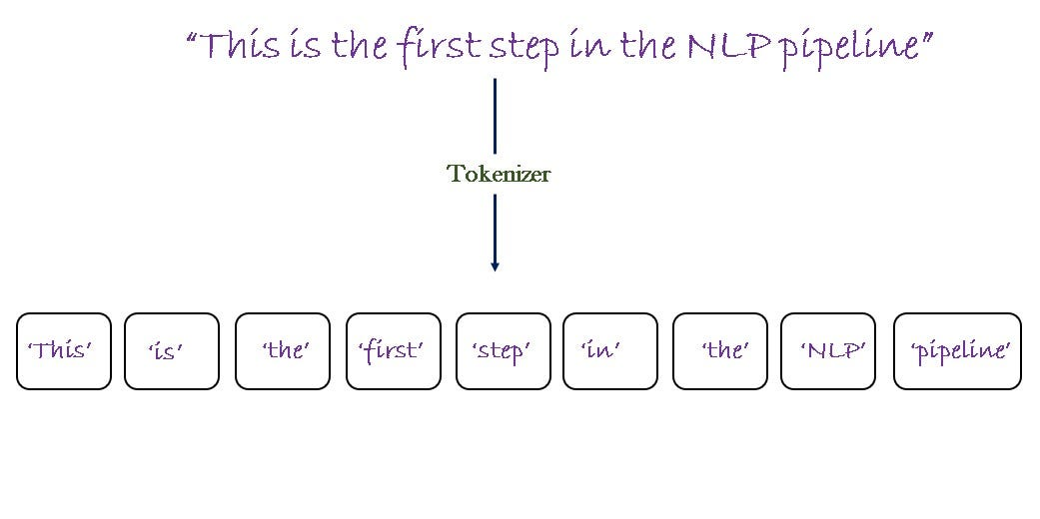

NER Model – Train Pipeline (I)
Load Data: load
the annotated dataset
containing titles,
abstracts and annotated
entities.
3) Preprocess Data: combine titles
and abstracts, convert character
level entity annotations into token
level spans using tokenizer’s offset
mapping.
Train
merged.json
2) Initialize Tokenizer:
Tokenizer breaks down
text into tokens, making it
ready for the model
input.
[0] [1] [2] [3] [4] [5] [6] [7] [8]
DE-BERTa-v3-large
Samuel Piron

Slide 14



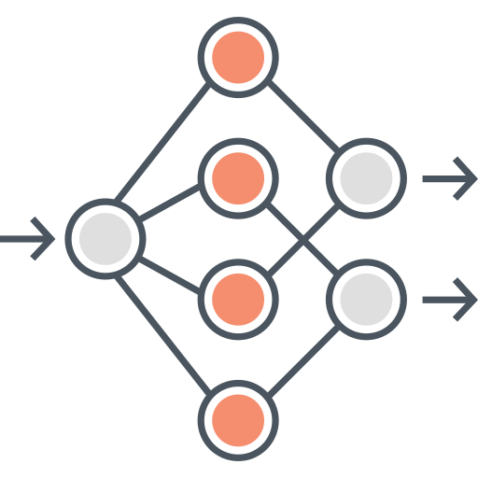
NER Model – Train Pipeline (II)
4) Define Hyperparameters:
Set parameters such as batch size,
learning rate, num. of training steps,
warmup ratio and others for training
stability.
6) Training Loops: iterate through
batches, perform forward pass,
compute loss and apply back prop.
Update model parameters using
AdamW optimizer.
5) Model Setup: initialize NER
model using GLiNER with pre-
trained weights (numind/NuNuner
Zero) and configure sampling
parameters to handle training
complexity.
7) Evaluation: periodically evaluate
the model performance using
validation data (Micro and Macro,
F1-score, entity-level accuracy)
and save it.
Samuel Piron

Slide 15
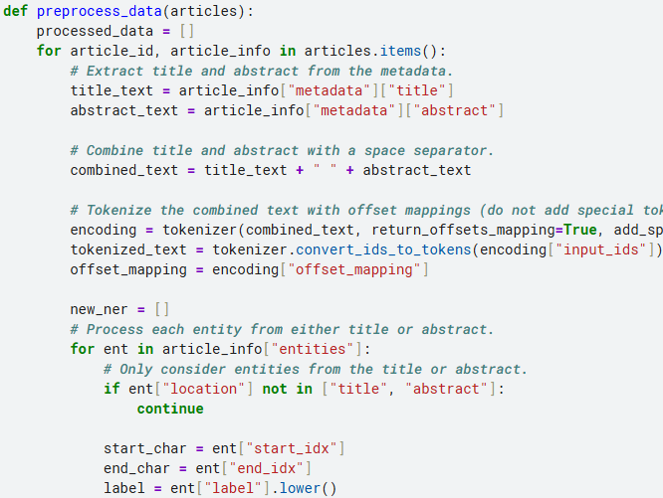
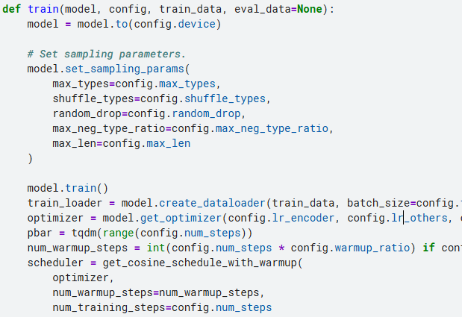
NER Model – Train Pipeline (III)
Data Processing function.
Train Model function.
Samuel Piron

Slide 16
4. Data Augmentation

Slide 17
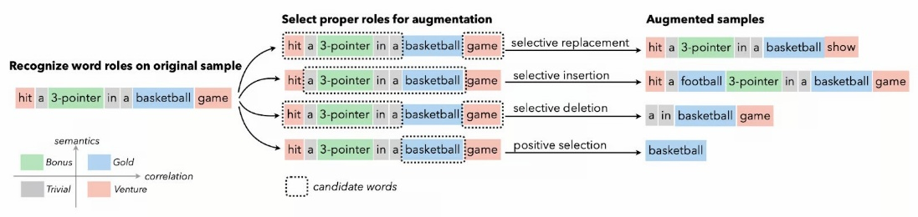
Data Augmentation
Why should we use
data augmentation?
It helps machine learning models perform better
by improving the existing data.
It prevents overfitting, improves accuracy, and
creates diversity in training data.
Data augmentation is a technique of artificially increasing the training set by creating modified copies of a dataset using existing data.
It includes making minor changes to the dataset or using deep learning to generate new data points.
Samuel Piron

Slide 18

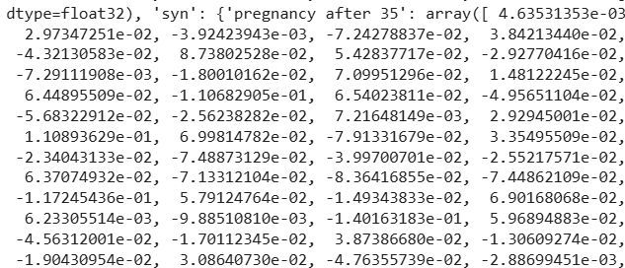
Data Augmentation - Implementation (I)
1) Retrieve from MeSH (the
Official Medicine Vocabulary Online) all the terms and their synonyms.
2) Parse the .xml file obtained, and after that, save it into a JSON format.
3) For each term and its synonyms,
compute the embedding using the model
all-mpnet-base-v2.
Samuel Piron

Slide 19
Data Augmentation - Implementation (II)
4) Compute the Cosine Similarity between the original term and its synonyms. If the similarity is above a threshold, it is kept, otherwise, it is rejected.
5) Replace in the title or in the abstract the original term with the augmented one and save the new file.
6) With a trained model, use it to predict the entities and then retrain it using the augmented file.
Samuel Piron

Slide 20
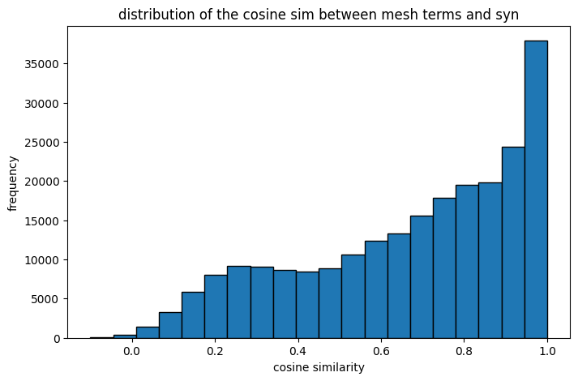
Data Augmentation - Implementation (II)
The data augmentation process
does not improve so much the P, R, F1
score.
Why?
The GLiNER model maps similar words close so that most of the terms with the Cosine similarity greater than 0.8 that are replaced do not affect the precision, recall and f1 score so much.
Samuel Piron

Slide 21
5. RE Model

Slide 22
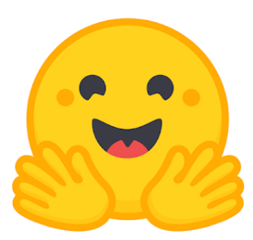


RE Model – Implementation (I)
1) Load the JSON file
& Tokenizer: load the
articles, relations and
entities; then use BERT Tokenizer
to prepare the input for the NN adding
[E1],[E2] to highlight entities in the text.
3) The PubMedBERT Model: initialize a BERT model pre-trained on PubMed abstracts. Resize the token embedding to include the markers ([E1], etc.).
Set up the model to perform Sequence Classification: each sequence corresponds to a potential relation between two entities.
2) Data Preprocessing:
Separate entities in the title or
in the abstract, filter relations that involve
both of them; create valid relations
and non valid relations.
4) Training Setup: Set optimizer to AdamW; set up hyperparameters that are going to be used to train the model (epoch, steps, learning rate).
Samuel Piron

Slide 23



RE Model – Implementation (II)
5) Model Training: the
model undergoes forward
and backward pass. Update
the scheduler and optimizer at
each step.
7) Save the model: save the model weights and tokenizer for future use.
6) Evaluation Metrics:
after each epoch, evaluate the
model on a validation set printing
Precision, Recall, F1 Score.
Samuel Piron

Slide 24
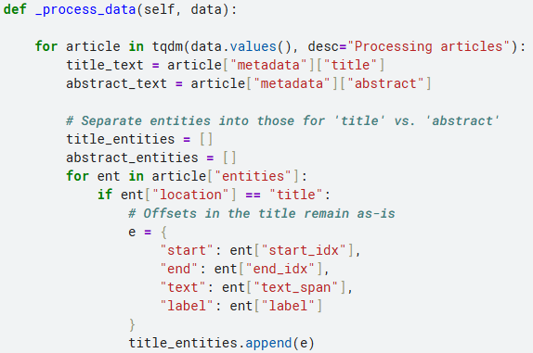
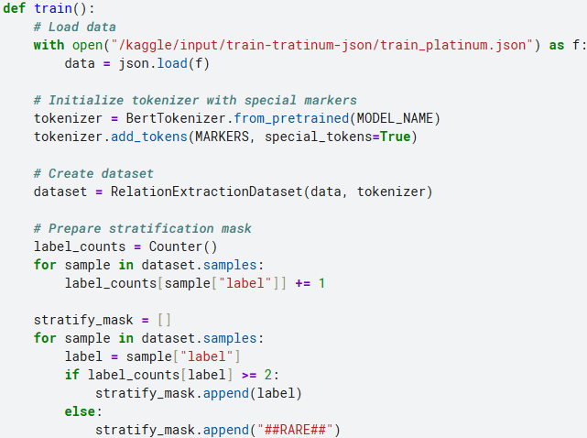
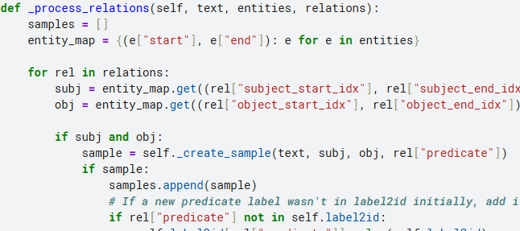
RE Model – Train Pipeline (III)
Process data and relations function and
train function.
Samuel Piron

Slide 25
RE Model – Key Points
1) Using a pre-trained model on PubMed abstracts improved the precision, recall and f1 score of the predictions.
The model uses special entity markers to improve its ability to recognize relationships between entities.
2) Label2id converts relationship labels from text to numerical form, essential for multi-class classification.
It allows loss calculation and efficient model training, simplifies predictions, calculates loss, and interprets model predictions easily.
3) The controlled negative ratio helps to create negative samples: it helps the model to
distinguish between actual relationships and non-relationships.
Samuel Piron

Slide 26
4. Model Evaluation

Slide 27
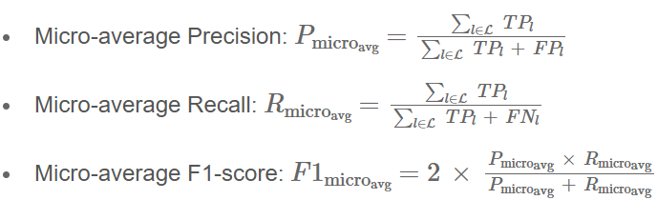
Evaluation Metrics
TP (True Positives) refers to the number of correctly predicted entities or relations.
FP (False Positives) refers to the number of wrongly predicted entities or relations.
FN (False Negatives) refers to the number of entities or relations in the ground truth
that were not predicted.
L is the set of labels referring to each subtask (e.g. for NER entity labels; for Binary subject, object)
Samuel Piron

Slide 28
NER Model - Evaluation
Test Train | Platinum Collection | Gold Collection | Silver Collection | Bronze Collection
Platinum + Gold | P:0.9634 R:0.8906 F1:0.9256 | P:0.9775 R:0.8775 F1:0.9248 | P:0.7862 R:0.6708 F1:0.7239 | P:0.9021 R:0.7905 F1:0.8426
Platinum + Gold + Silver | P:0.8179 R:0.8233 F1:0.8205 | P:0.8325 R:0.8386 F1:0.8355 | P:0.8074 R:0.7799 F1:0.7934 | P:0.8165 R:0.8179 F1:0.8172
Platinum + Gold + Bronze Augmented | - | - | - | P:0.7071 R:0.8025 F1:0.7518
The Dev Dataset in this evaluation is considered as the Test Dataset.
Precision: 0.8017, Recall: 0.6947, F1: 0.7444
The model used for NER of the Dev Dataset is platinum + gold.
Samuel Piron

Slide 29
Binary Tag-Based Relation Extraction
Test Train | Platinum Collection | Gold Collection | Silver Collection | Bronze Collection
Platinum + Gold | P:0.5130 R:0.9135 F1:0.6571 | P:0.4154 R:0.8640 F1:0.5610 | P:0.4397 R:0.7479 F1:0.5538 | P:0.3471 R:0.8646 F1:0.4953
The Dev Dataset in this evaluation is considered as the Test Dataset.
Precision: 0.5978
Recall: 0.7364
F1: 0.6599
This is the best result so far, with a threshold of 0.7 for the predictions.
Samuel Piron

Slide 30
Ternary Tag-Based RE
Test Train | Platinum Collection | Gold Collection | Silver Collection | Bronze Collection
Platinum + Gold | P:0.8753 R:0.6757 F1:0.7627 | P:0.7694 R:0.6085 F1:0.6795 | P:0.6938 R:0.4493 F1:0.5454 | P:0.7060 R:0.5433 F1:0.6140
The Dev Dataset in this evaluation is considered as the Test Dataset.
Precision: 0.8100
Recall: 0.3522
F1: 0.4909
This is the best result so far, with a threshold of 0.7 for the predictions.
Samuel Piron

Slide 31
Ternary Mention-Based RE
Test Train | Platinum Collection | Gold Collection | Silver Collection | Bronze Collection
Platinum + Gold | P:0.8288 R:1.2329 F1:0.9912 | P:0.7283 R:1.0661 F1:0.8654 | P:0.5762 R:0.5259 F1:0.5499 | P:0.6382 R:0.9184 F1:0.7531
The Dev Dataset in this evaluation is considered as the Test Dataset.
Precision: 0.6573
Recall: 0.5821
F1: 0.6174
This is the best result so far, with a threshold of 0.7 for the predictions.
Samuel Piron

Slide 32
5. Conclusions and Future Work

Slide 33
Conclusions & Future Work
Conclusions
The training strategies of the NER and RE models helped perform complex information extraction on biomedical data.
The process of Data Augmentation did not help to improve the scores of the NER model caused by the GLiNER embeddings.
The results compared to the Baseline provided in the official site show an improvement for the relation extraction subtask.
Future Work
Try, for example, the SCIBert v2.1-Large for the RE Subtask and compare the results with the PubMedBERT model.
Test the trained model on the test data upon release.
Samuel Piron

Slide 34
Code, Runs & Devices used for Training
The code with the implementation can be found here:
https://github.com/Vezzero/ataupd2425-gainer
The training setups are:
Tesla T4 GPU Google Colab (https://colab.research.google.com/)
NVIDIA T4 x 2 GPU Kaggle (https://www.kaggle.com/)
8x NVIDIA A40 GPU DEI Machines (https://docs.dei.unipd.it/)
Samuel Piron

Slide 35
Bibliography
PubMed: https://pubmed.ncbi.nlm.nih.gov/
Clef2025: https://clef2025.clef-initiative.eu/index.php?page=Pages/Labs/BioASQ.html
Embedding Model: https://huggingface.co/sentence-transformers/all-mpnet-base-v2
NuNer_Zero: https://huggingface.co/numind/NuNER_Zero
MeSH: https://www.nlm.nih.gov/mesh/meshhome.html
PubMedBERT: https://huggingface.co/microsoft/BiomedNLP-BiomedBERT-base-
uncased-abstract-fulltext
Samuel Piron

Slide 36
THANK YOU FOR YOUR ATTENTION
Gut Brain 2025 Challenge
ADVANCED TEXT ANALYTICS
10/04/2025
Any Questions?
Samuel Piron

