Slide 1


Samuel Piron
Medical Data:
How to
Protect Them
Privacy Preserving Information Access
Homework 1
A.Y. 2024-2025

Slide 2


SCENARIO
Why Medical Data?
Medical Data are stored in digital databases, making them accessible but also vulnerable to breaches
Every Hospital generates lots of Data every year and they need to be managed
Medical data requires deep analysis because of the wide variety of data points (lab results, prescriptions, imaging)

Slide 3
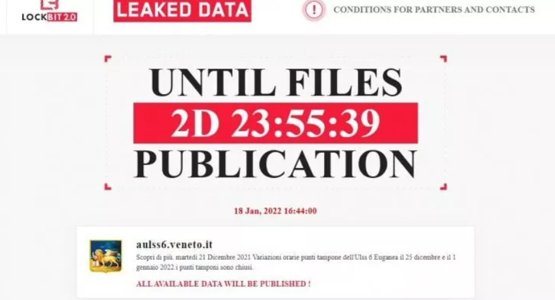
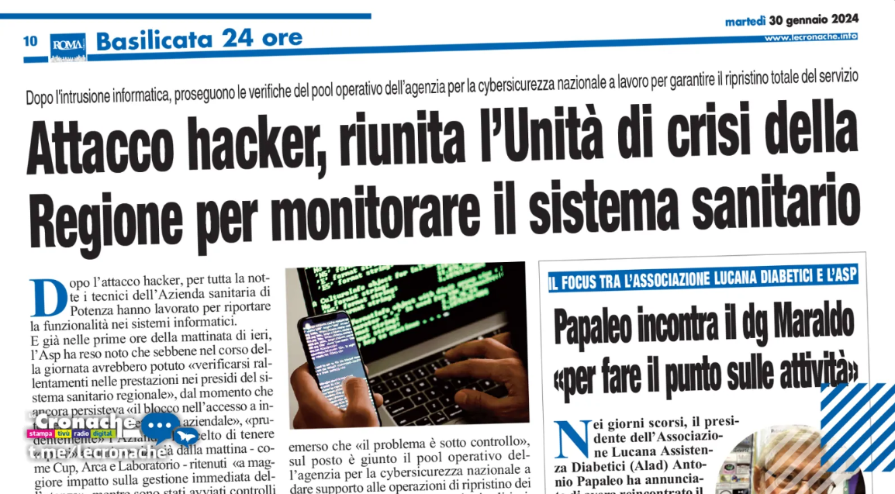
MOTIVATIONS
Protecting medical data means safeguarding people’s private health information
Sensitive health data can be stolen and can lead to exposure of patients’ medical condition
Protecting medical data ensures public trust in healthcare systems

Slide 4
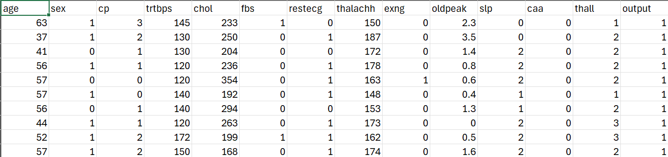
The Heart Attack Dataset
https://www.kaggle.com/datasets/rashikrahmanpritom/heart-attack-analysis-prediction-dataset

Slide 5
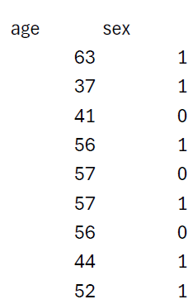
Identifiers
Attributes that allow one to identify a person univocally.
Heart Attack Dataset: No identifiers!
Quasi-Identifiers
Attributes that, when combined together might
identify a person.
Heart Attack Dataset – Age, Sex, Cp, Trtbps.

Slide 6
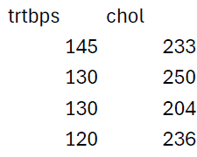
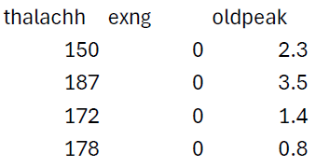
Sensitive Attributes
Some Attributes might be considered sensitive, especially if they have outliers or provide private health information:
Cholesterol
Blood Pressure
Fasting Blood Sugar

Slide 7
POTENTIAL ADVERSARIES AND RISKS
Who might be able to access your data?
Internal Threads: people that work in the medical field can view and leak your data
External Hackers: malicious people that steal and divulge sensitive information
Data Brokers: companies or third-party brokers interested in selling health data
For example, competitors can use your data to develop similar products (or services) or to influence the market unfairly.
This can lead to a loss of competitive advantage, reduced market share, and financial impact.

Slide 8
MICRODATA PROTECTION TECNIQUES
Global Recoding & Top and Bottom Coding
Sampling
Uncorreleted additive noise
K-anonymity

Slide 9
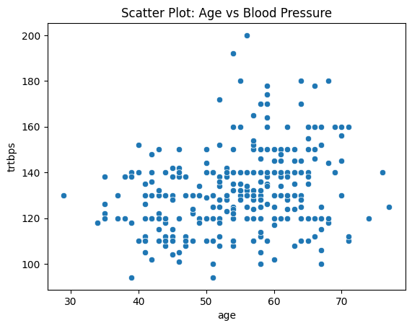
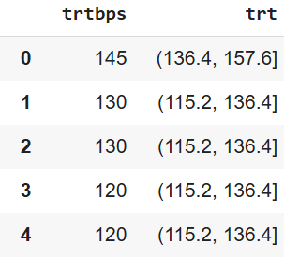
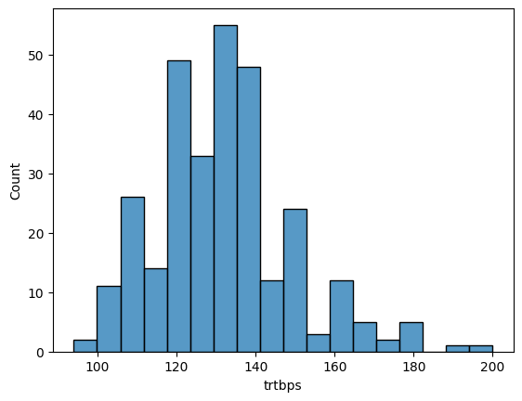
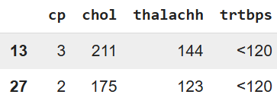
Global Recoding & Top and Bottom Coding
heartdf['trt'] = pd.cut(heartdf['trtbps'], bins=5)
heartdf[['trtbps', 'trt']]
greater_than_180 = heartdf[heartdf['trtbps']>180].index.to_list()
smaller_than_120 = heartdf[heartdf['trtbps']<120].index.to_list()

Slide 10
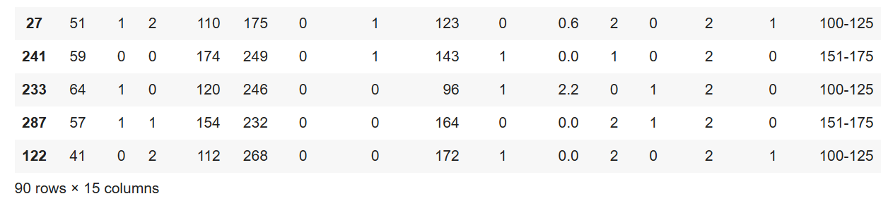
Sampling
#select a sample of the individuals, by randomly sampling the indexes
sampled_individuals = npr.choice(heartdf.index.to_list(), int(len(heartdf.index.to_list())*0.3), replace=False)
#filter out individuals whose index is not among the sampled ones
sampled_heartdf = heartdf.loc[sampled_individuals, :]
sampled_heartdf

Slide 11
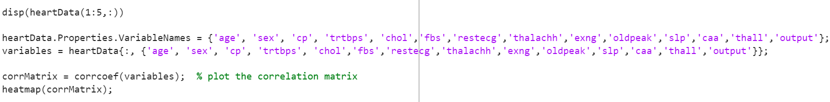
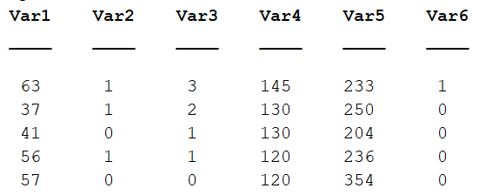
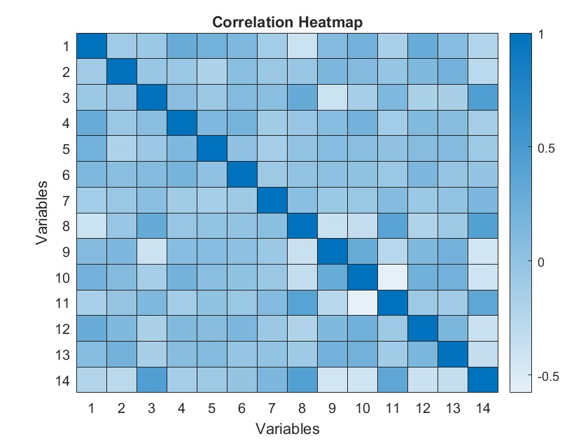
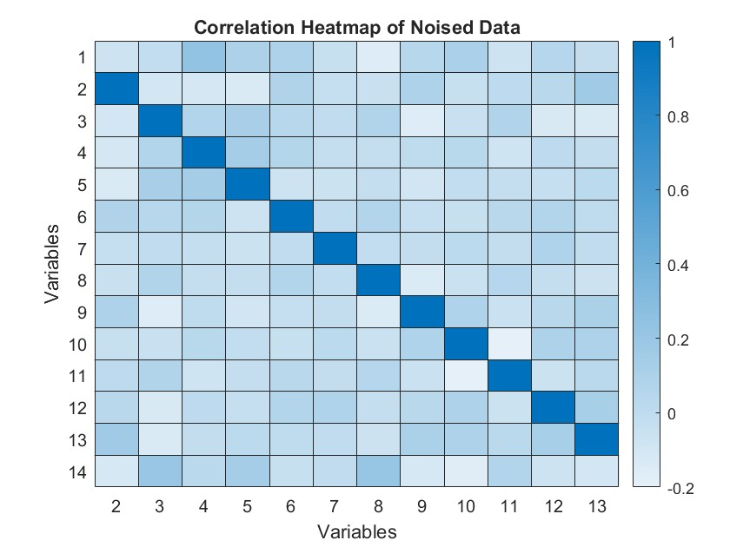
Random noise: Uncorrelated additive noise
Noised data

Slide 12
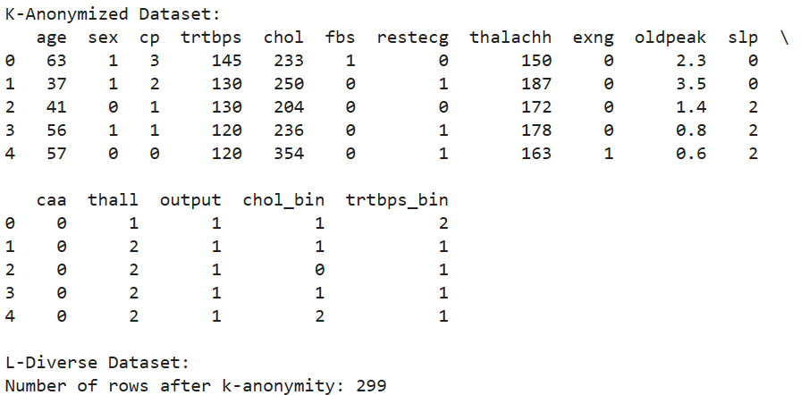
K-Anonymity
def generalize_k_anonymity(df, quasi_identifiers, k):
df['chol_bin'] = pd.cut(df['chol'], bins=5, labels=False)
df['trtbps_bin'] = pd.cut(df['trtbps'], bins=5, labels=False)
#df['trtbps_bin'] = df['trtbps']
anonymized_df = df.groupby(quasi_identifiers).filter(lambda x: len(x) >= k)
return anonymized_df
k_anonymous_df = generalize_k_anonymity(heartdf.copy(), ['chol_bin', 'trtbps_bin'], k=3)

Slide 13
CONCLUSIONS & FUTURE WORK
The techniques presented enhanced data anonymization, significantly reducing the risk of patient identification
Future work will explore more advanced techniques such as t-closeness and differential privacy, to build up data protection without compromising analytical value.
Open Questions:
How can medical databases balance privacy and utility while remaining beneficial for gathering critical medical information from patients?
How can patients retain control over their data while still enabling meaningful research in healthcare?

Slide 14
CHECK THE CODE!
https://github.com/Vezzero/privacy-homework1
If you have any doubts or suggestions regarding the code or anything else, write me an email:
samuel.piron@studenti.unipd.it

Slide 15
Samuel Piron
Medical Data:
How to
Protect Them!
Thanks for the attention Question Time!
A.Y. 2024-2025

