Slide 1


Samuel Piron
Differential Privacy techniques applied on
Medical Data
Privacy Preserving Information Access
Homework 2
A.Y. 2024-2025

Slide 2
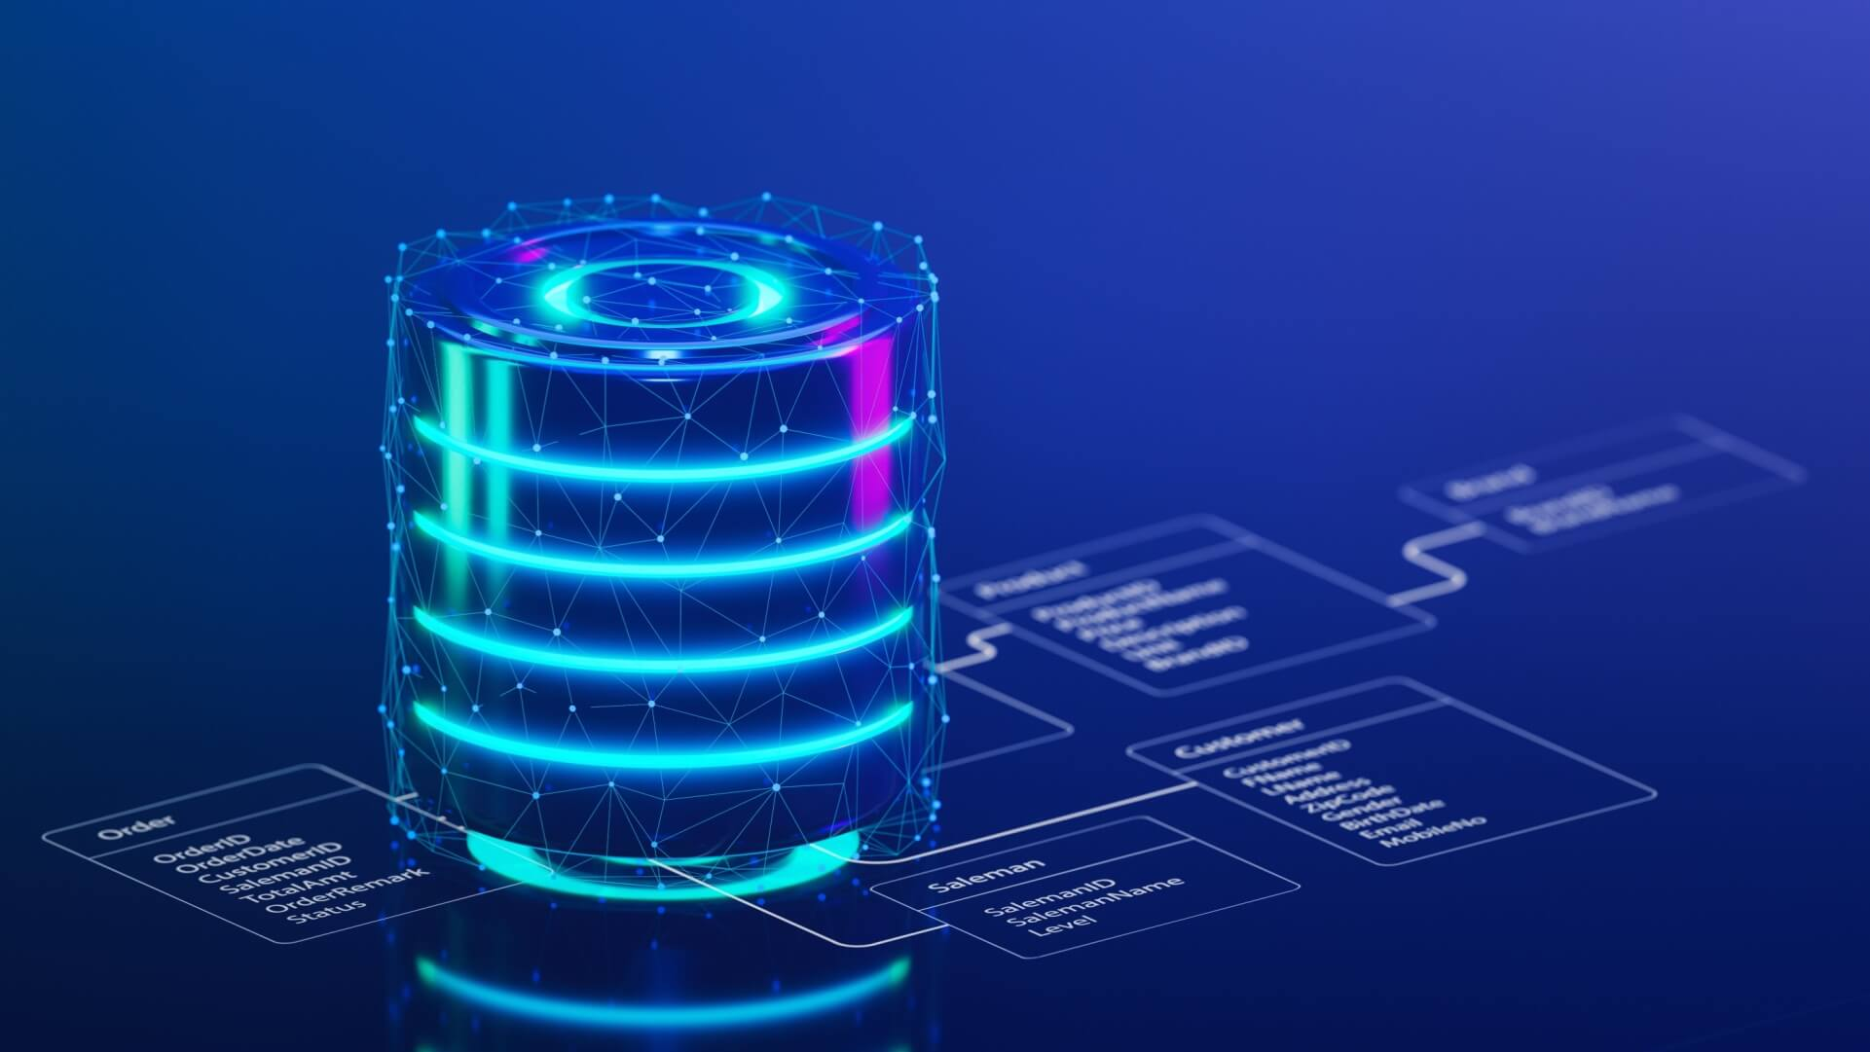

SCENARIO & MOTIVATIONS
Every individual generates medical data, such as lab tests, and diagnoses, stored in medical databases.
Medical data requires deep statistical analysis
Ensuring the privacy of medical data is crucial to prevent privacy breaches, such as differencing attacks or linkage attacks, which can reveal personal information.

Slide 3
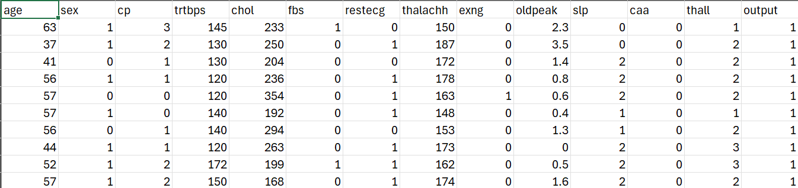
Queries in Heart Attack Dataset
E.g.
What is the mean of the cholesterol of the people with age > 50?
What is the mean of the mean of the blood pressure?
How many people have cp=3 and cholesterol > 180?

Slide 4
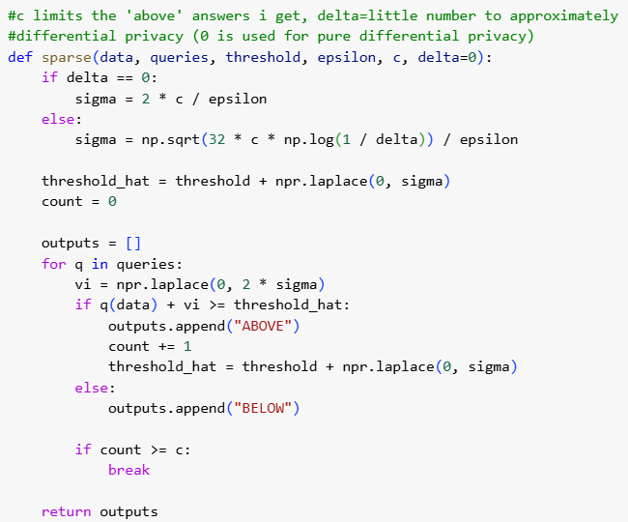
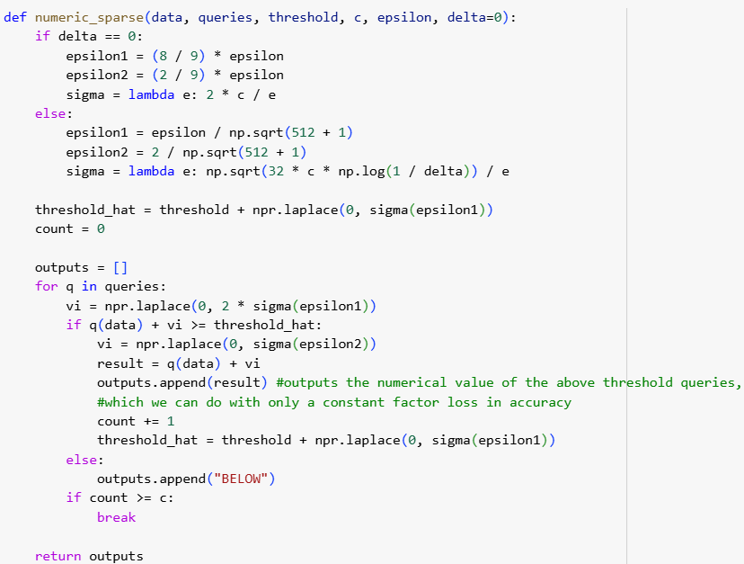
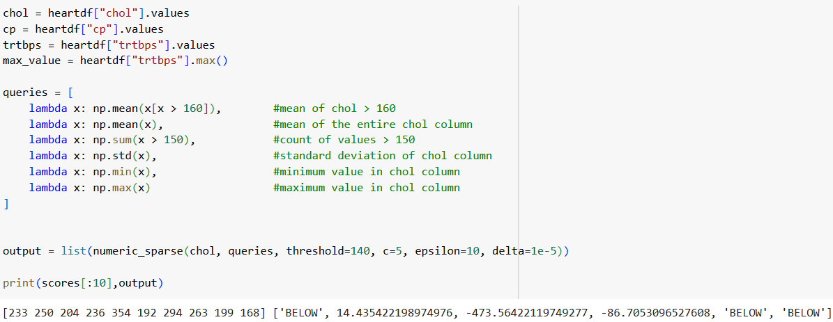
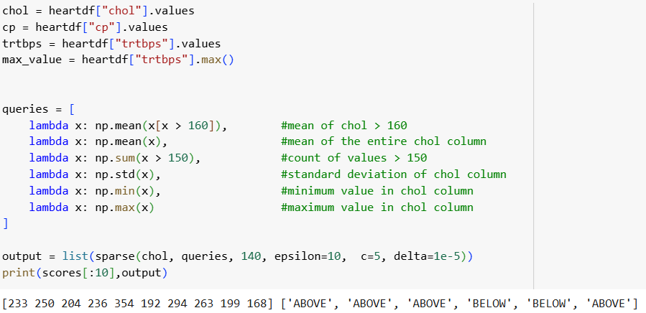
Sparse Vector & Numeric Sparse

Slide 5
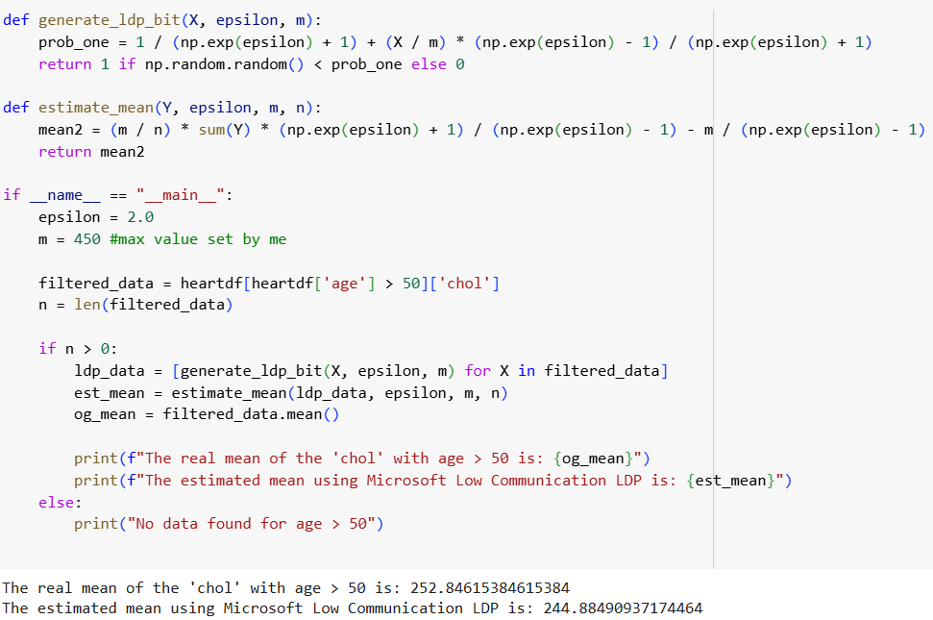
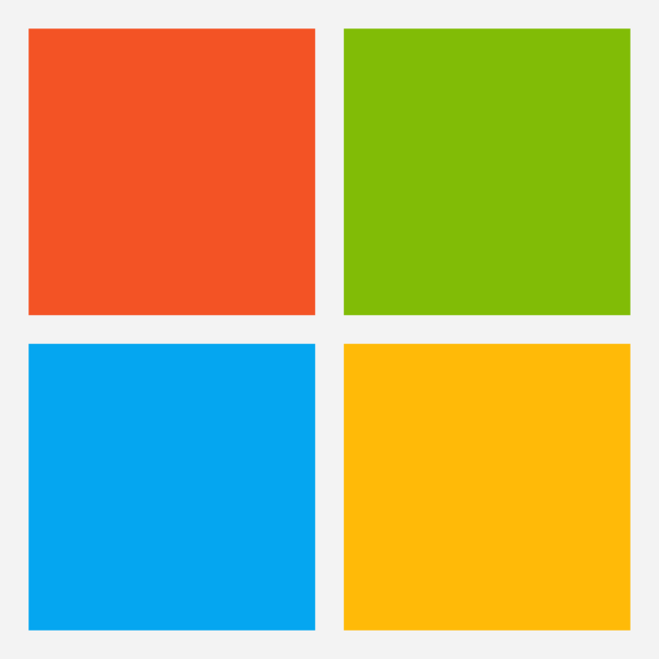
Microsoft Low Communication LDP
Let’s answer this query:
What is the mean cholesterol of people with age > 50

Slide 6
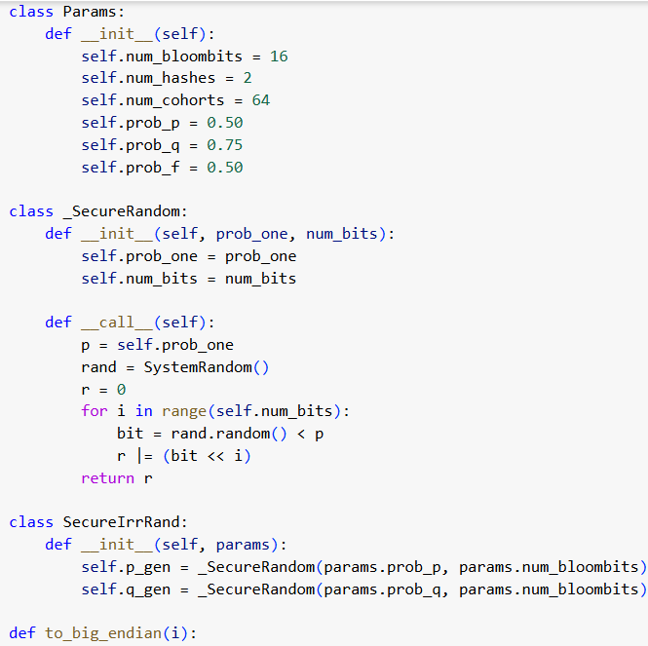
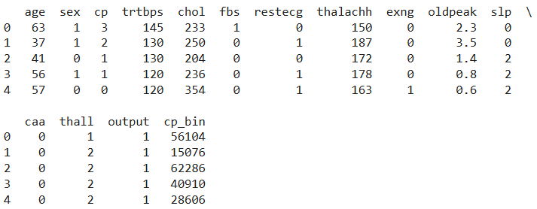
Google RAPPOR
Applying the Google RAPPOR algorithm on
the cholesterol column: we can use the perturbed data
to query something.

Slide 7
CONCLUSIONS
The techniques presented provided differential privacy ensuring the anonymization and protecting the sensitive data sent to the server.
Future research will explore advanced differential privacy techniques, such as Private Multiplicative Weights to improve LDP and apply them to the queries.
Open Questions?
What are the best strategies for selecting thresholds and sensitivity?
What are the computational costs of implementing more advanced DP techniques?

Slide 8
Samuel Piron
Differential Privacy techniques applied on
Medical Data
Thanks for the attention Question Time!
A.Y. 2024-2025 https://github.com/Vezzero/privacy-homework2

